Slide 1
INFRASTRUCTURE PROJECTS
PRESENTATION
03th Apr 2026
1

Slide 2
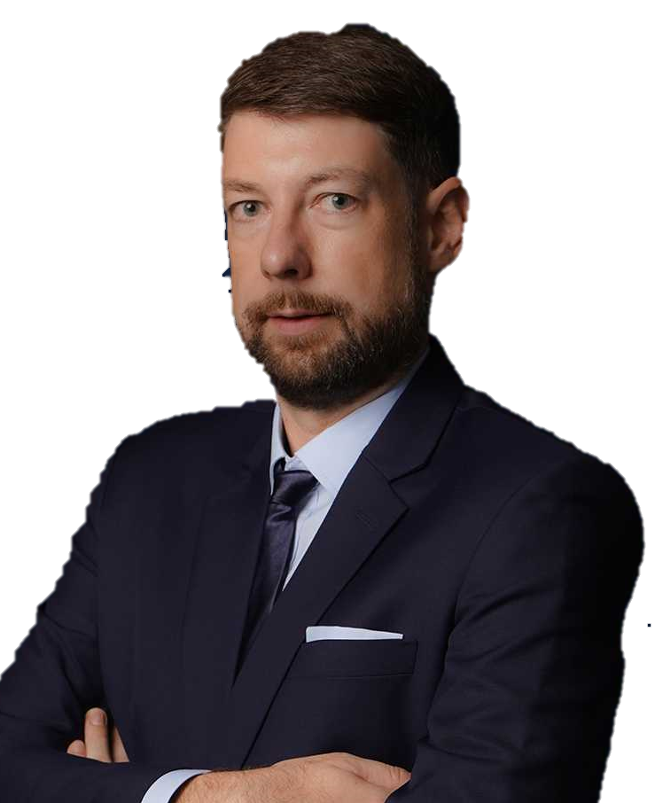
OUR MISSION:
“We keep the world moving, by deploying the best expertise to craft tailor-made solutions that solve the most challenging logistic problems all around the world.”
TORBJÖRN LARISCH
CHIEF EXECUTIVE OFFICER

Slide 3
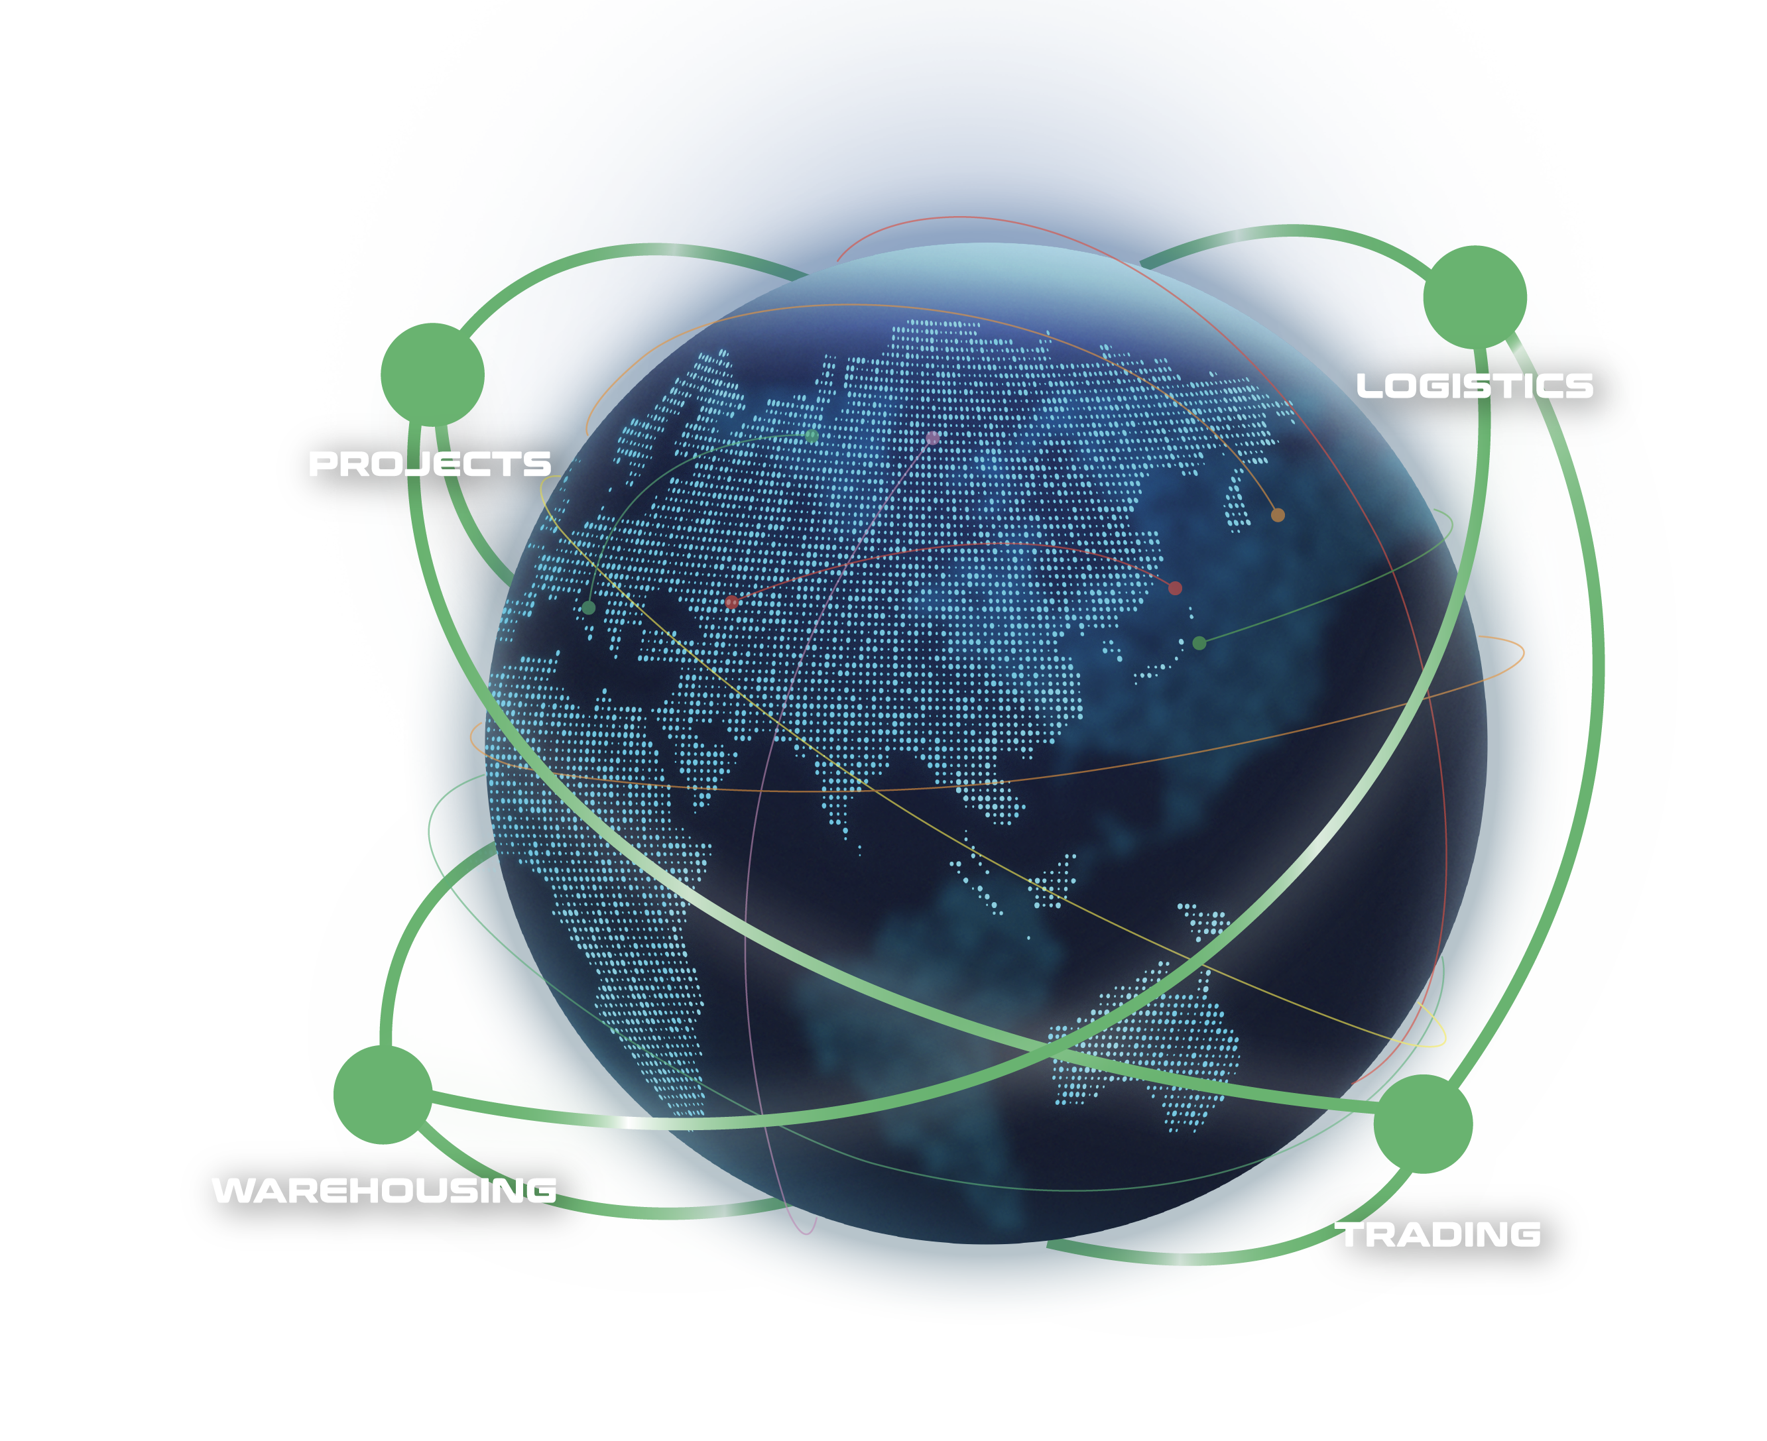
WHAT ARE OUR CAPABILITIES
Our interconnected supply chain solutions are tailor-made to keep your world in business.
OUR VISION:
To be recognized globally as the logistics experts who understand and empower global business leaders to dream and act big; moving the world forward.
PROJECTS: With expert hands, we handle the complicated with precision.
LOGISTICS: We humanize a seemingly standardized experience.
WAREHOUSING: We envision spaces that bring supply chains to the next level.
TRADING: We define and shape solutions to meet ever-changing needs.
3

Slide 4
FLS SNAPSHOT
32
500+
100+
years of experience
professionals
global partners
14
$65 million
countries
is the largest single contract award
ANNUALLY
15,000+
5,000+
trucks moved
customs clearance cases
25,000+
20,000+
14 million kg
$219 million
TEUs shipped
shipments delivered
air freight cargo handled
consolidated revenue
4

Slide 5
FLS HISTORY
FLS ventured more and more into handling export projects from steel fabricators in Thailand, Korea, China, Vietnam, Malaysia and Indonesia to global destinations for major engineering companies in the Power, Petrochemical and Mining industries.
After almost three decades, we have expanded our services from project cargo into a wider portfolio include:
FLS Logistics
FLS Warehousing
FLS Trading
Neon Orient acquisition
FLS Supply Chain Center establishment
2001 – 2010
2020 – 2023
1993 - 2000
2011 – 2020
NOW
The company was founded in Bangkok in May 1993 by Martin Häberli when he was awarded several major projects in Thailand.
In 2011 FLS (Vietnam) Ltd. was established, followed by
FLS (Australia) Pty Ltd. in 2013
FLS (Singapore) Pte Ltd. in 2014
PT. Federal Logistik Sistem (Indonesia) in 2014
FLS Projects (USA) Inc. in 2016
FLS Projects (Taiwan) Ltd. in 2016
FLS Projects (Malaysia) Sdn. Bhd, in 2018
FLS 1993 (India) Pvt Ltd.
In 2024, we embarked on a new chapter, broadening our global reach with the establishment of
FLS Scandinavia
FLS Norfolk, USA
FLS Group (Japan)
ITL acquisition
FLS Philippines
FLS Italy
5

Slide 6
OUR GLOBAL PRESENCE
USA
Denmark
India
Thailand
Italy
China
Japan
Myanmar
Vietnam
Philippines
Malaysia
Singapore
Australia
FLS Offices
Indonesia
FLS close network partners
6

Slide 7
OUR COMPETENCIES
EXPERIENCED
COMPETIVE
More than 30 years of experience
Global access to carriers, local contract negotiations
FLEXIBLE
INNOVATIVE
Matching right partners for each project
We can solve problems with creative solutions and will adjust our operation to your requirements
PRO-ACTIVENESS
Eyes and ears always on the market and therefore can react to possible constraints early
DYNAMIC
Growth through opportunity, where others see a problem, we see an opportunity
Fast decision-making process
CONTINUITY
High employee retention rate: average is 8.32 years. Some key staff have been with FLS for more than 15 years
7

Slide 8






WE ARE A PROUD MEMBER OF:
8

Slide 9
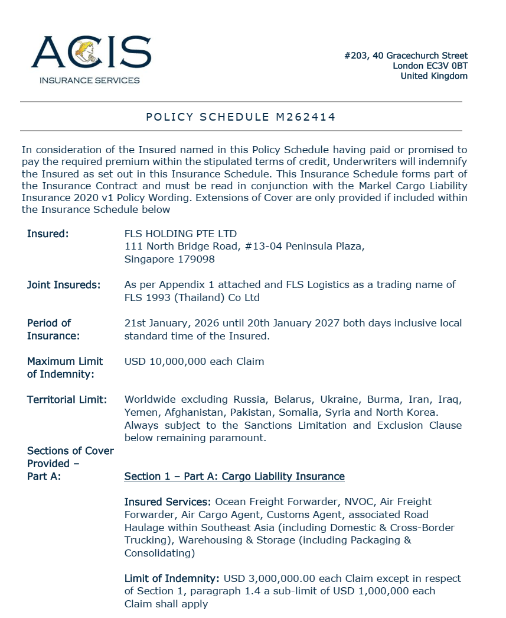
INSURANCE POLICY
Base coverage:
Cargo liability
USD 3,000,000 each claim
3rd party legal liability
USD 3,000,000 each claim
Professional indemnity
USD 400,000 each claim
Fines and duties liability
USD 100,000 each claim
Please note: Limits are flexible & negotiable, and liabilities can be extended on request and a case-by-case basis. Marine cargo insurance can be provided. on request.
9

Slide 10
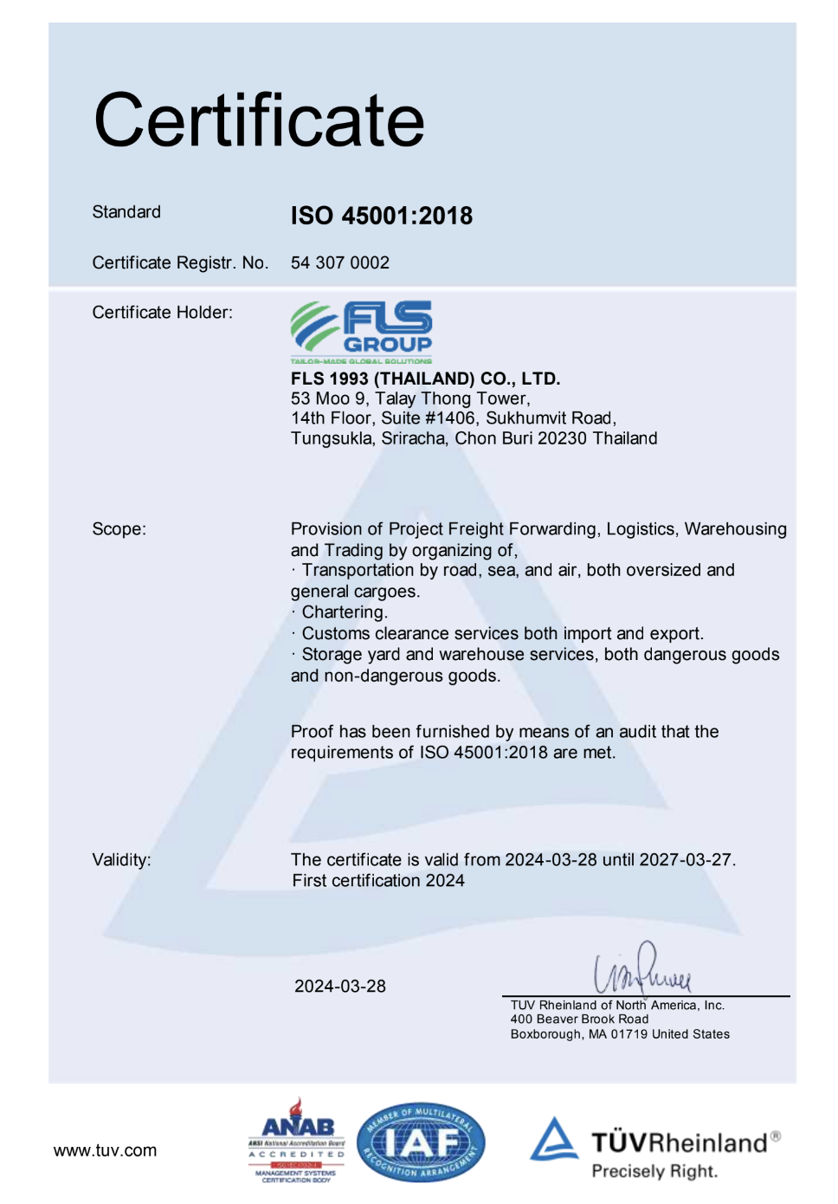
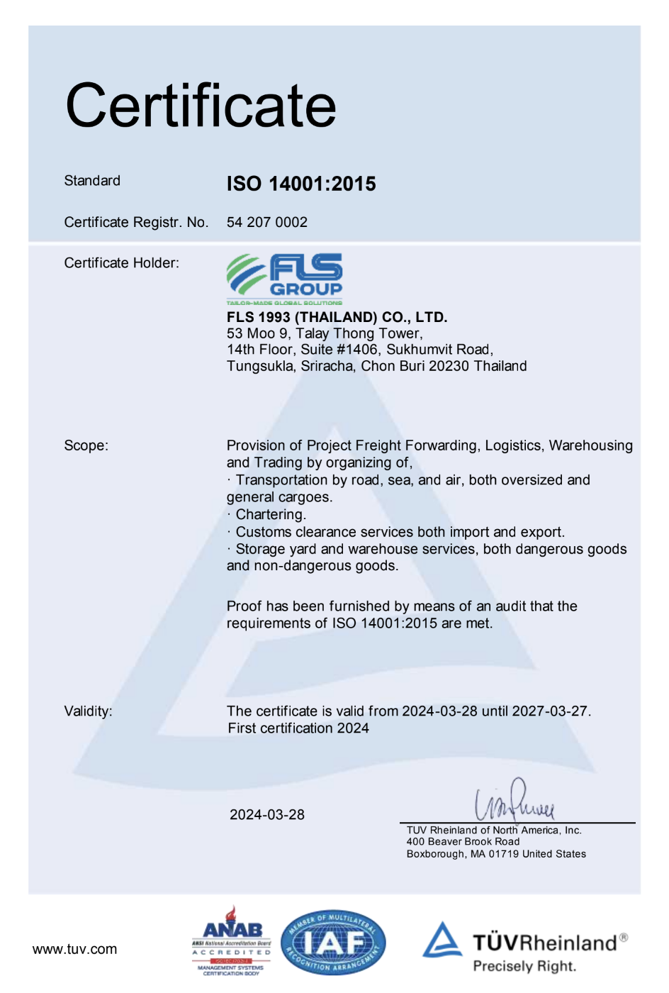
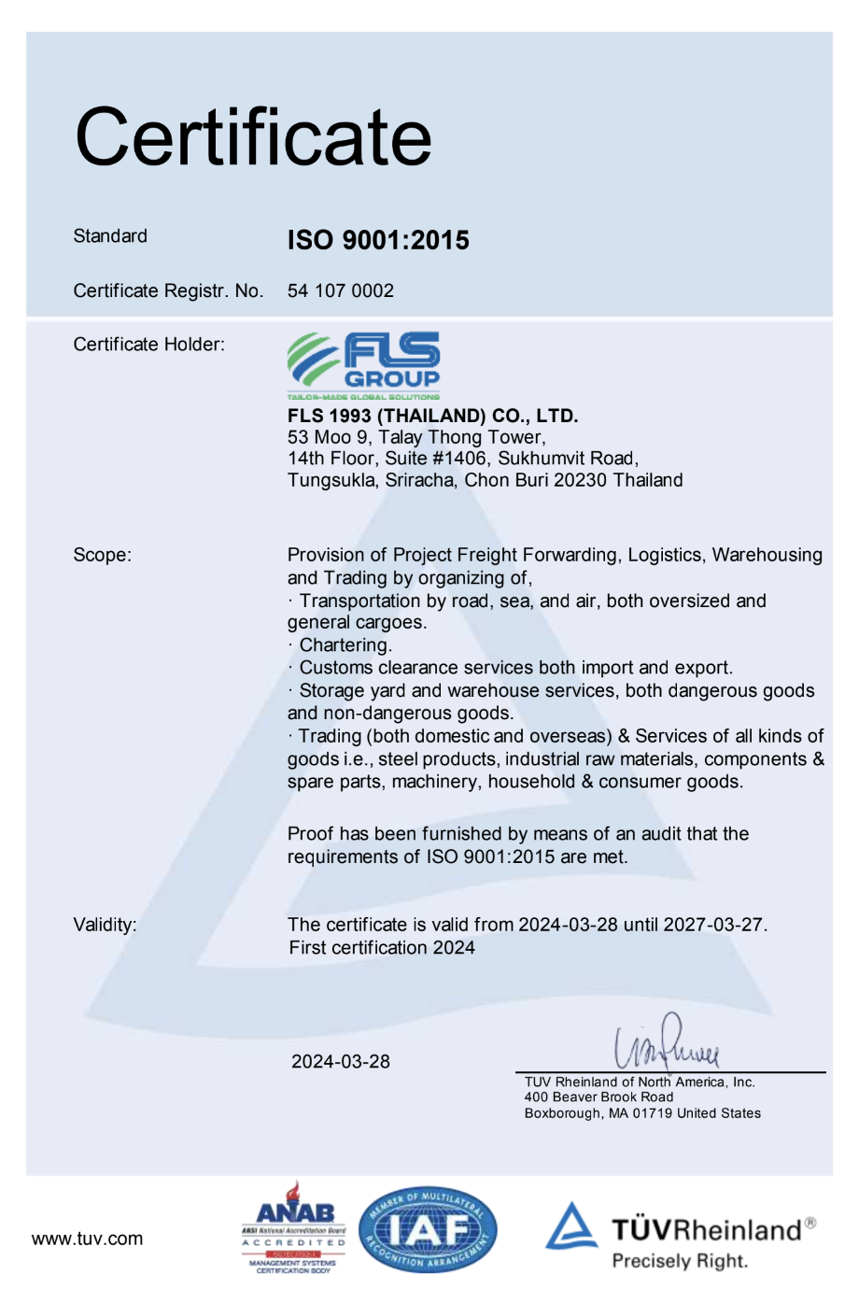
HSEQ Procedures
SAFETY, QUALITY & INTERNATIONAL COMPLIANCE
ISO 45001:2018 CERTIFICATE
ISO 4001:2015 CERTIFICATE
ISO 9001:2015 CERTIFICATE
ISO-certified own operations in Thailand, Australia, Singapore, USA, Vietnam, Taiwan, Indonesia, Malaysia, India and Myanmar.
10

Slide 11


SAFETY, QUALITY
& INTERNATIONAL COMPLIANCE
QUALITY ASSURANCE
HEALTH & SAFETY
OUR STANDARDS
FLS Quality Management Systems meet all our customer’s applicable statutory and regulatory requirements.
We use one of the world’s leading modular enterprise systems to streamline operations, accounting and business development.
Provide Health & Safety training for all members of staff as well as blue-collar and sub-contracting parties.
Follow international rules and guidelines to foster a safe and healthy working environment for our teams.
Ensure that each project and every shipment is handled in a safe, timely, systematic, and efficient manner.
We select and work only with agents and partners who:
are fully certified to international standards
fulfill our own strict quality standards
have sufficient insurance coverage
operate with well-maintained and regularly tested equipment
are well managed and staff regularly trained
have a long successful history and proven track record.
11

Slide 12

OCCUPATIONAL HEALTH, SAFETY
AND ENVIRONMENTAL POLICY
FLS requires the active commitment to, and accountability for, occupational health, safety and environment from all employees and contractors.
Comply with all relevant legislations and corporate requirements of OHSE;
Meet specified customer requirements and ensure continuous customer satisfaction;
Protect, and strive for improvement of, the health, safety and security of our people at all time;
Eliminate accidents and minimize potential risks;
Set OHSE performance objectives, measure results, assess and continuously improve processes and services, through the use of an effective management system;
Plan for, respond to and recover from any emergency, crisis and business disruption;
Minimize our impact on the environment through pollution prevention, reduction of natural resource consumption and emissions, and the reduction and recycling of waste;
Apply our technical skills to all OHSE aspects in the design and engineering of our services;
Communicate openly with stakeholders and ensure an understanding of our OHSE policies, standards, programs and performance. Reward outstanding OHSE performance;
Improve our performance on issues relevant to our stakeholders that are global concern and on which we can have an impact and share with them our knowledge of successful OHSE programs and initiatives.
12

Slide 13

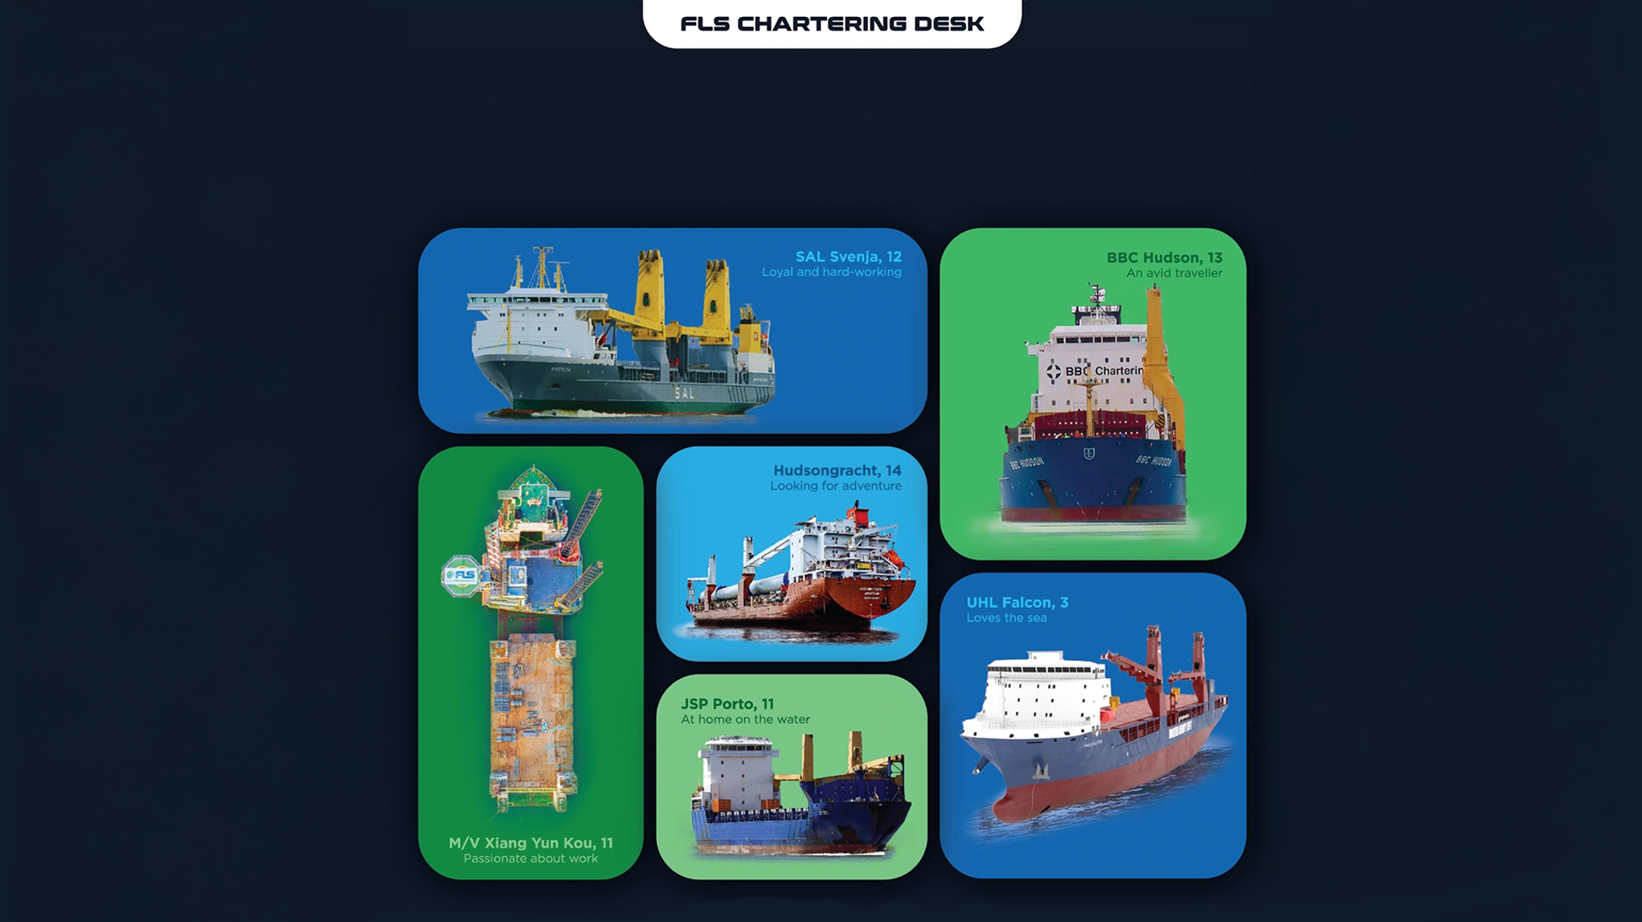
WE’LL FIND YOU
THE PERFECT MATCH

Slide 14
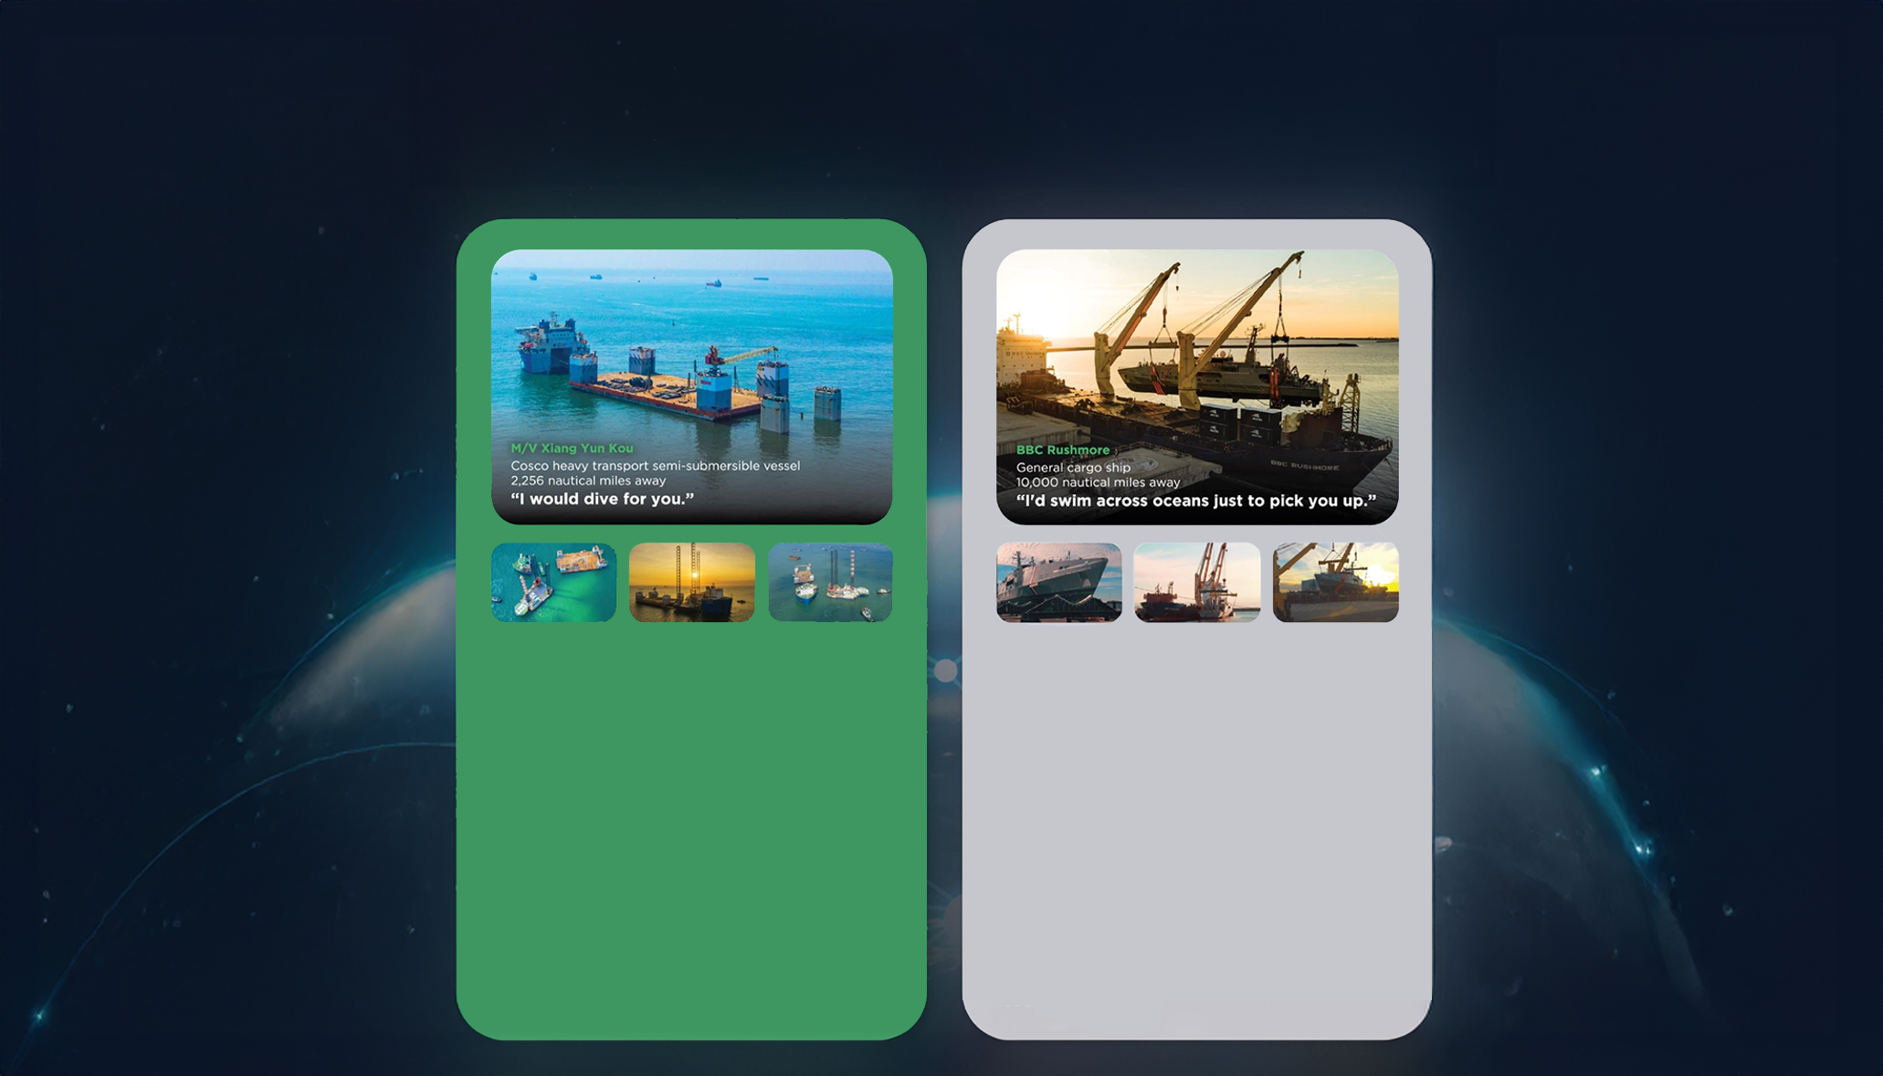
THE RIGHT VESSEL AT THE
RIGHT PRICE AT THE RIGHT TIME
• Half swimmer, half diver
• The big lady of the sea
• Nothing is too big to handle
• Matched with: a 7.000 tonne-floatina drudock and a 6.000-tonne liftboat.
Our buying power and creative solution of combining two shipments allowed us to lock in thebest pricing and the fastest shipping time, despite an extremelv short notice period.
The float-on, float-off loading operation went smoothly and the threesome enioyed a safe journey from Vietnam to Malavsia and the Philippines.
• Any port. Any cargo.
• Accommodating and spacious
• Sailing under the name of the global market
leader of ocean
• Matched with: Austal-built coast guard vessels
As these state-of-the-art vessels are crucial assets for the Trinidad and Tobago coast guard, a best-in-class, door-to-door delivery solution was needed. After securing the reputable BBC Rushmore for these vessels.
FLS experts designed special shipping cradles to support and protect the mono aluminum hulls during the lifting operation and arranged professional divers for a precise loading operation

Slide 15
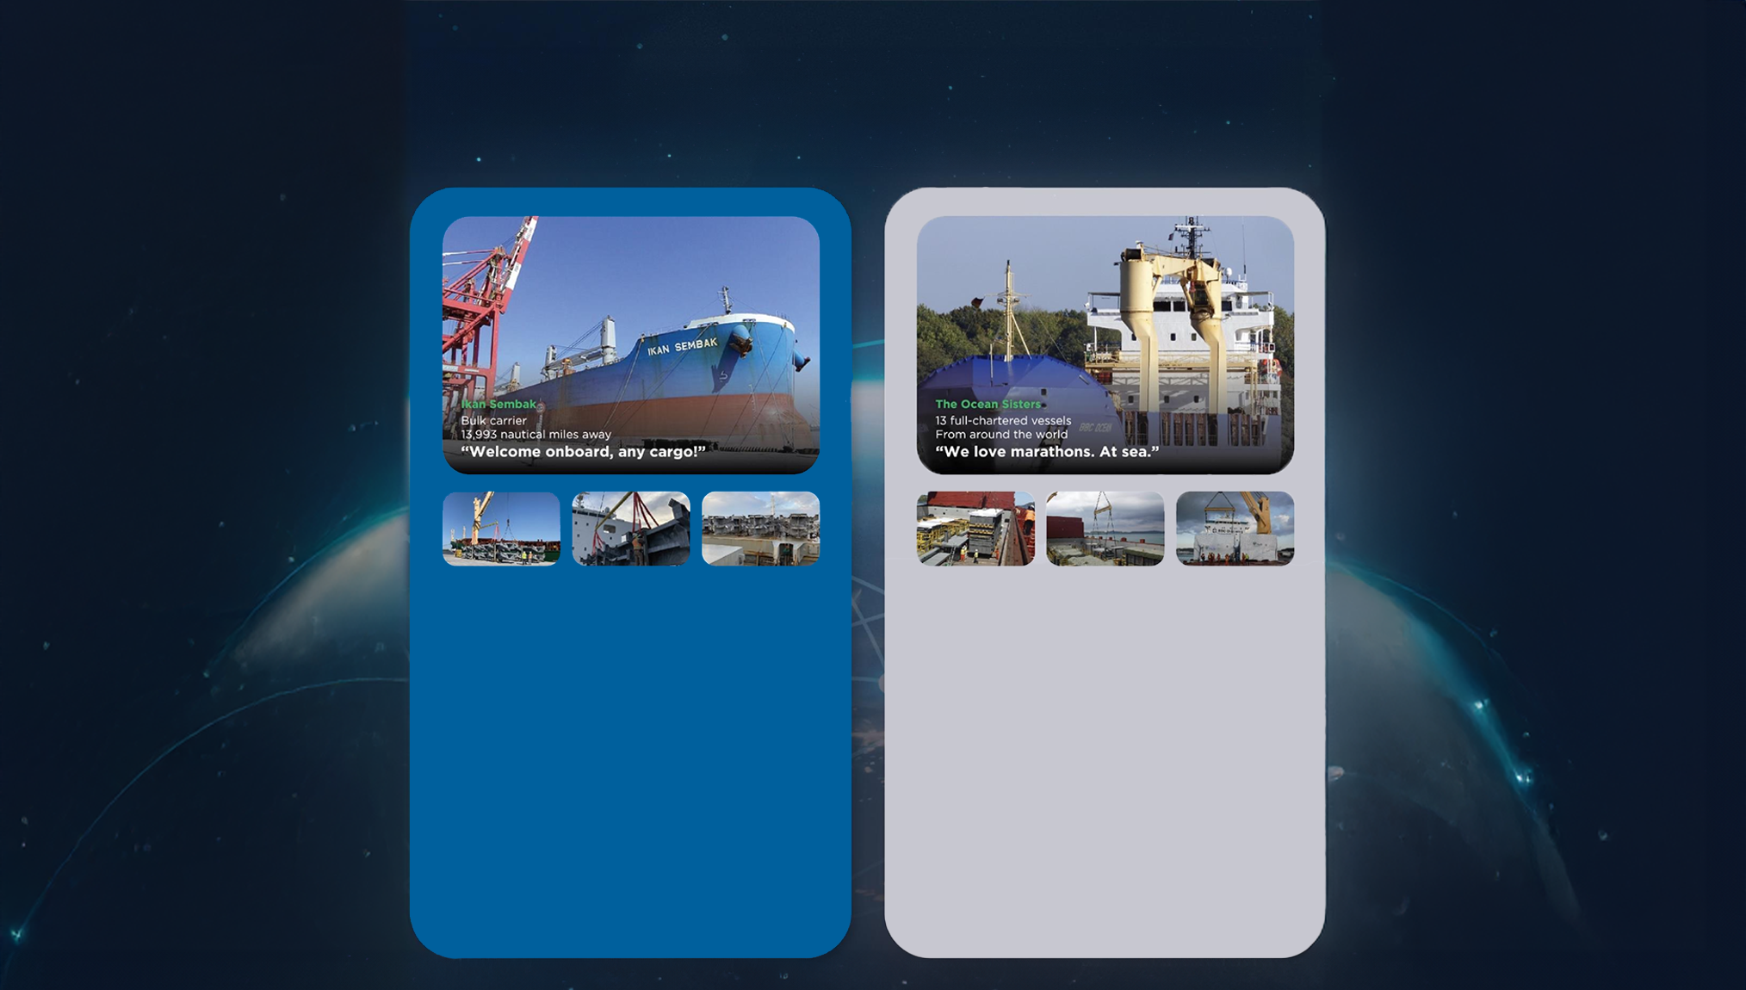
At FLS Chartering Desk we pride ourselves on having long-standing relationships with vessel owners all around the world. This means we can find the perfect match for your needs, while also trying to fulfill your budget and time requirements.
Below are just a few of the perfect matches we've made for our customers.
• Born in Japan
• Enjoying fantastic voyages for the last decade
• Making friends across the globe
• Matched with: Niles, Guernsey and Jackson
combined-cvcle power plants.
Six successful voyages matched so far! FLS
provided packaging guidance and improvement, with customised metal frames to protect the stability of the heavy cargos and our in house stevedores assisted various lifting and lashing operations.
We successfullv saved costs and reduced transit time for two clients in this consolidated shipment.
• We go where cargos love to be
• Devoted to you
• Teamwork is dreamwork
• Matched with: 164 modules, around 225.000
FRT of equipment for a petrochemical plant
in Houston, USA.
A complicated multimodal project which took us 1,5 years to complete. As well as 13 full-chartered vessels, we also provided bespoke trucking, wrapping, stowage and barging solutions.
Our good relationship with carriers and local authorities helped the cargo enjoy a comfortable journey.

Slide 16
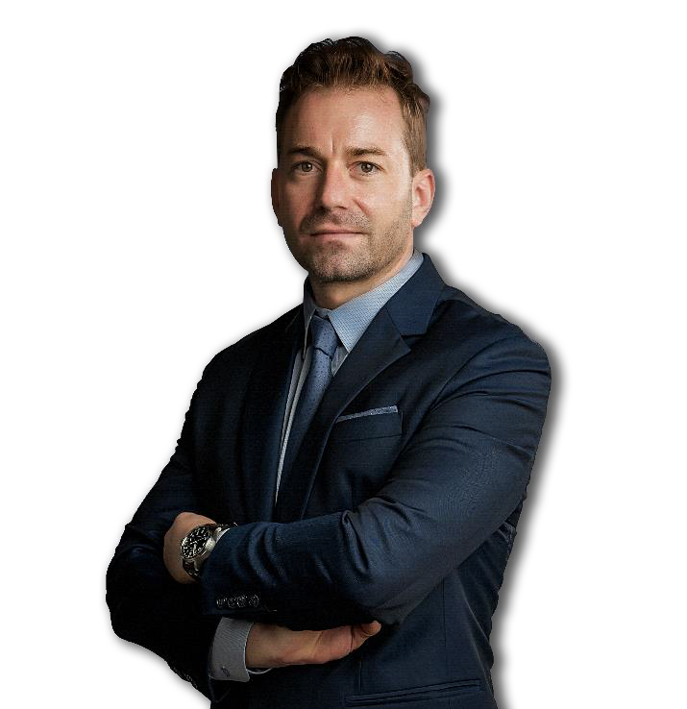
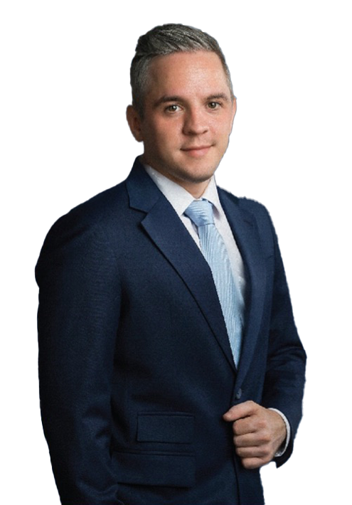
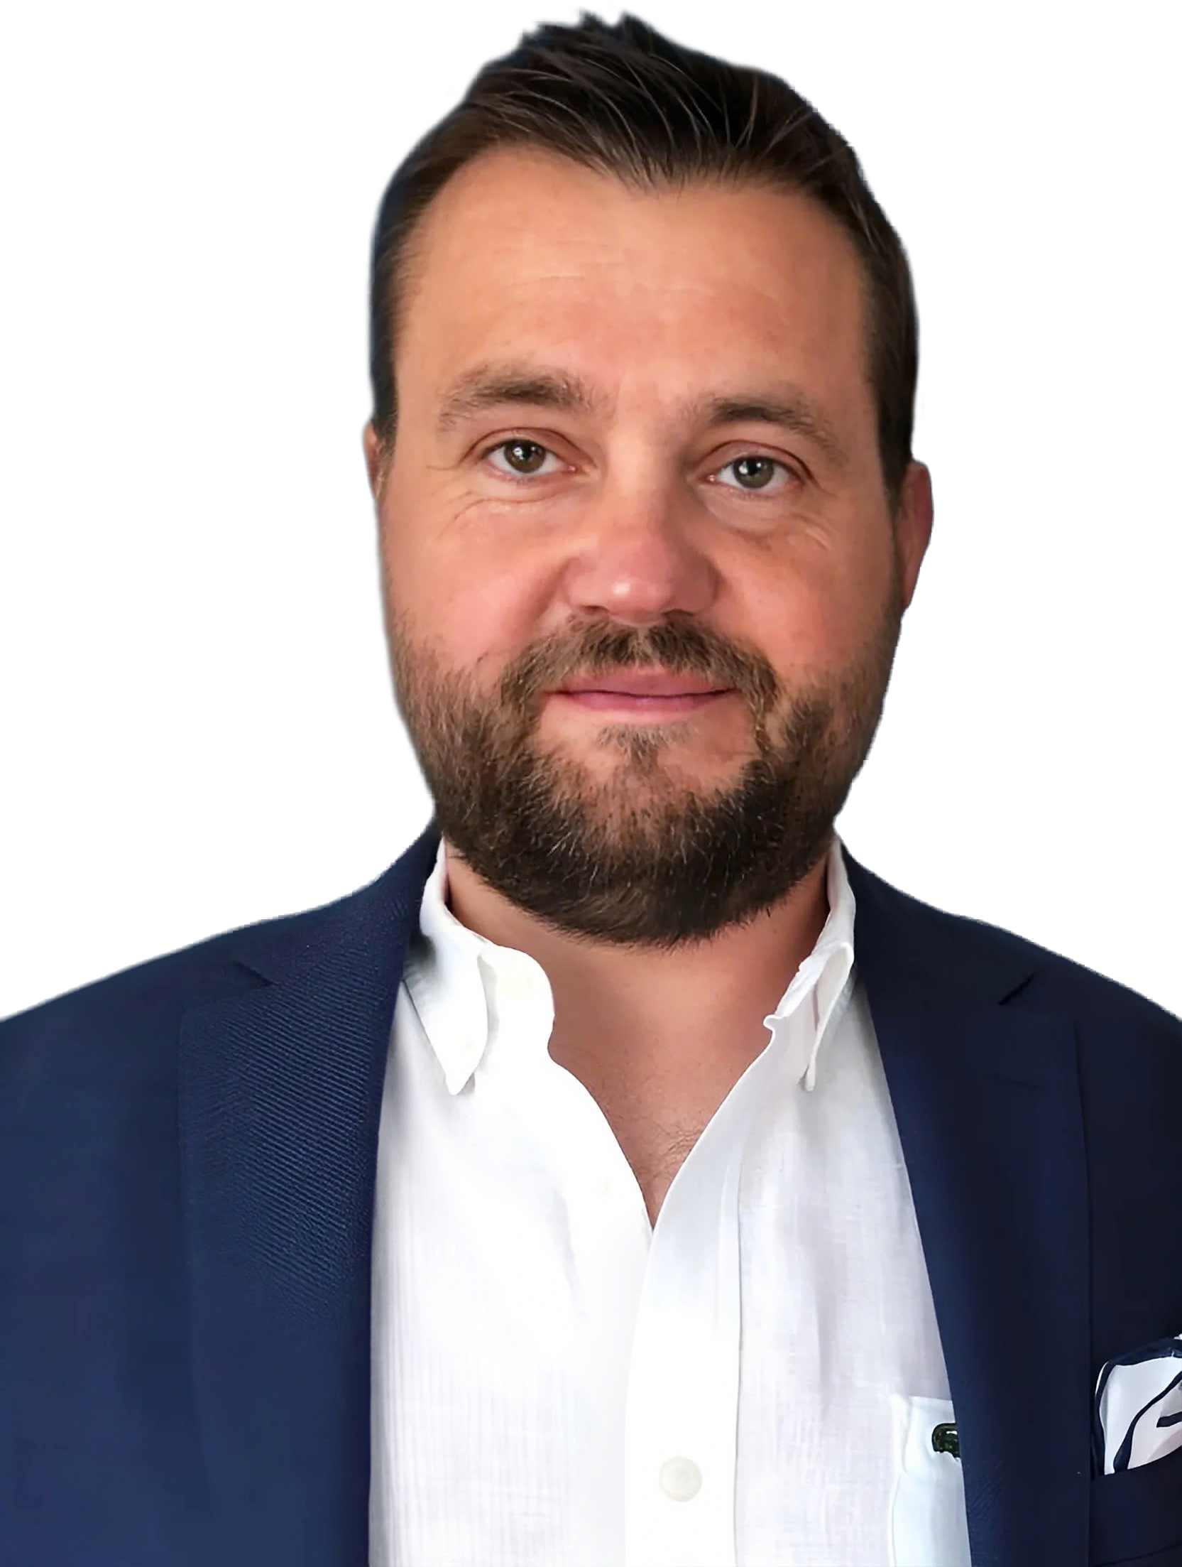
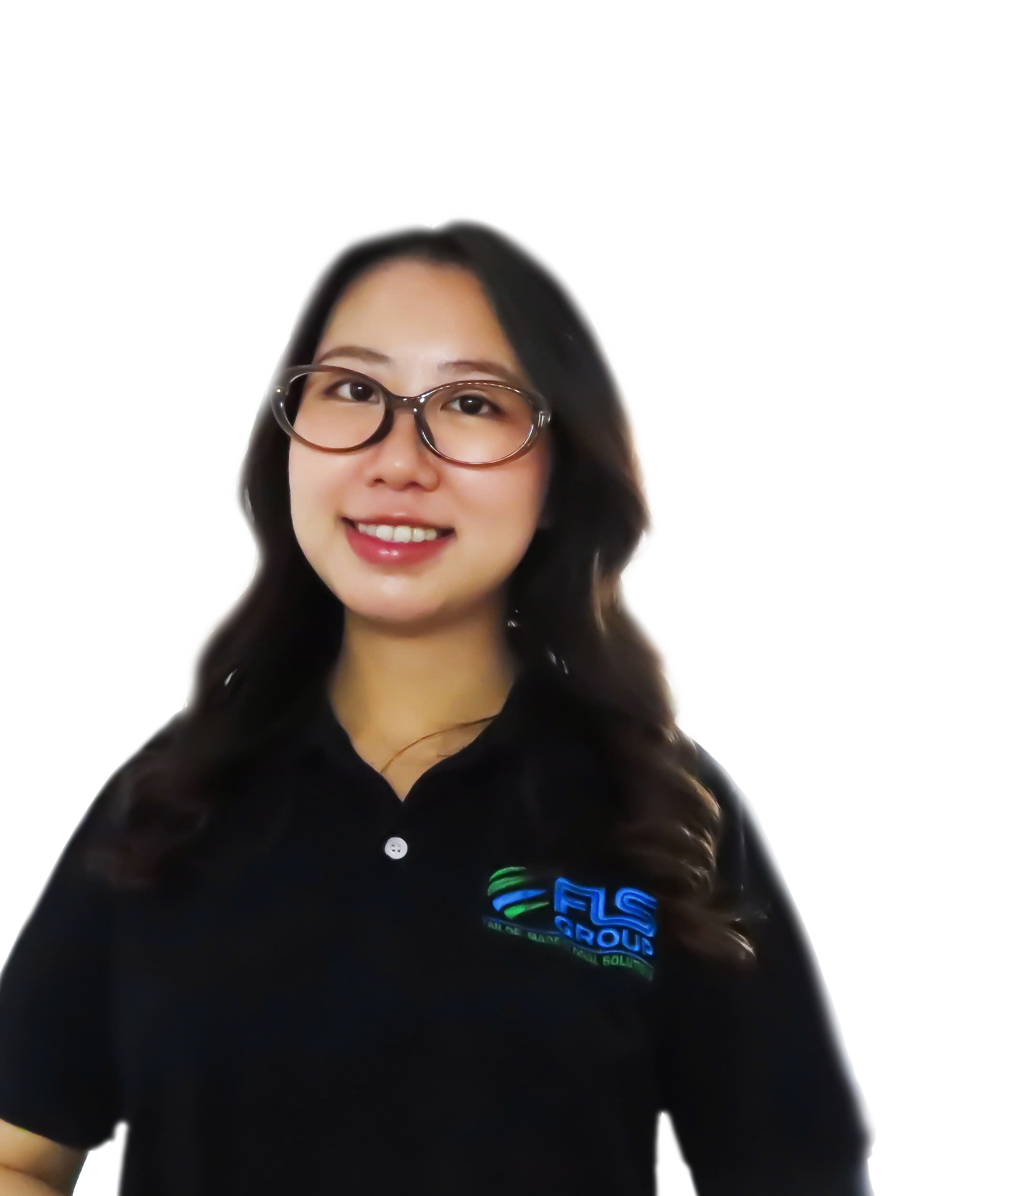
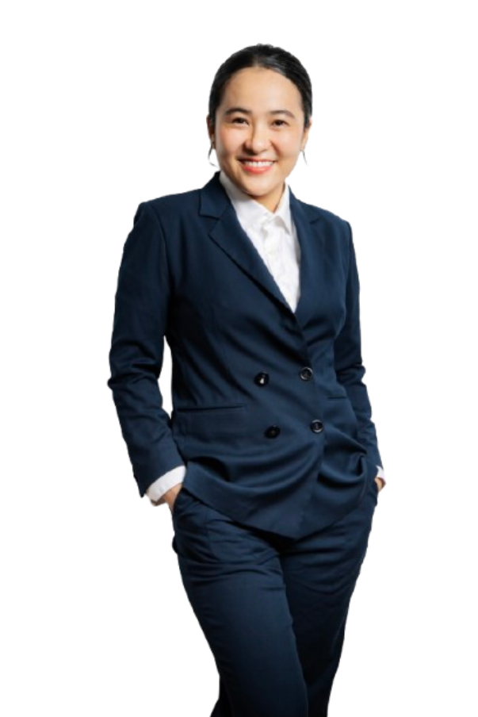
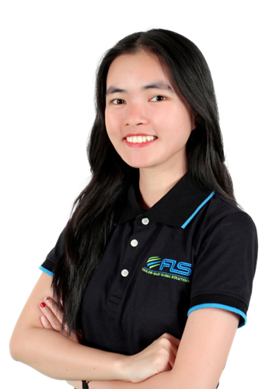
GLOBAL VESSEL ACCESS. PRECISION OPTIMIZATION
FLS Chartering Desk provides direct access to a global network of vessel owners, enabling unrestricted selection across the market. Leveraging strong buying power and deep market understanding, we optimise every charter for cost, timing and operational performance.
SVEN
HOEHLE
HEAD OF GLOBAL PROJECT SOLUTIONS
CHARTERING DESK
CHRISTOPHER SCHNIEDERS
GLOBAL DIRECTOR PROJECTS
SUNE
THORLEIFSSON
MANAGING PARTNER | CHARTERING
VI
NGUYEN
CHARTERING
MANAGER
KHUONG
NGUYEN
PROJECT SOLUTIONS
EXECUTIVE
LINH
NGUYEN
CHARTERING
EXECUTIVE

Slide 17
FLS Group Chartering Desk
Purpose of the chartering desk
1 | Centralize market insight, customers benefit from up-to-date insights on freight rates, bunker prices, and carrier performance, conditions, often securing better deals than if the customer approached shipowners directly
2 | Legal and limit commercial risk, direct oversight ensures that all transport activities comply with regulations, reducing the risk of legal issues, ensuring smooth operations and protecting customer interests
3 | Get unfiltered first-hand information in order to make quick and qualified decisions (in case of delays in production, on the job-site etc.). Greater visibility into supply chain.
4 | Provide technical input and increased usage of inhouse engineer to add value. Transport plan will be tailor-made to your needs.
17

Slide 18
Infrastructure References

Slide 19
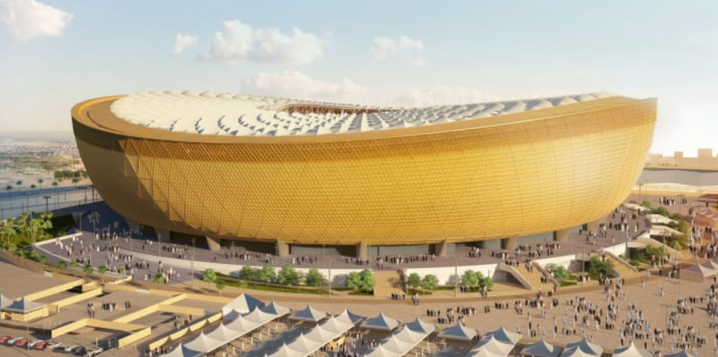
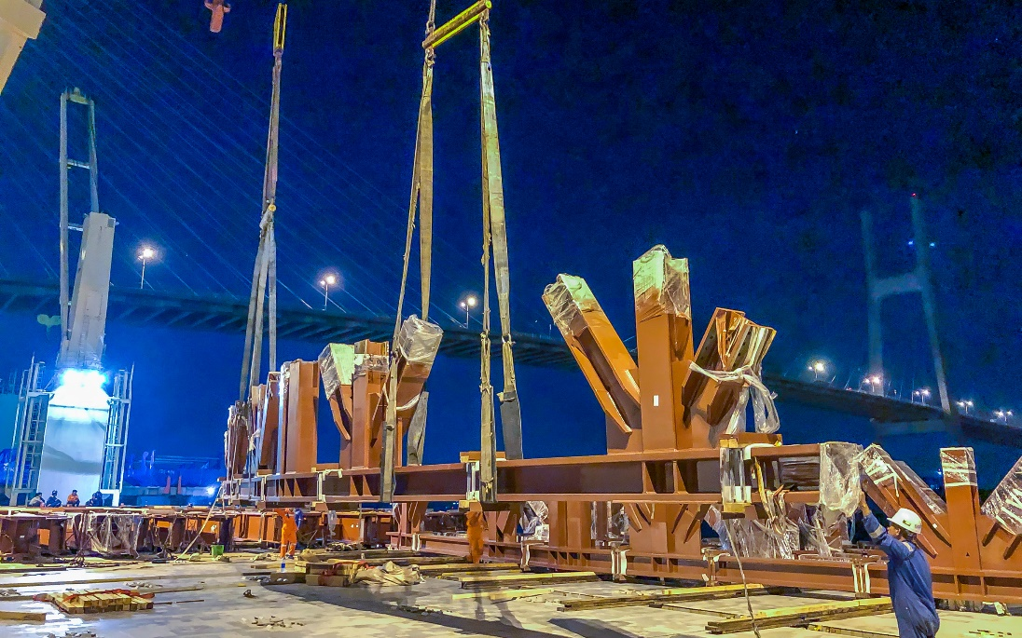
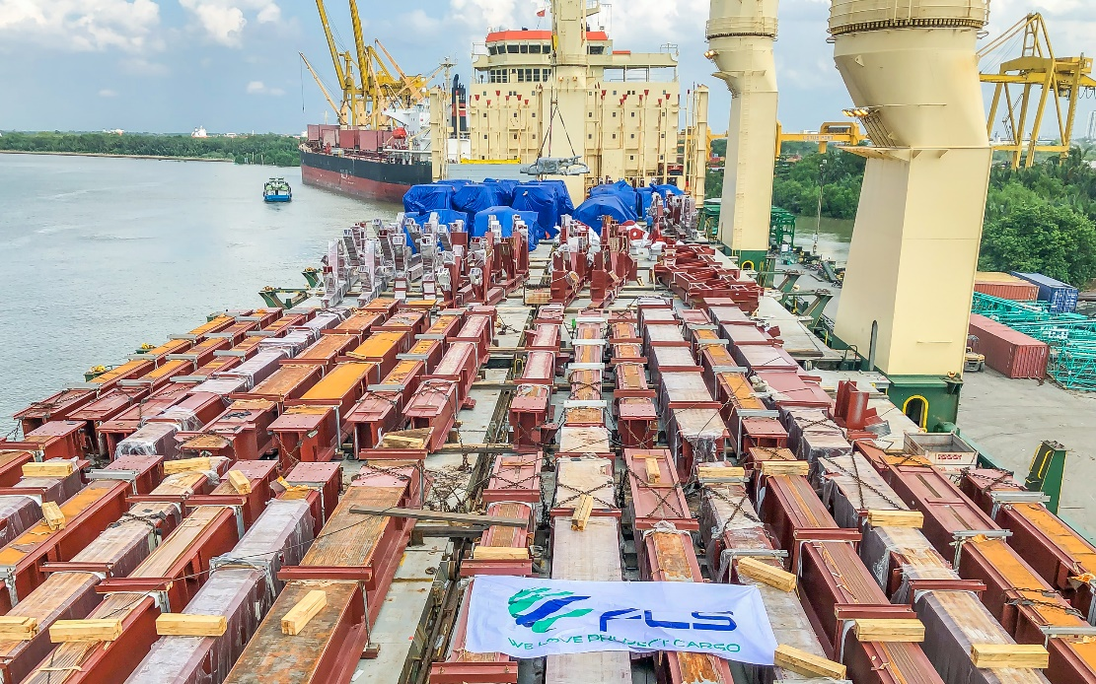
PROJECT REFERENCES
PROJECT REFERENCES
CASE STUDY – LUSAIL WORLD CUP STADIUM
Project Name: Lusail World Cup Stadium
Volume: 6,500 FRT over 4 shipments
Commodity: Structural steel for roof of World Cup 2022 stadium
Origin: Ho Chi Minh City, Vietnam
Destination: Hamad, Qatar
Chartering of suitable vessel + supervising on board
Co-ordination and supervision of the loading operation
Scope:
19

Slide 20
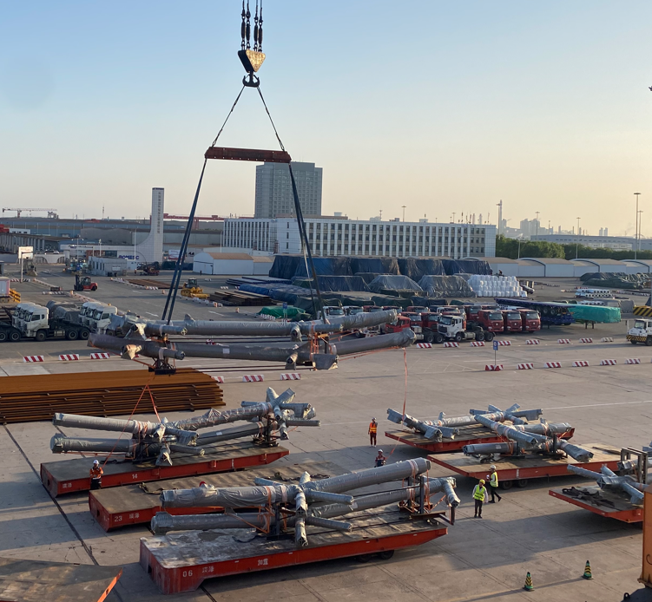
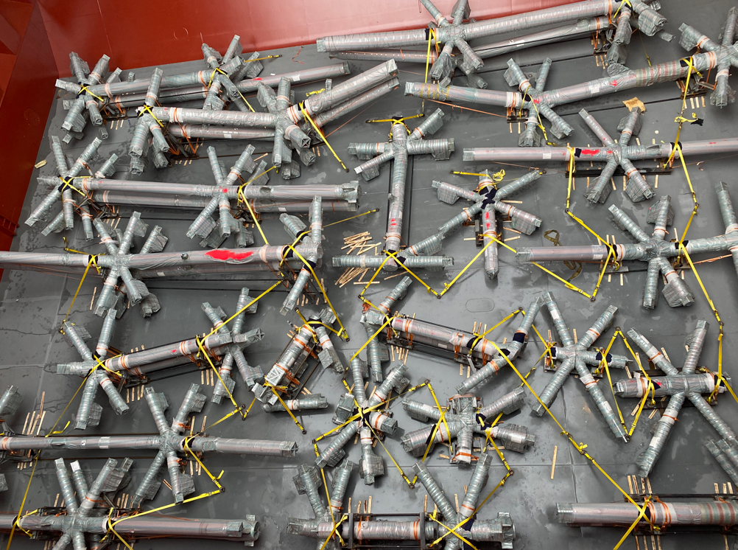
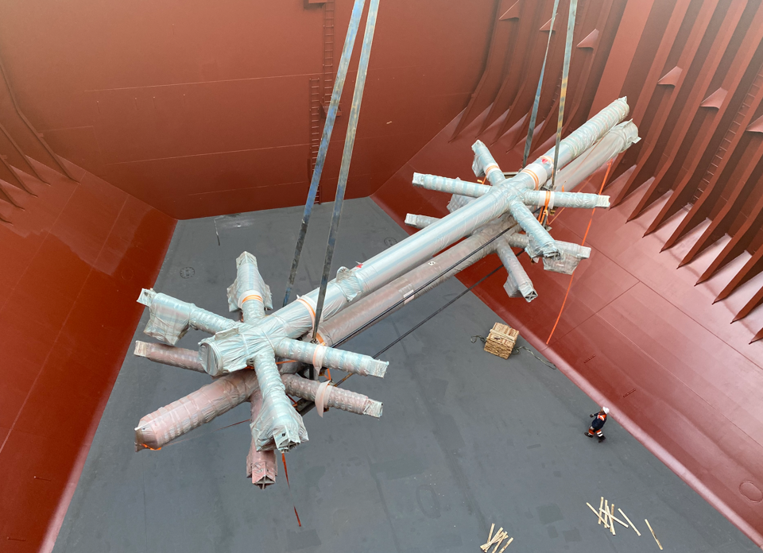
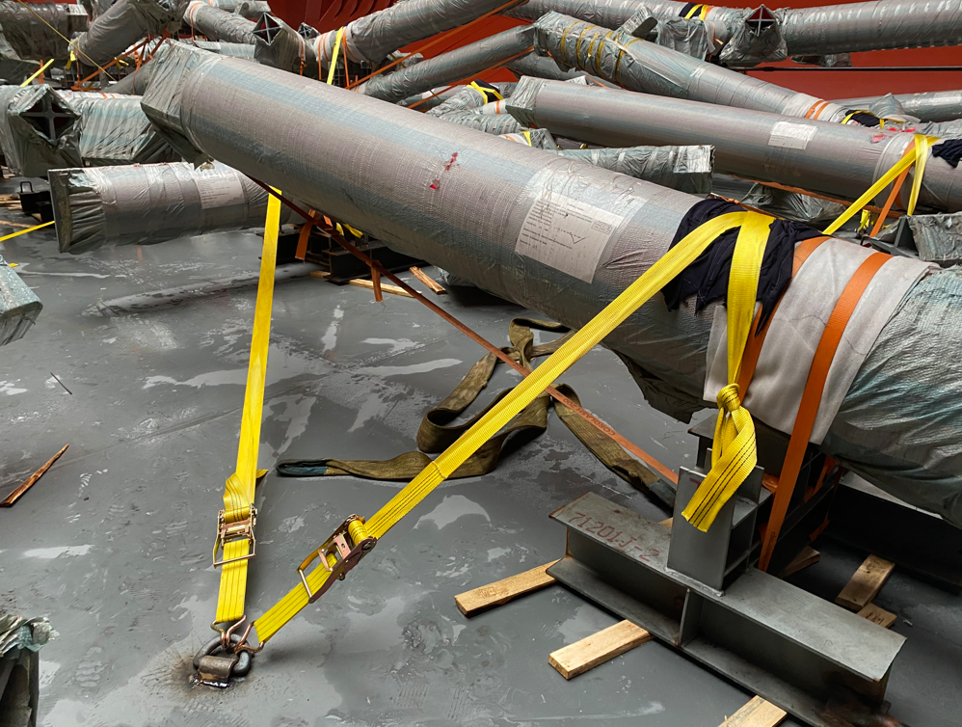
PROJECT REFERENCES
PROJECT REFERENCES
CASE STUDY – LA clippers stadium
Volume: 22,900 CBM / 3,000 MT / 4 shipments
Origin: Tianjin port, China
Port of Discharge: Long Beach, USA
Full liner terms Ocean freight
Chartering break bulk carrier vessel
Loading onto vessel incl appropriate cargo stow arrangements. Cargo hold preparation for loading, layout dunnage by FLS own stevedores
Loading supervision by FLS Port supervisor
Scope:
20

Slide 21
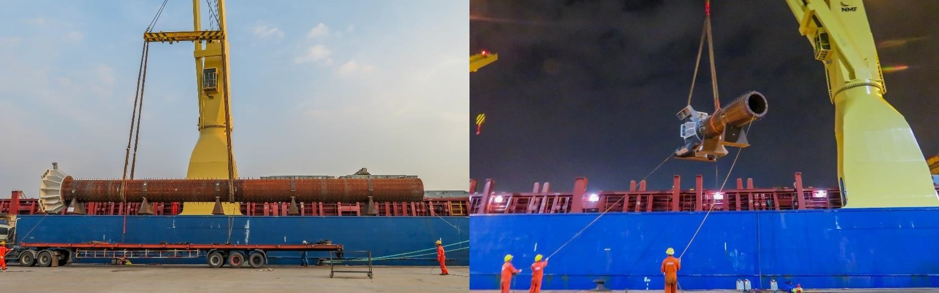
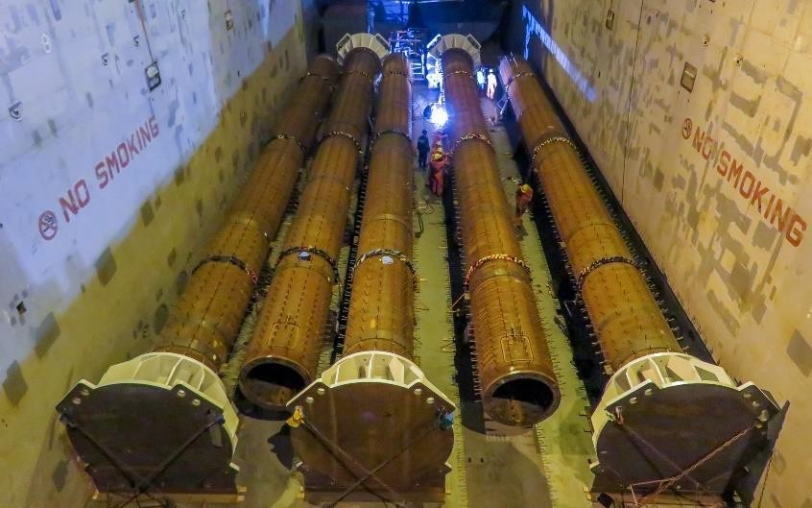
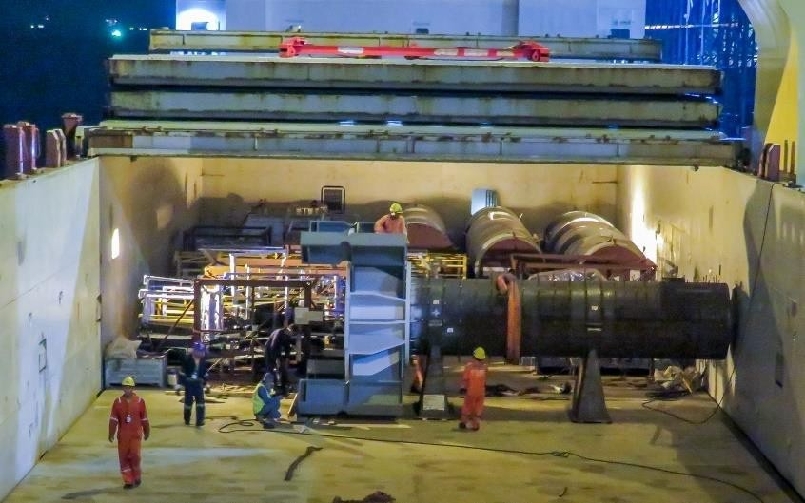
PROJECT REFERENCES
CASE STUDY – LA RAMS STADIUM
Project Name: LA Rams Stadium
Volume: Commodity: Origin: Destination:
2,000 cbm, max. GW 35 MT Steel pipe column
Thailand
Los Angeles, USA
Scope:
Pre-Carriage EXW to Laem Chabang port
Re-loading and FAS delivery at Laem Chabang port
Loading and securing onto break bulk vessel
Break bulk ocean freight from Laem Chabang port up to Port of Los Angeles + on-carriage to site

Slide 22
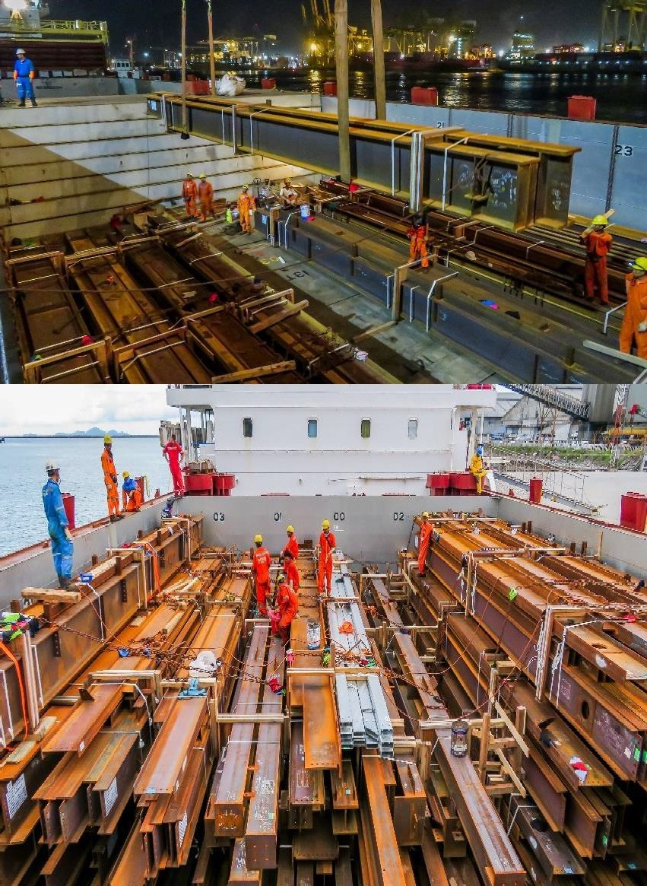
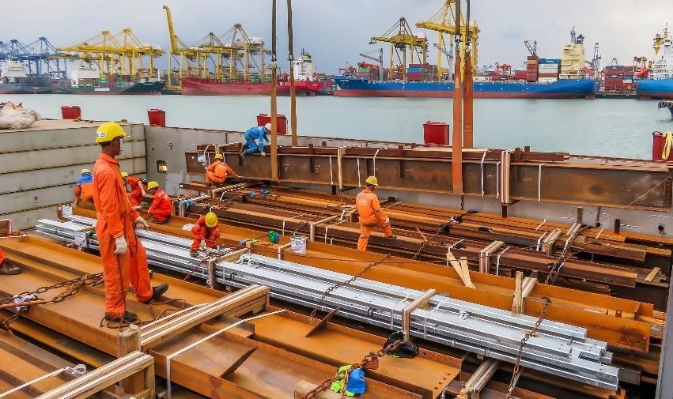
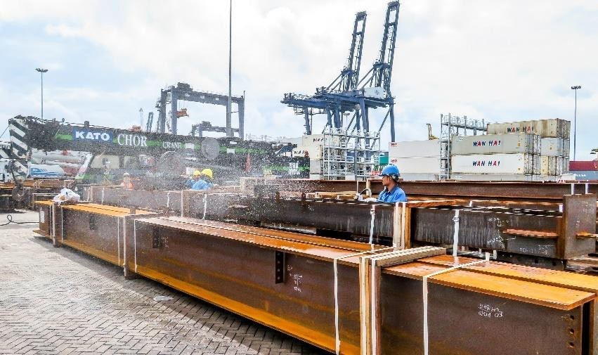
PROJECT REFERENCES
CASE STUDY – BURLINGAME POINT
Project Name: Volume: Commodity: Origin: Destination:
Burlingame Point Project 5,000 cbm, Max. GW 20 MT
Steel beams
Thailand Stockton, USA
Scope:
Pre-Carriage EXW to Laem Chabang port
Re-loading and FAS delivery at Laem Chabang port
Loading and securing onto break bulk vessel
Break bulk ocean freight from Laem Chabang port to port of Stockton
On-carriage to site

Slide 23
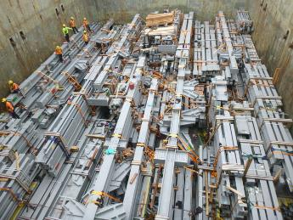
PROJECT REFERENCES
CASE STUDY – STEEL STRUCTURES
Commodity: Steel Structure
Origin: Laem Chabang, Thailand
Destination: USWC
Scope:
  Arranging pre-carriage, lashing container, cleaning cargo
  operational FAS delivery and loading supervision
  Design solutions to stack cargo in close communication with port captain of the vessel
  Coordination with container terminal for loading BB on container vessel
  Ocean freight by BB vessel, BB on container vessel and FR container
  on-carriage to site
  Customs clearance both ends
23

Slide 24
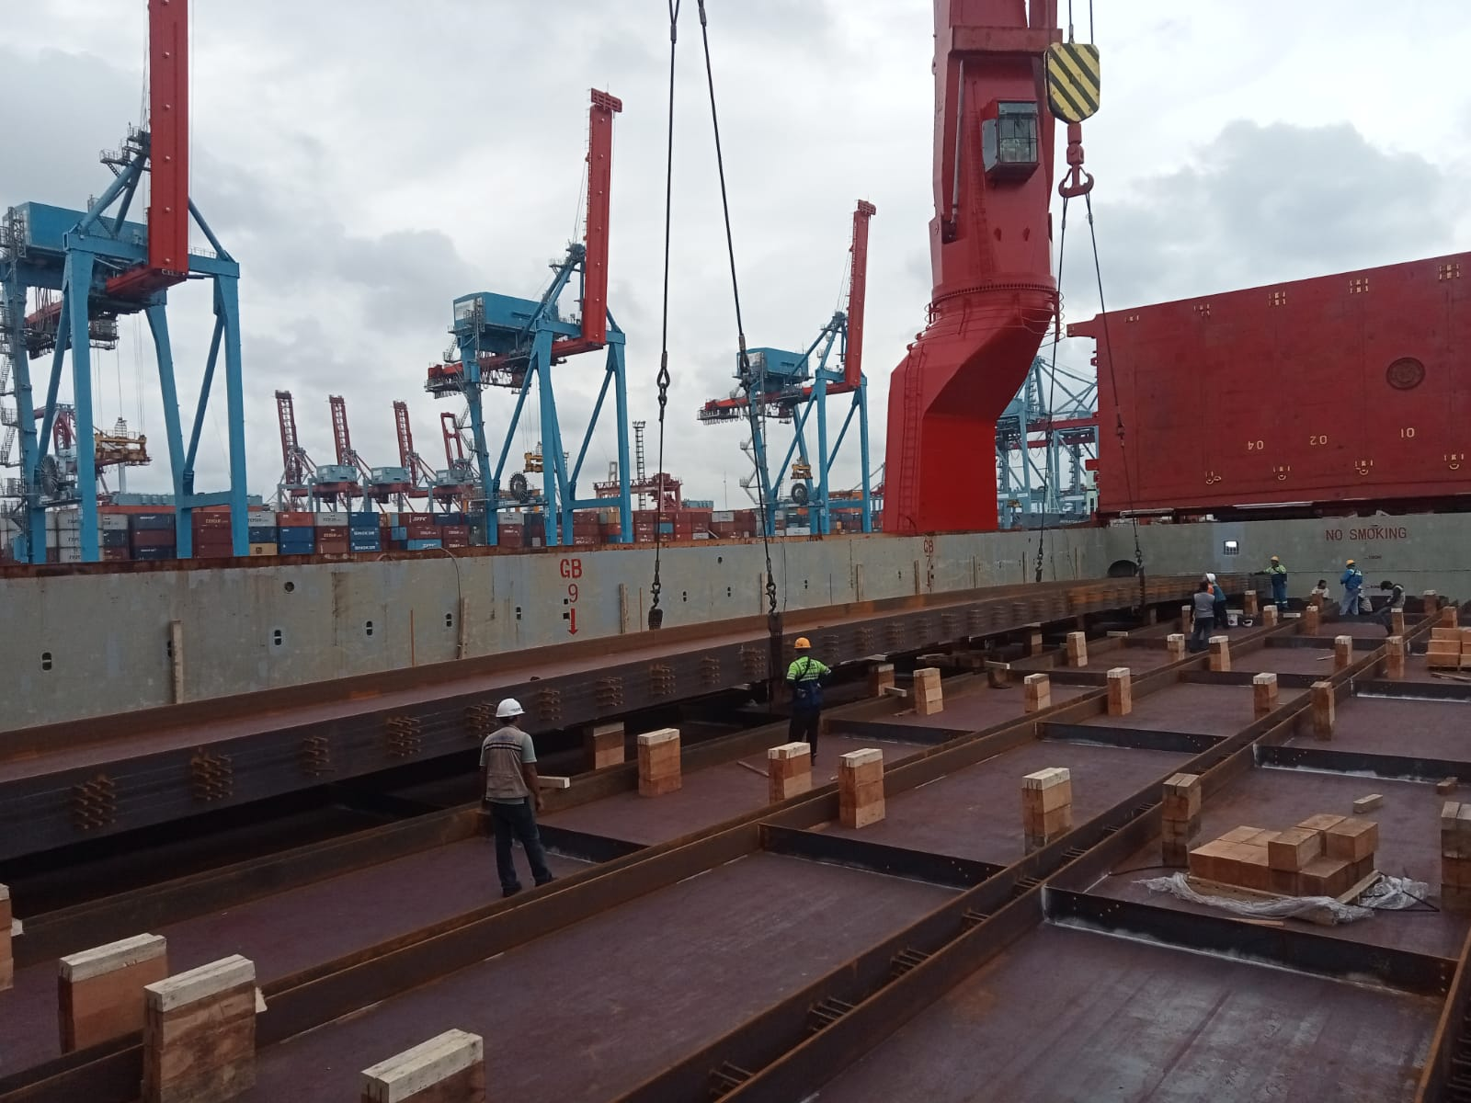
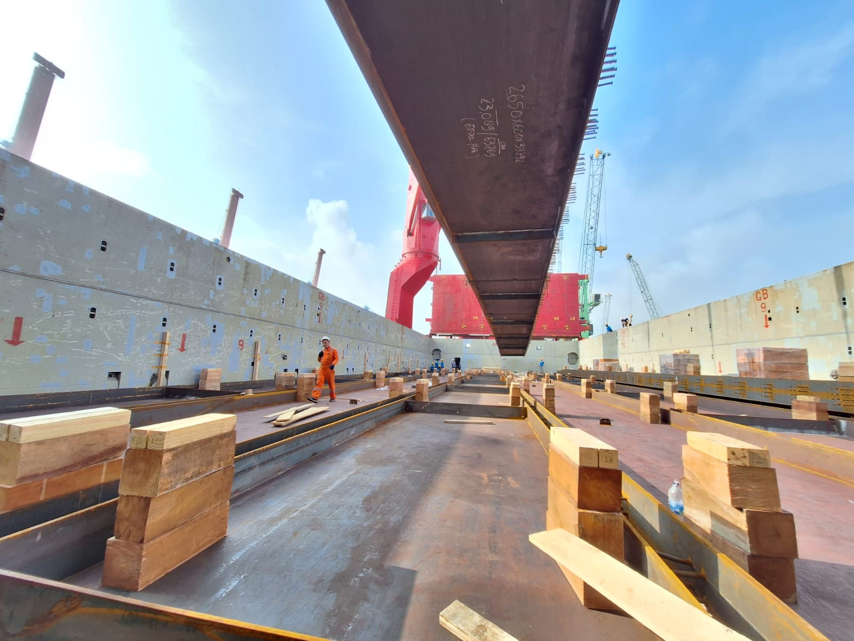
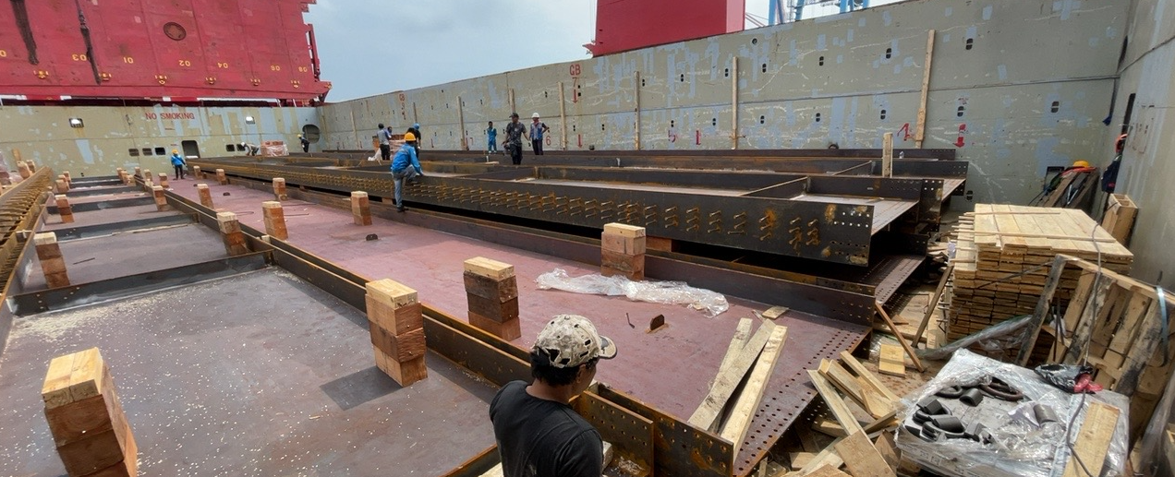
PROJECT REFERENCES
CASE STUDY – steel bridge
Commodity: Steel girders
Origin: Jakarta, Indonesia
Destination: Skagway, Alaska
Scope:
  Chartering of suitable vessel to meet tight schedule and budget
  Co-ordination and supervision of the loading operation
24

Slide 25
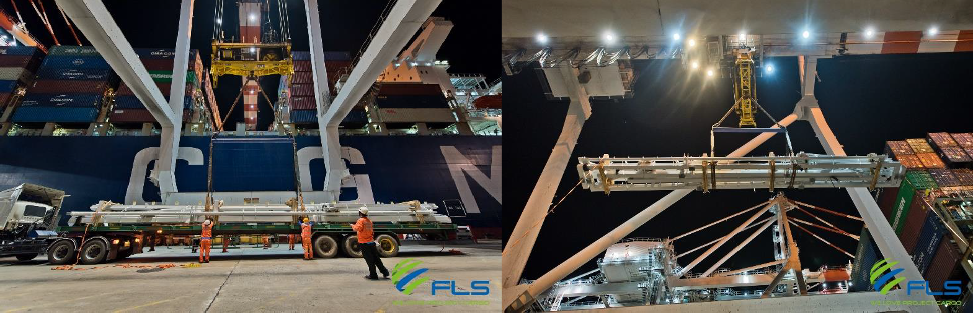
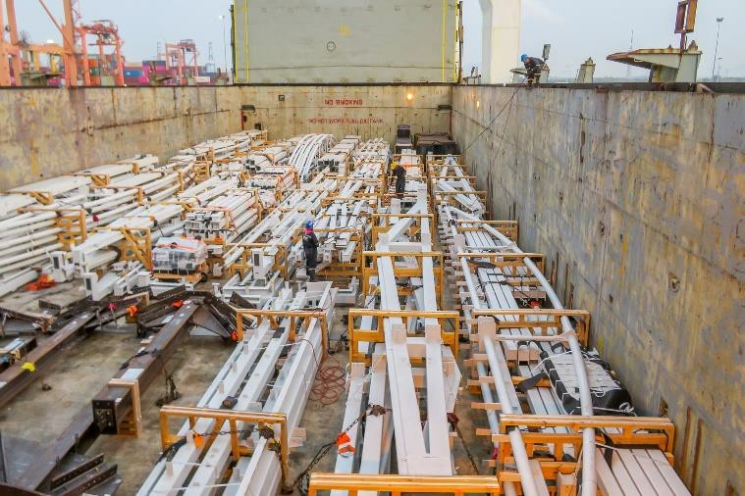
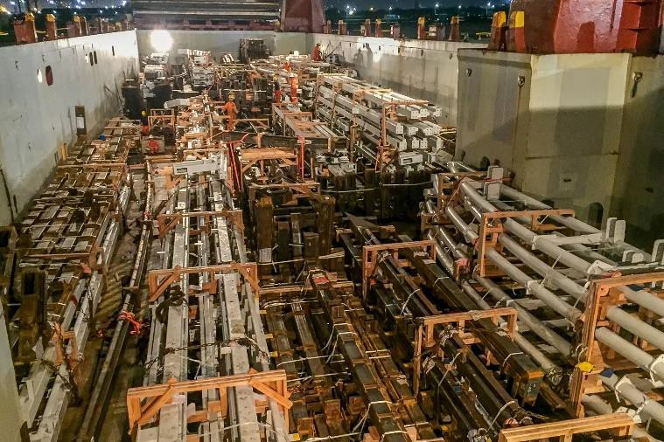
PROJECT REFERENCES
CASE STUDY – Lased roof steel structures
Project Name:
Project Owner:
Volume:
Commodity:
Origin:
Destination:
Lucas Arts Museum
Thai Herrick
10,000 cbm, Max. GW 20 MT
Various steel structures
Thailand
Los Angeles, USA
Scope:
Pre-Carriage EXW to Laem Chabang port
Re-loading and FAS delivery at Laem Chabang port
Loading and securing onto break bulk vessel
Break bulk ocean freight from Laem Chabang port to port of Los Angeles
On-carriage to site

Slide 26
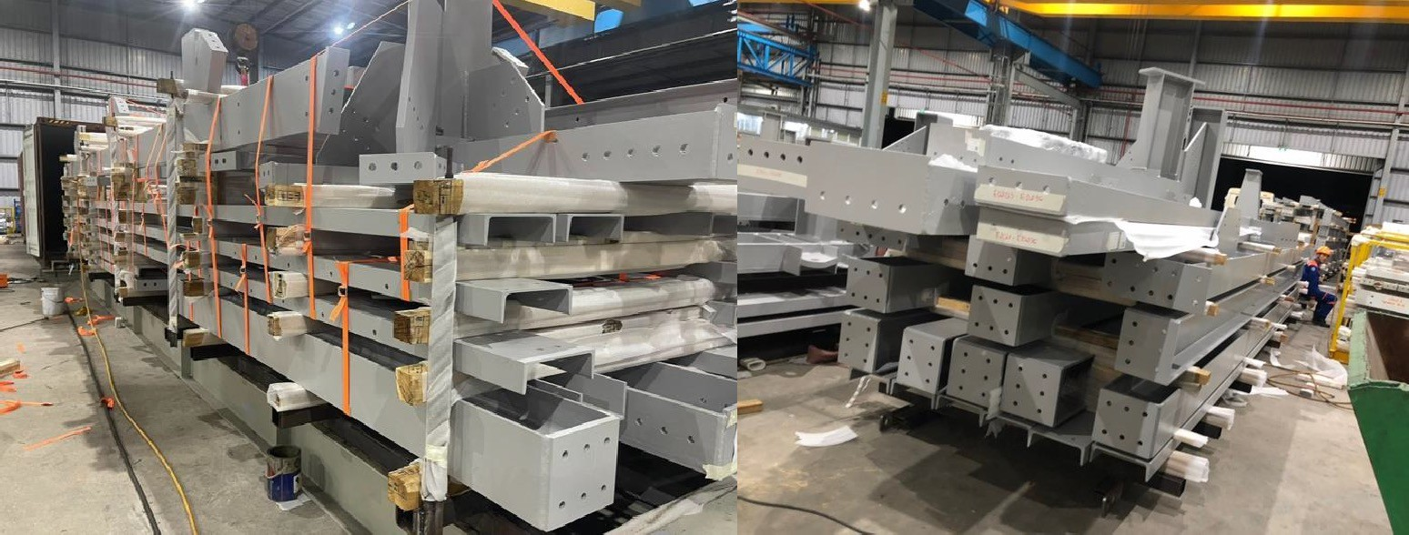
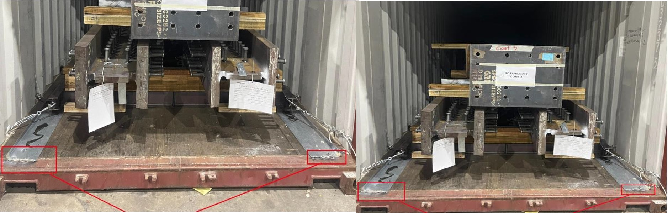
PROJECT REFERENCES
CASE STUDY – ALGOMA DUSTWOOD – WEATHERING STEEL PROJECT
Project Name:
Volume: Commodity: Origin (POL): Destination (POD):
Algoma Dusthood /Weathering steel project Steel Structures
Containers : 71 (40’HC and 45’HC) 1700 MT
Vung Tau
Vancouver – Toronto – Jobsite Saul St. Marie, Canada
Scope:
Handling and booking the transport from FOB Vung Tau up to DDP Canada
Supporting our client with a special tracking system tool, to keep control for every container
Co-ordination and supervision at the port and jobsite

Slide 27
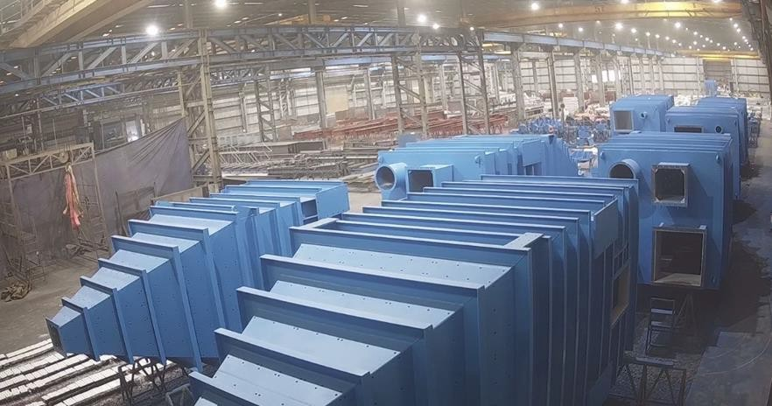
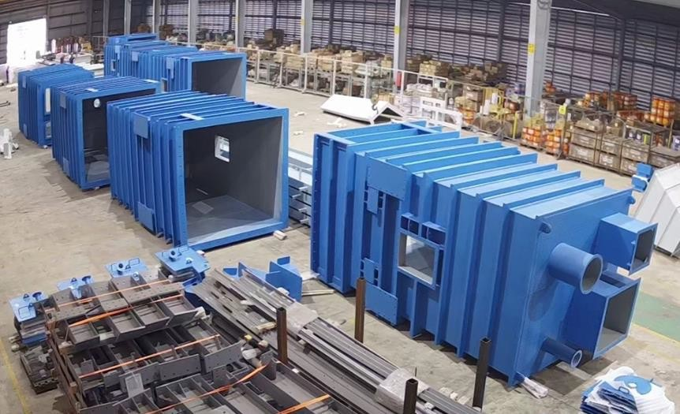
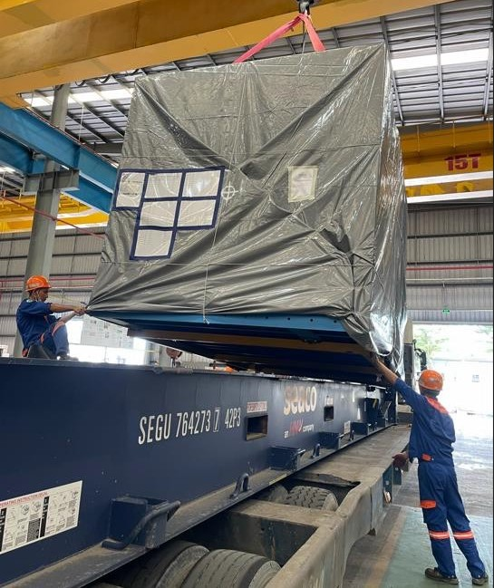
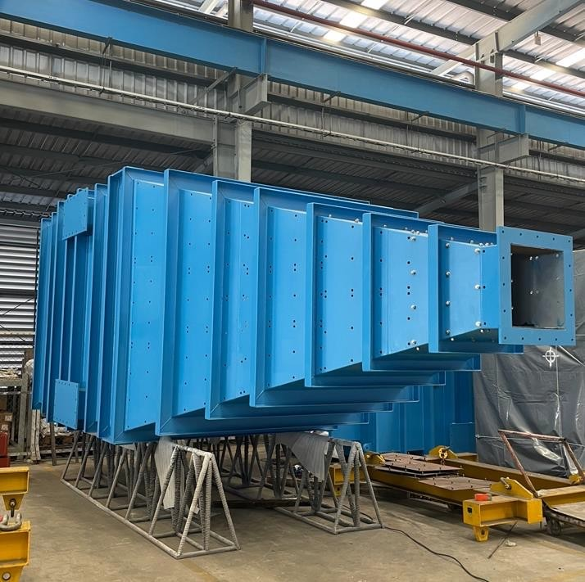
PROJECT REFERENCES
CASE STUDY – AURUBIS PROJECT USA
Project Name: Volume: Commodity:
Period:
Origin (POL): Destination (POD):
Aurubis Project USA
Containers: 25 (40’FR and 40’HC) 600MT Steel Structures
2023-2024
Vung Tau, Vietnam Charleston, USA
Handling and booking the transport from FOB Vung Tau up to CFR Charleston/Savannah USA
Co-ordination and supervision of containers at loading port
Worked on behalf of SMS Group
Scope:

Slide 28
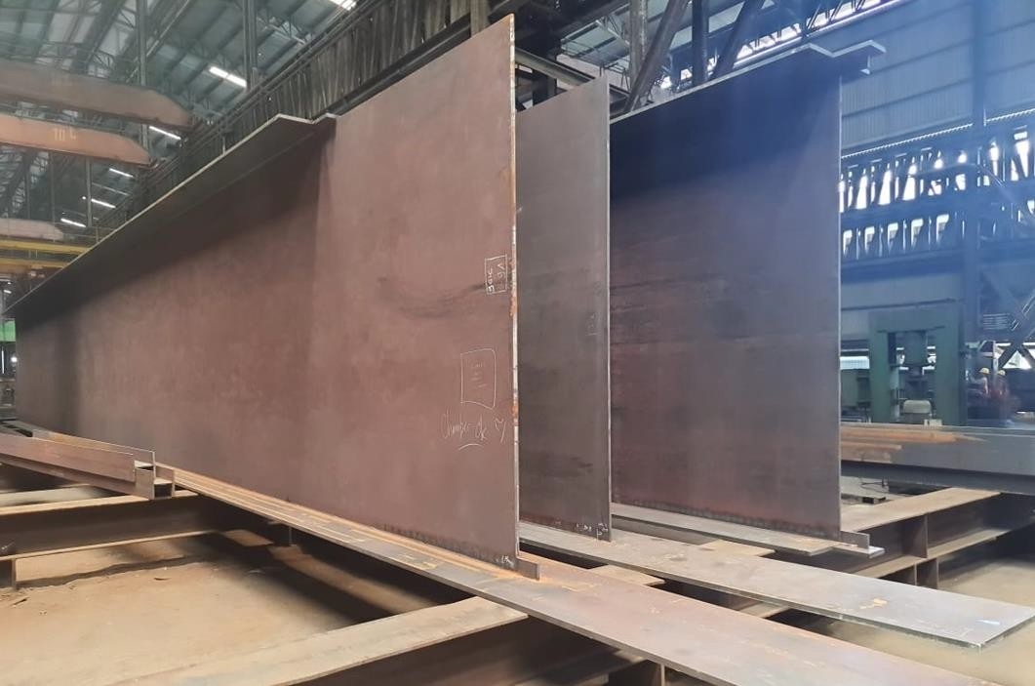
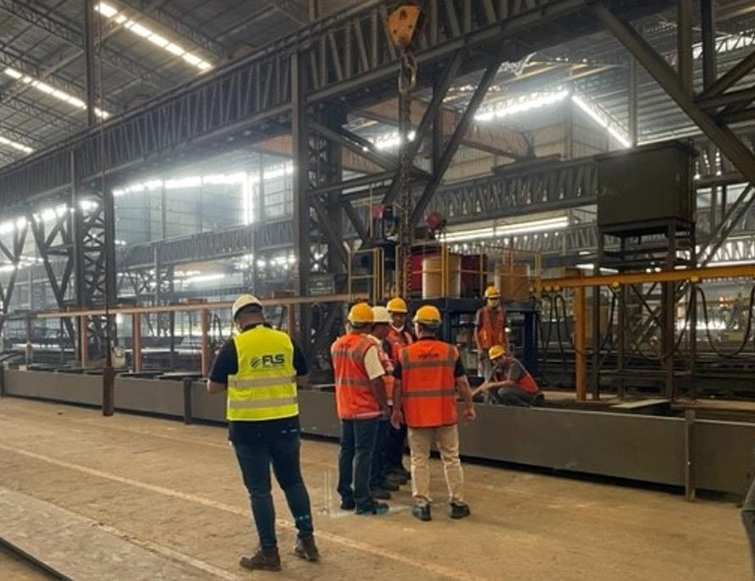
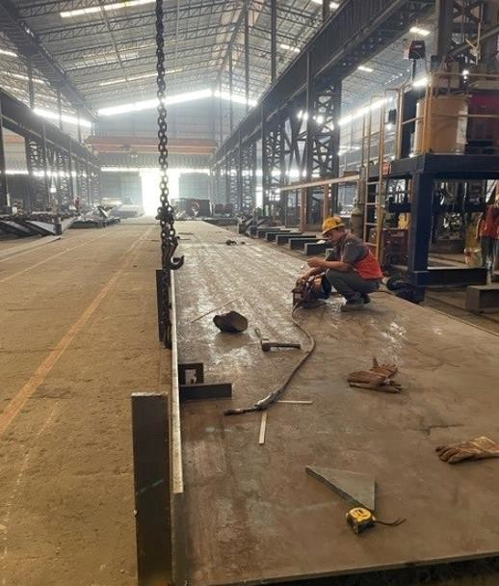
PROJECT REFERENCES
CASE STUDY – NITSULIN YUKON BRIDGE PROJECT
Project Name: Volume:
Commodity:
Origin (POL):
Destination (POD):
Nisutlin Yukon Bridge Project, Canada Containers 50 Containers and 1400 MT/ 3900 cbm Break Bulk
Steel Structures
Indonesia
Project site West coast, Canada
Scope:
Handling and booking the ocean freight for containers + break bulk ex Indonesia
Supporting the project owner with FLS supervising + know how from A-Z

Slide 29
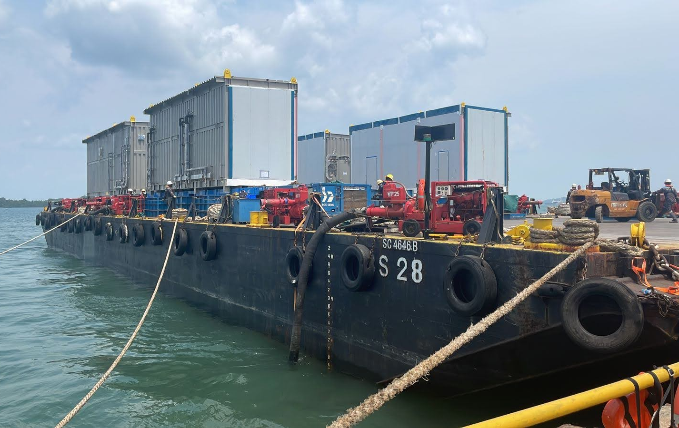
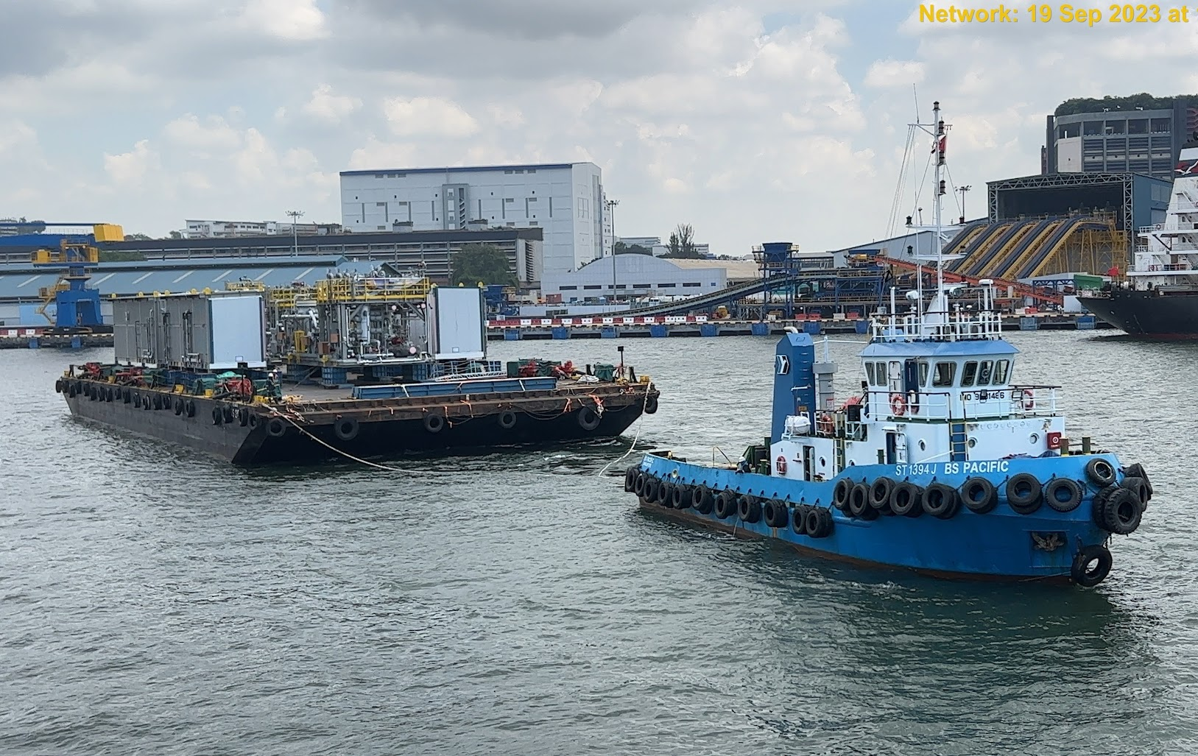
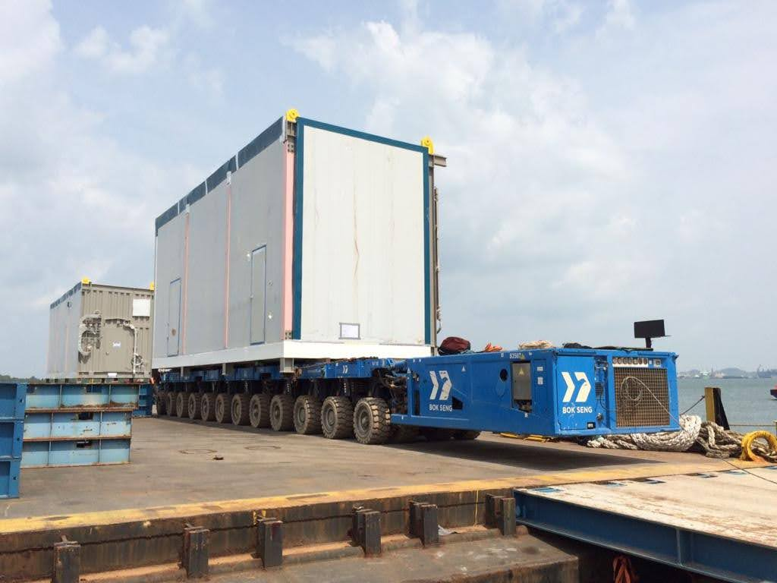
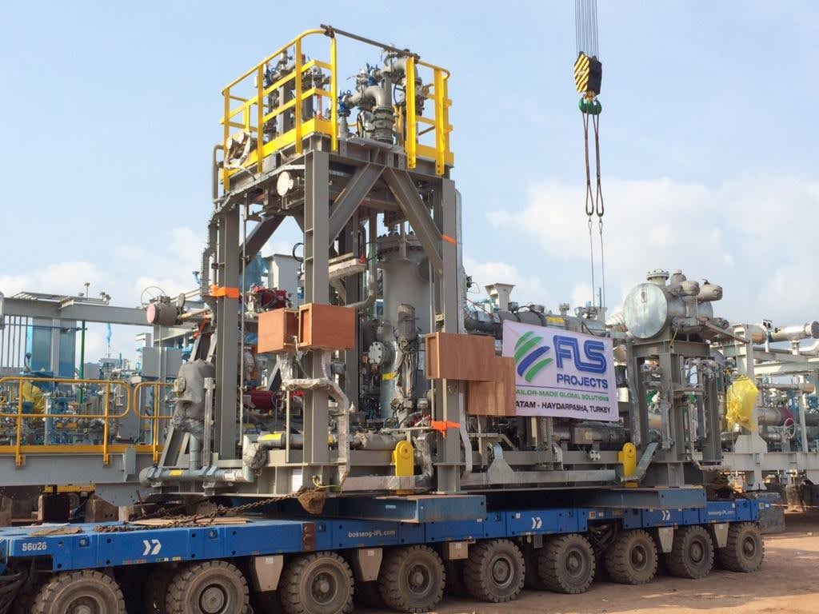
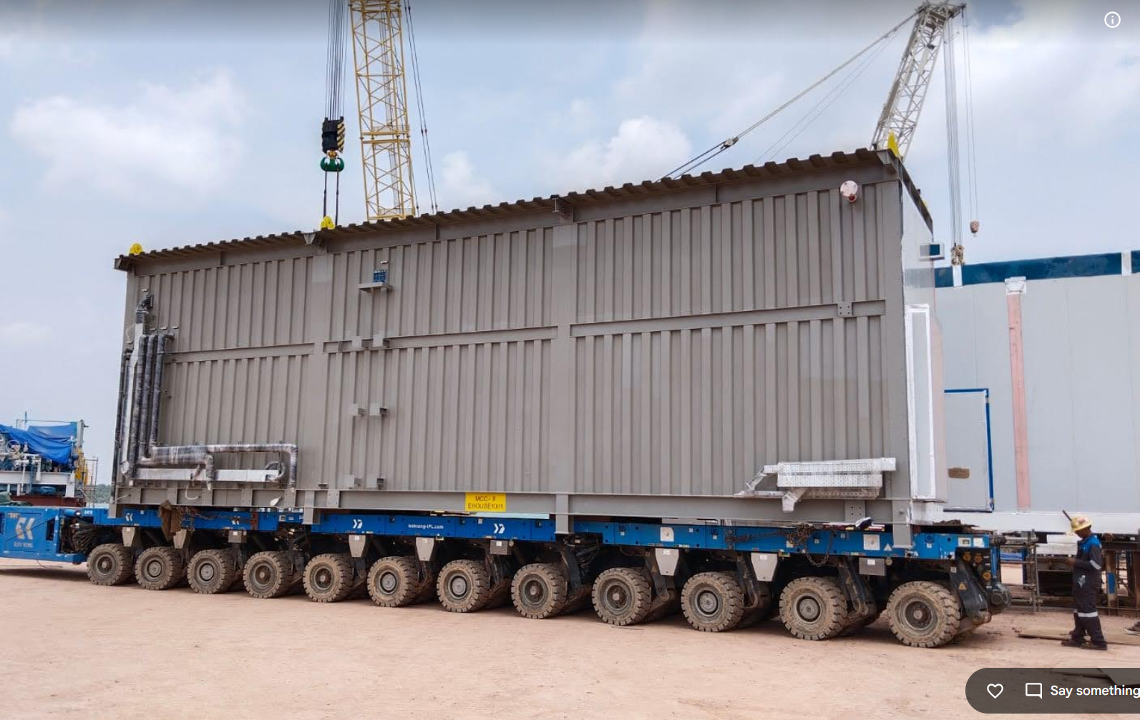
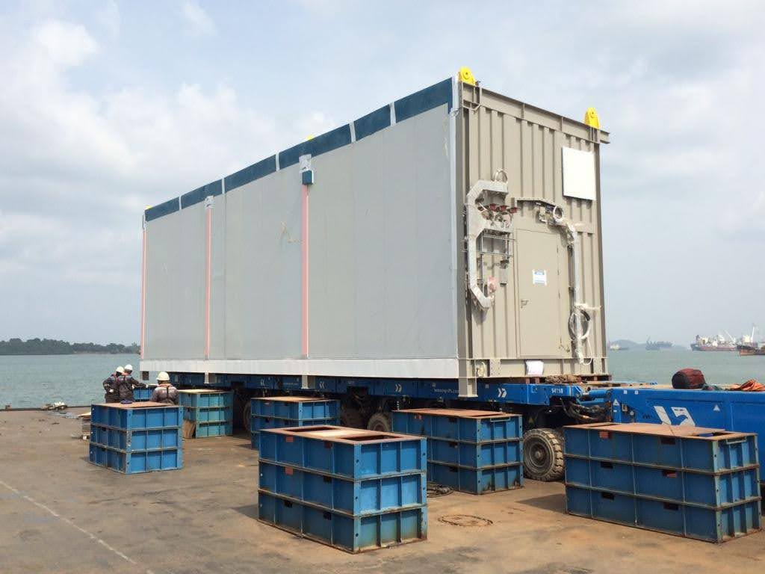
PROJECT REFERENCES
CASE STUDY – Roll-on / Roll-off and Barging of Modules/Sea Freight
Project Name: PROJECT DP3 COMPRESSION PACKAGE
Cargo: Compressor Modules and E-houses
Volume: 43 packages / 566,423 kgs / 3,824.08CBM
Heaviest 138Mt (MAIN INLET COMPRESSOR)
Origin: WASCO, Batam
Destination: Jurong, Singapore
Consignee: Total
Scope:
RORO ex Wasco Batam Jetty onto barge for the OOG items (Bok Seng’s Barge)
LOLO ex Wasco Batam Jetty onto barge for other smaller items (Infiniti’s Barge)
Freight from Batam to Singapore, Jurong port
Overside loading in Jurong port

Slide 30








PROJECT REFERENCES
PROJECT REFERENCES
CASE STUDY – CORE-LOC PROJECT
Commodity: Core-loc
Origin: Laem Chabang, Thailand
Destination: Brisbane, Australia
30

Slide 31
office.vn@fls-group.com
+84 828 73 002 864
31

