Slide 1
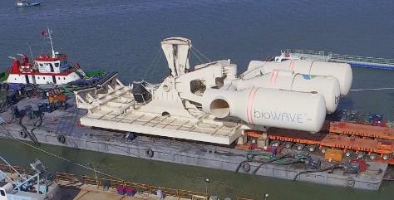
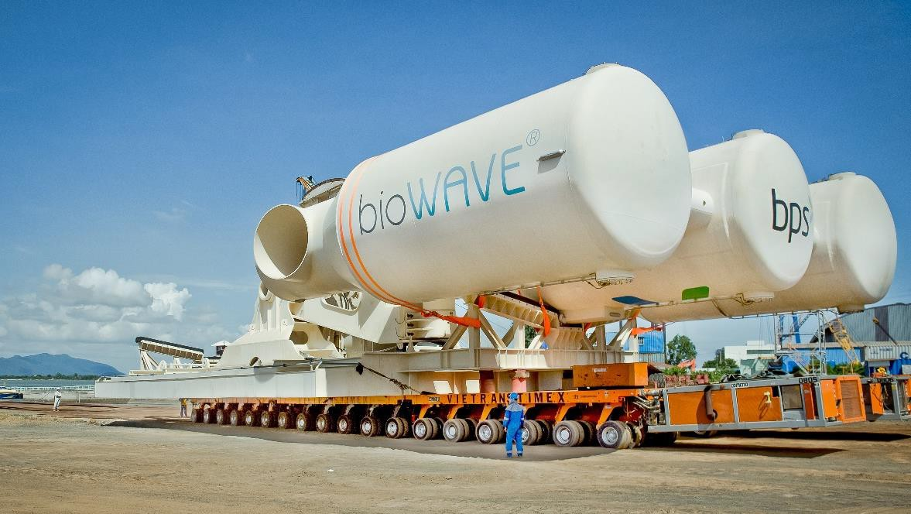
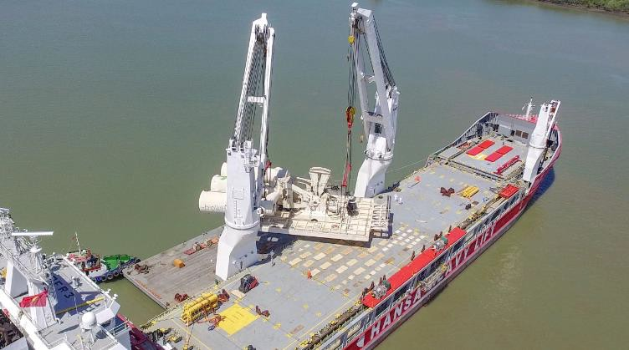
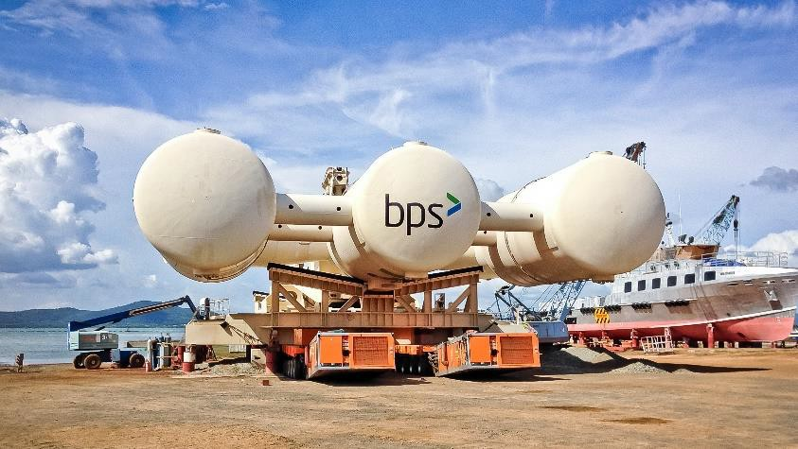
PROJECT REFERENCES
CASE STUDY – BIOPOWER UNIT
Project Name:
Volume:
Commodity: Origin: Destination:
BioPower Unit
Unit 1: 36 x 18.3 x 8.3 m / 700 MT
Unit 2: 13.2 x 9.2 x 5.56 m / 61 MT
Renewable Energy System
Vung Tau Anchorage, Vietnam
Australia
Scope:
Chartering of a suitable geared multi-purpose heavy lift vessel
Co-ordination of the FAS delivery (Roll-out onto barge via SPMT’s)
Loading and securing the cargo board of the vessel
Subsea installation in Australia incl. all customs and quarantine formalities, as well as divers
Extended scope: Use of the ships dynamic positioning (DP2) system, to discharge from deck under water onto the foundation

