Slide 1
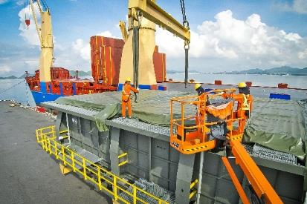
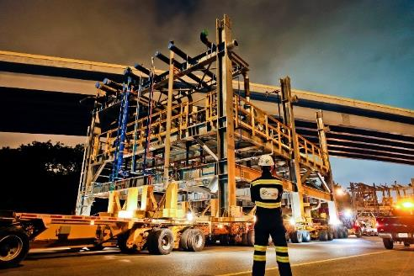
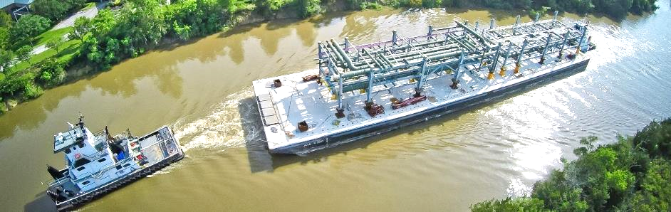
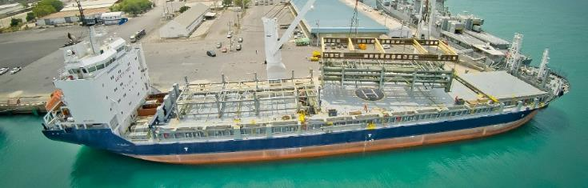
PROJECT REFERENCES
CASE STUDY – BAYTOWN REFINERY Project
Project Name: NAG Baytown Refinery
Client: MES, Heurtey Petrochem
Project Owner: Exxon Mobile
Volume: Appr. 225,000 FRT
Commodity: Equipment for a petrochemical plant, incl. 164 modules
Origin: Worldwide
Destination: Houston
Project duration: 2015 – 2017
Scope:
Surveys and selection of storage facility close to fabrication yard
Trucking from fabrication yard to storage area
Shrink wrapping of modules
Trucking from storage area to port
Stowage planning and scheduling
Shipping modules from Sattahip, Thailand and Shanghai, China to Houston, USA on 13 full charter vessels
Surveys and selection of suitable jetty location
Barging from Houston Port to jetty with 28 Barge trips
Trucking from jetty to site
Coordination with local authorities for permits

