Slide 1
HRSG PRESENTATION
09th Mar, 2026
1

Slide 2
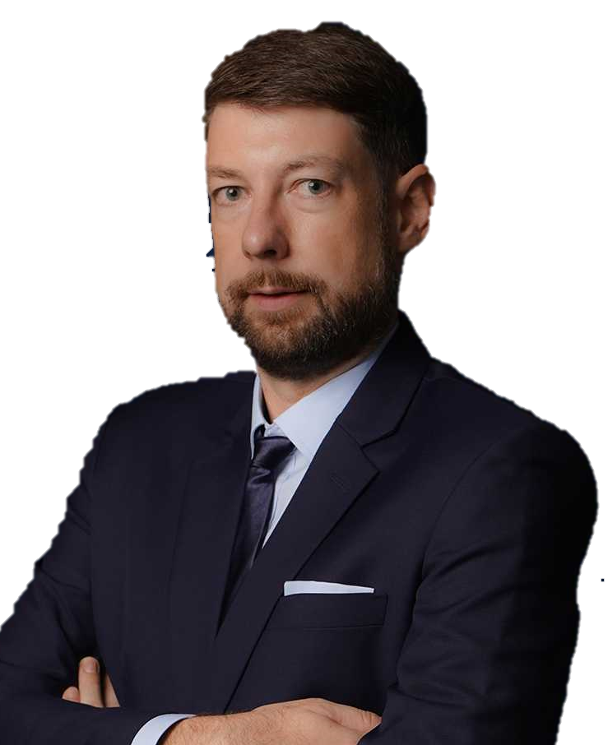
OUR MISSION:
“We keep the world moving, by deploying the best expertise to craft tailor-made solutions that solve the most challenging logistic problems all around the world.”
TORBJÖRN LARISCH
CHIEF EXECUTIVE OFFICER

Slide 3
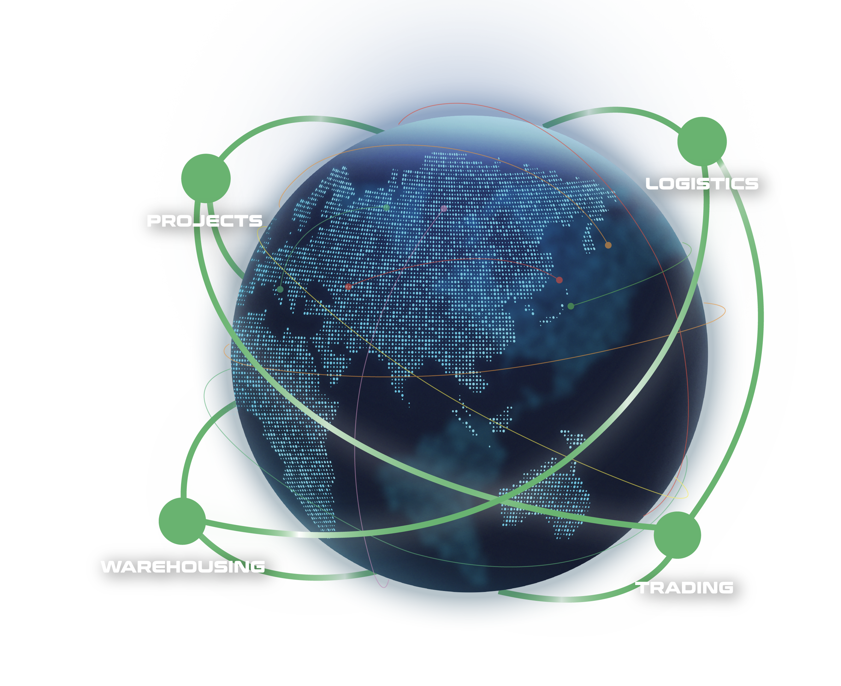
WHAT ARE OUR CAPABILITIES
Our interconnected supply chain solutions are tailor-made to keep your world in business.
OUR VISION:
To be recognized globally as the logistics experts who understand and empower global business leaders to dream and act big; moving the world forward.
PROJECTS: With expert hands, we handle the complicated with precision.
LOGISTICS: We humanize a seemingly standardized experience.
WAREHOUSING: We envision spaces that bring supply chains to the next level.
TRADING: We define and shape solutions to meet ever-changing needs.
3

Slide 4











FLS SNAPSHOT
32
500+
100+
years of experience
professionals
global partners
14
$65 million
countries
is the largest single contract award
ANNUALLY
15,000+
5,000+
trucks moved
customs clearance cases
25,000+
20,000+
14 million kg
$219 million
TEUs shipped
shipments delivered
air freight cargo handled
consolidated revenue
4

Slide 5
FLS HISTORY
FLS ventured more and more into handling export projects from steel fabricators in Thailand, Korea, China, Vietnam, Malaysia and Indonesia to global destinations for major engineering companies in the Power, Petrochemical and Mining industries.
After almost three decades, we have expanded our services from project cargo into a wider portfolio include:
FLS Logistics
FLS Warehousing
FLS Trading
Neon Orient acquisition
FLS Supply Chain Center establishment
2001 – 2010
2020 – 2023
1993 - 2000
2011 – 2020
NOW
The company was founded in Bangkok in May 1993 by Martin Häberli when he was awarded several major projects in Thailand.
In 2011 FLS (Vietnam) Ltd. was established, followed by
FLS (Australia) Pty Ltd. in 2013
FLS (Singapore) Pte Ltd. in 2014
PT. Federal Logistik Sistem (Indonesia) in 2014
FLS Projects (USA) Inc. in 2016
FLS Projects (Taiwan) Ltd. in 2016
FLS Projects (Malaysia) Sdn. Bhd, in 2018
FLS 1993 (India) Pvt Ltd.
In 2024, we embarked on a new chapter, broadening our global reach with the establishment of
FLS Scandinavia
FLS Norfolk, USA
FLS Group (Japan)
ITL acquisition
FLS Philippines
FLS Italy
5

Slide 6
OUR GLOBAL PRESENCE
USA
Denmark
India
Thailand
Italy
China
Japan
Myanmar
Vietnam
Philippines
Malaysia
Singapore
Australia
FLS Offices
Indonesia
FLS close network partners
6

Slide 7
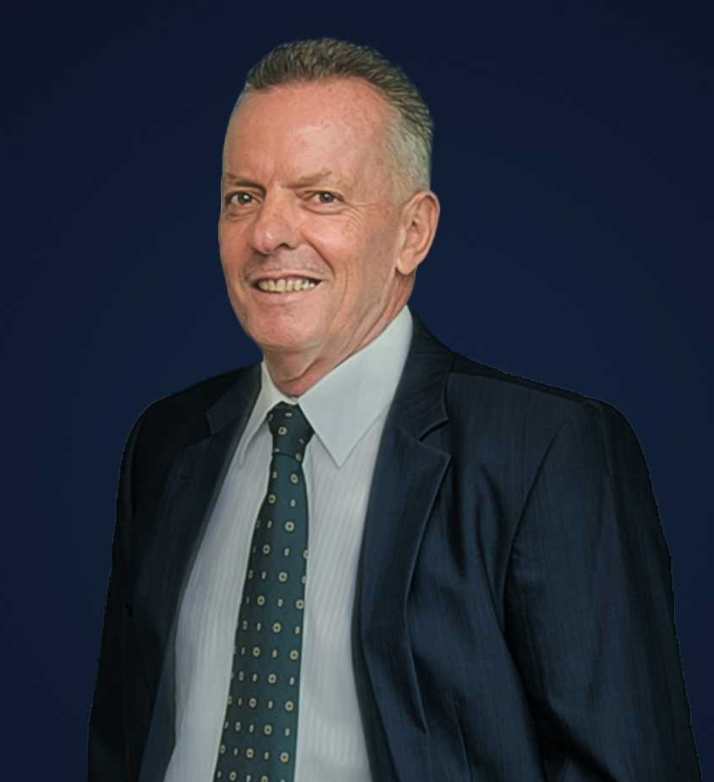
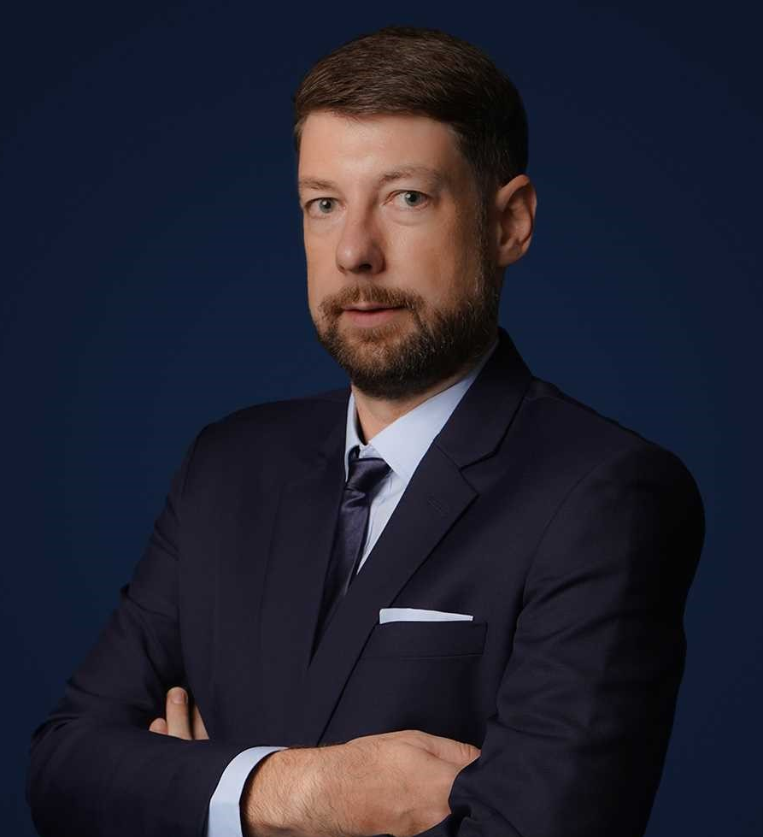
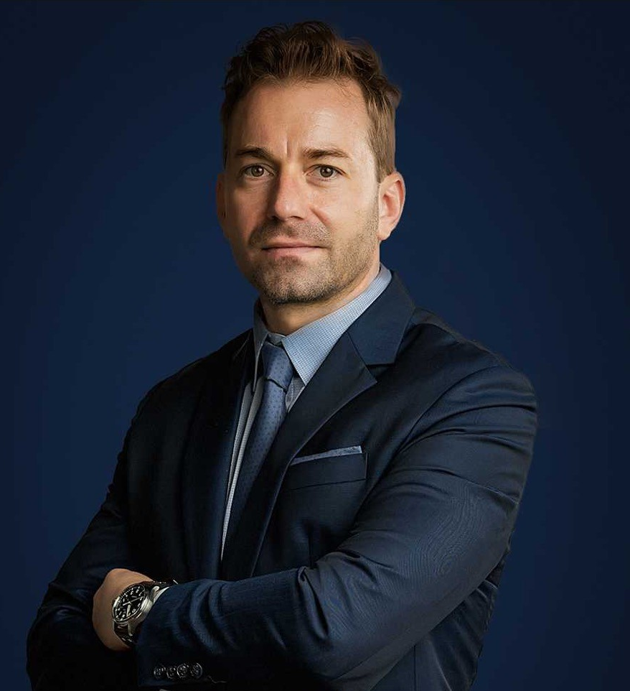
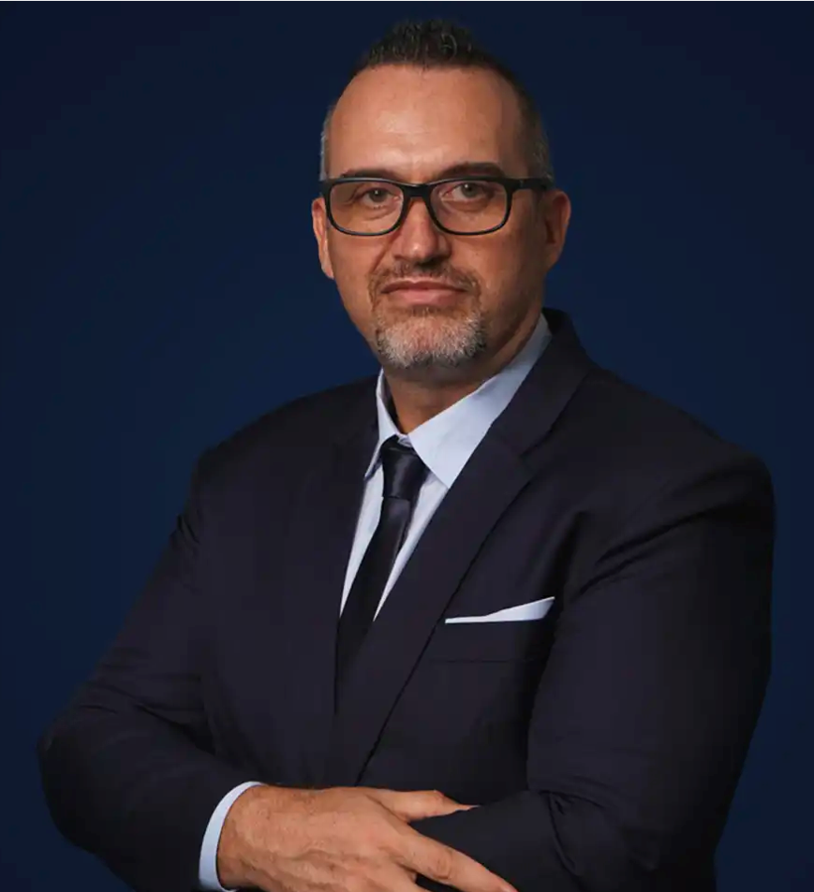
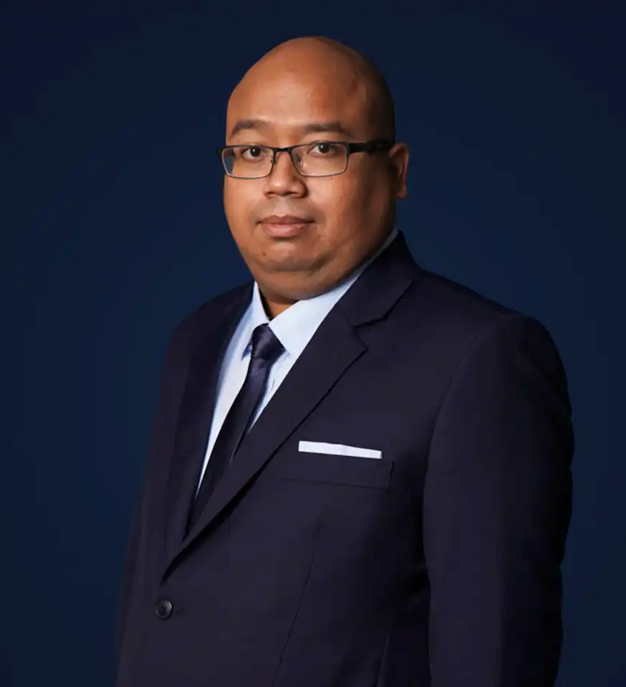
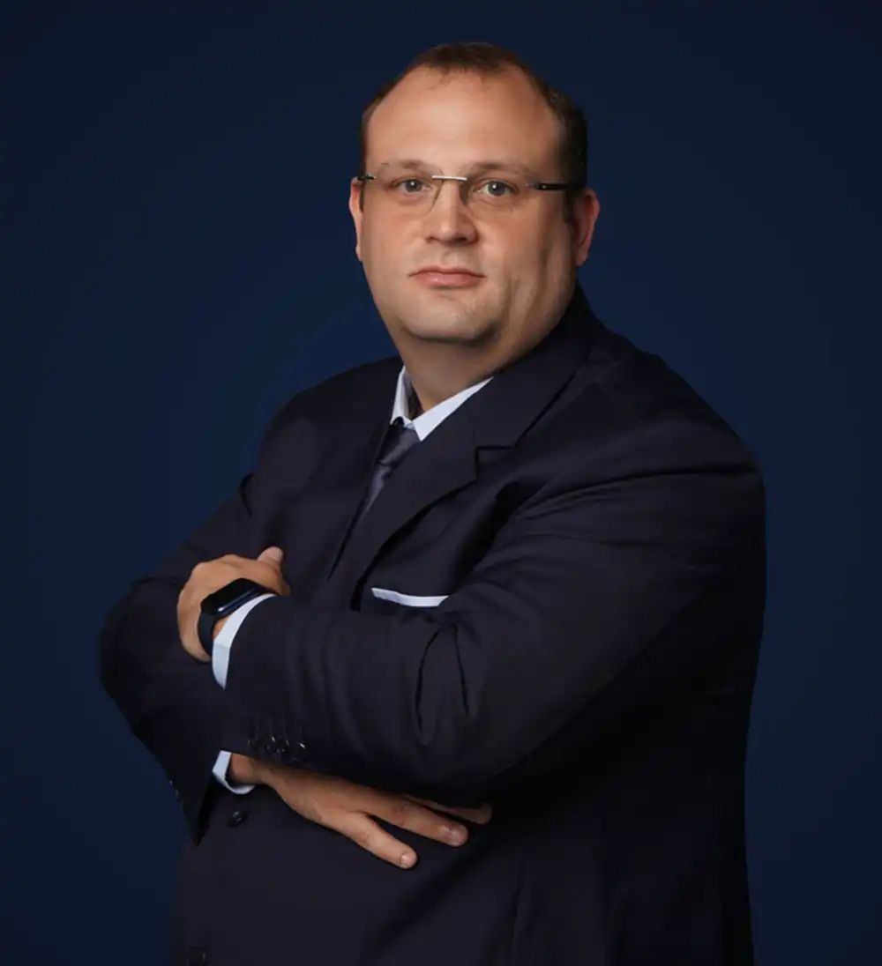
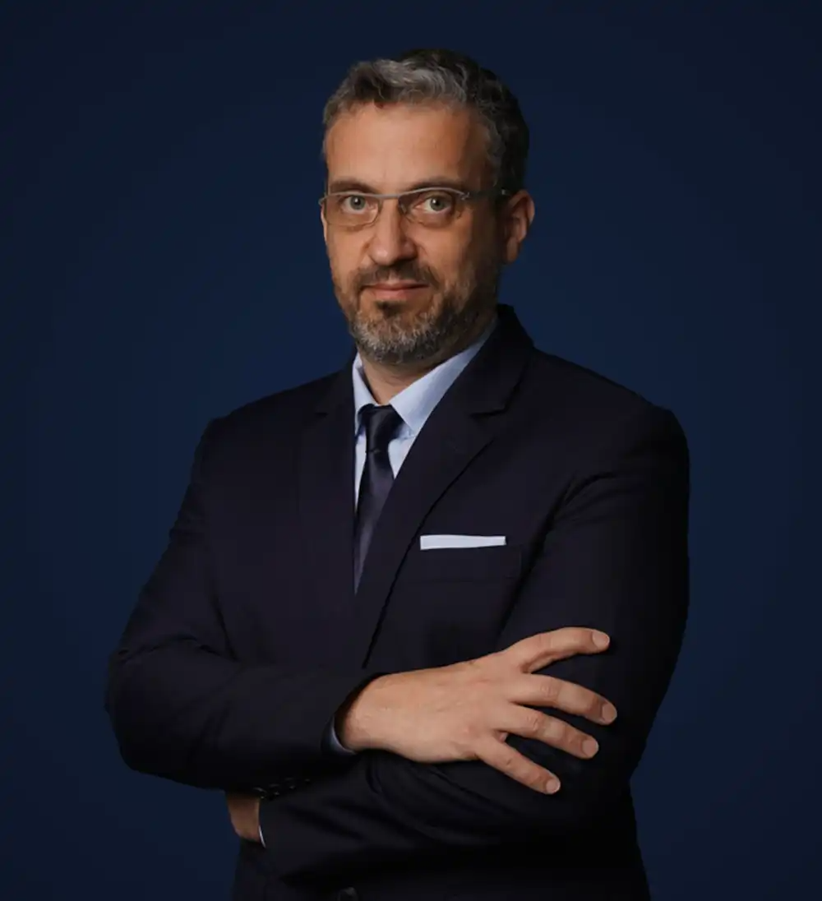
OUR MANAGEMENT TEAM
MARTIN HÄBERLI
Chairman
Founded FLS in 1993, Martin has over 40 years of international freight forwarding experience.
TORBJÖRN LARISCH
Chief Executive Officer
With more than 23 years of experience, Torbjörn joined as Managing Director in 2007 and became CEO in 2016.
CHRISTOPHER SCHNIEDERS
Global Director Projects
Christopher has been in the project forwarding industry for 19 years with an extensive network in Vietnam.
FRANCESCO JOSÈ RIVI
Global Head of Warehousing & Managing Director APAC
Francesco has been in the logistics industry for over 20 years, with various experiences in France, Spain, Romania, Poland and Italy.
HAFIZ ROSLAN
Chief Financial Officer
To lead the transformation of the Finance and Human Resources functions, Hafiz Roslan joined us in 2020 as the CFO and CPO.
Marcel Kirschnick
Global Director Logistics
FLS Logistics was launched in 2019, headed by the Director, Marcel Kirschnick.
Christoph Campbell
Managing Director - FLS Trading
Christoph joined FLS Group in 2021, where he established the Trading division and later also assumed the role of Managing Director at Neon Orient following its acquisition by FLS.
7

Slide 8





OUR COMPETENCIES
EXPERIENCED
COMPETIVE
More than 30 years of experience
Global access to carriers, local contract negotiations
FLEXIBLE
INNOVATIVE
Matching right partners for each project
We can solve problems with creative solutions and will adjust our operation to your requirements
PRO-ACTIVENESS
Eyes and ears always on the market and therefore can react to possible constraints early
DYNAMIC
Growth through opportunity, where others see a problem, we see an opportunity
Fast decision-making process
CONTINUITY
High employee retention rate: average is 8.32 years. Some key staff have been with FLS for more than 15 years
8

Slide 9






WE ARE A PROUD MEMBER OF:
9

Slide 10
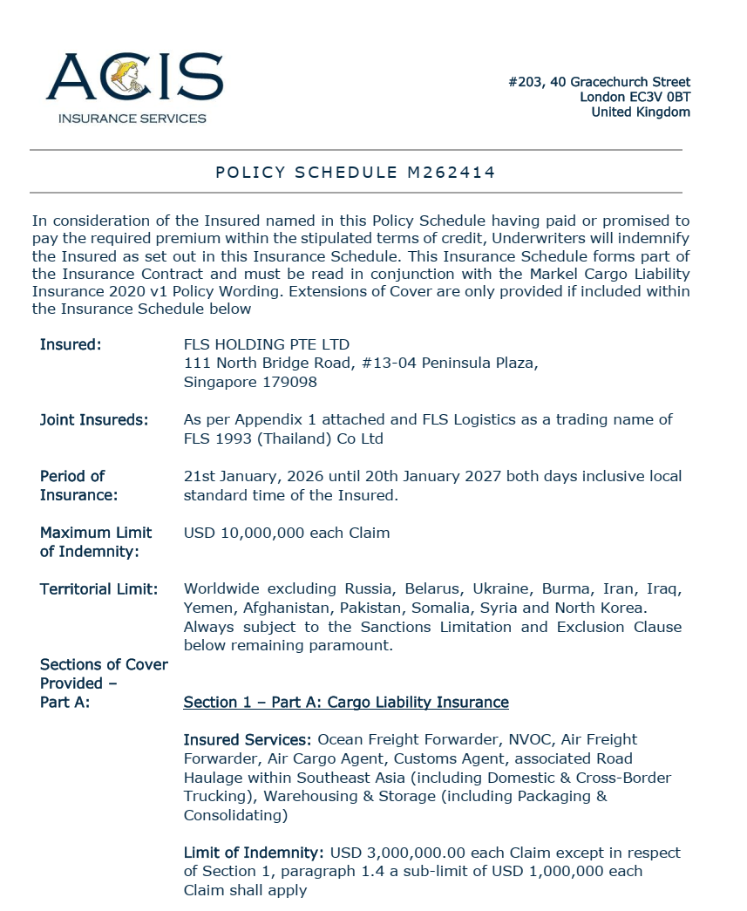
INSURANCE POLICY
Base coverage:
Cargo liability
USD 3,000,000 each claim
3rd party legal liability
USD 3,000,000 each claim
Professional indemnity
USD 400,000 each claim
Fines and duties liability
USD 100,000 each claim
Please note: Limits are flexible & negotiable, and liabilities can be extended on request and a case-by-case basis. Marine cargo insurance can be provided. on request.
10

Slide 11
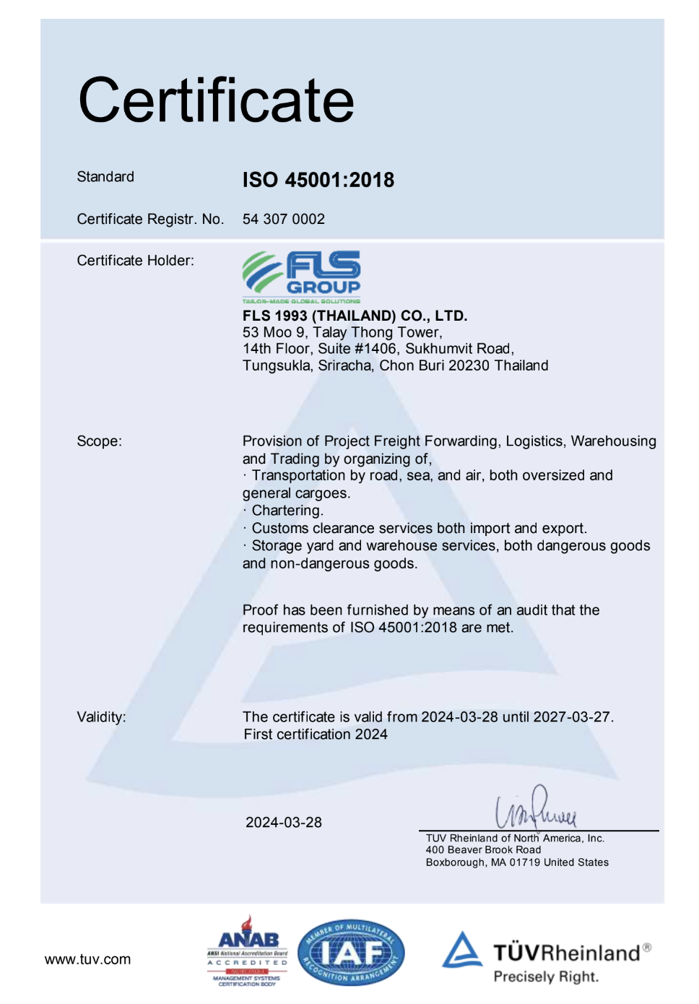
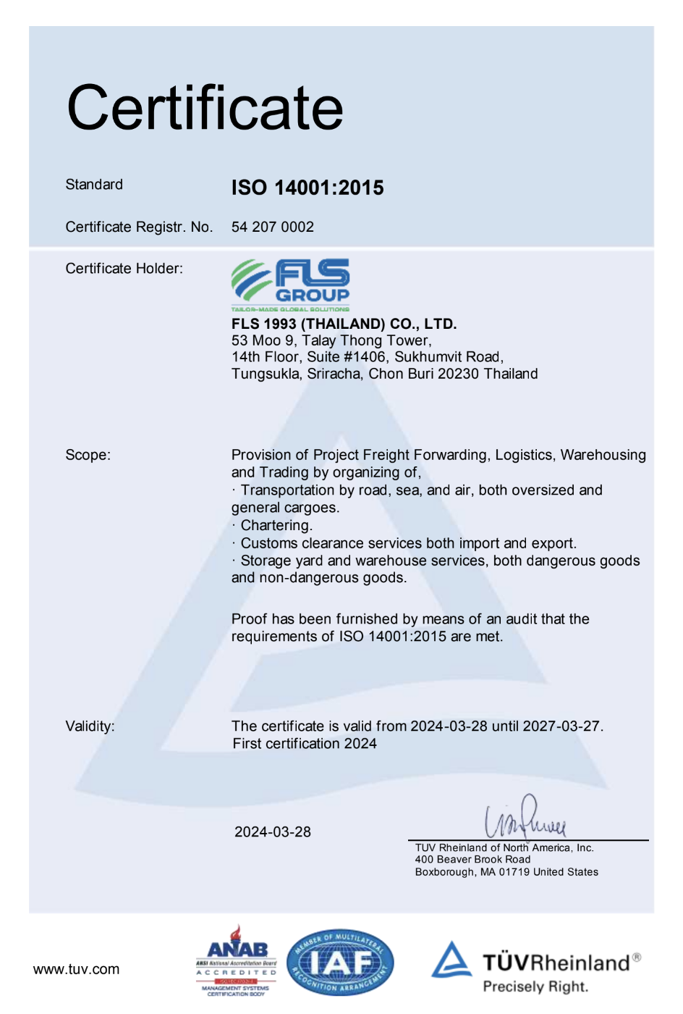
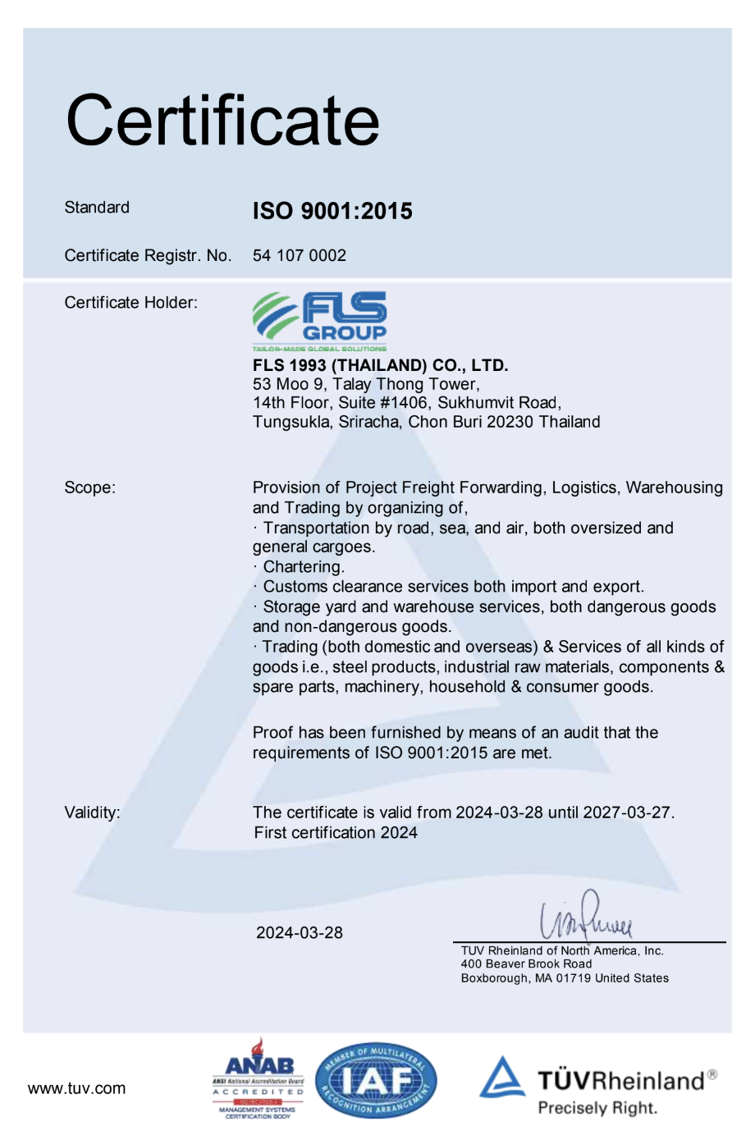
HSEQ Procedures
SAFETY, QUALITY & INTERNATIONAL COMPLIANCE
ISO 45001:2018 CERTIFICATE
ISO 4001:2015 CERTIFICATE
ISO 9001:2015 CERTIFICATE
ISO-certified own operations in Thailand, Australia, Singapore, USA, Vietnam, Taiwan, Indonesia, Malaysia, India and Myanmar.
11

Slide 12


SAFETY, QUALITY
& INTERNATIONAL COMPLIANCE
QUALITY ASSURANCE
HEALTH & SAFETY
OUR STANDARDS
FLS Quality Management Systems meet all our customer’s applicable statutory and regulatory requirements.
We use one of the world’s leading modular enterprise systems to streamline operations, accounting and business development.
Provide Health & Safety training for all members of staff as well as blue-collar and sub-contracting parties.
Follow international rules and guidelines to foster a safe and healthy working environment for our teams.
Ensure that each project and every shipment is handled in a safe, timely, systematic, and efficient manner.
We select and work only with agents and partners who:
are fully certified to international standards
fulfill our own strict quality standards
have sufficient insurance coverage
operate with well-maintained and regularly tested equipment
are well managed and staff regularly trained
have a long successful history and proven track record.
12

Slide 13

OCCUPATIONAL HEALTH, SAFETY
AND ENVIRONMENTAL POLICY
FLS requires the active commitment to, and accountability for, occupational health, safety and environment from all employees and contractors.
Comply with all relevant legislations and corporate requirements of OHSE;
Meet specified customer requirements and ensure continuous customer satisfaction;
Protect, and strive for improvement of, the health, safety and security of our people at all time;
Eliminate accidents and minimize potential risks;
Set OHSE performance objectives, measure results, assess and continuously improve processes and services, through the use of an effective management system;
Plan for, respond to and recover from any emergency, crisis and business disruption;
Minimize our impact on the environment through pollution prevention, reduction of natural resource consumption and emissions, and the reduction and recycling of waste;
Apply our technical skills to all OHSE aspects in the design and engineering of our services;
Communicate openly with stakeholders and ensure an understanding of our OHSE policies, standards, programs and performance. Reward outstanding OHSE performance;
Improve our performance on issues relevant to our stakeholders that are global concern and on which we can have an impact and share with them our knowledge of successful OHSE programs and initiatives.
13

Slide 14
CASE STDUIES

Slide 15
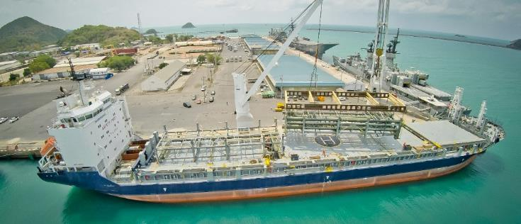
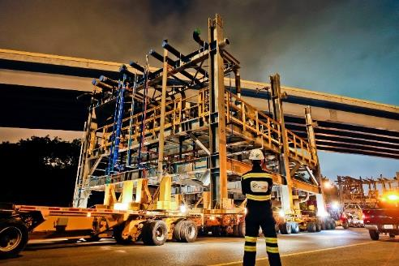
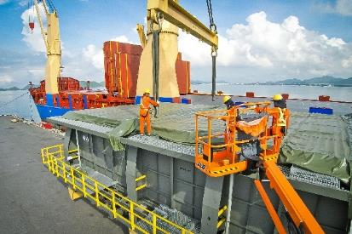
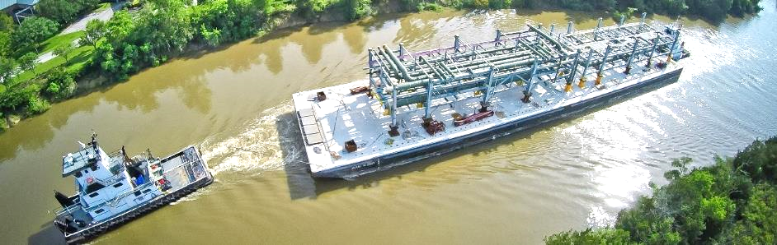
PROJECT REFERENCES
PROJECT REFERENCES
CASE STUDY – BAYTOWN REFINERY Project
Project Name: NAG Baytown Refinery
Client: MES, Heurtey Petrochem
Project Owner: Exxon Mobile
Volume: Appr. 225,000 FRT
Commodity: Equipment for a petrochemical plant,
incl. 164 modules
Origin: Worldwide
Destination: Houston
Project duration: 2015 – 2017
Scope:
Surveys and selection of storage facility close to fabrication yard
Trucking from fabrication yard to storage area
Shrink wrapping of modules
Trucking from storage area to port
Stowage planning and scheduling
Shipping modules from Sattahip, Thailand and Shanghai, China to Houston, USA on 13 full charter vessels
Surveys and selection of suitable jetty location
Barging from Houston Port to jetty with 28 Barge trips
Trucking from jetty to site
Coordination with local authorities for permits
15

Slide 16
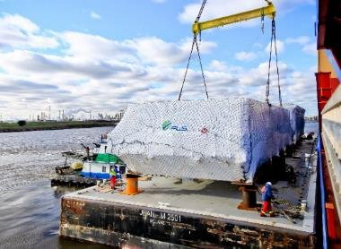
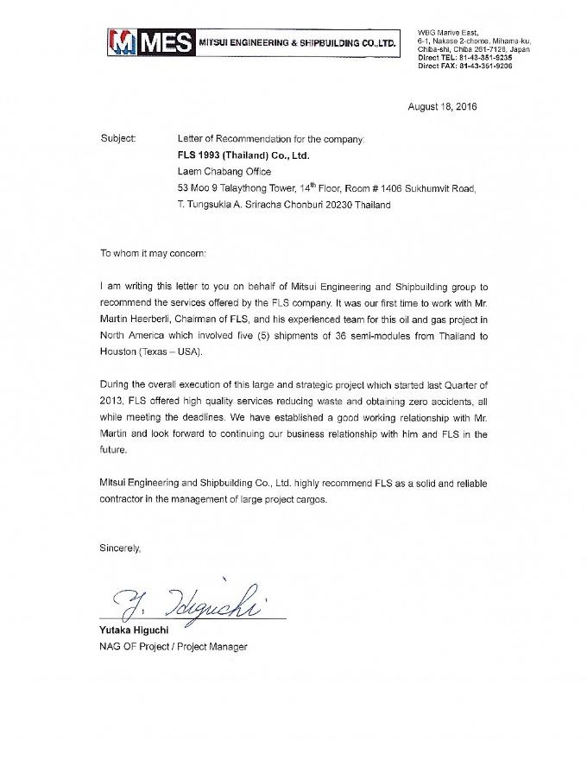
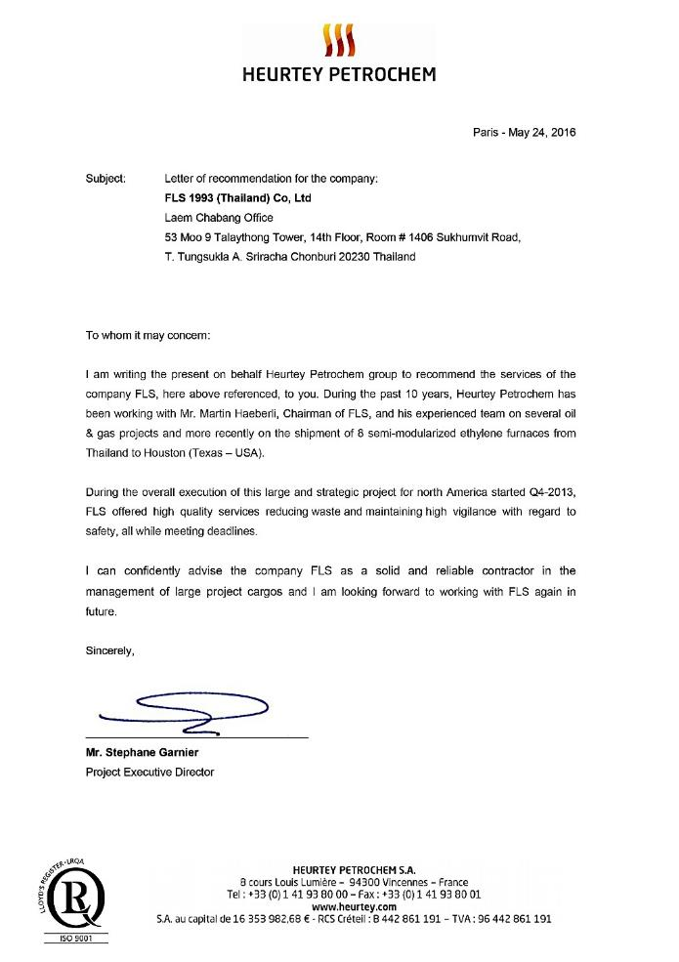
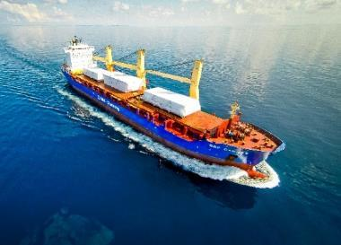
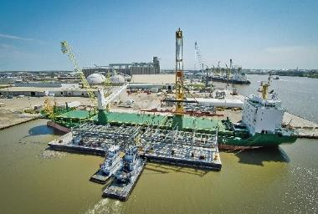
PROJECT REFERENCES
CASE STUDY - letter of recommendation
16

Slide 17
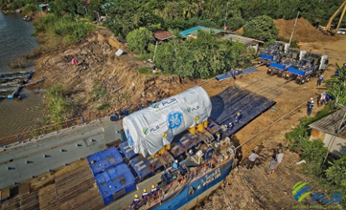
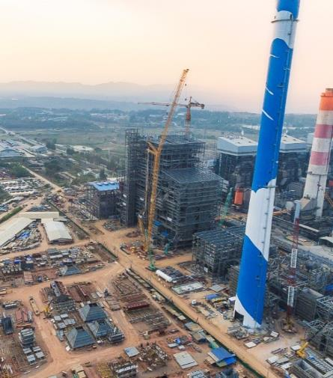
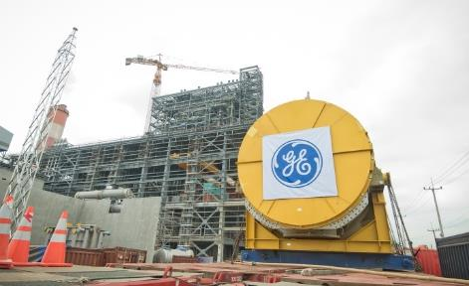
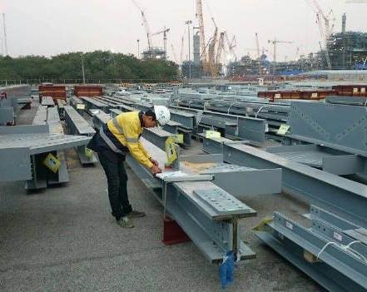
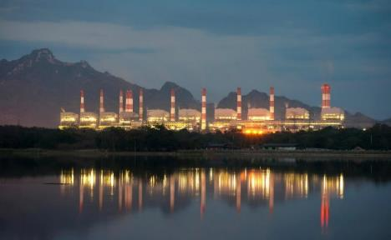
PROJECT REFERENCES
PROJECT REFERENCES
CASE STUDY – MAE MOH POWER PLANT PROJECT
Project Name: Mae Moh Unit 4-7 Replacement Project
Client: GE Power Switzerland, USA, China and India
Black & Veatch, USA
Balanced Engineering & Construction,
Volume: Appr. 135,000 FRT break bulk, 25,000 FRT
Commodity: Structure steel for boiler house, turbines,
generators (including one 360 metric tons), tanks, environmental control, units, feed water system,
Origin: Worldwide
Destination: Mae Moh, appr. 600 km north of Bangkok (around 444km north of Nakhon Sawan)
Scope:
Import port handling in Laem Chabang, customs clearance
Thai Flag Waiver, road transport to construction site, barging, site co-ordination
Ocean freight for specific parts of the project
Warehousing and storage, re-packing, repair, de-and re-consolidation
Survey and consultation work
Co-ordination with suppliers worldwide
17

Slide 18
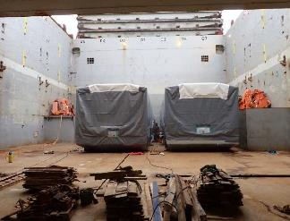
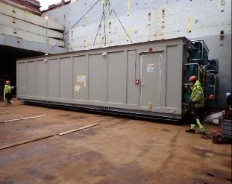
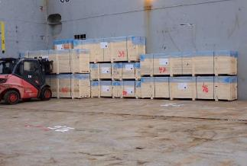
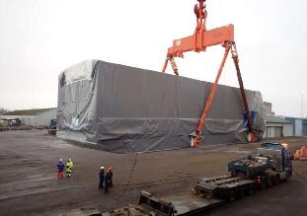
PROJECT REFERENCES
PROJECT REFERENCES
CASE STUDY – Saha cogen & egco cogen
Project Name: SAHA COGEN & EGCO COGEN
Volume: Approx 5,700 CBM
Commodity: Gas Turbine, Generator and Accessories
Origin: Mersin, Hamburg, Norrkoping
Destination: Laem Chabang, Thailand
Scope:
Booking vessel according to client’s requirement
Coordinating with shippers at origins for delivery cargo alongside
Coordinate with vessel agents and vessel owner, port Captain for proper loading / lashing method as per client’s instruction
Loading survey at Origins and Discharging supervision at destination
18

Slide 19
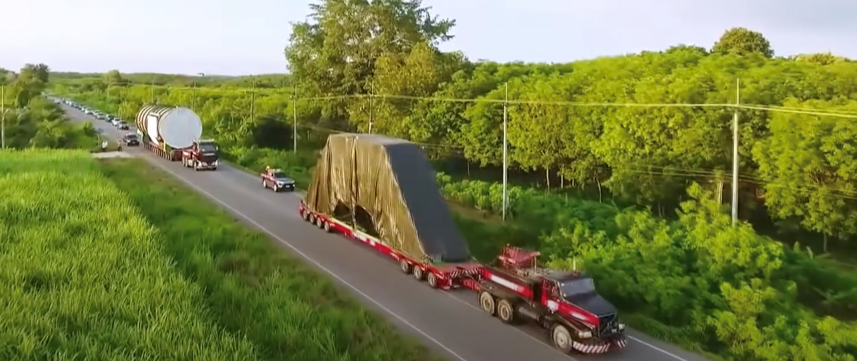
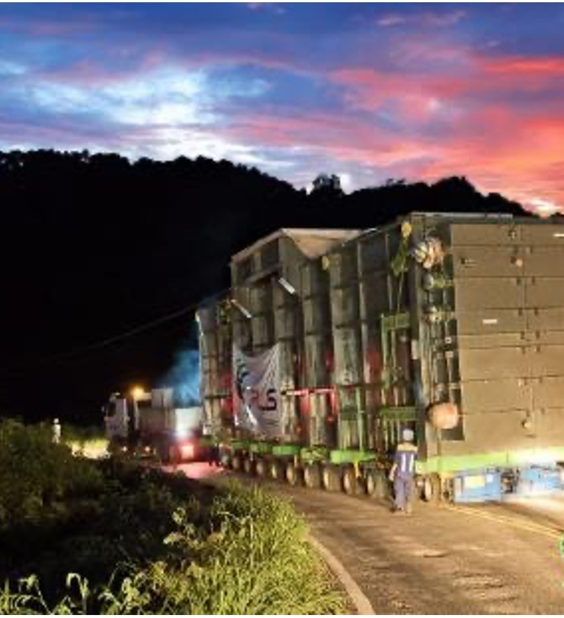
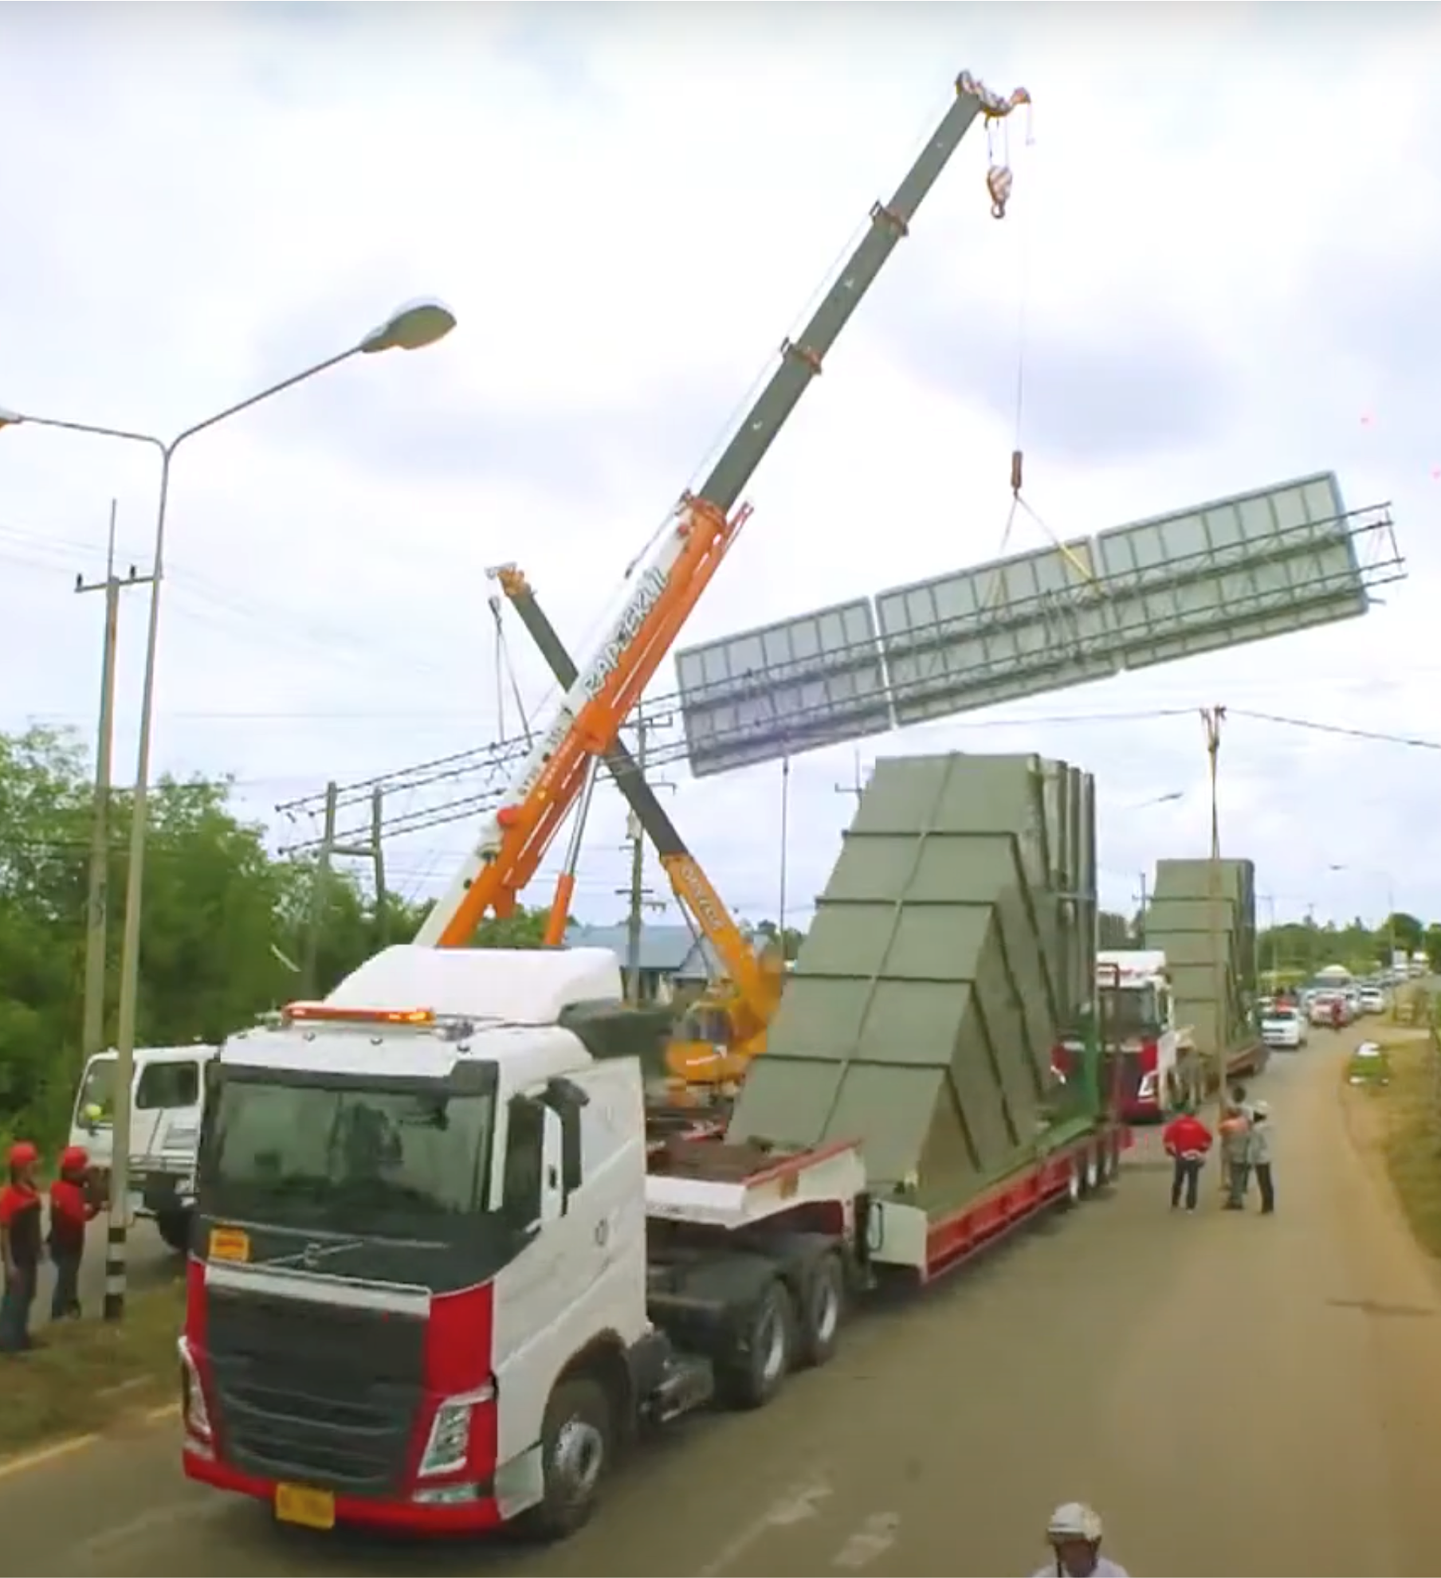
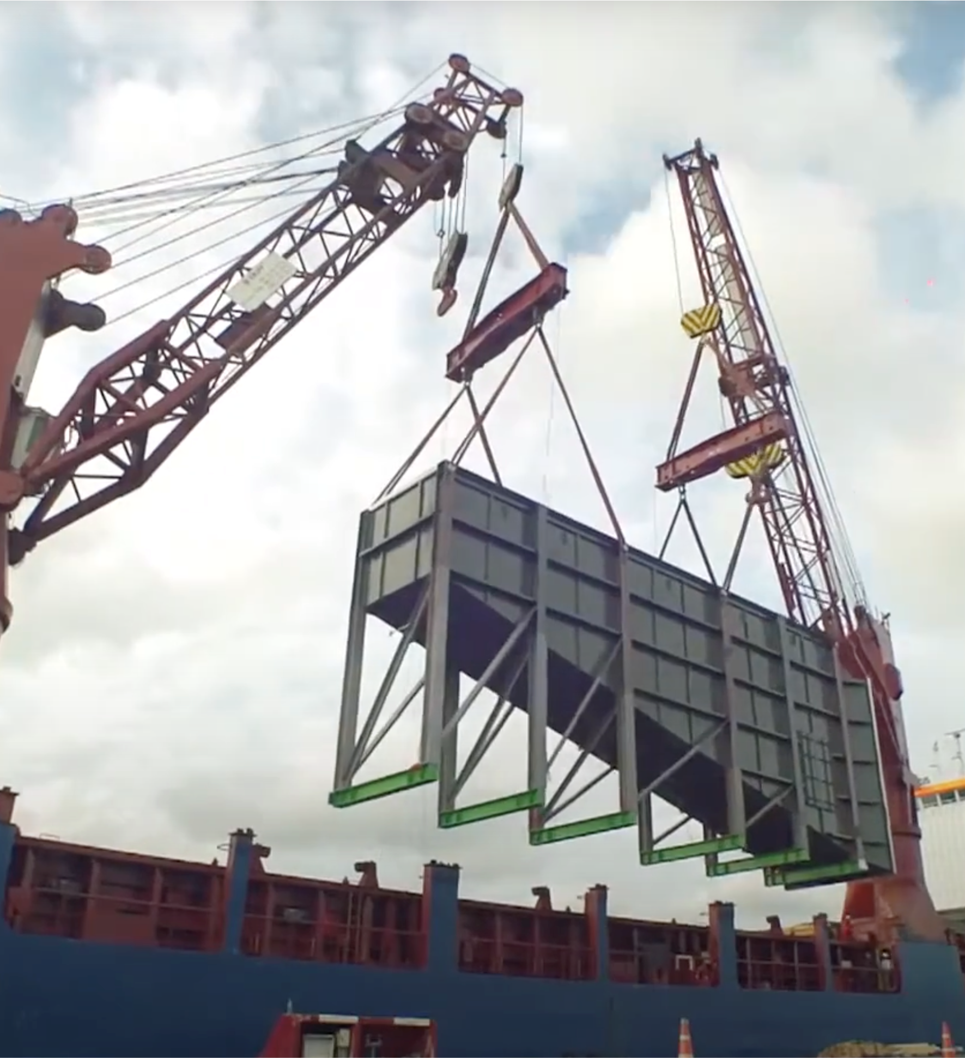
PROJECT REFERENCES
PROJECT REFERENCES
CASE STUDY – CAMERON PROJECT
Project Name: Cameron LNG Liquefaction Project
Volume: Appr. 10,000 cbm break bulk cargo, incl. items with 8.5 M height, over 30 meters length and up to 190 MT heavy
Commodity: Waste Heat Recovery Units
Origin: Sattahip, Thailand
Destination: Houston, USA
Scope:
Arranging for road surveys and road permits from Department of Highways
Road transport from the fabrication shop in Khao Hin Sorn to Sattahip port
Signboard and cable lifting, trimming of trees
Port storage and handling
Export customs clearance
FAS delivery and loading supervision
19

Slide 20
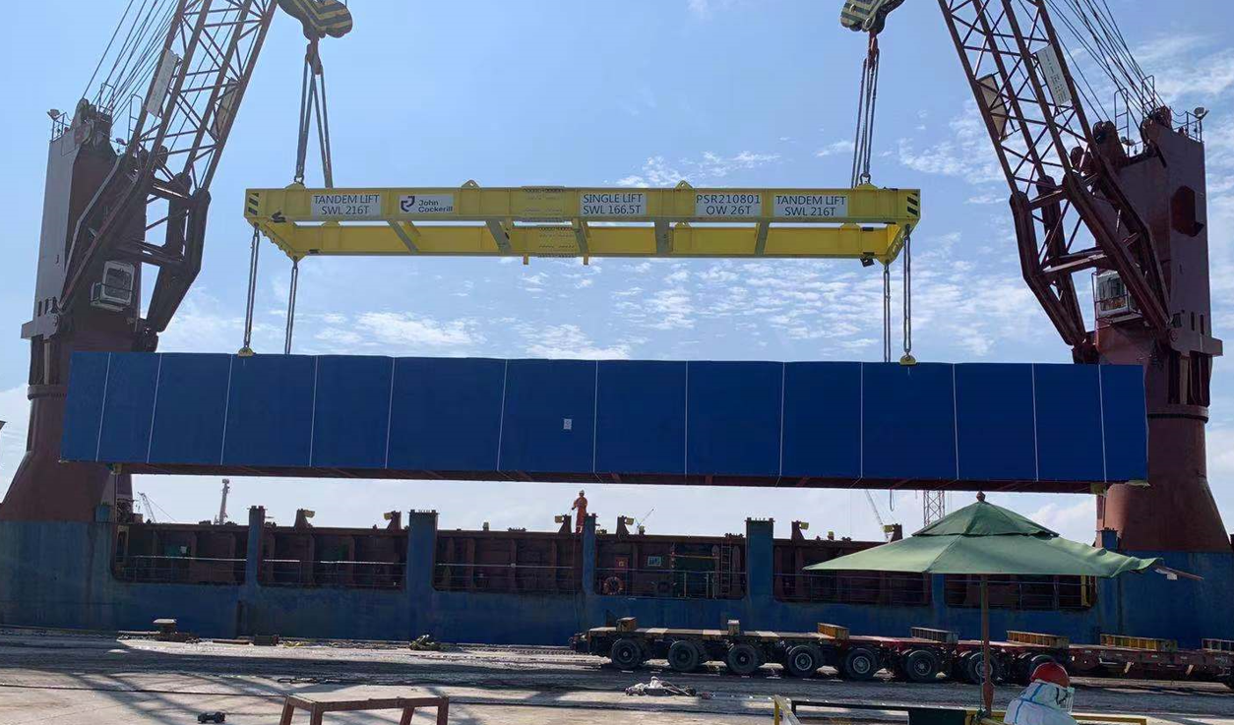
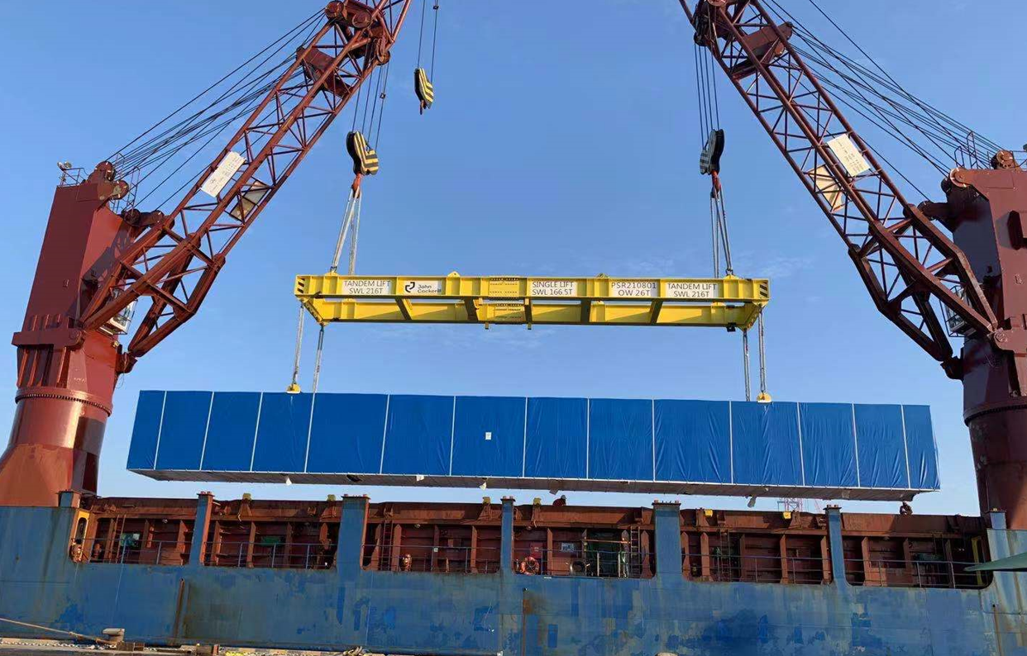
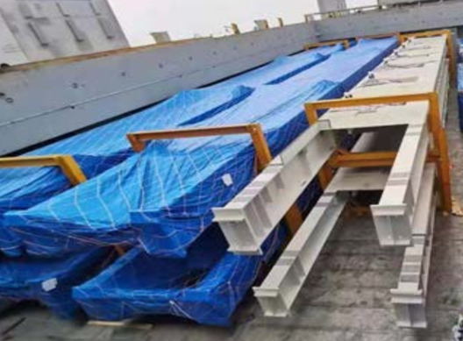
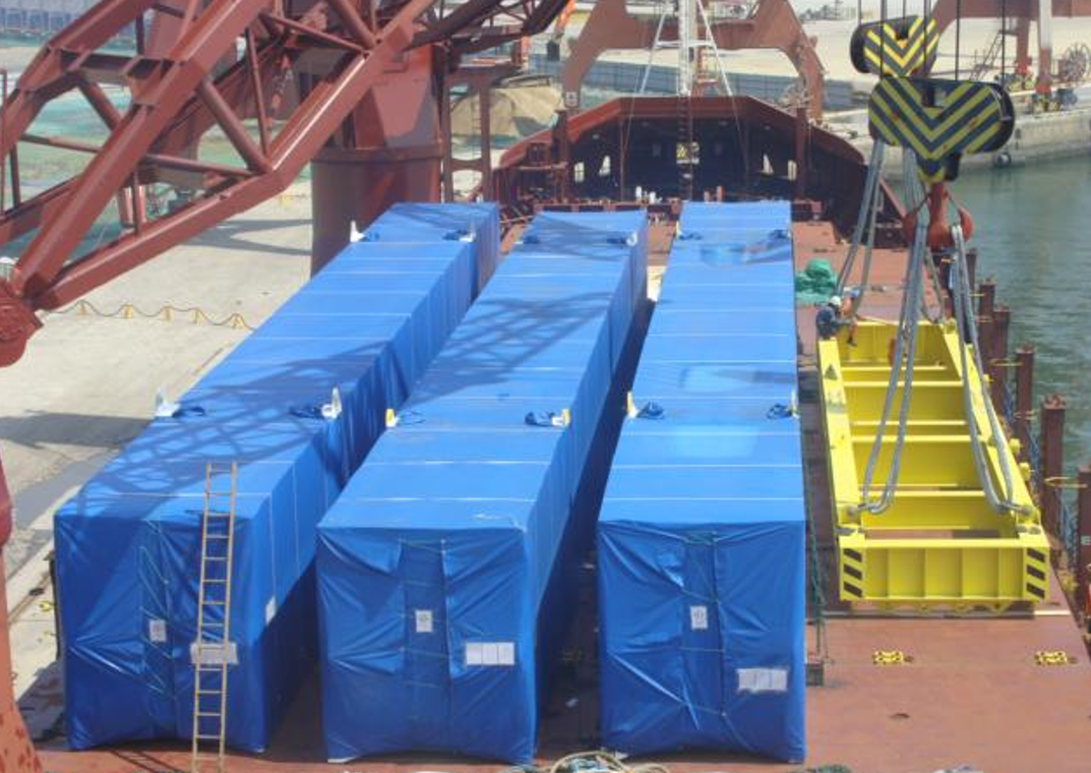
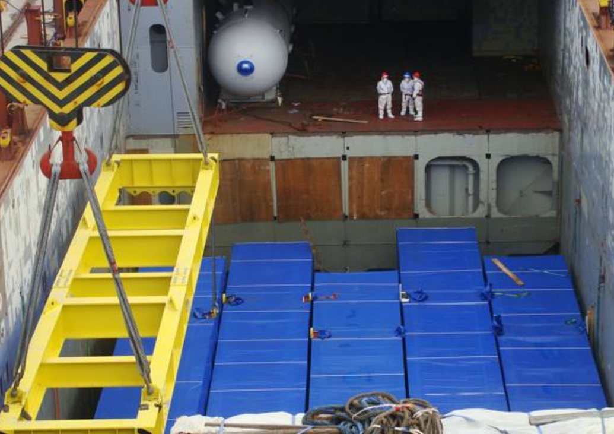
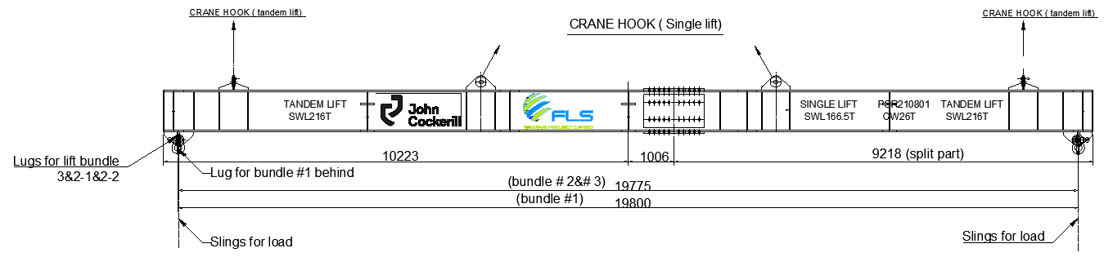
PROJECT REFERENCES
PROJECT REFERENCES
CASE STUDY – SUNCOR, CANADA
Volume: 273 packages / 13,366 CBM / 5,800 MT
Origin: Penglai + Zhangjiagang + Masan
Destination: Longview, USA
Scope:
Full liner terms Ocean freight
Shrink wrapping and protection
Pre-carriage cargo ex-work to port
Chartering Heavy lift vessel
Under dynamic covid condition
In house designed lifting frame SWL 216mt tandem lift, SWL 166.5 single lift BV Class Certificate, FEA calculation
20

Slide 21
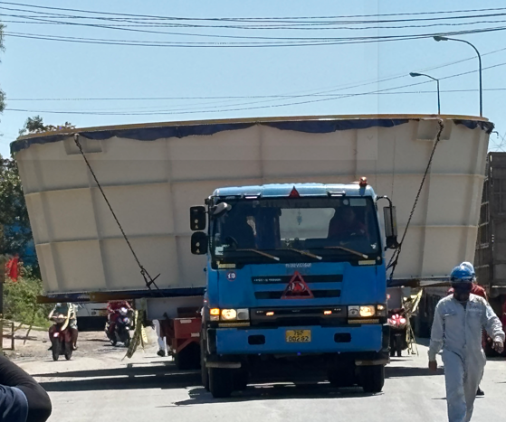
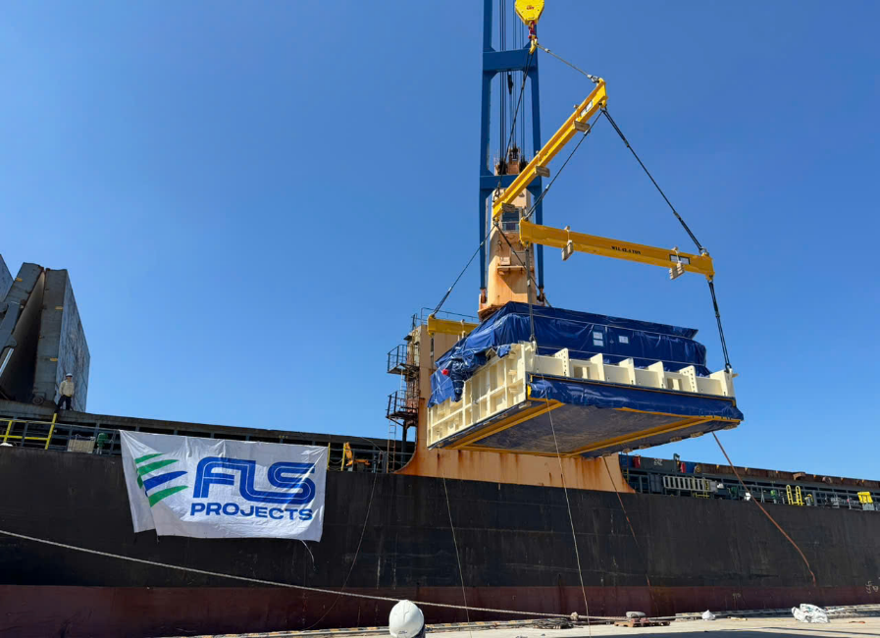
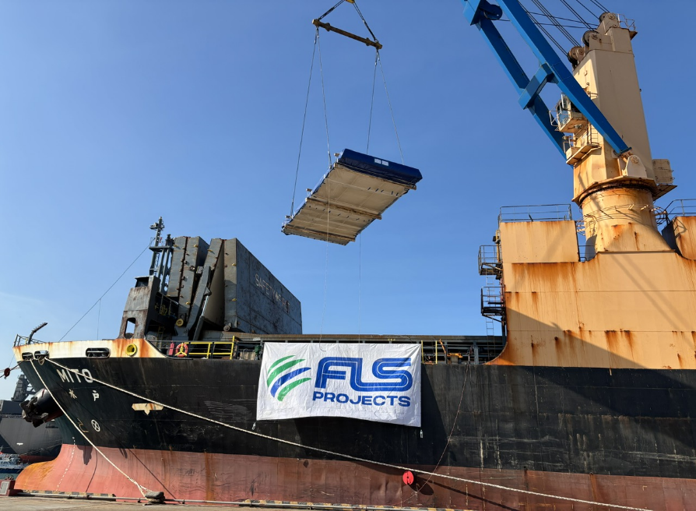
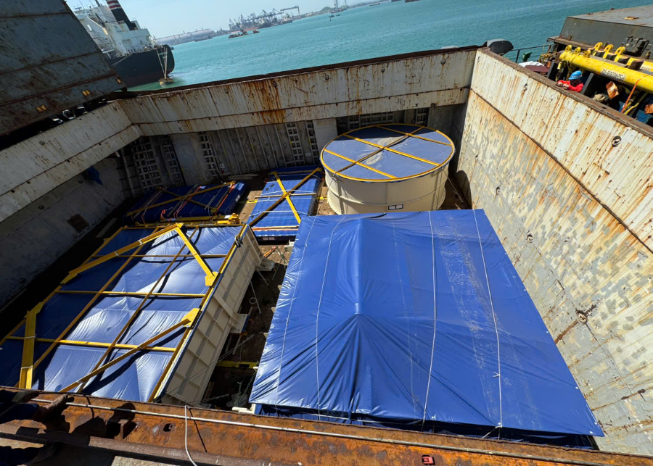
PROJECT REFERENCES
PROJECT REFERENCES
CASE STUDY – PELICAN POINT POWER PLANT PROJECT 1/2
Volume: 28 packages, 3,779 CBM, 341.212 MT
Origin: Dung Quat port, Viet Nam
Port of Discharge: Adelaide, Australia
Final Destination: Pelican Point jobsite
Scope:
Apply for a special oversize transportation permit
Transporting cargo from the workshop to the port of loading
Two specialized electric power teams providing escort services throughout the transportation process to ensure safety and operational efficiency
Third party survey and inspection of the cargo
Coordination and strategic placement of lifting beams to ensure alignment with the appropriate Working Load Limit (WLL) for safe and efficient operations.
Ocean freight from Dung Quat to port of discharge Adelaide
Loading onto vessel incl appropriate cargo stow arrangements. Cargo hold preparation for loading, including layout of dunnage by FLS owned stevedores
Lashing and securing FLS port Captain supervised the whole trucking and loading operation
21

Slide 22
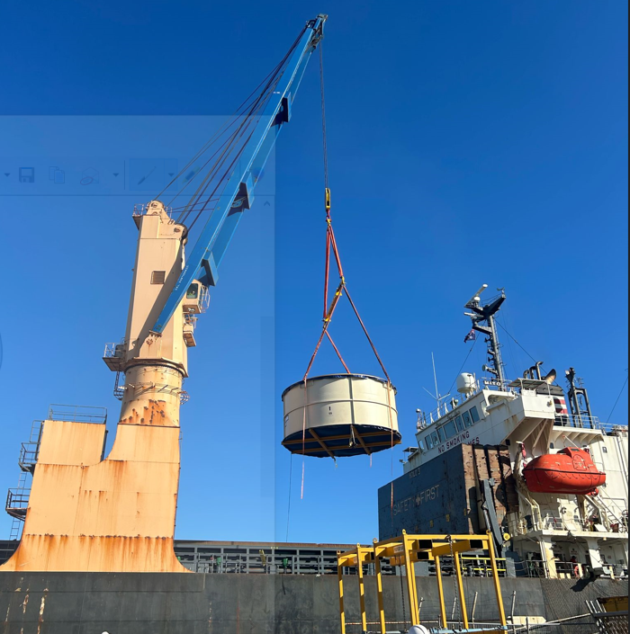
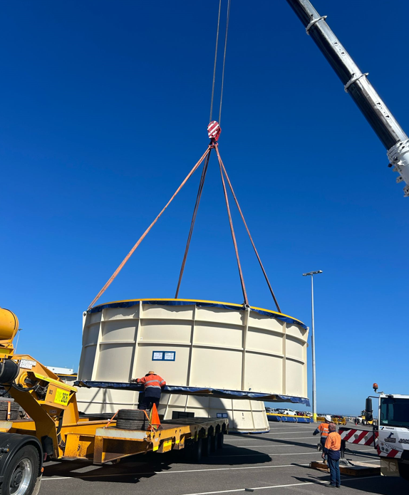
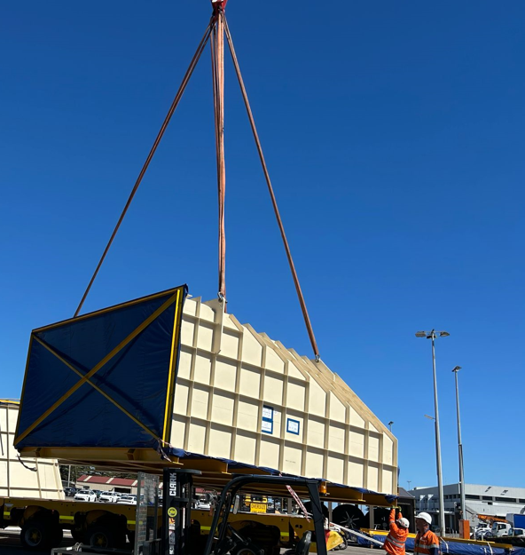
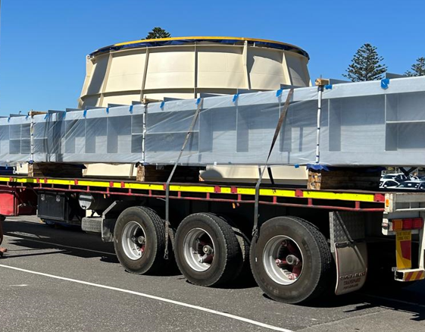
PROJECT REFERENCES
CASE STUDY – PELICAN POINT POWER PLANT PROJECT 2/2
Volume: 28 packages, 3,779 CBM, 341.212 MT
Origin: Dung Quat, Vietnam
Port of Discharge: Adelaide, Australia
Final Destination: Pelican Point jobsite
Challenge:
Complexity of the cargo’s size with max length 15.46M, width 9.55M, height 5.30M
The nearest BBK terminal at the POD to job site is not workable
Investigate suitable direction to the job site, adjust construction to fit the cargo during transportation
→ We got involved in the discussions at a very early stage, which allowed the client to design and fabricate up to the absolute limit/maximum.
→ Coordinate with carrier for special berthing at RO-RO/ Cruise ship terminal
Scope:
Apply for a special permit in order to berth at the RO-RO/ cruise terminal.
Traffic management survey in Australia
Vessel berthed at a RO-RO/ Cruise ship berth
Cargo unlashing discharge operation, supervision by FLS PM
Due to cargo dimensions, FLS had to remove fencing at the port gate
Traffic lights, traffic signs had to be removed during the trucking from port to the jobsite
Police escorted our trucks and stopped the traffic when necessary
22

Slide 23
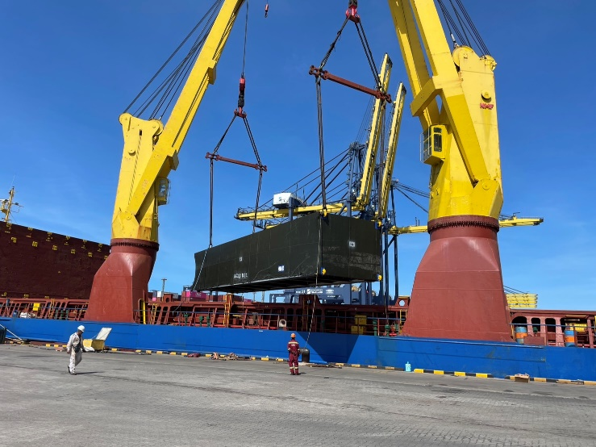




PROJECT REFERENCES
PROJECT REFERENCES
CASE STUDY – auroa 130mw combined cycle gas turbin
Volume: 100 packages, 3,742 CBM, 1,384 MT
Origin: Laem Chabang port, Thailand / Hai Phong
Destination: Penang port , Malaysia
Scope:
Chartering Heavy lift vessel
Pre-carriage from workshop to the port of loading
Loading , securing and lashing
Ocean freight from Laem Chabang and Hai Phong to port of discharge Malaysia
Discharge of Penang port , Malaysia
FLS supervisor available both side
23

Slide 24




PROJECT REFERENCES
PROJECT REFERENCES
CASE STUDY – plp 100mw fast start power plant project
Project Name: PLP 100mw fast start power plant project
Client: JEL
Volume: 176 packages , 4,103CBM, 838.3 MT,
Heaviest cargo 86 MT
Commodity: Structure for power plant
Origin: Ex Norrkoping, Hamburg
Destination: Singapore
Scope:
Full liner terms Ocean freight
Chartering Heavy lift vessel
Loading onto vessel incl appropriate cargo stow arrangements. Cargo hold preparation for loading, layout dunnage by FLS own stevedores
Securing and lashing cargo
Loading supervision by FLS port supervisor
24

Slide 25





PROJECT REFERENCES
PROJECT REFERENCES
CASE STUDY – POWER PLANt NIGERIA
Volume: 24 packages / 5,905 CBM / 403 MT
Origin: Dung Quat port, Viet Nam
Destination: Warri port, Nigeria
Scope:
Full liner terms Ocean freight
Pre-carriage ex-work to port
Chartering Heavy lift vessel
Loading onto vessel incl appropriate cargo stow arrangements. Cargo hold preparation for loading, layout dunnage by FLS own stevedores
Loading supervision by FLS Port Captain
25

Slide 26






PROJECT REFERENCES
PROJECT REFERENCES
CASE STUDY – POWER PLANT SINGAPORE
Volume: 44 packages / 6,594 CBM / 774 MT
Origin: Dung Quat port, Viet Nam
Destination: Singapore port
Scope:
Full liner terms Ocean freight
To receive cargo along side ship
Chartering Heavy lift vessel
Loading onto vessel incl appropriate cargo stow arrangements. Cargo hold preparation for loading, layout dunnage by FLS own stevedores
Loading supervision by FLS Port Captain
26

Slide 27






PROJECT REFERENCES
PROJECT REFERENCES
CASE STUDY – Wayne County
Project Name: Wayne County Combined Cycle PP
Client: Vogt Power
Volume: 35,000 CBM / Heaviest cargo 200 MT
Commodity: HRSG, Breakbulk
Origin: Laem Chabang, Thailand and Ulsan, South Korea
Destination: Charleston, USA
Scope:
Receive and reload the cargo at the port storage area.
Deliver the cargo to alongside the vessel for loading .
Ocean freight.
27

Slide 28




PROJECT REFERENCES
PROJECT REFERENCES
CASE STUDY – BATU hijau ccpp-1 plant project
Project Name: BATU hijau ccpp-1 plant project
Client: JEL
Volume: 179 packages , 4,148 CBM, 779.4 MT, Heaviest cargo 92 MT
Commodity: Structure for power plant
Origin: Ex Norrkoping, Hamburg
Destination: Benete bay , Indonesia
Scope:
Full liner terms Ocean freight
Chartering Heavy lift vessel
Loading onto vessel incl appropriate cargo stow arrangements. Cargo hold preparation for loading, layout dunnage by FLS own stevedores
Securing and lashing cargo
Loading supervision by FLS port supervisor
28

Slide 29






PROJECT REFERENCES
PROJECT REFERENCES
CASE STUDY – Astoria
Project Name: Astoria Combined Cycle PP
Volume: 16,000 CBM / Heaviest cargo 175 MT
Commodity: HRSG, Modules, Breakbulk
Origin: Laem Chabang, Sriracha, Sattahip, Thailand
Destination: New York, USA
Scope:
Receive the cargo at port storage area and deliver them alongside the vessel for both Sriracha harbor port and Sattahip port.
Ocean freight.
29

Slide 30






PROJECT REFERENCES
PROJECT REFERENCES
CASE STUDY – Dan river
Project Name: Astoria Combined Cycle PP
Volume: 4,200 CBM / Heaviest cargo 200 MT
Commodity: HRSG, Modules, Breakbulk
Origin: Laem Chabang, Thailand and Masan, South Korea
Destination: Charleston, USA
Scope:
Receive and reload the cargo at the port storage area.
Deliver the cargo to alongside the vessel for loading.
Ocean freight.
30

Slide 31






PROJECT REFERENCES
PROJECT REFERENCES
CASE STUDY – COMANCHE
Project Name: Comanche Coal Fired PP
Volume: 40,000 FRT
Commodity: HRSG, Modules, Breakbulk
Origin: Laem Chabang, Thailand
Destination: Colorado, USA
Scope:
Arrange for the temporally storage area close to LCB port.
Receive and reload the cargo at storage area, store them waiting for the ship and delivery them to alongside the vessel for loading.
Ocean freight.
31

Slide 32






PROJECT REFERENCES
PROJECT REFERENCES
CASE STUDY – Chana CCP Plant
Project Name: Chana Combined Cycle Power Plant
Volume: 30 HRSG Boiler modules and two HP drums of up to 200 MT each
Commodity: HRSG Boiler modules, HP drums
Origin: Masan, South Korea
Destination: Songkhla, Thailand
Scope:
Shipping modules from Masan, South Korea to Songkhla, Thailand
Import port handling in Songkhla, customs clearance, Thai Flag Waiver
Stowage planning and scheduling
Shrink wrapping of modules
Surveys and selection of suitable jetty location
Barging from Songkhla Port to jetty
Trucking from jetty to site
Trucking from storage area to port
Coordination with local authorities for permits
32

Slide 33






PROJECT REFERENCES
PROJECT REFERENCES
CASE STUDY – Moxie Liberty & Patriot
Project Name: Moxie Liberty & Patriot Combined Cycle PP
Volume: 50,000 CBM / Heaviest cargo 200 MT
Commodity: HRSG modules
Origin: Laem Chabang, Thailand and Masan, South Korea
Destination: Norfolk, VA, USA
Scope:
Shipping modules from Masan, South Korea to Norfolk, VA, USA
Stowage planning and scheduling
Shrink wrapping of modules
Trucking from storage area to port
Coordination with local authorities for permits
33

Slide 34




PROJECT REFERENCES
PROJECT REFERENCES
CASE STUDY – Niles + Guernsey Combined-Cycle Power
Volume: Approx. 29,000 FRT
Commodity: Power plant structure
Origin: Phu My, Vietnam
Port of Discharge: Houston, TX, USA
Giving packaging solutions to ensure cargo optimize handling efficiency
Chartering of suitable bulk and multi-purpose (MPP) vessels for six scheduled voyages, tailored to cargo specifications and route requirements
Deployment of in-house stevedoring teams to support complex lifting and lashing operations, ensuring safe and compliant cargo handling
Scope:
34

Slide 35











PROJECT REFERENCES
PROJECT REFERENCES
PackCASE STUDY – CRISP Project age C
Project Name: CRISP Project
Client: UTE TR Jurong Project ( Spain )
Project Owner: Exxon Mobil Asia Pacific Pte. Ltd
( Singapore )
Volume: Appr. 200,000 FRT of Breakbulk and RORO
Commodity: Machinery and Equipment use for construction of Refinery Plant
Origin: Europe, Southeast Asia
Destination: Singapore
Project duration: 2020-2023
Import handling in Singapore,
Arrange road transport with Haulier to Jurong Island,
Site co-ordination with TR site team of the project
Unloading supervision for Breakbulk shipment
Co-ordination with Agents and Carrier
Co-ordinating with Transport Haulier for day and night delivery
Scope:
35

Slide 36




PROJECT REFERENCES
PROJECT REFERENCES
CASE STUDY – WASIT GAS REFINERY
Project Name: Wasit Gas Refinery
Client: VME Process Pte. Ltd.
Volume: Approximately 90,000 FRT
Commodity: Pipe-racks, skids, spools
Origin: Batam, Indonesia
Destination: Wasit Project Site, Saudi Arabia
Loading at fabrication site in Batam, ocean freight to KSA, customs clearance and storage and haulage to project site
5 full and part charter break bulk ocean vessels, of approximately 90,000 Frtons of modules, from Batam to Jubail Industrial Port, KSA
100 container loads of loose items from Batam to Dammam Port
Haulage of cargo from Jubail Industrial Port and Dammam Port to site (approximately 80 km & 120km respectively)
Scope:
36

Slide 37

PROJECT REFERENCES
PROJECT REFERENCES
Case Study – SURGE BIN
Project name: Surge bin
Dimensions: Height: 24 M / 350 MT;
Unit 2: 13.2 x 9.2 x 5.56 M / 61 MT
Commodity: Surge bin for coal export terminal
Origin: Phu My, Vietnam
Destination: Gladstone, Australia
Pre-carriage ex shipper’s jetty up to port via barge
Organizing and loading onto vessel + ocean transport
Loading and securing the cargo on the vessel
Scope:
37

Slide 38




PROJECT REFERENCES
PROJECT REFERENCES
CASE STUDY – BIOPOWER UNIT
Project name: BioPower Unit
Dimensions: Unit 1: 36 x 18.3 x 8.3 M / 700 MT
Unit 2: 13.2 x 9.2 x 5.56 M / 61 MT
Commodity: Renewable Energy System Vung Tau Anchorage
Origin: Vung Tau, Vietnam
Destination: Australia
Chartering of a suitable geared multi-purpose heavy lift vessel
Co-ordination of the FAS delivery (Roll-out onto barge via SPMT’s)
Loading and securing the cargo board of the vessel
Subsea installation in Australia incl. all customs and quarantine formalities, as well as divers
Extended scope: Use of the ships dynamic positioning (DP2) system, to discharge from deck under water onto the foundation
Scope:
38

Slide 39




PROJECT REFERENCES
PROJECT REFERENCES
CASE STUDY – TENOVA S.P.A GENOA ITALIA
Project name: Tenova DS0036
Dimensions: 2,826 CBM / 350.99MT / 45 PKGS
Commodity: Duct and Panel
Origin: Hoang Dieu Haiphong, Vietnam Port
Destination: Antwerp, Belgium
Delivery from Vietnam to Belgium ,Dec 2021
Chartering of suitable heavy lift vessel within tight schedule and in budget
Hooking on including arrangement of operation
Supervision both ends
Lashing and securing on the vessel
Experienced marine surveyor perform Control
Scope:
39

Slide 40
office.vn@fls-group.com
+84 828 73 002 864
40

