Slide 1
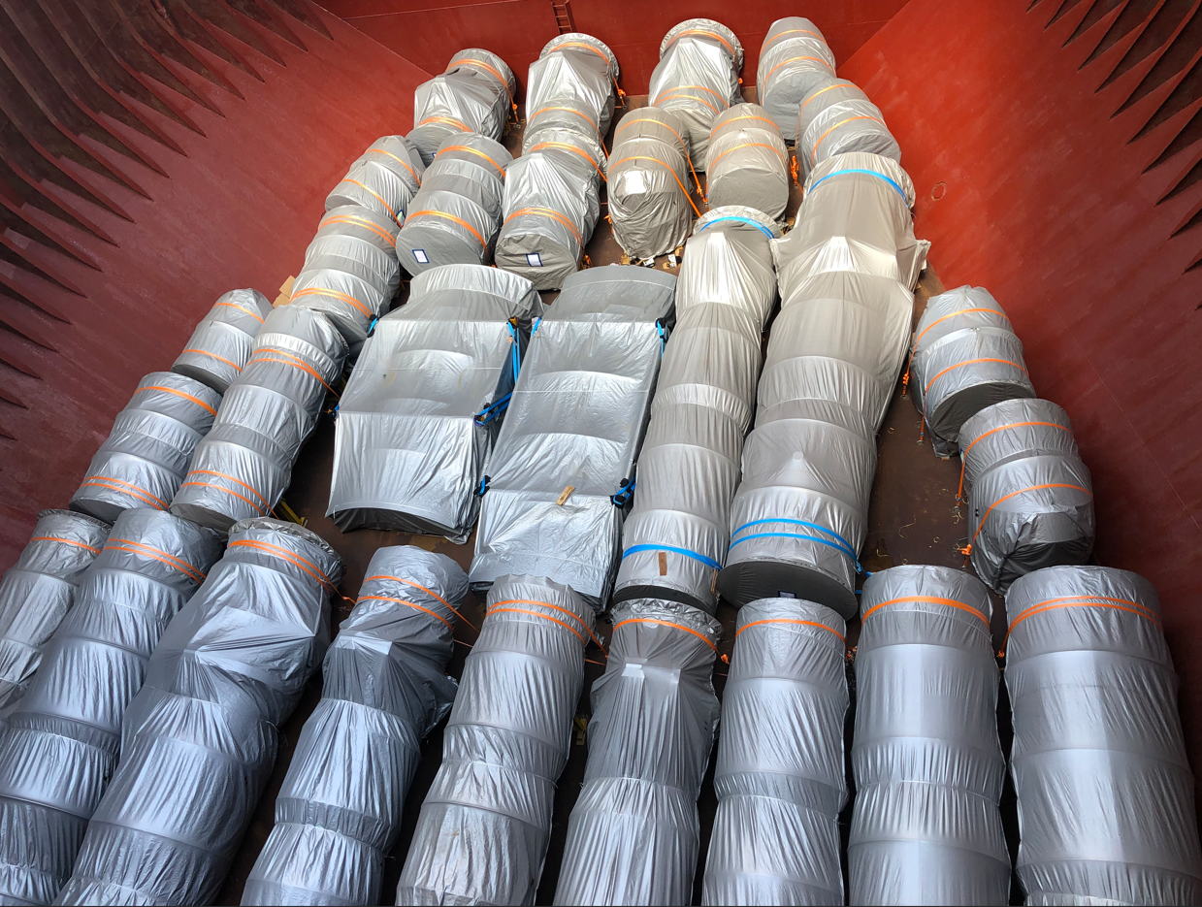
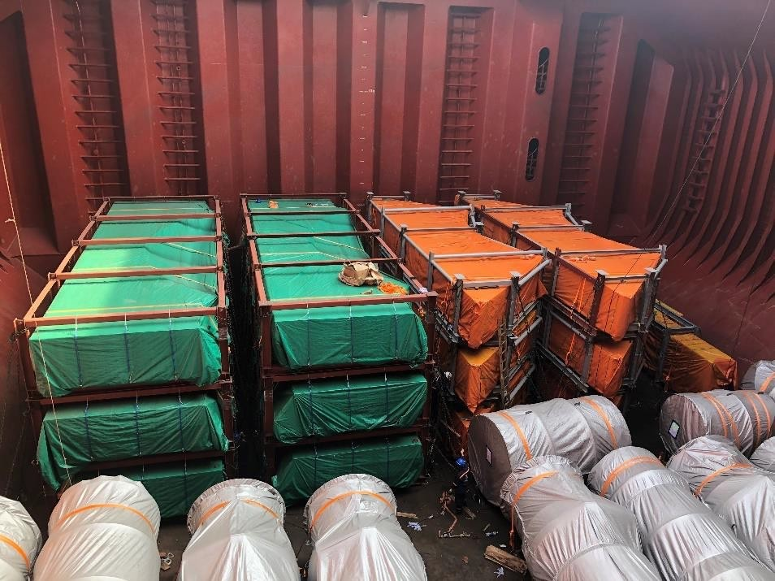
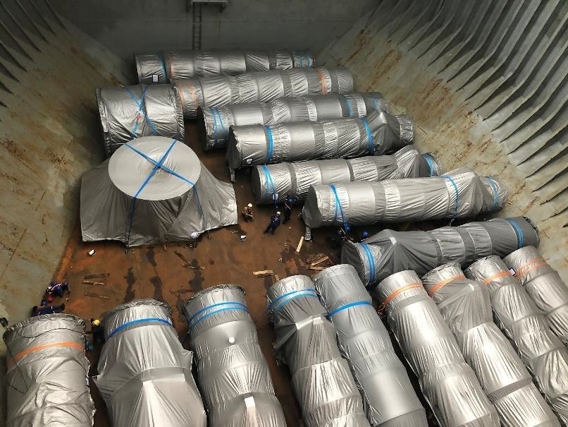
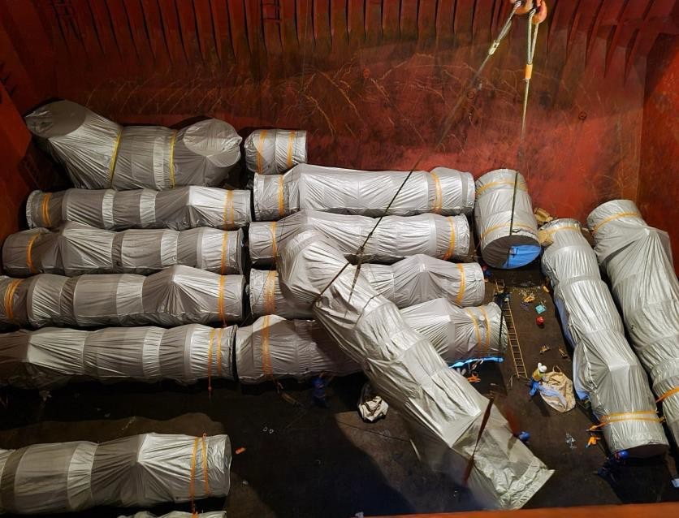
PROJECT REFERENCES
PROJECT REFERENCES
CASE STUDY – Niles + Guernsey Combined-Cycle Power
Volume: Approx. 29,000 FRT
Commodity: Modules, Framing – Bottom beam
Origin: Phu My, Vietnam
Port of Discharge: Houston, TX, USA
Giving packaging solutions to ensure cargo optimize handling efficiency
Chartering of suitable bulk and multi-purpose (MPP) vessels for six scheduled voyages, tailored to cargo specifications and route requirements
Deployment of in-house stevedoring teams to support complex lifting and lashing operations, ensuring safe and compliant cargo handling
Scope:
1

