Slide 1
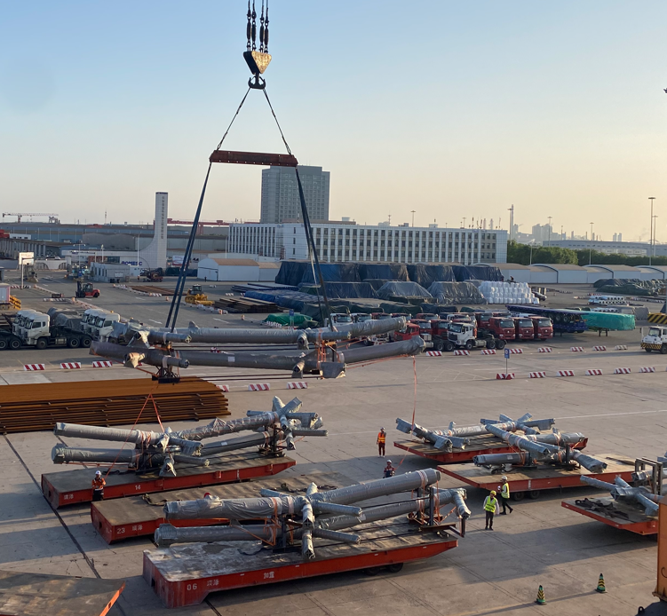
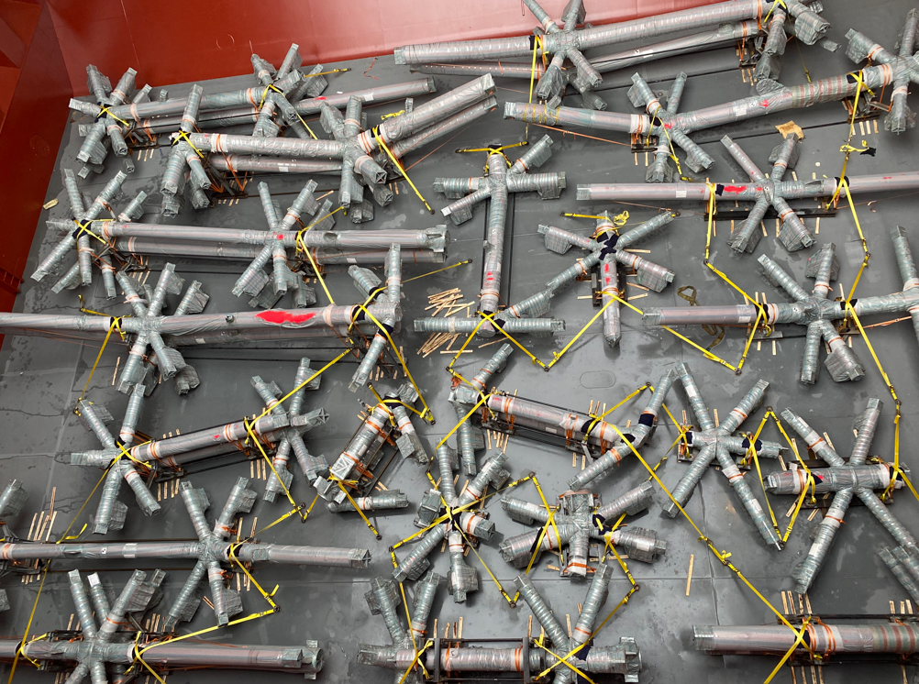
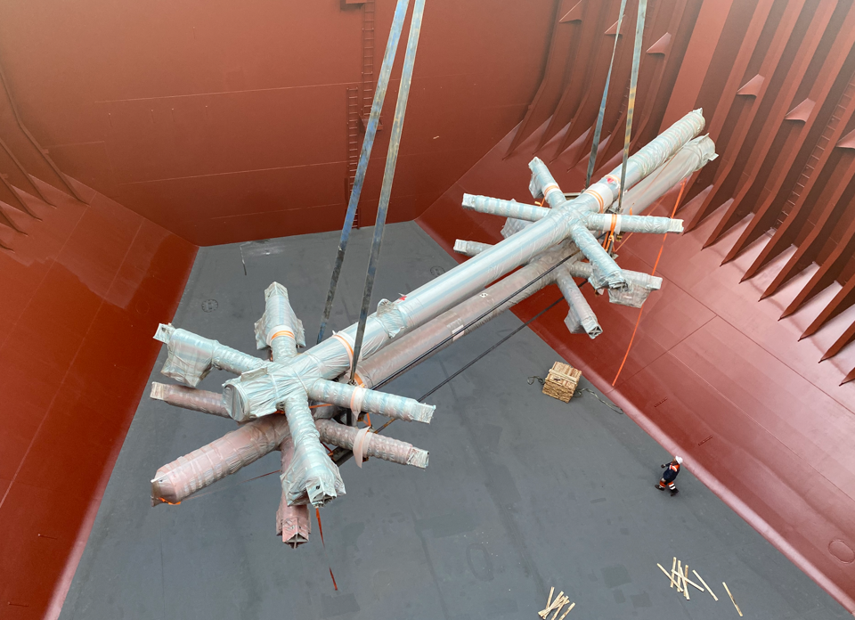
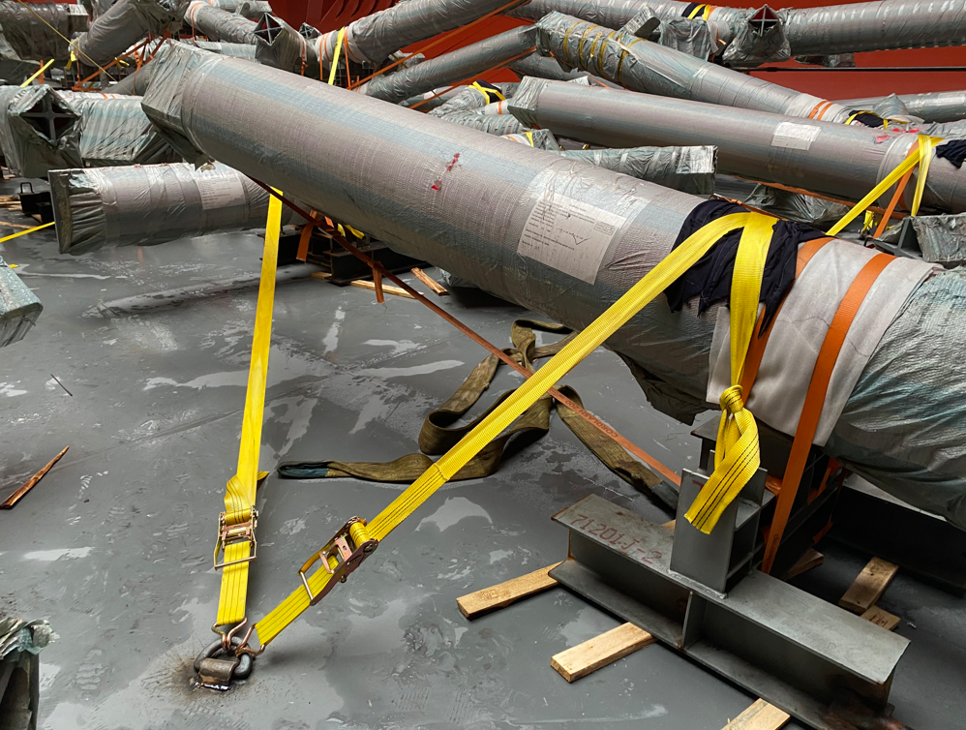
PROJECT REFERENCES
PROJECT REFERENCES
CASE STUDY – LA clippers stadium
Volume: 22,900 CBM / 3,000 MT / 4 shipments
Origin: Tianjin port, China
Port of Discharge: Long Beach, USA
Full liner terms Ocean freight
Chartering break bulk carrier vessel
Loading onto vessel incl appropriate cargo stow arrangements. Cargo hold preparation for loading, layout dunnage by FLS own stevedores
Loading supervision by FLS Port supervisor
Scope:
1

