Slide 1
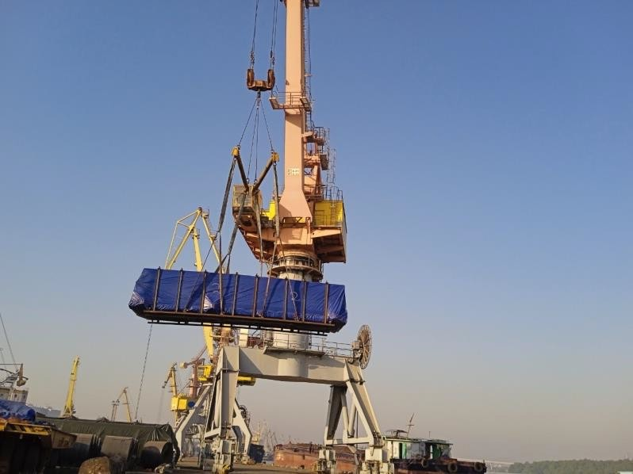
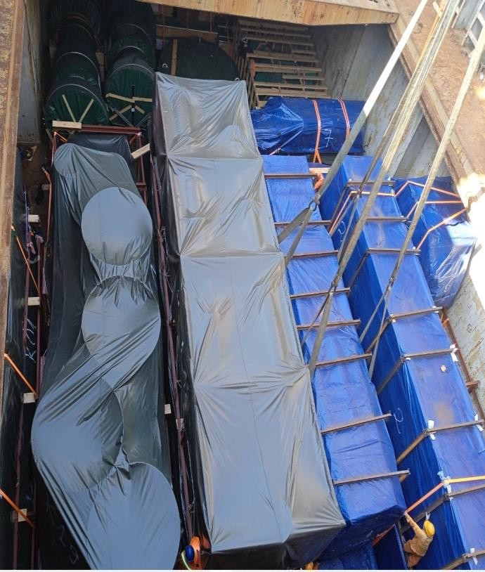
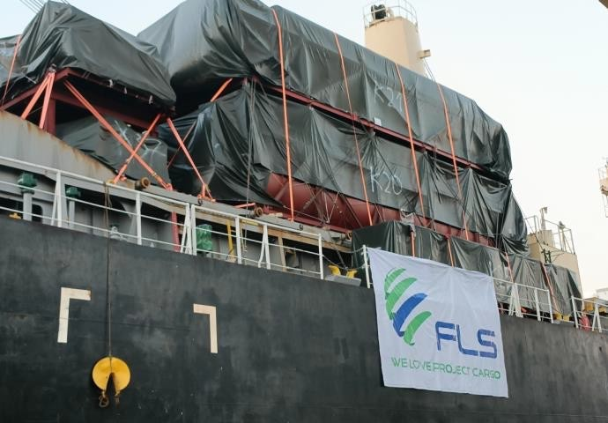
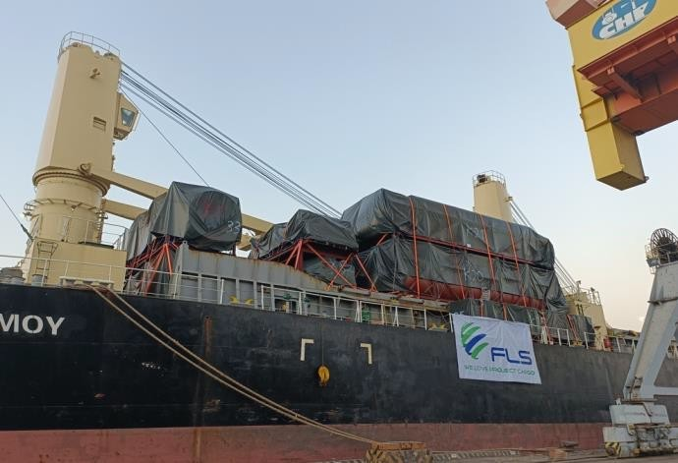
PROJECT REFERENCES
PROJECT REFERENCES
CASE STUDY – TENOVA S.P.A GENOA ITALIA
Project name: Tenova DS0036
Dimensions: 2,826 CBM / 350.99MT / 45 PKGS
Commodity: Duct and Panel
Origin: Hoang Dieu Haiphong, Vietnam Port
Destination: Antwerp, Belgium
Delivery from Vietnam to Belgium ,Dec 2021
Chartering of suitable heavy lift vessel within tight schedule and in budget
Hooking on including arrangement of operation
Supervision both ends
Lashing and securing on the vessel
Experienced marine surveyor perform Control
Scope:
1

