Slide 1
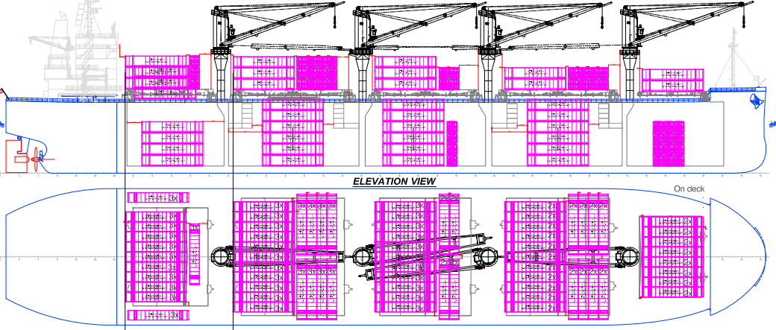
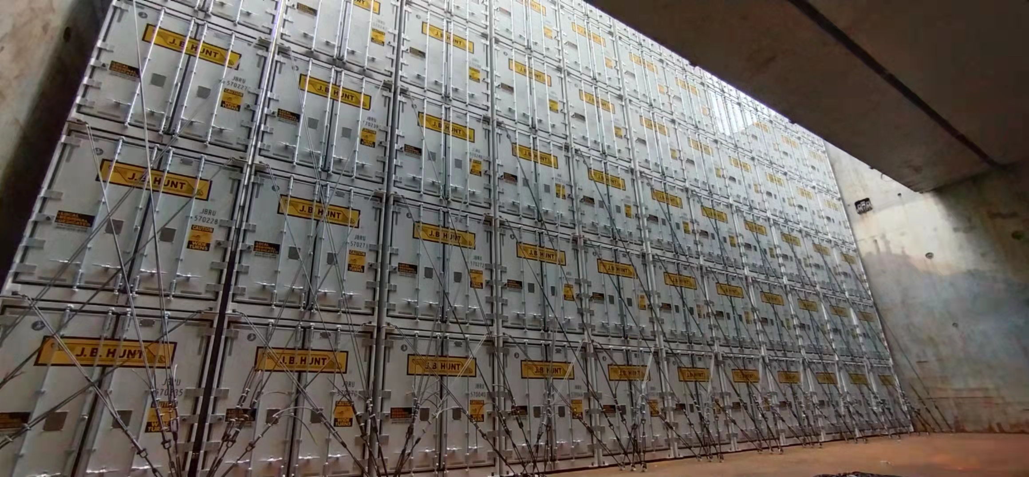
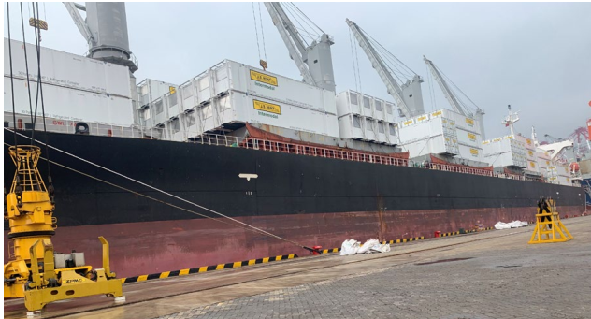
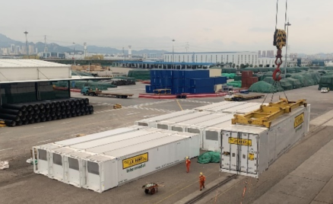
PROJECT REFERENCES
PROJECT REFERENCES
CASE STUDY – 53’ INTERMODAL BOXES CHINA to us West Coast
Volume: 805 x 53’ boxes
Origin: Qingdao and Humen, China
Port of Discharge: Long Beach, USA
Full charter of suitable vessels within a very tight schedule – within the budget
Engineering calculation for Lashing-securing
Loading and discharging
Lashing and securing on board
Customs clearance
Special COVID 19 action plan incl. disinfection required during critical time in China (end of 2021)
Scope:
1

