Slide 1
MACHINERY PROJECTS PRESENTATION
03th Apr 2026
1

Slide 2
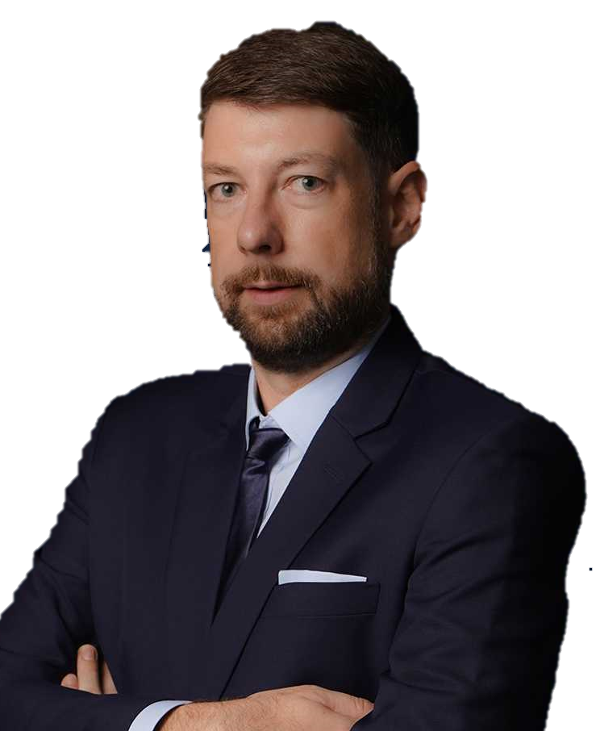
OUR MISSION:
“We keep the world moving, by deploying the best expertise to craft tailor-made solutions that solve the most challenging logistic problems all around the world.”
TORBJÖRN LARISCH
CHIEF EXECUTIVE OFFICER

Slide 3
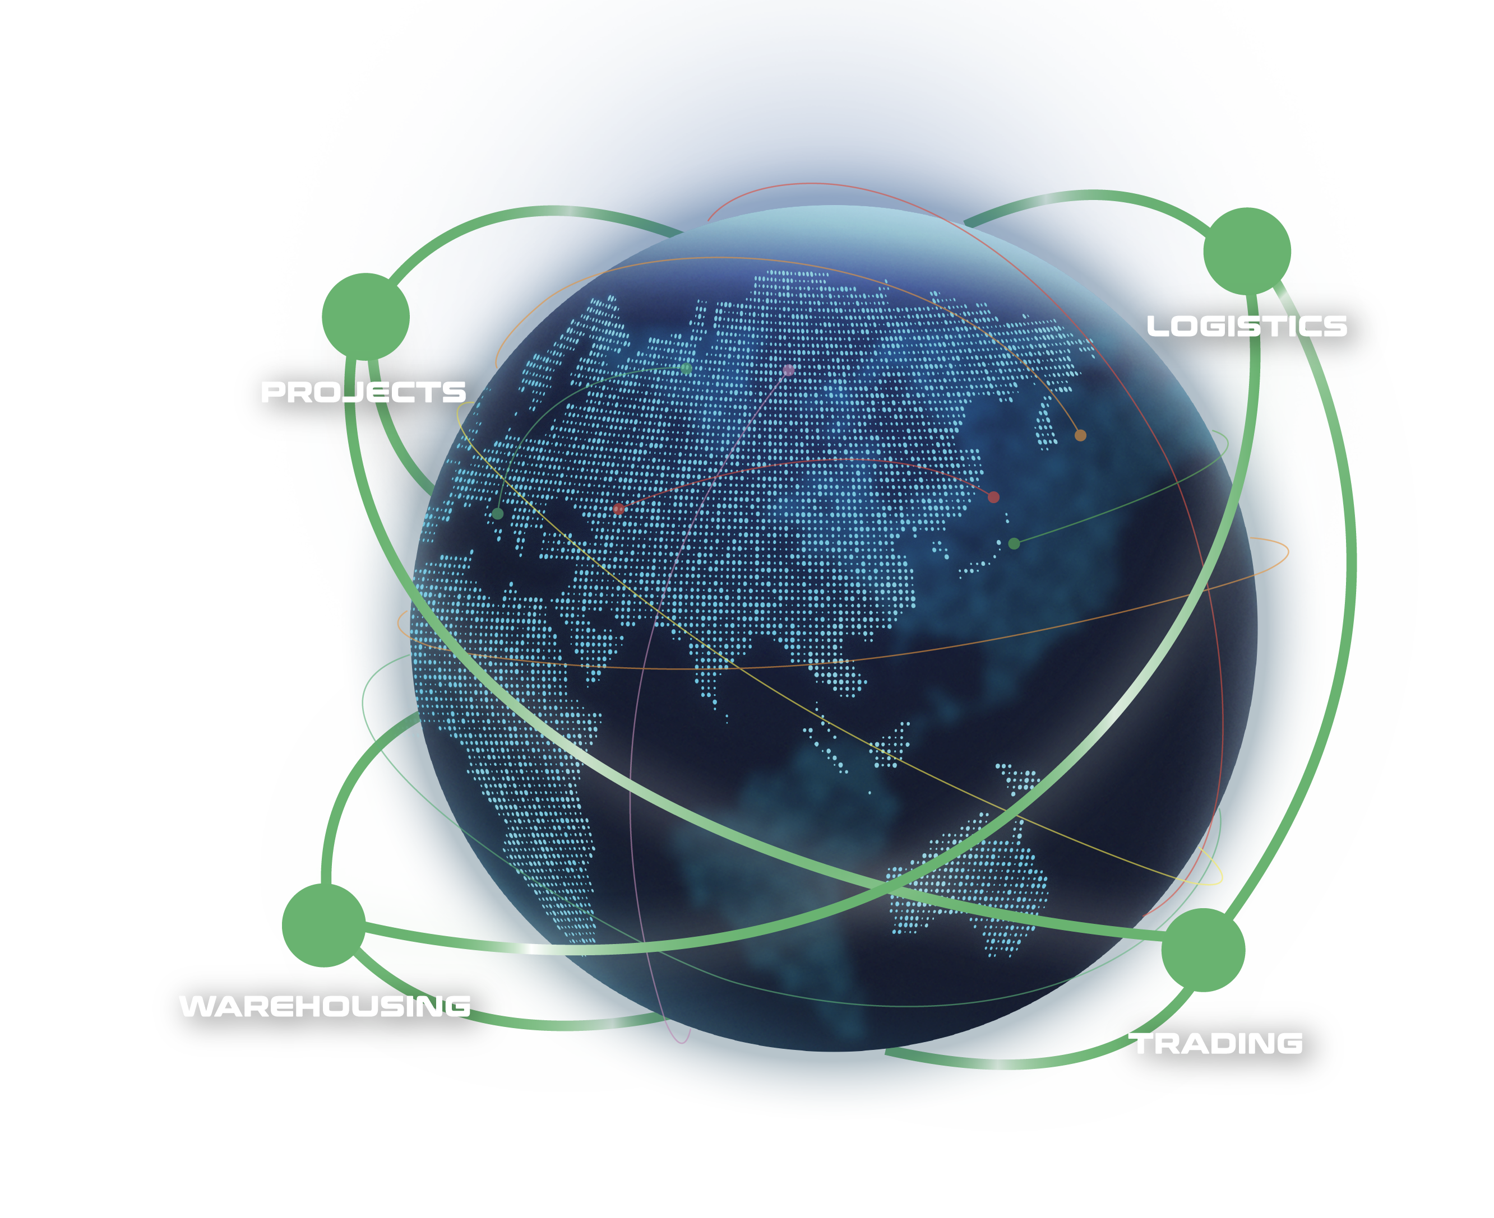
WHAT ARE OUR CAPABILITIES
Our interconnected supply chain solutions are tailor-made to keep your world in business.
OUR VISION:
To be recognized globally as the logistics experts who understand and empower global business leaders to dream and act big; moving the world forward.
PROJECTS: With expert hands, we handle the complicated with precision.
LOGISTICS: We humanize a seemingly standardized experience.
WAREHOUSING: We envision spaces that bring supply chains to the next level.
TRADING: We define and shape solutions to meet ever-changing needs.
3

Slide 4
FLS SNAPSHOT
32
500+
100+
years of experience
professionals
global partners
14
$65 million
countries
is the largest single contract award
ANNUALLY
15,000+
5,000+
trucks moved
customs clearance cases
25,000+
20,000+
14 million kg
$219 million
TEUs shipped
shipments delivered
air freight cargo handled
consolidated revenue
4

Slide 5
FLS HISTORY
FLS ventured more and more into handling export projects from steel fabricators in Thailand, Korea, China, Vietnam, Malaysia and Indonesia to global destinations for major engineering companies in the Power, Petrochemical and Mining industries.
After almost three decades, we have expanded our services from project cargo into a wider portfolio include:
FLS Logistics
FLS Warehousing
FLS Trading
Neon Orient acquisition
FLS Supply Chain Center establishment
2001 – 2010
2020 – 2023
1993 - 2000
2011 – 2020
NOW
The company was founded in Bangkok in May 1993 by Martin Häberli when he was awarded several major projects in Thailand.
In 2011 FLS (Vietnam) Ltd. was established, followed by
FLS (Australia) Pty Ltd. in 2013
FLS (Singapore) Pte Ltd. in 2014
PT. Federal Logistik Sistem (Indonesia) in 2014
FLS Projects (USA) Inc. in 2016
FLS Projects (Taiwan) Ltd. in 2016
FLS Projects (Malaysia) Sdn. Bhd, in 2018
FLS 1993 (India) Pvt Ltd.
In 2024, we embarked on a new chapter, broadening our global reach with the establishment of
FLS Scandinavia
FLS Norfolk, USA
FLS Group (Japan)
ITL acquisition
FLS Philippines
FLS Italy
5

Slide 6
OUR GLOBAL PRESENCE
USA
Denmark
India
Thailand
Italy
China
Japan
Myanmar
Vietnam
Philippines
Malaysia
Singapore
Australia
FLS Offices
Indonesia
FLS close network partners
6

Slide 7
OUR COMPETENCIES
EXPERIENCED
COMPETIVE
More than 30 years of experience
Global access to carriers, local contract negotiations
FLEXIBLE
INNOVATIVE
Matching right partners for each project
We can solve problems with creative solutions and will adjust our operation to your requirements
PRO-ACTIVENESS
Eyes and ears always on the market and therefore can react to possible constraints early
DYNAMIC
Growth through opportunity, where others see a problem, we see an opportunity
Fast decision-making process
CONTINUITY
High employee retention rate: average is 8.32 years. Some key staff have been with FLS for more than 15 years
7

Slide 8






WE ARE A PROUD MEMBER OF:
8

Slide 9
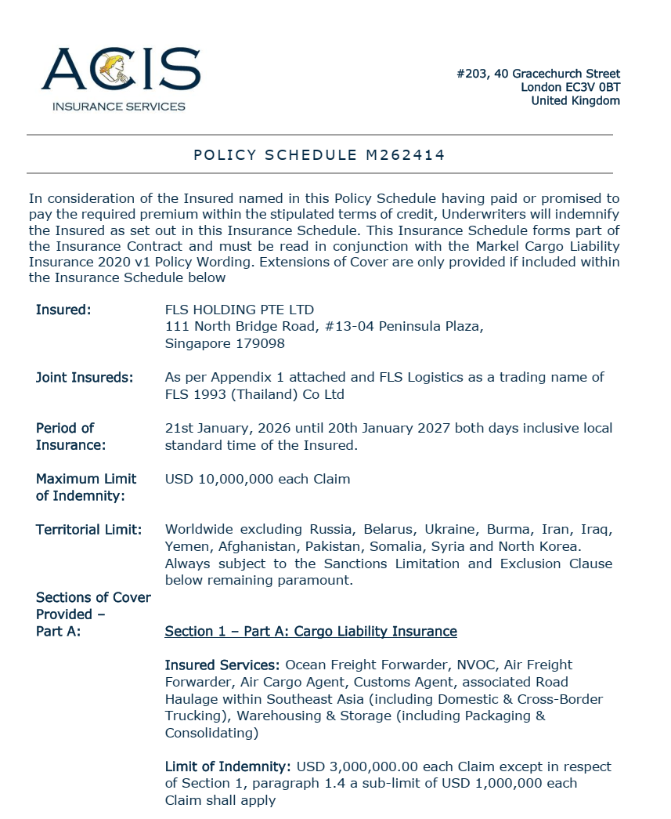
INSURANCE POLICY
Base coverage:
Cargo liability
USD 3,000,000 each claim
3rd party legal liability
USD 3,000,000 each claim
Professional indemnity
USD 400,000 each claim
Fines and duties liability
USD 100,000 each claim
Please note: Limits are flexible & negotiable, and liabilities can be extended on request and a case-by-case basis. Marine cargo insurance can be provided. on request.
9

Slide 10
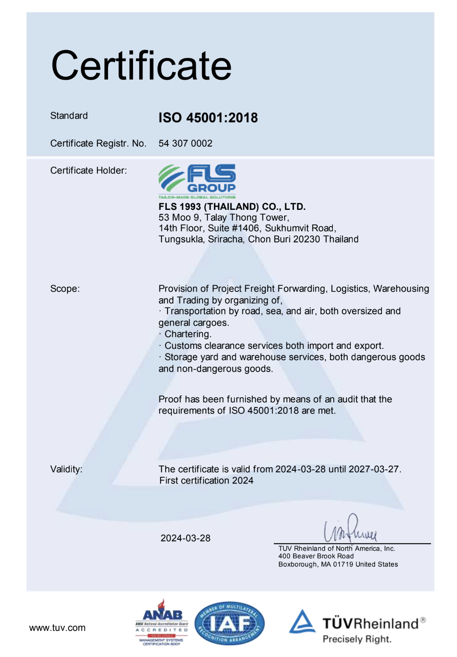
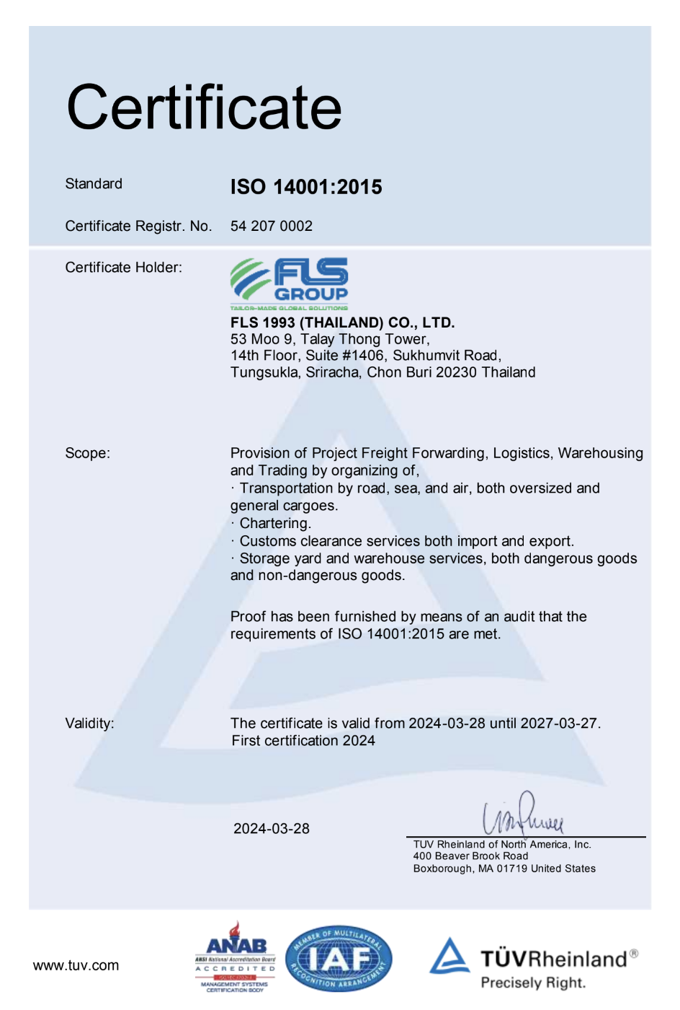
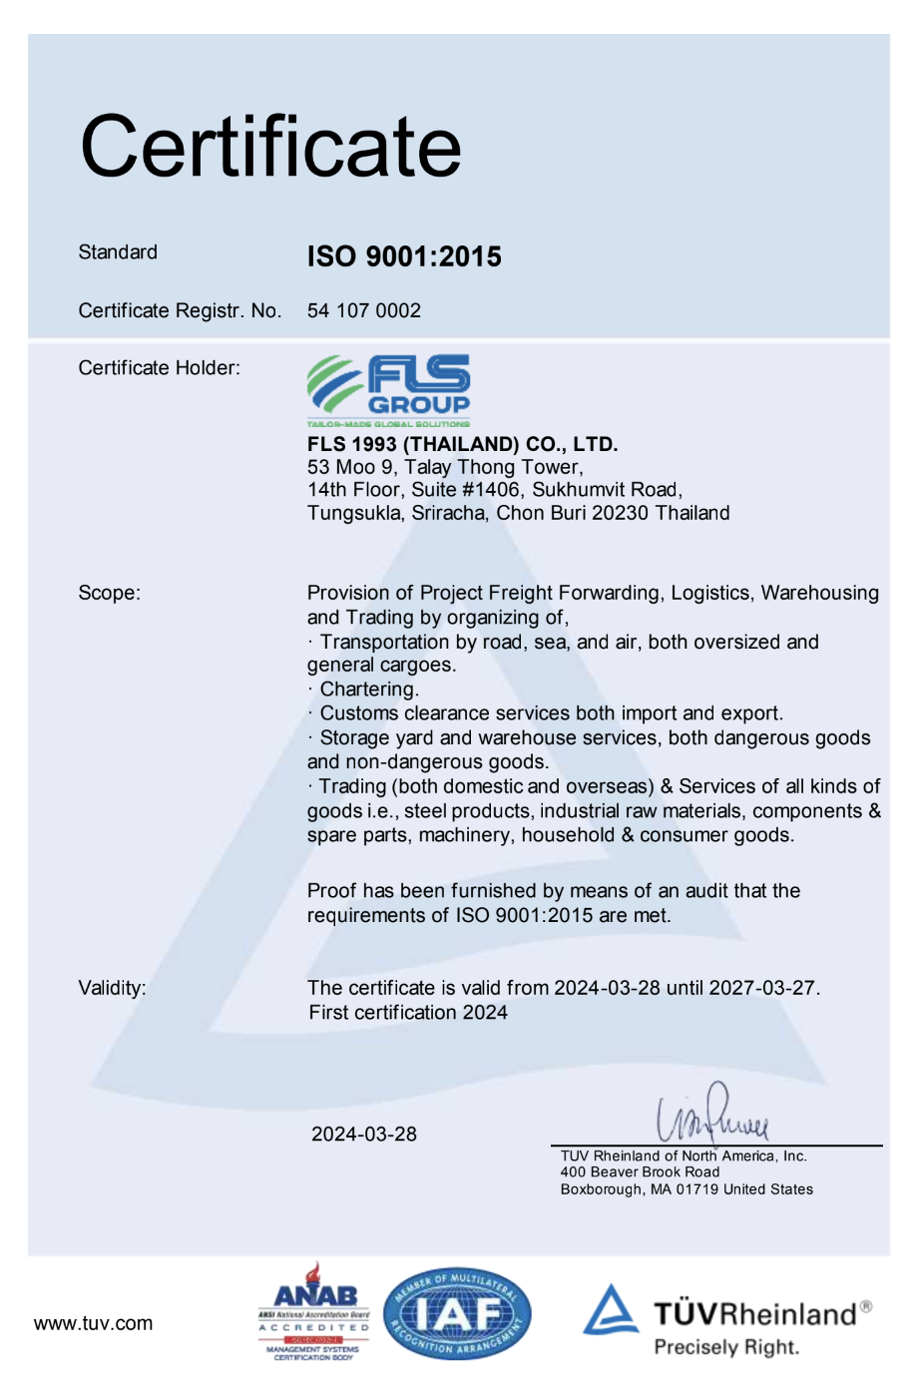
HSEQ Procedures
SAFETY, QUALITY & INTERNATIONAL COMPLIANCE
ISO 45001:2018 CERTIFICATE
ISO 4001:2015 CERTIFICATE
ISO 9001:2015 CERTIFICATE
ISO-certified own operations in Thailand, Australia, Singapore, USA, Vietnam, Taiwan, Indonesia, Malaysia, India and Myanmar.
10

Slide 11


SAFETY, QUALITY
& INTERNATIONAL COMPLIANCE
QUALITY ASSURANCE
HEALTH & SAFETY
OUR STANDARDS
FLS Quality Management Systems meet all our customer’s applicable statutory and regulatory requirements.
We use one of the world’s leading modular enterprise systems to streamline operations, accounting and business development.
Provide Health & Safety training for all members of staff as well as blue-collar and sub-contracting parties.
Follow international rules and guidelines to foster a safe and healthy working environment for our teams.
Ensure that each project and every shipment is handled in a safe, timely, systematic, and efficient manner.
We select and work only with agents and partners who:
are fully certified to international standards
fulfill our own strict quality standards
have sufficient insurance coverage
operate with well-maintained and regularly tested equipment
are well managed and staff regularly trained
have a long successful history and proven track record.
11

Slide 12

OCCUPATIONAL HEALTH, SAFETY AND ENVIRONMENTAL POLICY
FLS requires the active commitment to, and accountability for, occupational health, safety and environment from all employees and contractors.
Comply with all relevant legislations and corporate requirements of OHSE;
Meet specified customer requirements and ensure continuous customer satisfaction;
Protect, and strive for improvement of, the health, safety and security of our people at all time;
Eliminate accidents and minimize potential risks;
Set OHSE performance objectives, measure results, assess and continuously improve processes and services, through the use of an effective management system;
Plan for, respond to and recover from any emergency, crisis and business disruption;
Minimize our impact on the environment through pollution prevention, reduction of natural resource consumption and emissions, and the reduction and recycling of waste;
Apply our technical skills to all OHSE aspects in the design and engineering of our services;
Communicate openly with stakeholders and ensure an understanding of our OHSE policies, standards, programs and performance. Reward outstanding OHSE performance;
Improve our performance on issues relevant to our stakeholders that are global concern and on which we can have an impact and share with them our knowledge of successful OHSE programs and initiatives.
12

Slide 13

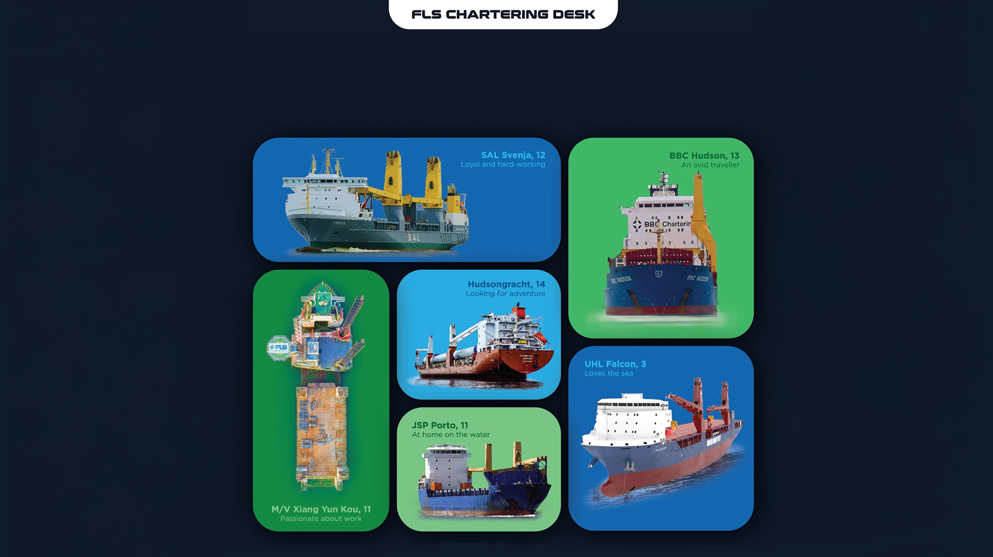
WE’LL FIND YOU
THE PERFECT MATCH

Slide 14
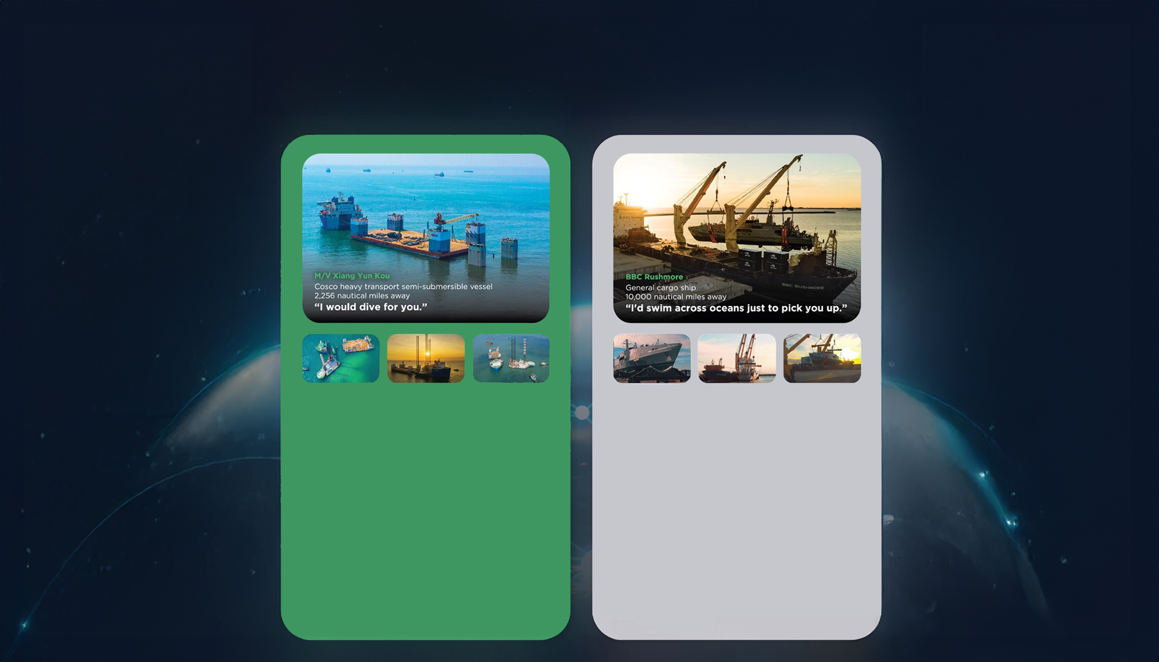
THE RIGHT VESSEL AT THE
RIGHT PRICE AT THE RIGHT TIME
• Half swimmer, half diver
• The big lady of the sea
• Nothing is too big to handle
• Matched with: a 7.000 tonne-floatina drudock and a 6.000-tonne liftboat.
Our buying power and creative solution of combining two shipments allowed us to lock in thebest pricing and the fastest shipping time, despite an extremelv short notice period.
The float-on, float-off loading operation went smoothly and the threesome enioyed a safe journey from Vietnam to Malavsia and the Philippines.
• Any port. Any cargo.
• Accommodating and spacious
• Sailing under the name of the global market
leader of ocean
• Matched with: Austal-built coast guard vessels
As these state-of-the-art vessels are crucial assets for the Trinidad and Tobago coast guard, a best-in-class, door-to-door delivery solution was needed. After securing the reputable BBC Rushmore for these vessels.
FLS experts designed special shipping cradles to support and protect the mono aluminum hulls during the lifting operation and arranged professional divers for a precise loading operation

Slide 15
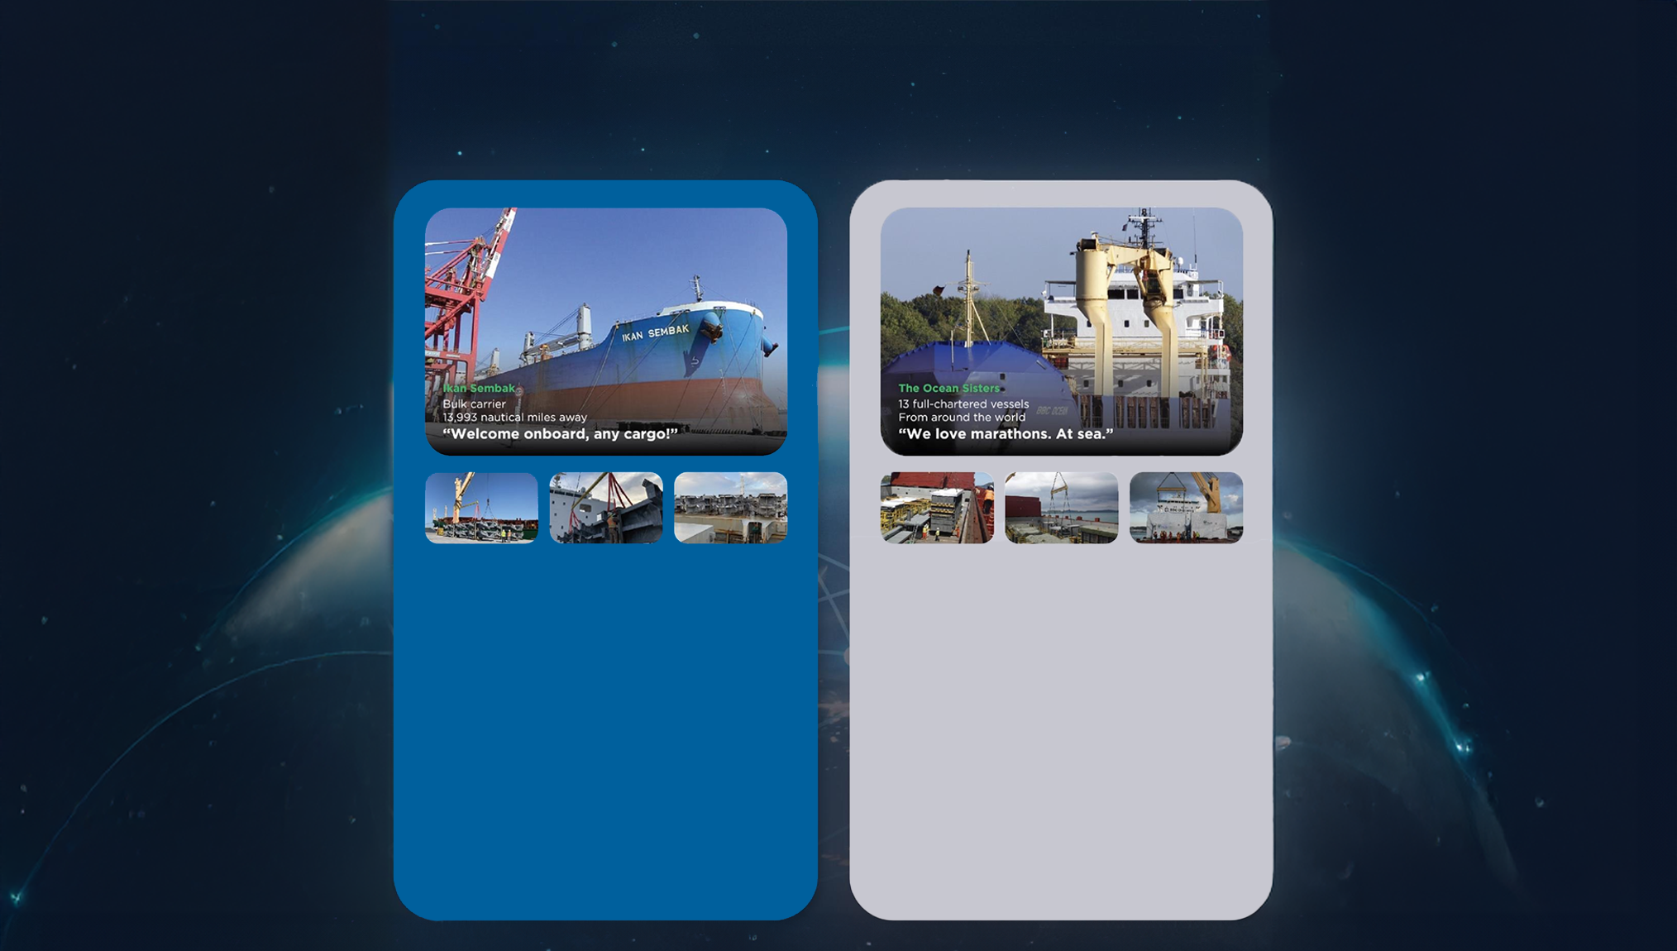
At FLS Chartering Desk we pride ourselves on having long-standing relationships with vessel owners all around the world. This means we can find the perfect match for your needs, while also trying to fulfill your budget and time requirements.
Below are just a few of the perfect matches we've made for our customers.
• Born in Japan
• Enjoying fantastic voyages for the last decade
• Making friends across the globe
• Matched with: Niles, Guernsey and Jackson
combined-cvcle power plants.
Six successful voyages matched so far! FLS
provided packaging guidance and improvement, with customised metal frames to protect the stability of the heavy cargos and our in house stevedores assisted various lifting and lashing operations.
We successfullv saved costs and reduced transit time for two clients in this consolidated shipment.
• We go where cargos love to be
• Devoted to you
• Teamwork is dreamwork
• Matched with: 164 modules, around 225.000
FRT of equipment for a petrochemical plant
in Houston, USA.
A complicated multimodal project which took us 1,5 years to complete. As well as 13 full-chartered vessels, we also provided bespoke trucking, wrapping, stowage and barging solutions.
Our good relationship with carriers and local authorities helped the cargo enjoy a comfortable journey.

Slide 16
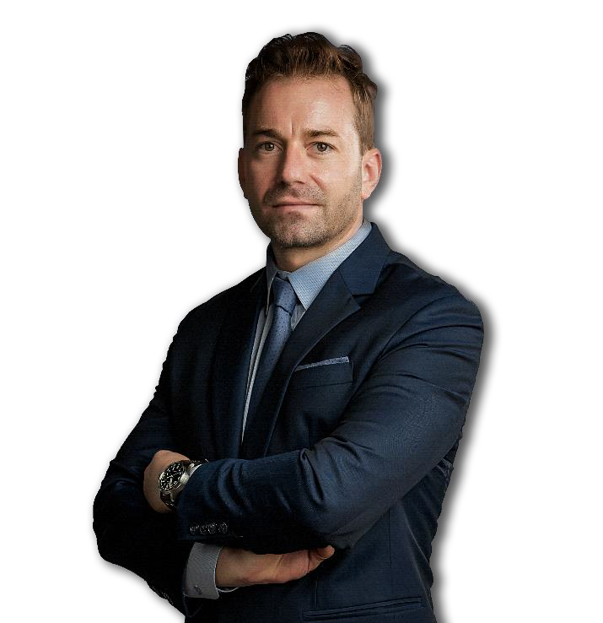
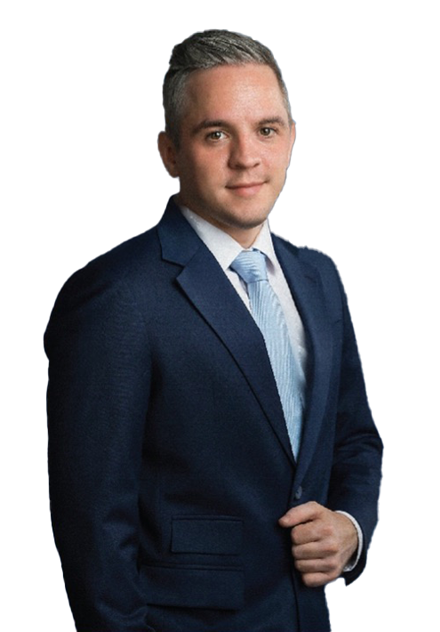
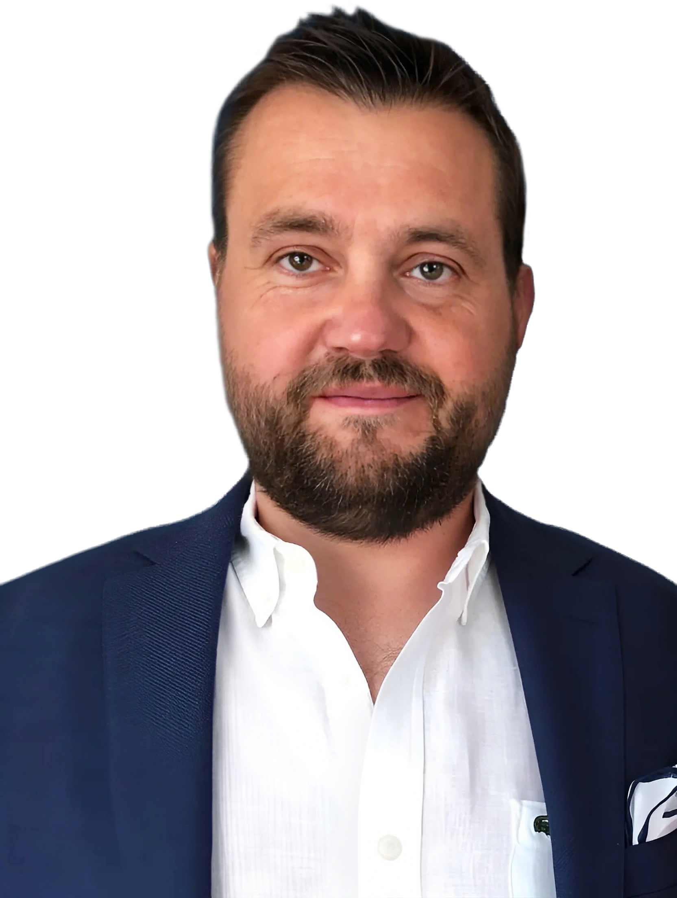
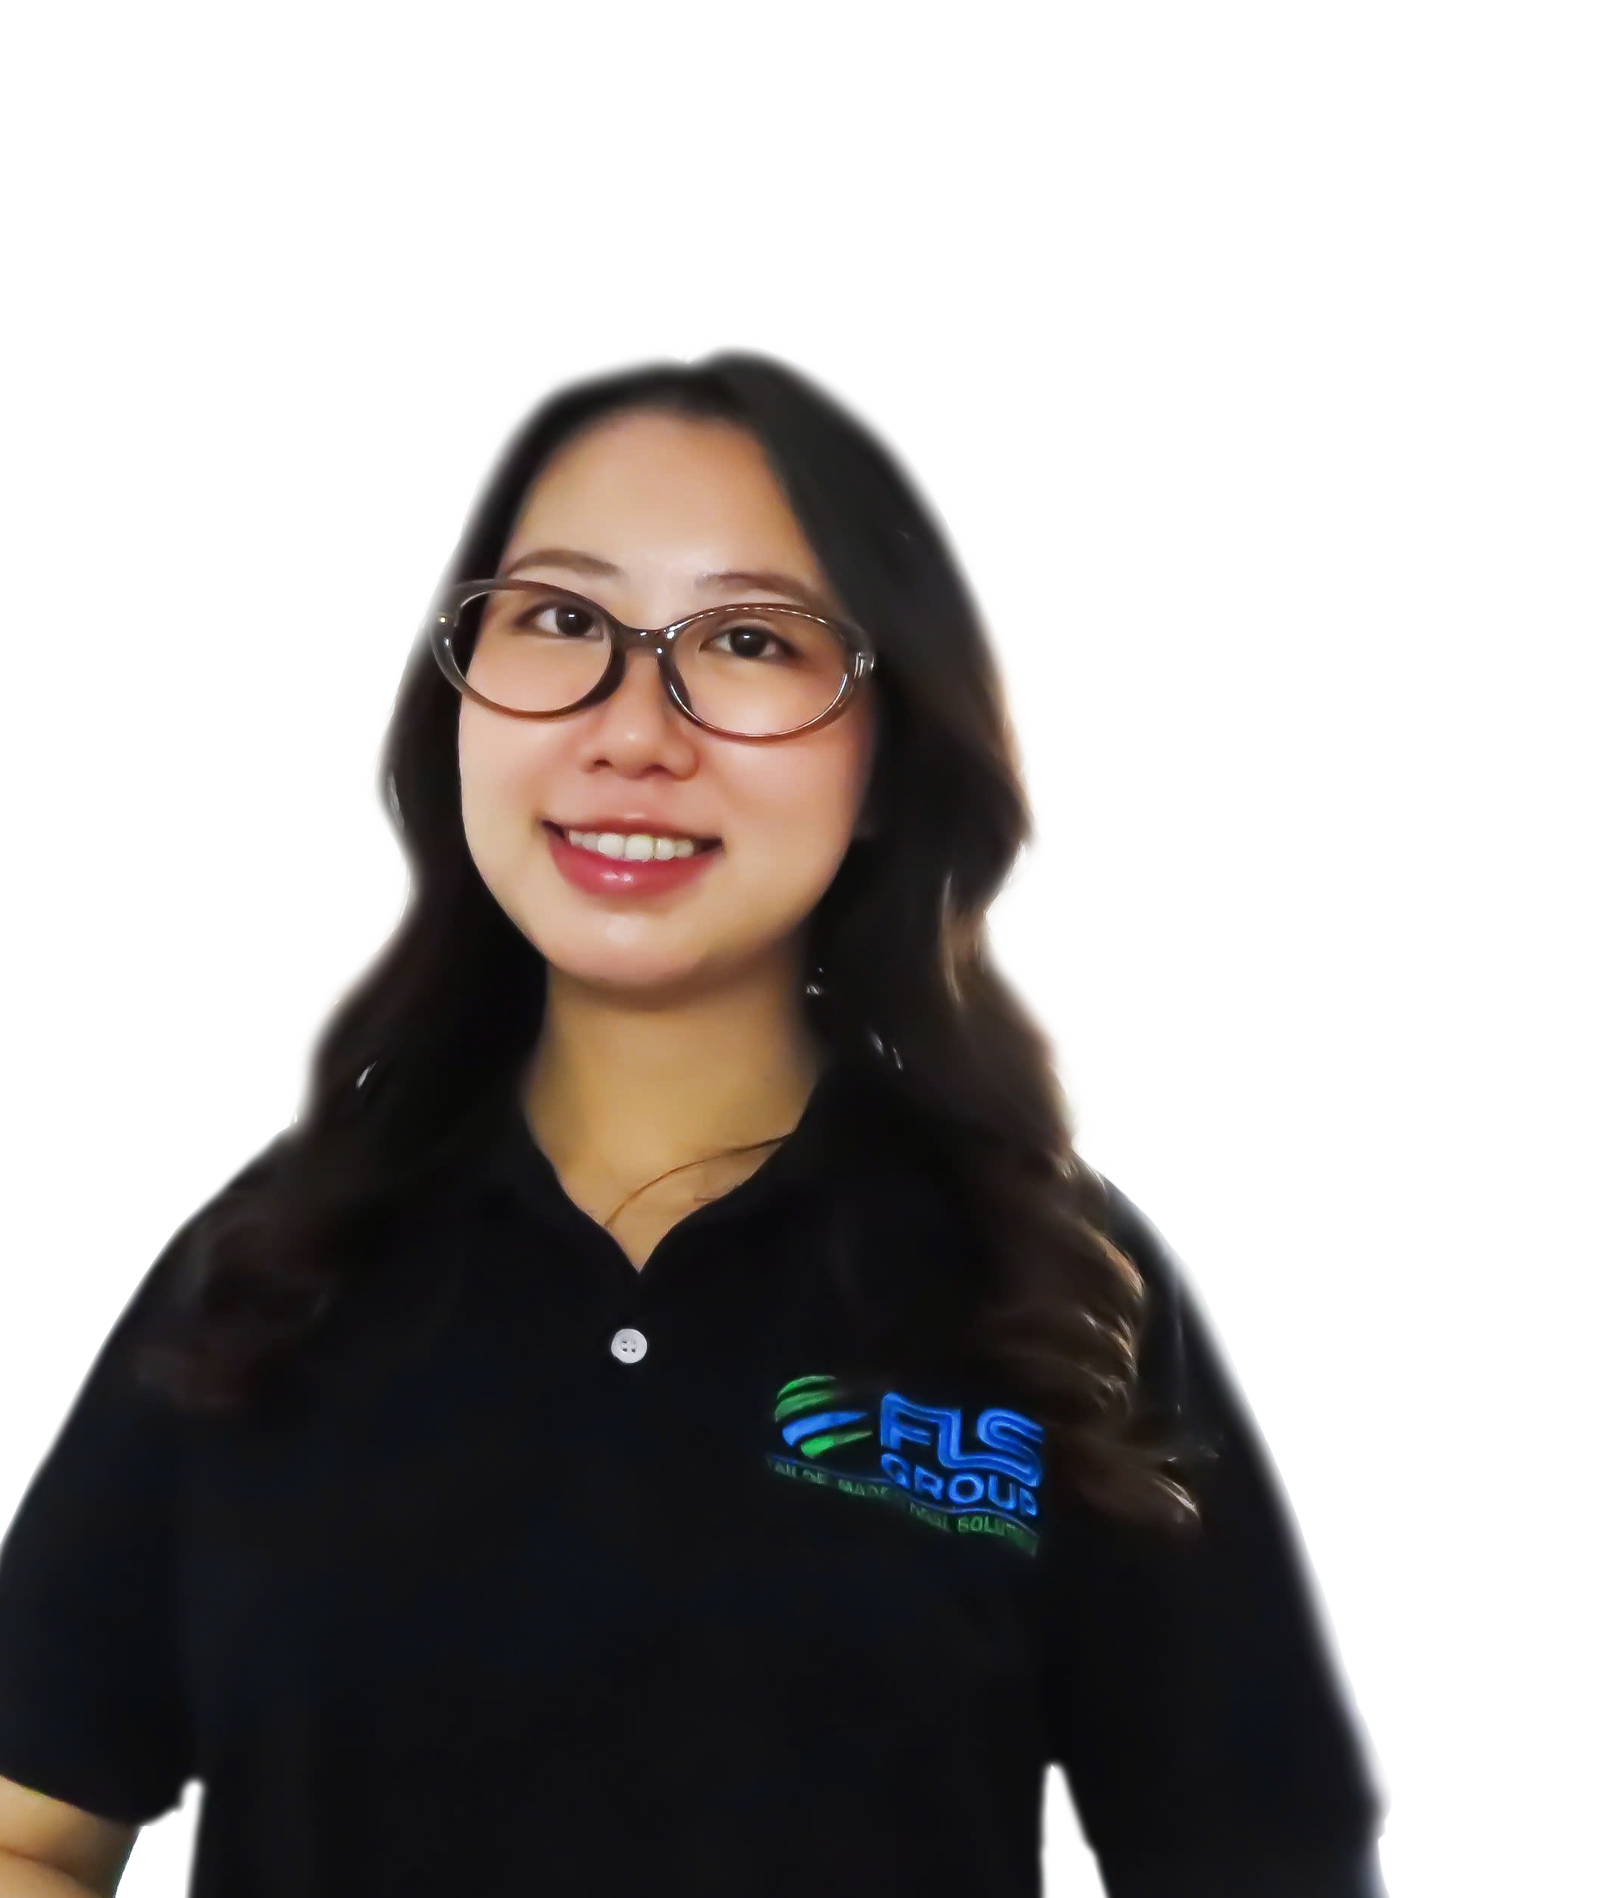
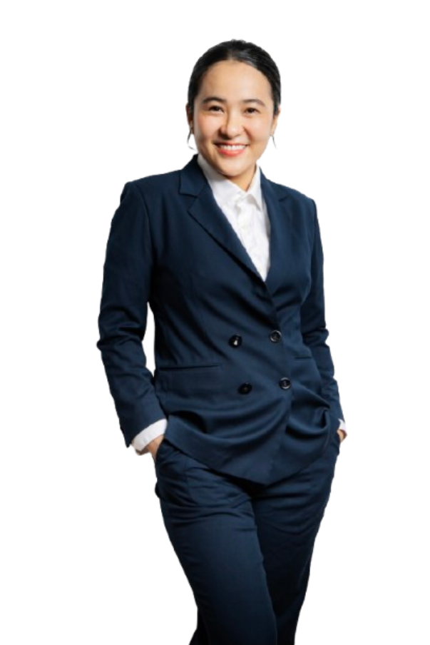
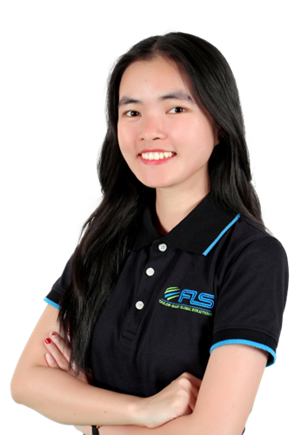
GLOBAL VESSEL ACCESS. PRECISION OPTIMIZATION
FLS Chartering Desk provides direct access to a global network of vessel owners, enabling unrestricted selection across the market. Leveraging strong buying power and deep market understanding, we optimise every charter for cost, timing and operational performance.
SVEN
HOEHLE
HEAD OF GLOBAL PROJECT SOLUTIONS
CHARTERING DESK
CHRISTOPHER SCHNIEDERS
GLOBAL DIRECTOR PROJECTS
SUNE
THORLEIFSSON
MANAGING PARTNER | CHARTERING
VI
NGUYEN
CHARTERING
MANAGER
KHUONG
NGUYEN
PROJECT SOLUTIONS
EXECUTIVE
LINH
NGUYEN
CHARTERING
EXECUTIVE

Slide 17
FLS Group Chartering Desk
Purpose of the chartering desk
1 | Centralize market insight, customers benefit from up-to-date insights on freight rates, bunker prices, and carrier performance, conditions, often securing better deals than if the customer approached shipowners directly
2 | Legal and limit commercial risk, direct oversight ensures that all transport activities comply with regulations, reducing the risk of legal issues, ensuring smooth operations and protecting customer interests
3 | Get unfiltered first-hand information in order to make quick and qualified decisions (in case of delays in production, on the job-site etc.). Greater visibility into supply chain.
4 | Provide technical input and increased usage of inhouse engineer to add value. Transport plan will be tailor-made to your needs.
17

Slide 18
Machinery References

Slide 19
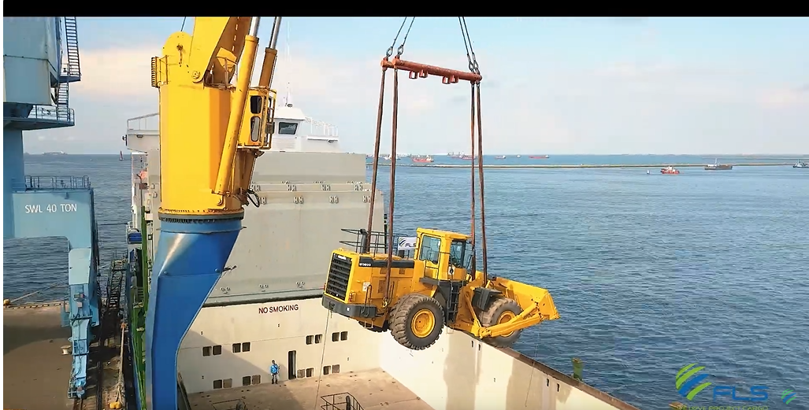
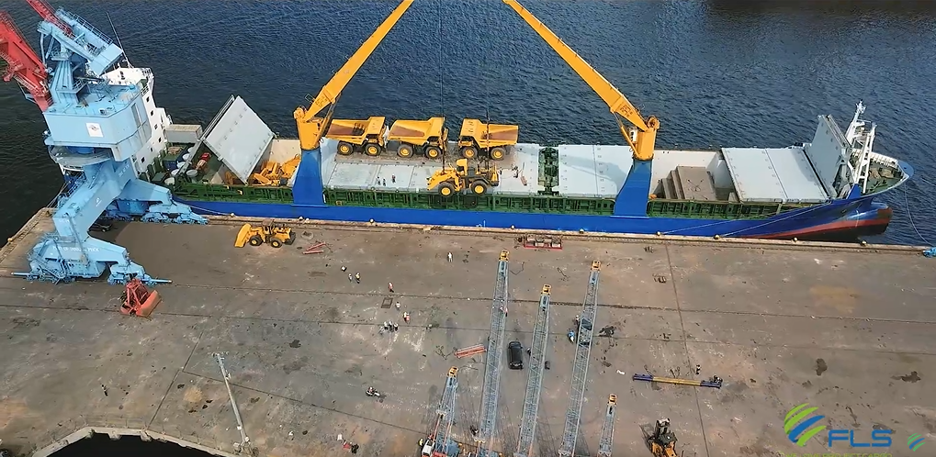
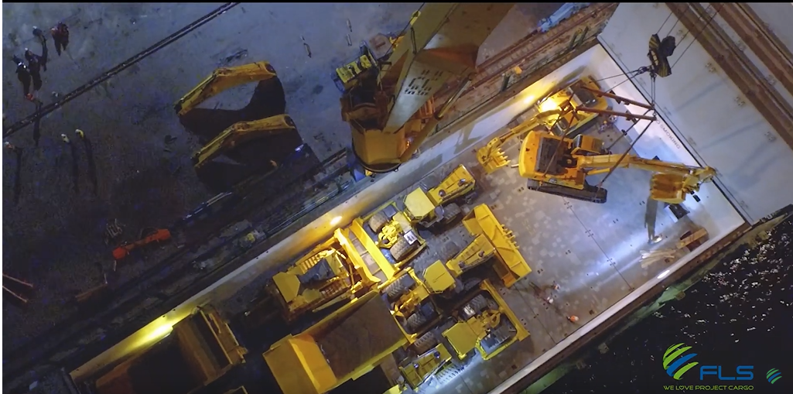
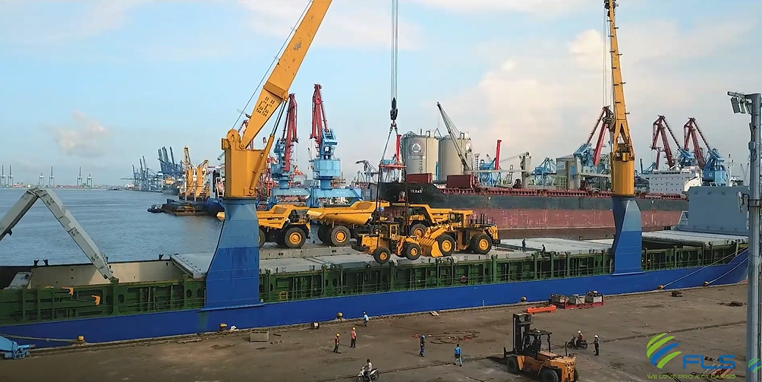
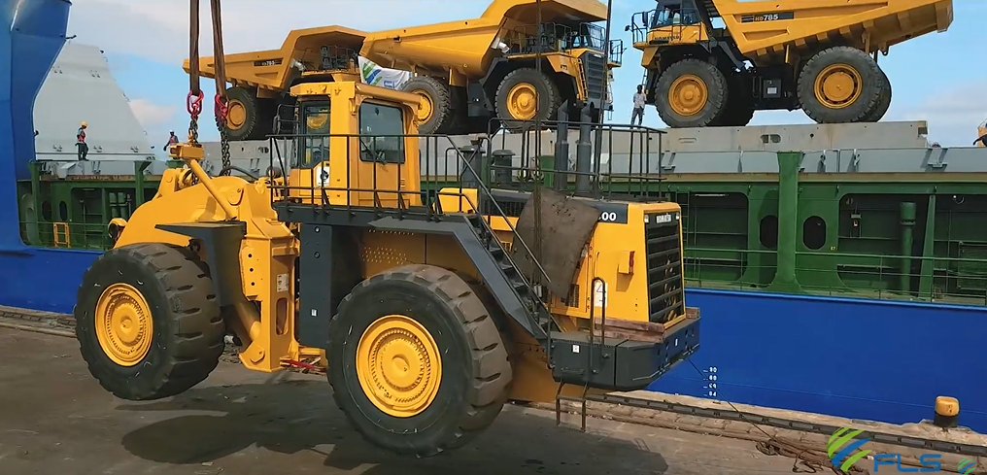
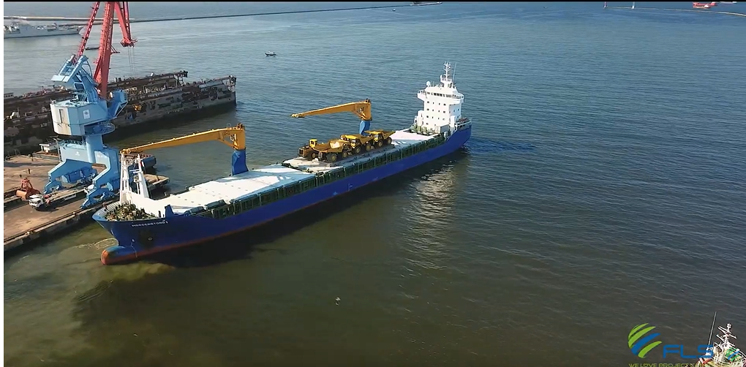
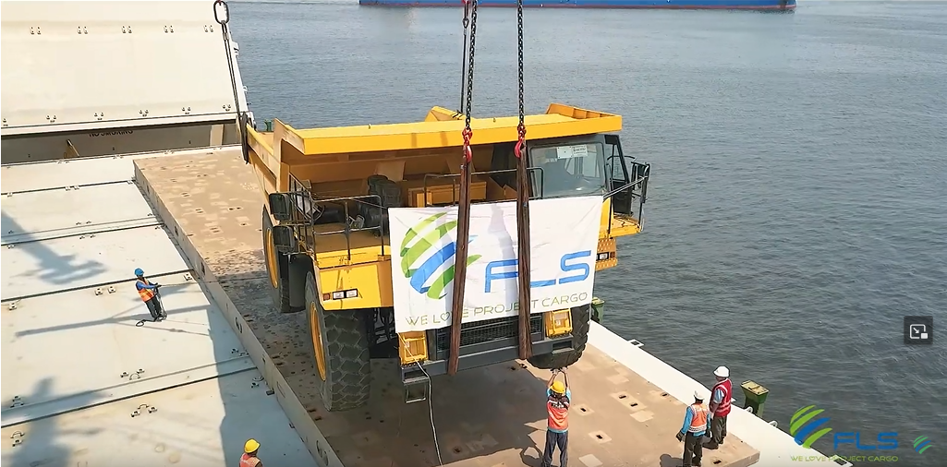
PROJECT REFERENCES
PROJECT REFERENCES
CASE STUDY – CAT
Commodity: Excavators, soil dozers, mining dump trucks
Origin: Ciwandan Port of Banten
Destination: Jebel Ali International Port of UAE
Vessel chartering services
Port and terminal handling services
Export customs clearance services
Stevedoring loading at Port of Shipment
Lashing, securing, and discharging all cargo material inside sea carrier
Sea freight from Port of Shipment up to Port of Discharging
Arrival at Port of Discharging under CFR terms
Scope:
19

Slide 20
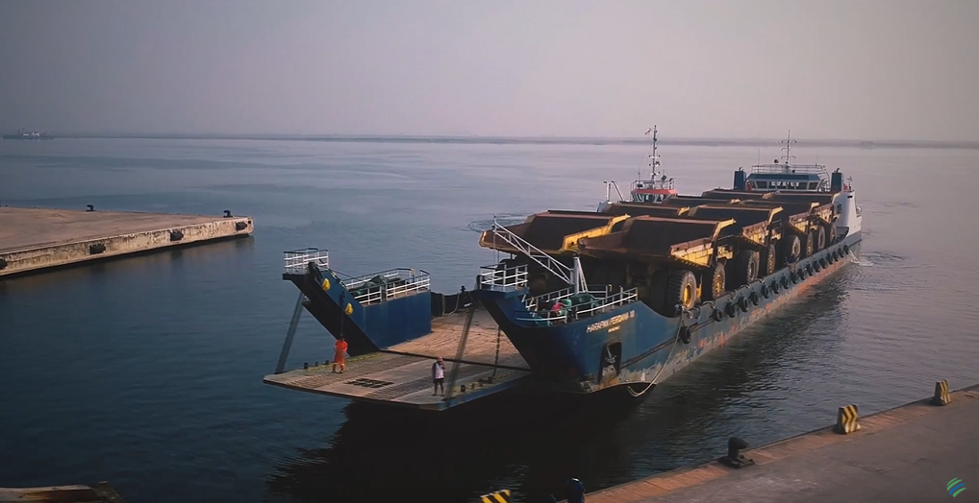
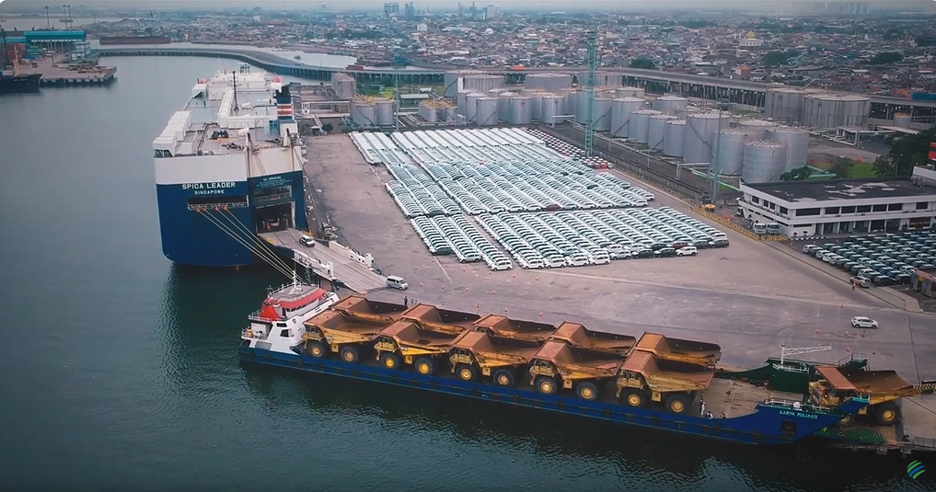
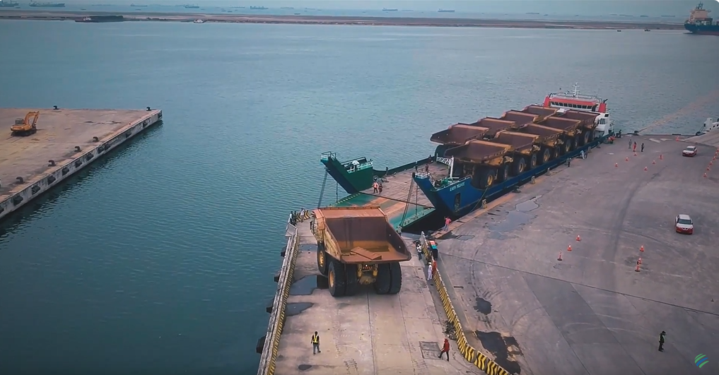
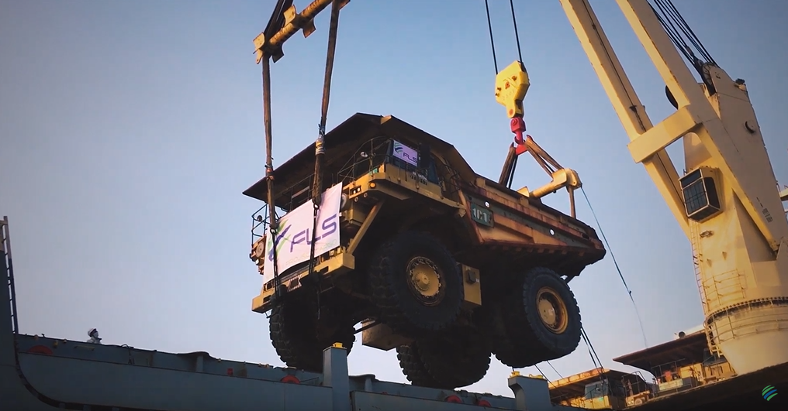
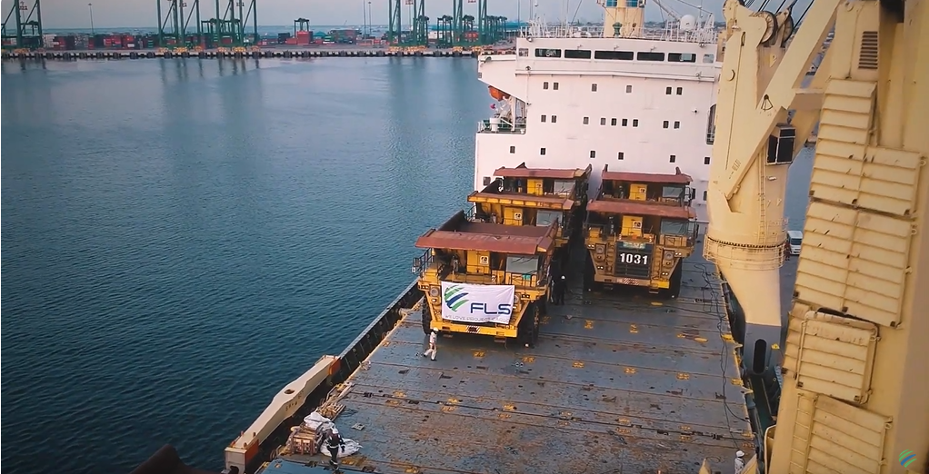
PROJECT REFERENCES
PROJECT REFERENCES
CASE STUDY – Equipment for Pipelines FZE Project
Commodity: 31 x Mining Dump Truck HD 1500-5 Series
Origin: Tanjung Priok International Port of Jakarta
Destination: Xingang International Port of China
Vessel chartering services
Port and terminal handling services
Export customs clearances services
Stevedoring loading at Port of Shipment
Lashing, securing, and discharging all cargo material inside sea carrier
Sea freight from Port of Shipment up to Port of Discharging
Arrival at Port of Discharging under CFR terms
Scope:
20

Slide 21
PROJECT REFERENCES
PROJECT REFERENCES
CASE STUDY – Caterpillar
Volume: Approx 5,000 CBM for 2 shipments under deck
Commodity: Bulldozers / Excavators
Origin: Laem Chabang, Thailand
Destination: Middle East
Vessel booking according to client’s requirements
Coordinating with agent and vessel for proper loading / lashing method as per client’s instruction
Port Storage and handling
Loading supervision at Origin and Discharging supervision at destination
Scope:
21

Slide 22
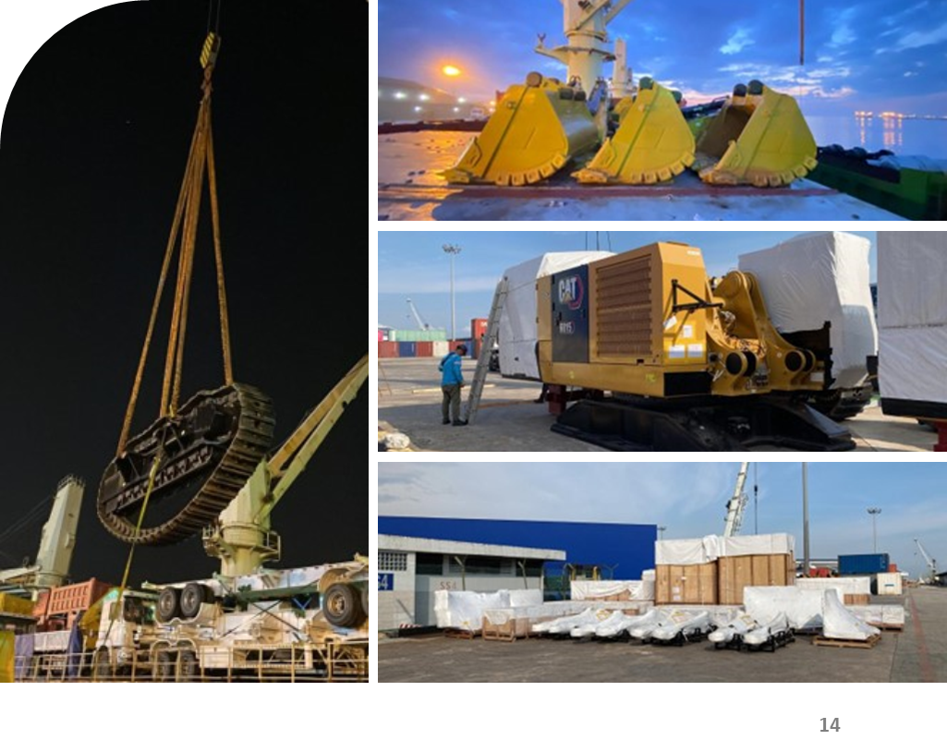
PROJECT REFERENCES
PROJECT REFERENCES
CASE STUDY – HEAVY EQUIPMENT – 4 X 6015B ACC
Volume: Heavy equipment – 4 x 6015B ACC
236.43 m3 (135,165 kg)
Origin: Indonesia
Destination: Durban (South Africa) & Luanda (Angola)
Chartering of Breakbulk from Batam to Durban & Luanda via Singapore Port
Transport cargo from CIB to Batu Ampar Port & from CIB to SCN Port Kabil
Port Supervision in Batam for loading
Arrangement and procurement of lifting gears
Transferred onto Barge to Singapore Port
Scope:
22

Slide 23
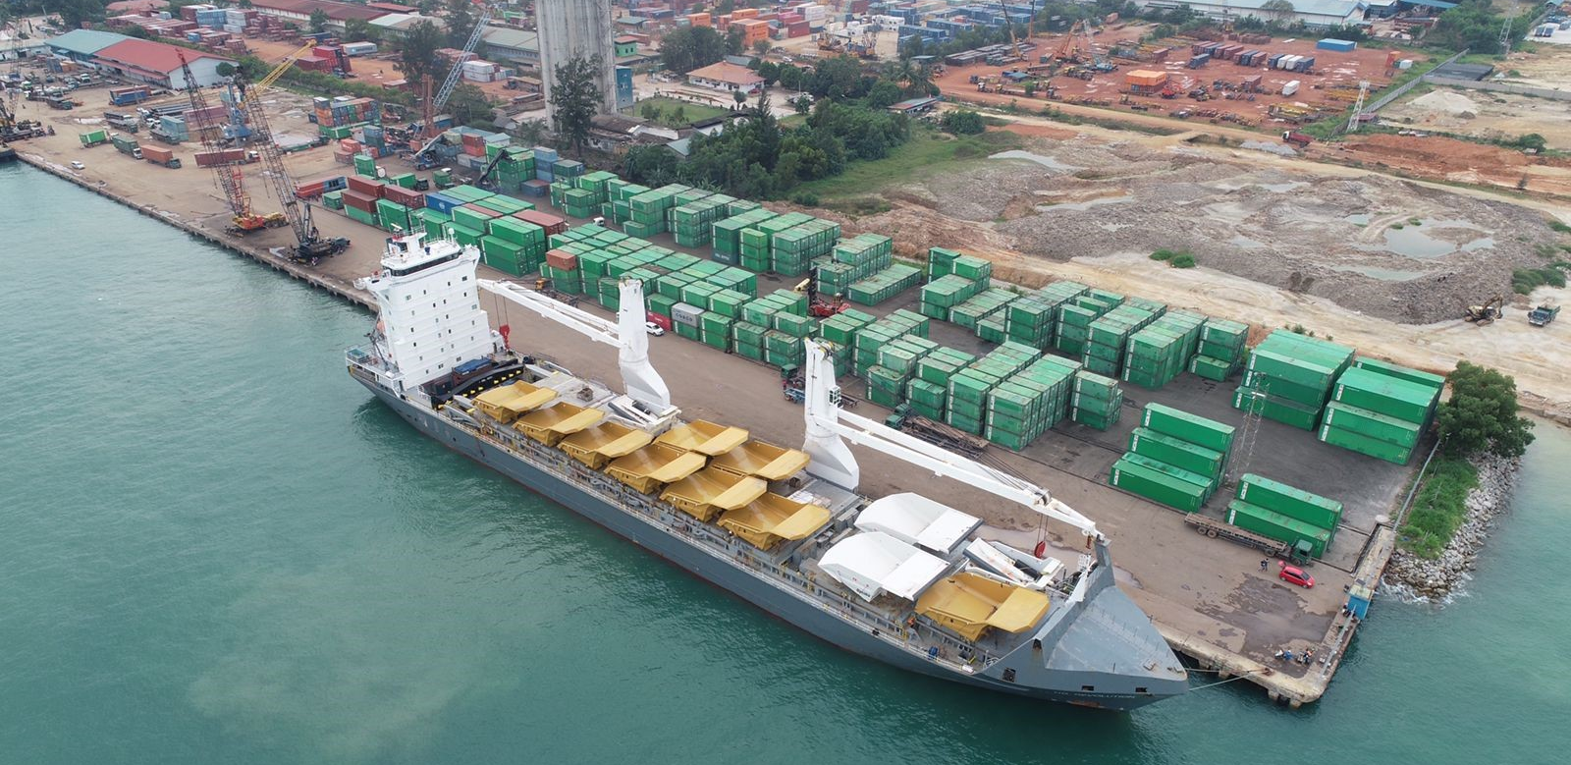
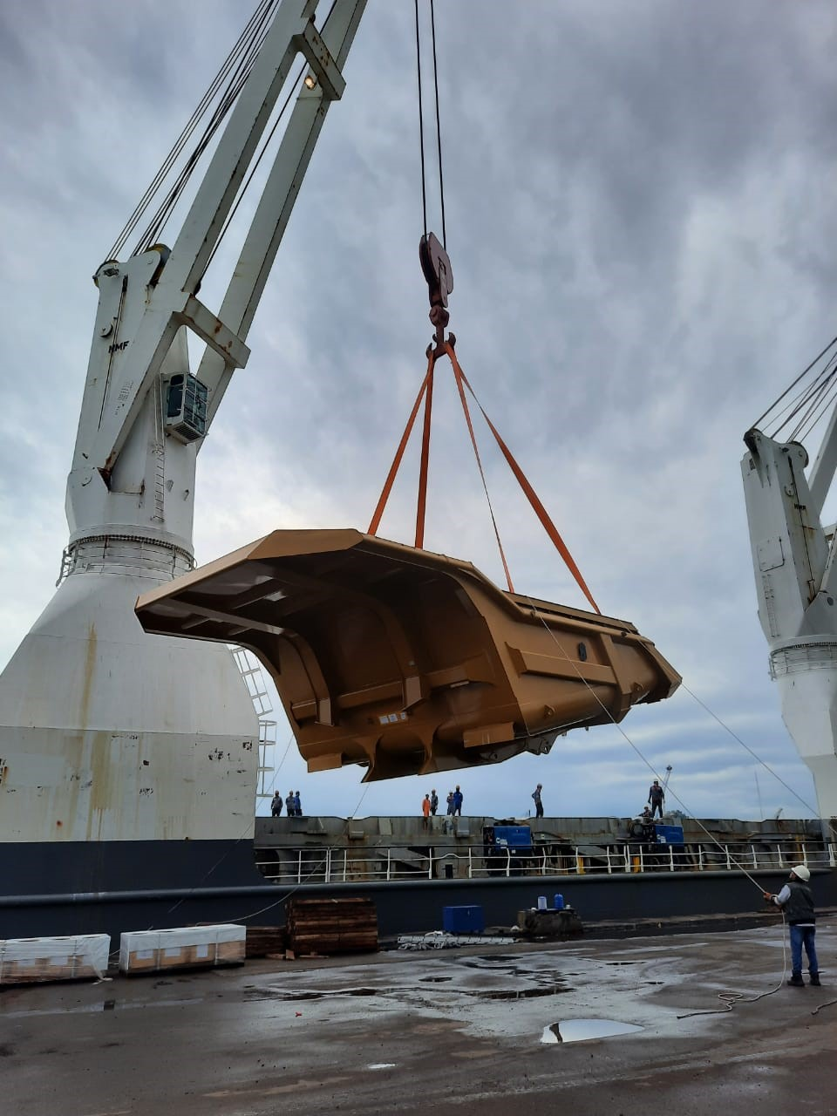
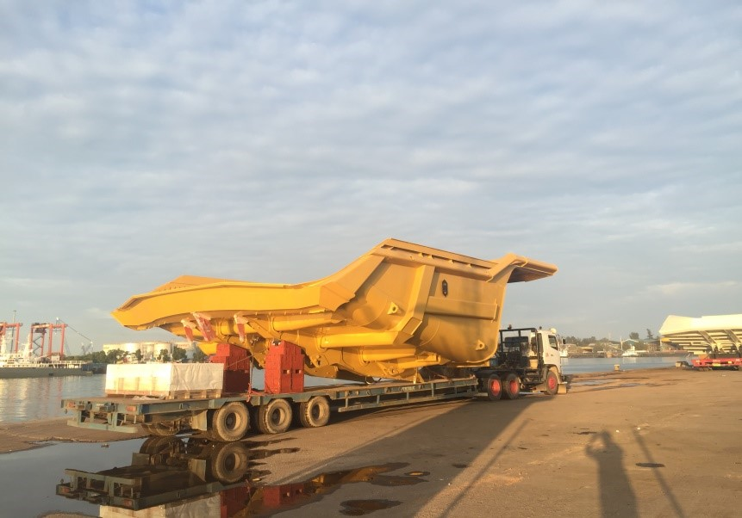
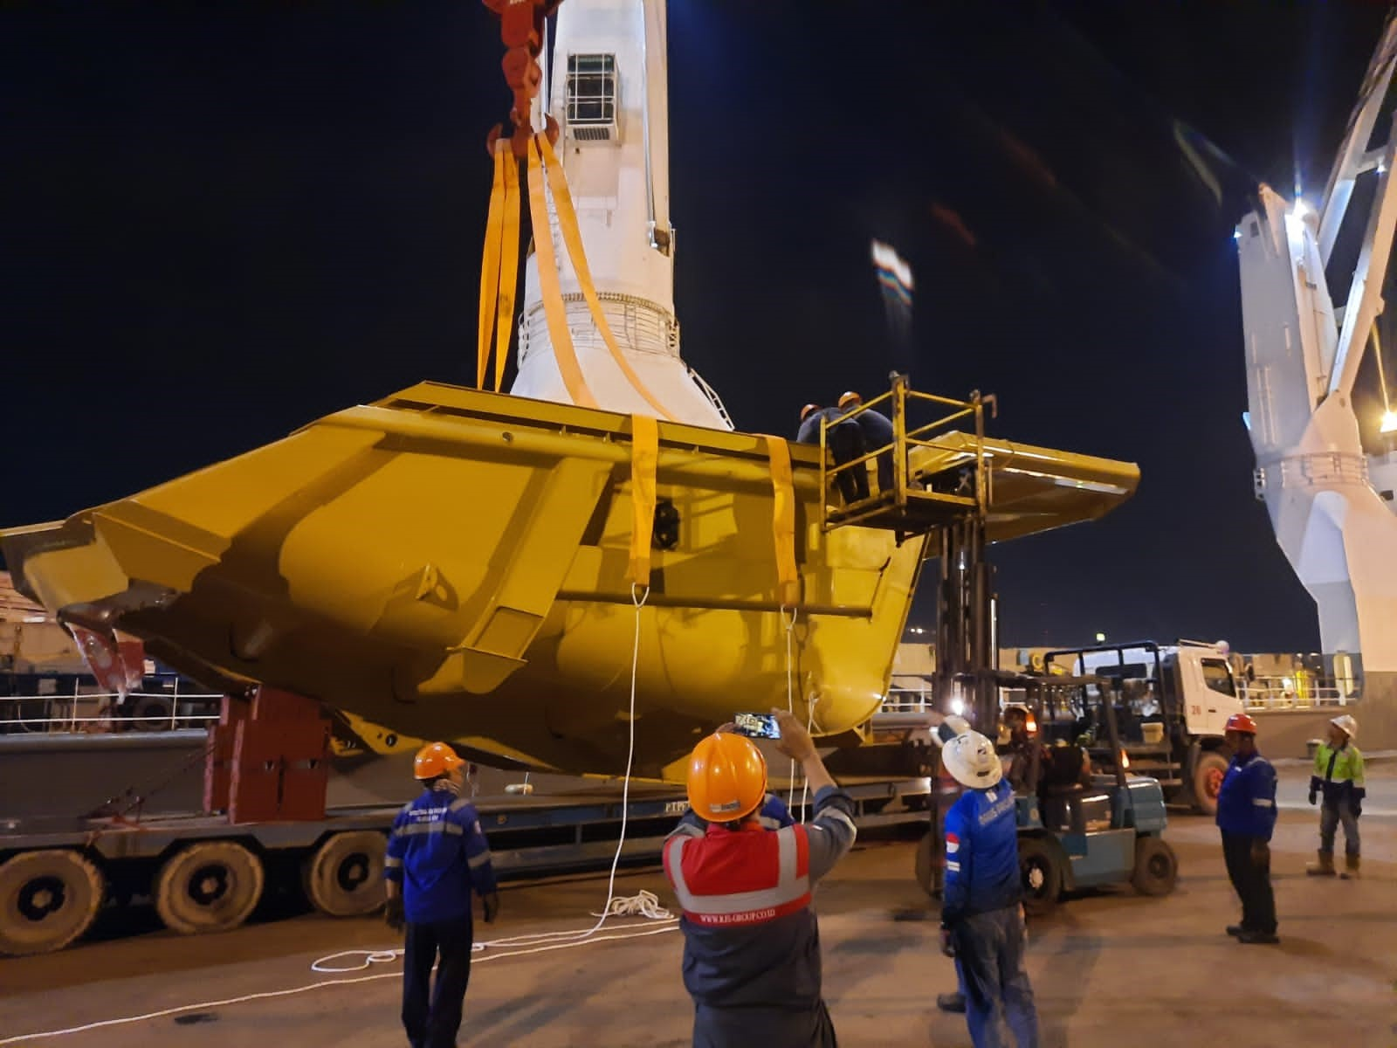
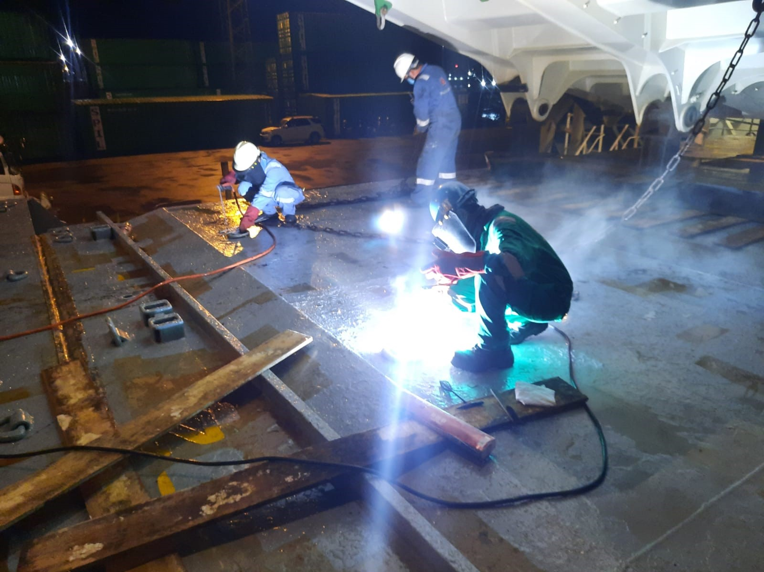
PROJECT REFERENCES
PROJECT REFERENCES
CASE STUDY – HEAVY EQUIPMENT – 9X CAT793 TRAYS (Austin)
Commodity: 9x cat793 trays
Volume: 9 x size: 13.2 x 8.24 x 4.75 m each
Origin: Cebu (Philippines)
Port of Discharge: Mackay & Newcastle (Australia)
Chartering of Breakbulk from Batam to Australia
Port Supervision in Batam for loading
Arrangement and procurement of lifting gears
Scope:
23

Slide 24
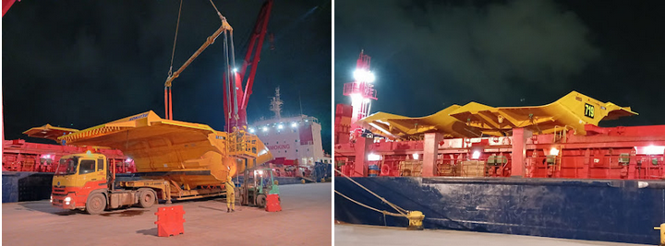
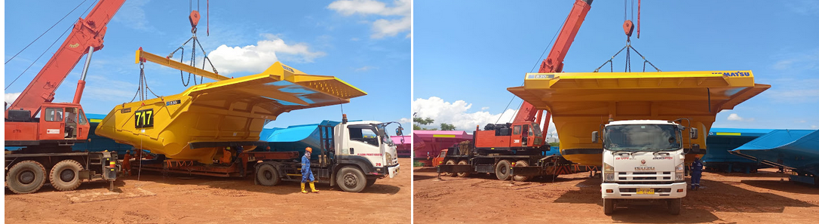
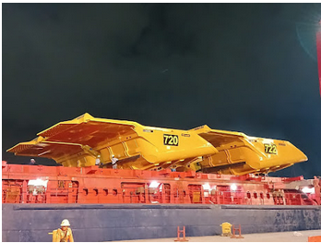
PROJECT REFERENCES
CASE STUDY – 7 UNITS OF DUMP TRAYS
Project Name:
Cargo:
Shipper:
Destination:
Consignee:
Scope:
7 units of Dump Trays
7 units capcoal kom 830-hpy c/w body additions total: 242,431.00 kgs / 3,963.249 cbm
Kabil, Batam, Indonesia
Mackay, Australia
Mrl asset management pty ltd
Chartering of Breakbulk from Batam to Australia
Port Supervision in Batam for loading
Arrangement and procurement of lifting gears

Slide 25
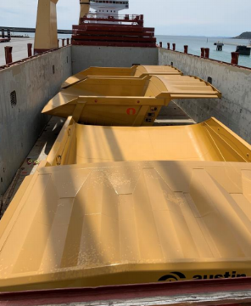
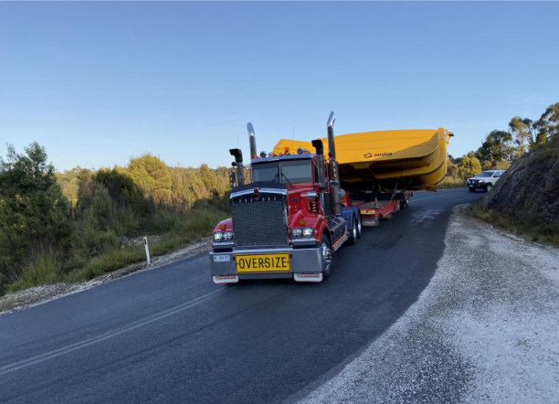
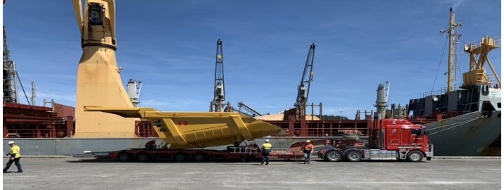
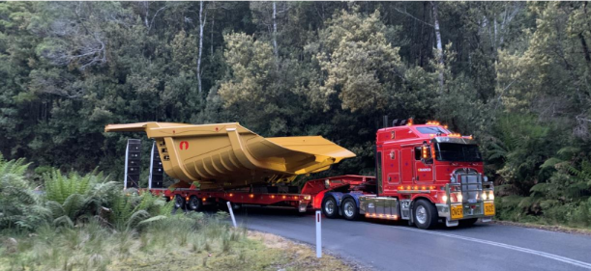
PROJECT REFERENCES
PROJECT REFERENCES
CASE STUDY – SAVAGE RIVER PROJECT
Volume: 5 x CAT 789 Dump Trays
Destination: Mackay, Australia
Chartering of Breakbulk from Batam to Australia
Port Supervision in Batam for loading
Arrangement and procurement of lifting gears
Port Handing in Australia and Delivery to Site
Scope:
25

Slide 26
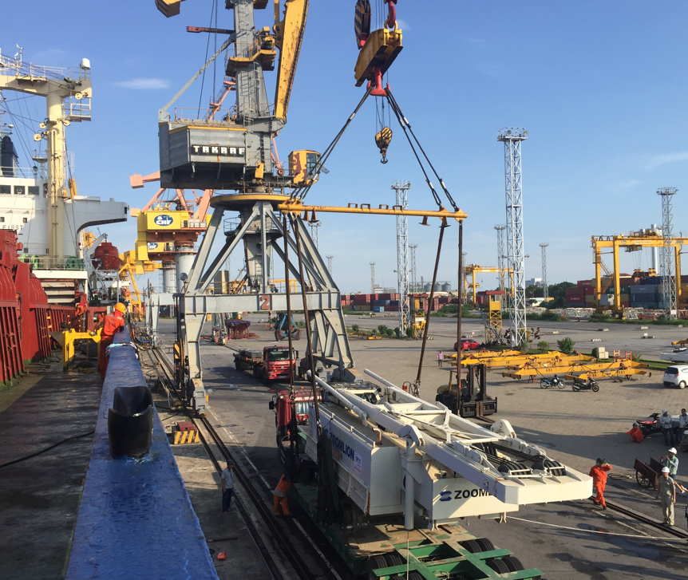
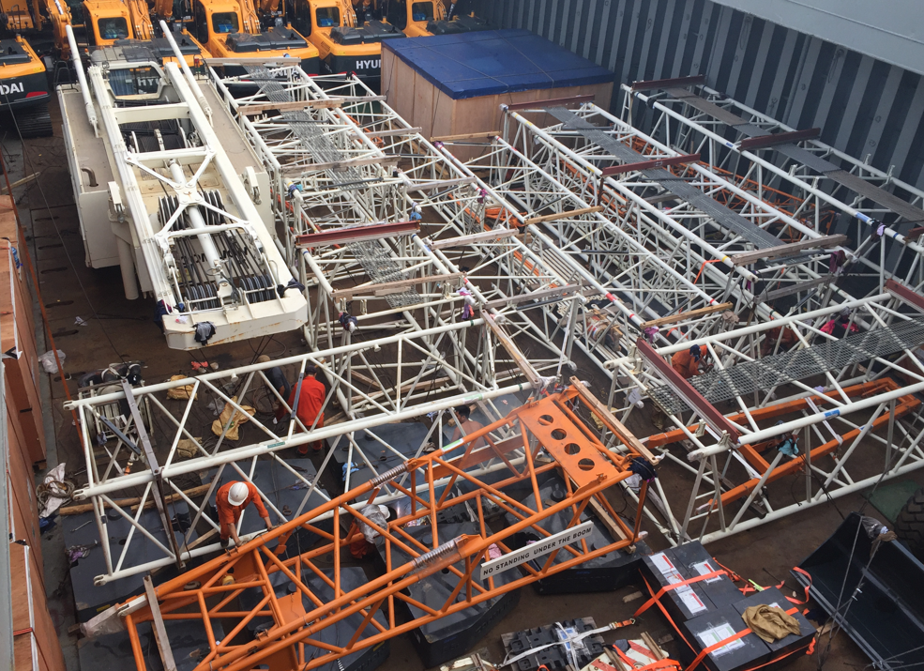
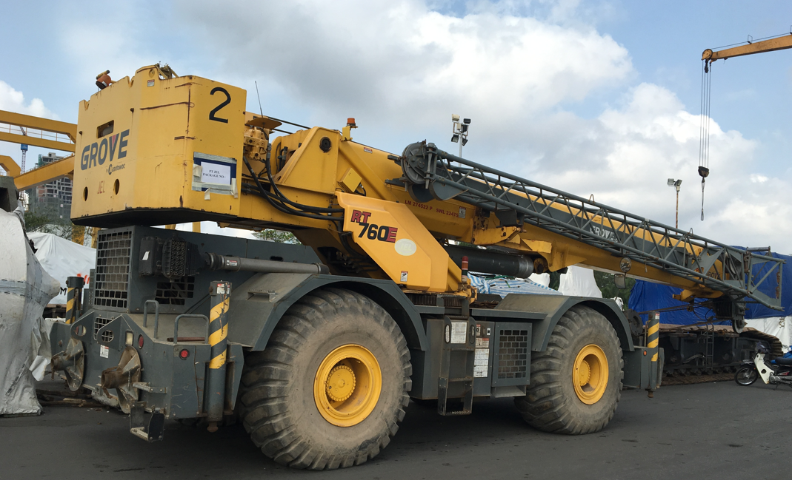
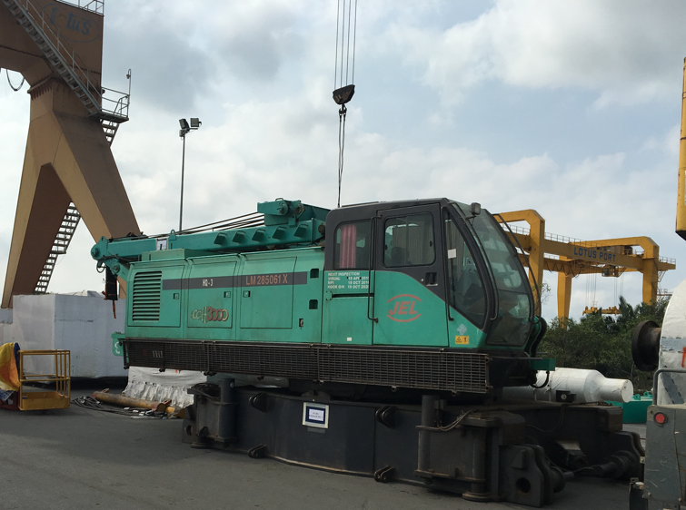
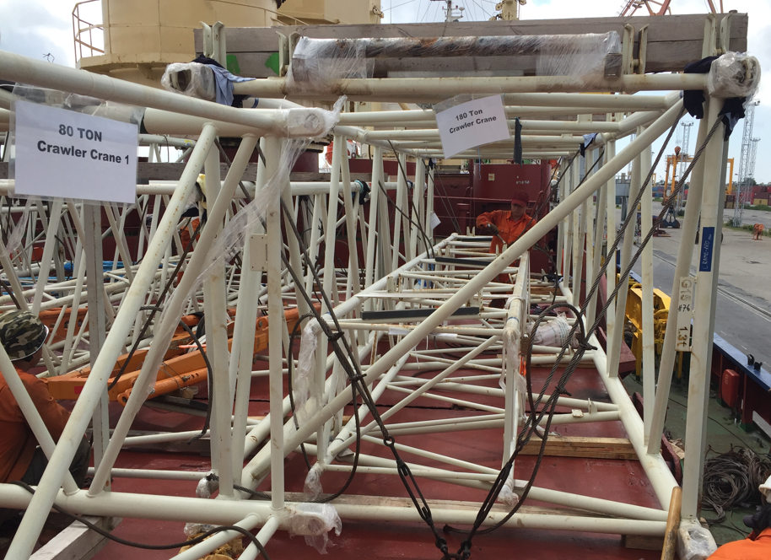
PROJECT REFERENCES
PROJECT REFERENCES
CASE STUDY – used cranes
Volume: 1 crane 260T, 3x cranes 180t, 1 crane 300T
Origin: Hai Phong, Vietnam
Port of Discharge: Semarang, Indonesia
Full liner terms Ocean freight
Chartering Heavy lift vessel
Loading onto vessel incl appropriate cargo stow arrangements. Cargo hold preparation for loading, layout dunnage by FLS own stevedores
Loading supervision by FLS Port Captain
Scope:
26

Slide 27
office.vn@fls-group.com
+84 828 73 002 864
27

