Slide 1
FLS VIETNAM PRESENTATION
2025
10th September
1

Slide 2
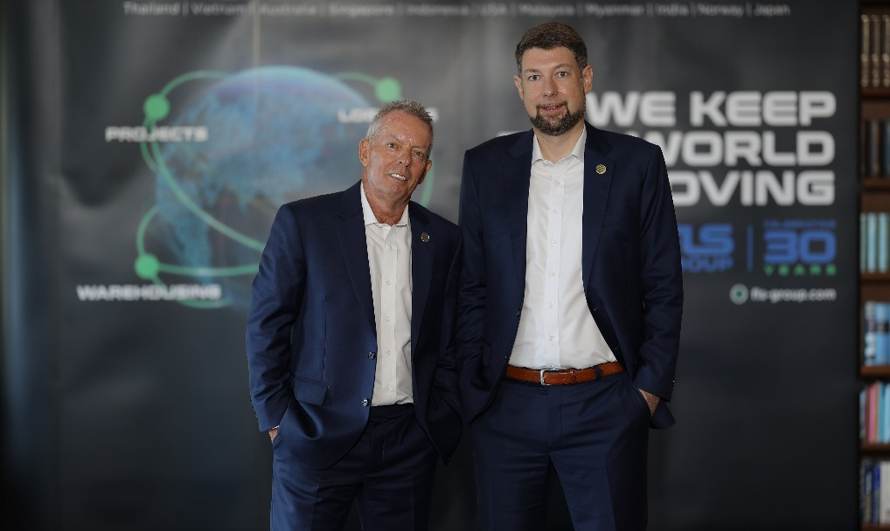
INTRODUCTION
1998 to 2024
By the year 1998, FLS ventured more and more into handling export projects from steel fabricators in Thailand, Korea, China, Vietnam, Malaysia and Indonesia to worldwide destinations for many global engineering companies and EPC contractors.
In order to support our customers with even better service and faster communication, we moved our office to Laem Chabang in June 2006. This strategic move – we are now located within maximum 50 km from Thailand’s most important project port facilities – proved to be very successful because it allows us to be even more “hands-on”.
Today our team consists of a number of expat and local project specialists, led by our CEO Torbjoern Larisch.
Regional Expansion
  2011 - FLS (Vietnam) Ltd.
  2013 - FLS (Australia) Pty Ltd.
  2014 - FLS (Singapore) Pte Ltd.
  2014 - PT. Federal Logistik Sistem (Indonesia)
  2016 - FLS USA
  2018 - FLS Malaysia
  2020 - FLS Myanmar
  2022 - FLS India
  2023 - FLS China and FLS Japan
  2024 - FLS Scandinavia, FLS Norfolk, USA, FLS Philippines and FLS Italy
  In the short to medium term further expansion is planned for Southeast Asia and the Middle East.
FLS History
Early Years
The company was founded in Bangkok in May 1993 by our current Chairman Martin Haeberli.
With his successful background in the project business, including many years of experience in the US, the Middle East and in Thailand FLS immediately started making an impact in Thailand’s project forwarding market.
Soon, FLS started winning various medium sized import projects in the industrial, power and mining sectors.
2

Slide 3






INTRODUCTION
“24 hours a day, 7 days a week, 365 days each year: we constantly handle many different and challenging projects.”
“Our tailor-made logistic solutions provides our customers with a unique level of service and know-how.”
Services:
“Turn-Key”, door to door project forwarding services
Heavy lift and oversized cargo handling
Full and part charter vessel chartering
Project related airfreight charters and container shipments
Project supervision and coordination
Cargo loading / discharging supervision
Port, road and equipment surveys
Feasibility studies
Transport insurance coverage
Warehousing, storage and export packing
Customs clearance services
Member of:
Get to know us
ISO certified own operations in
  Thailand • Vietnam
  Australia • Myanmar
  Singapore • Indonesia
  USA • Malaysia
  India • China
  Japan • Denmark
  Philippines • Italy
HSE and Compliance campaign for all offices.
A global network of carefully selected partners and agents.
3

Slide 4
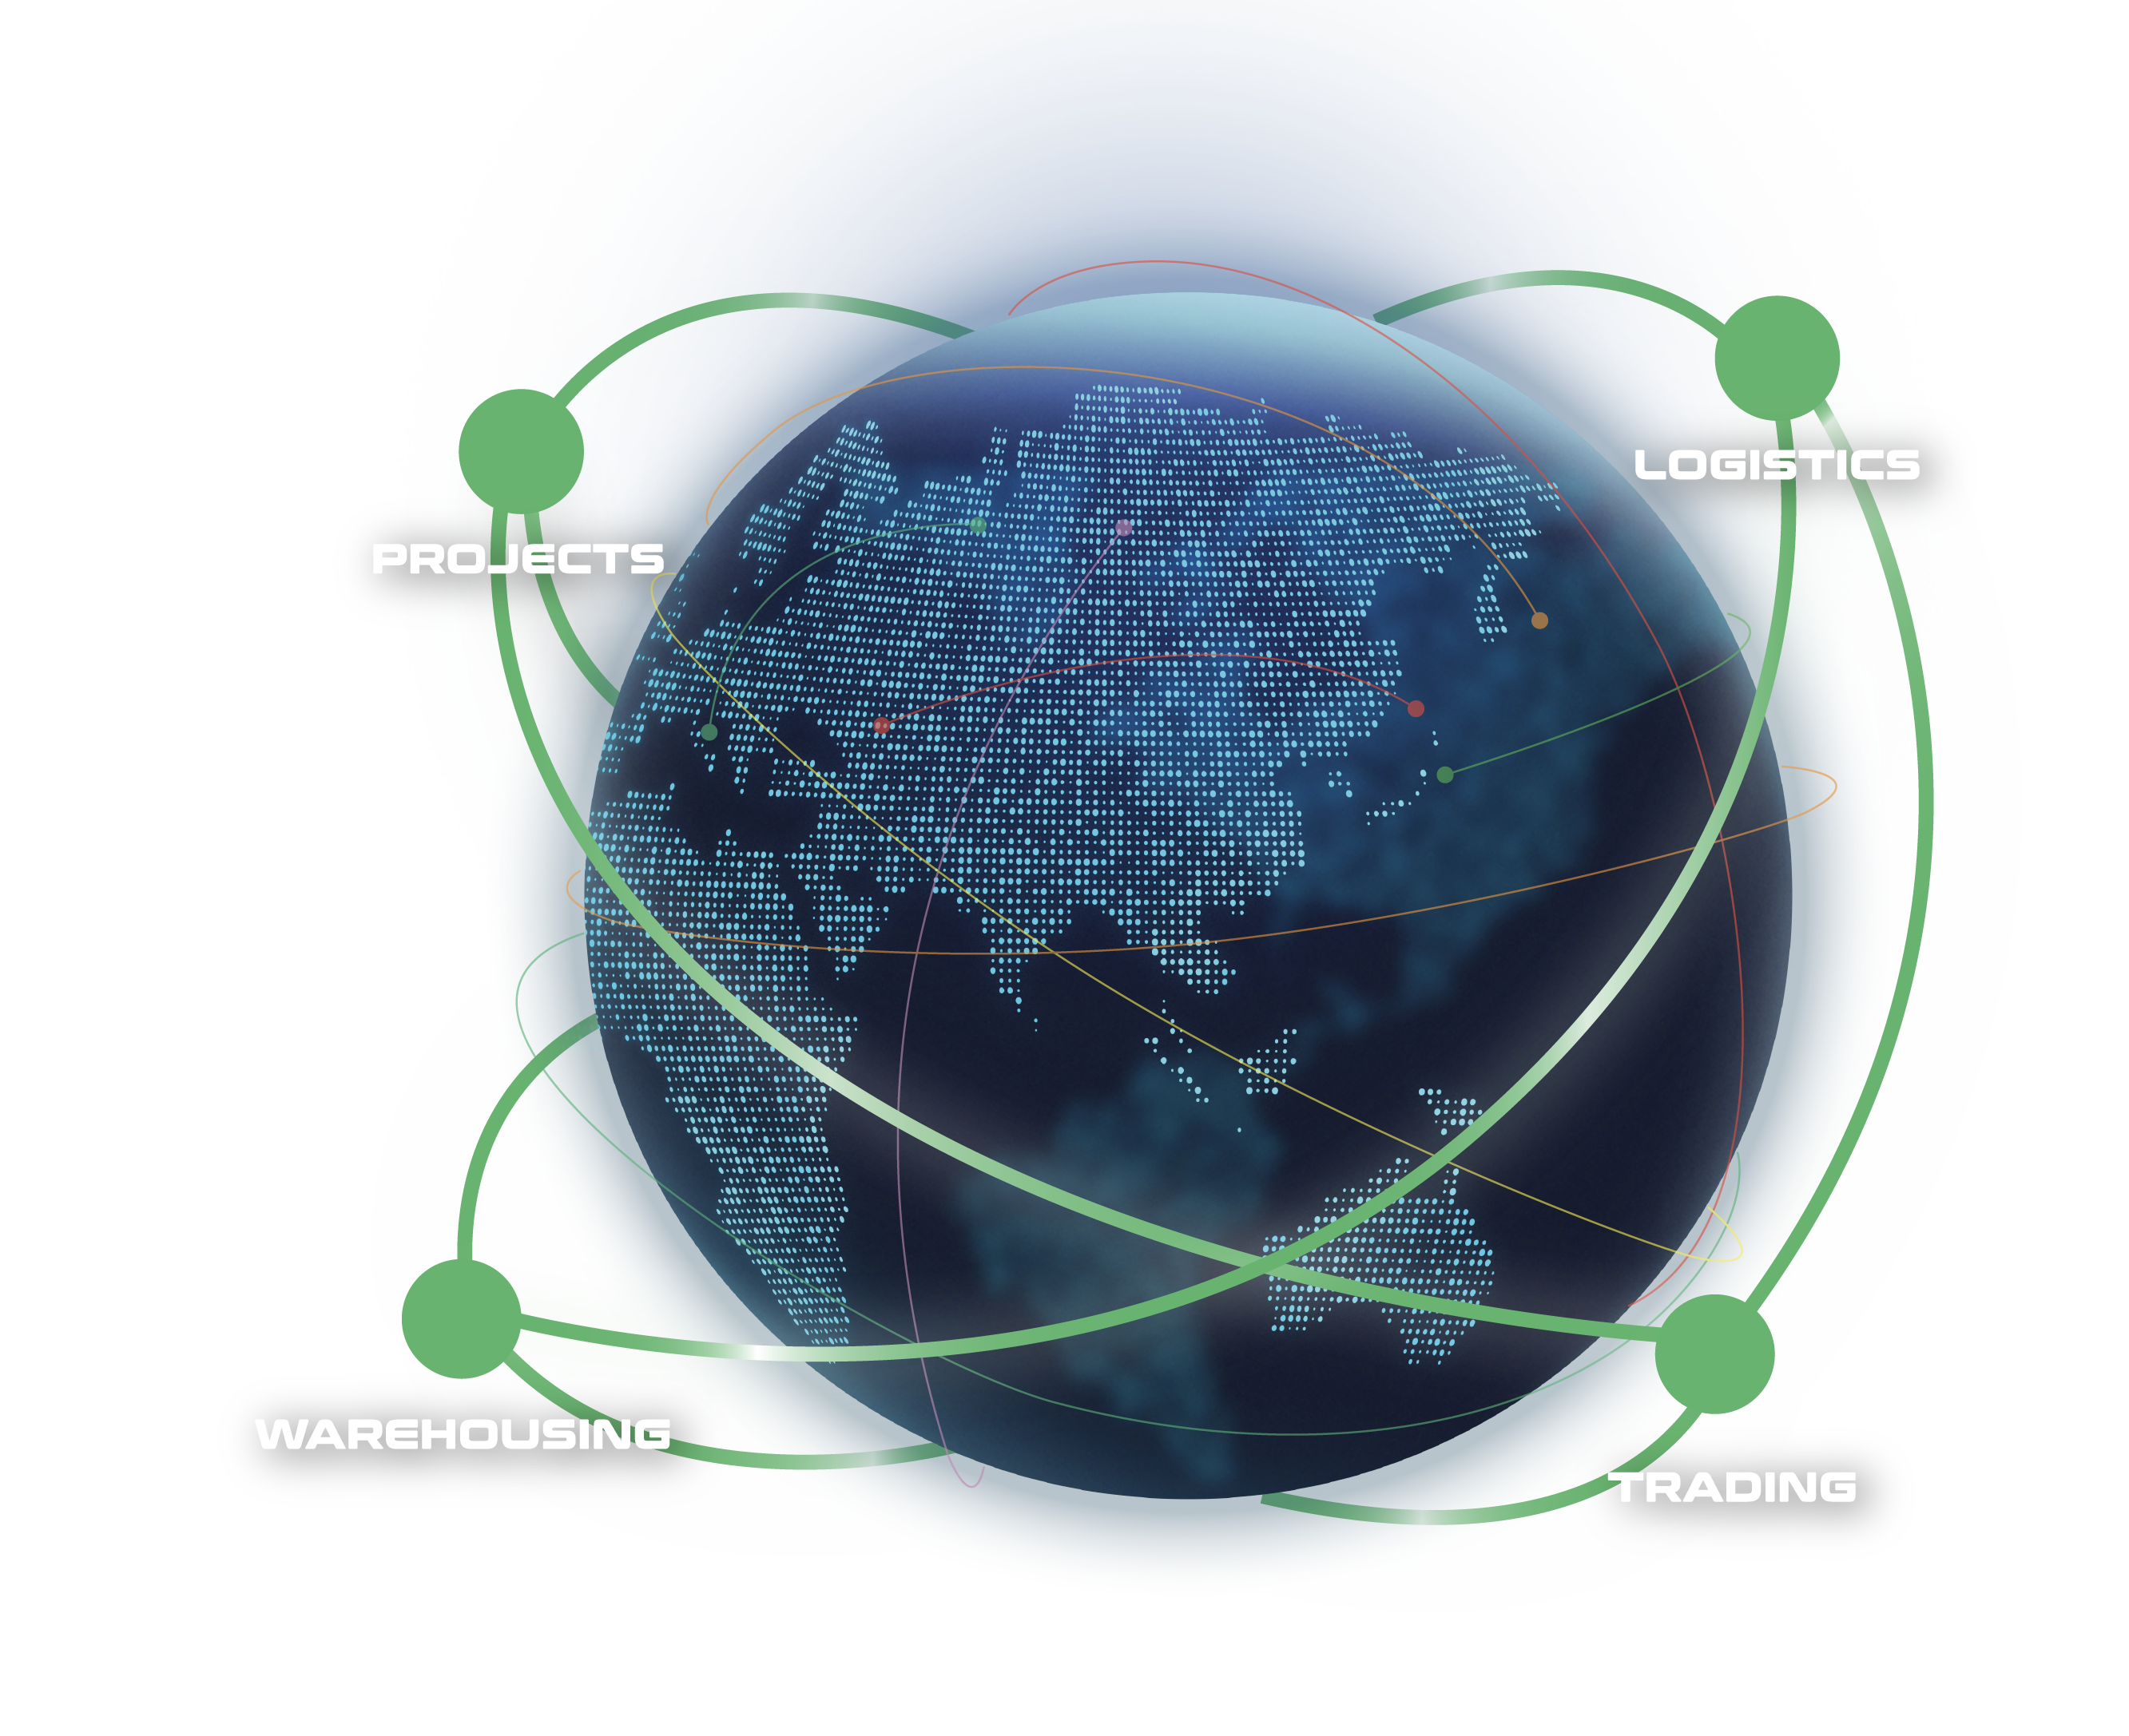
WHAT ARE OUR CAPABILITIES
Our interconnected supply chain solutions are tailor-made to keep your world in business.
OUR VISION:
To be recognized globally as the logistics experts who understand and empower global business leaders to dream and act big; moving the world forward.
PROJECTS: With expert hands, we handle the complicated with precision.
LOGISTICS: We humanize a seemingly standardized experience.
WAREHOUSING: We envision spaces that bring supply chains to the next level.
TRADING: We define and shape solutions to meet ever-changing needs.
4

Slide 5
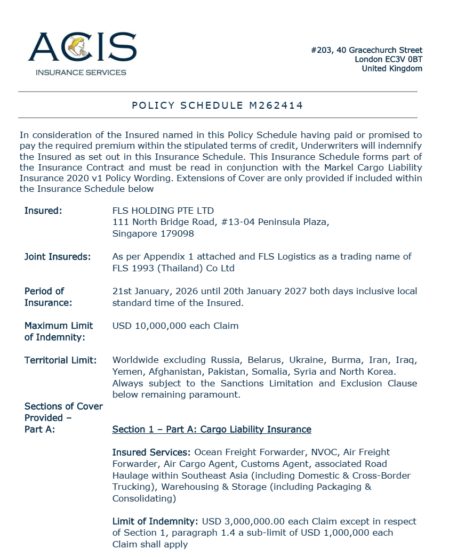
INSURANCE POLICY
Base coverage:
Cargo liability
USD 3,000,000 each claim
3rd party legal liability
USD 3,000,000 each claim
Professional indemnity
USD 400,000 each claim
Fines and duties liability
USD 100,000 each claim
Please note: Limits are flexible & negotiable, and liabilities can be extended on request and a case-by-case basis. Marine cargo insurance can be provided. on request.
5

Slide 6
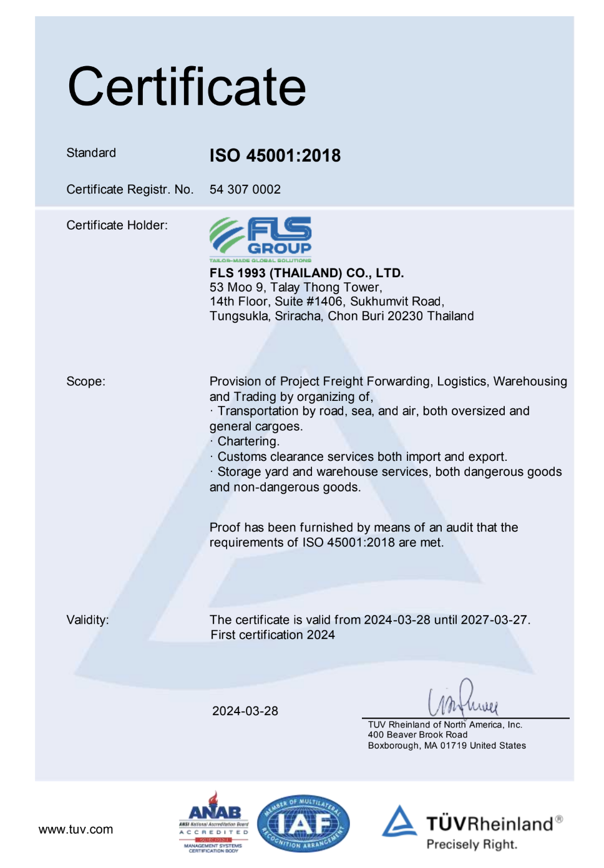
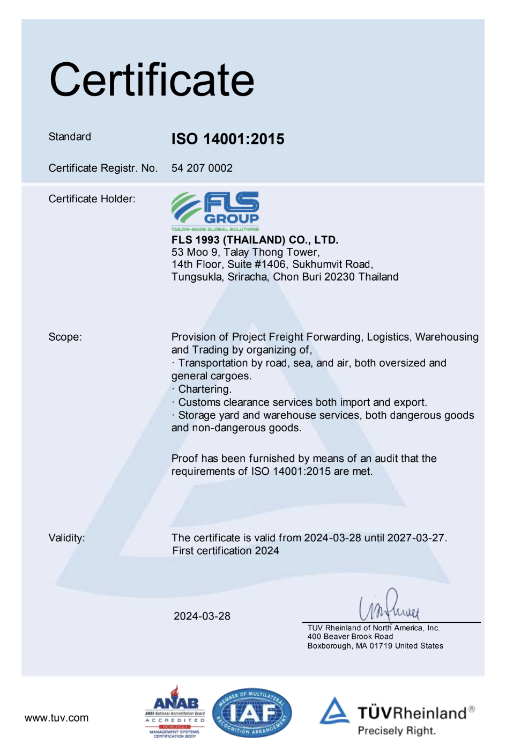
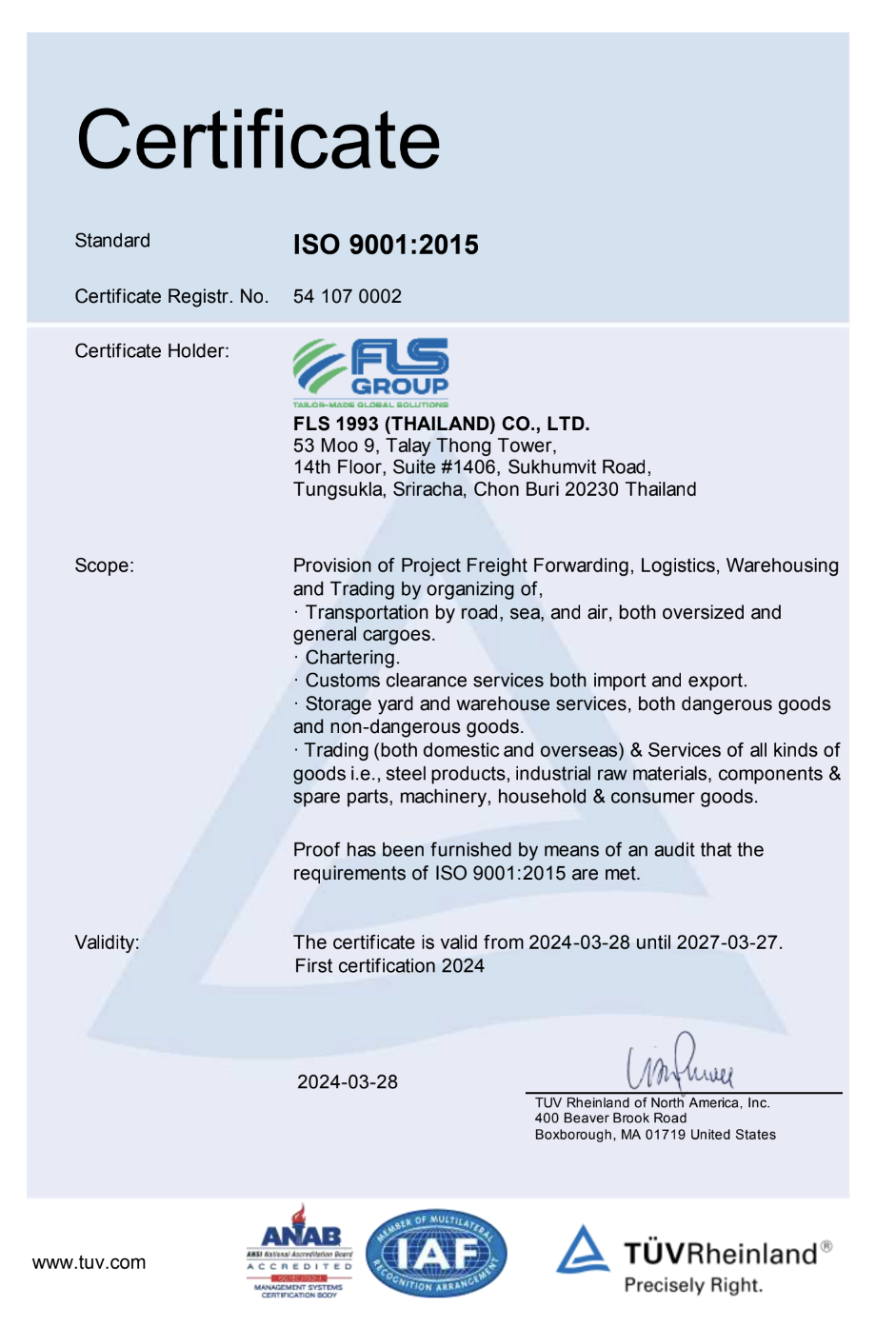
SAFETY, QUALITY
& INTERNATIONAL COMPLIANCE
ISO 45001:2018 CERTIFICATE
ISO 4001:2015 CERTIFICATE
ISO 9001:2015 CERTIFICATE
ISO-certified own operations in Thailand, Australia, Singapore, USA, Vietnam, Taiwan, Indonesia, Malaysia, India and Myanmar.
6

Slide 7
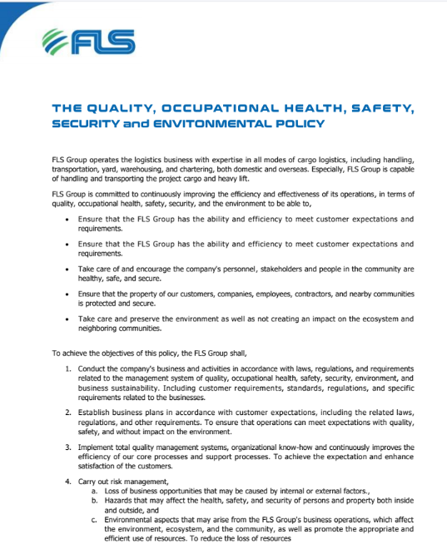
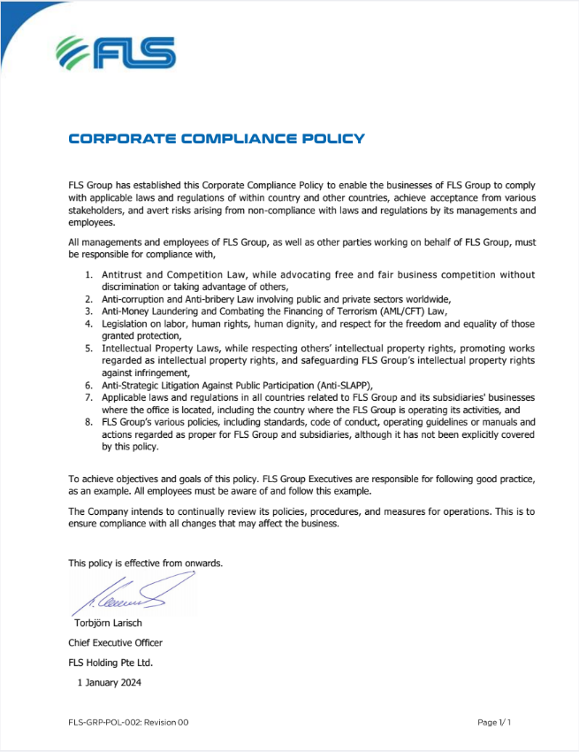
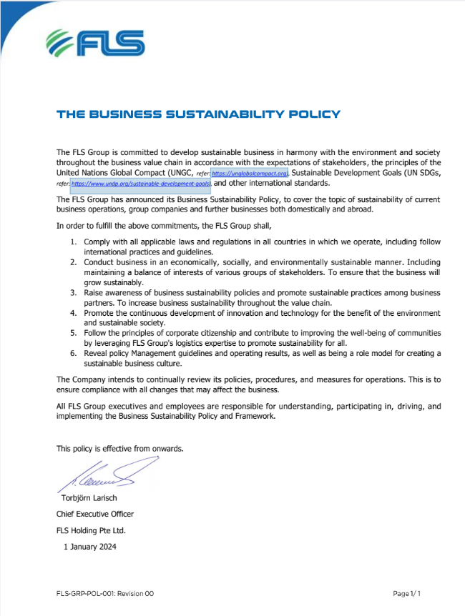
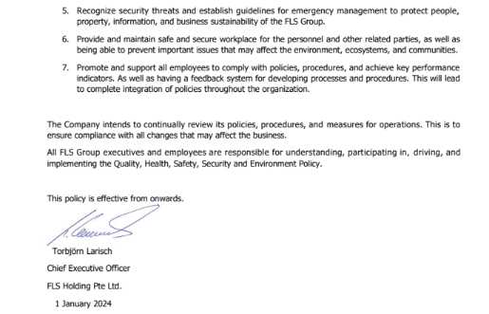
SAFETY, QUALITY
& INTERNATIONAL COMPLIANCE
QOHSE POLICY
CORPORATE COMPLIANCE POLICY
BUSINESS SUSTAINABILITY POLICY
7

Slide 8


SAFETY, QUALITY
& INTERNATIONAL COMPLIANCE
QUALITY ASSURANCE
HEALTH & SAFETY
OUR STANDARDS
FLS Quality Management Systems meet all our customer’s applicable statutory and regulatory requirements.
We use one of the world’s leading modular enterprise systems to streamline operations, accounting and business development.
Provide Health & Safety training for all members of staff as well as blue-collar and sub-contracting parties.
Follow international rules and guidelines to foster a safe and healthy working environment for our teams.
Ensure that each project and every shipment is handled in a safe, timely, systematic, and efficient manner.
We select and work only with agents and partners who:
are fully certified to international standards
fulfill our own strict quality standards
have sufficient insurance coverage
operate with well-maintained and regularly tested equipment
are well managed and staff regularly trained
have a long successful history and proven track record.
8

Slide 9

OCCUPATIONAL HEALTH, SAFETY
AND ENVIRONMENTAL POLICY
FLS requires the active commitment to, and accountability for, occupational health, safety and environment from all employees and contractors.
Comply with all relevant legislations and corporate requirements of OHSE;
Meet specified customer requirements and ensure continuous customer satisfaction;
Protect, and strive for improvement of, the health, safety and security of our people at all time;
Eliminate accidents and minimize potential risks;
Set OHSE performance objectives, measure results, assess and continuously improve processes and services, through the use of an effective management system;
Plan for, respond to and recover from any emergency, crisis and business disruption;
Minimize our impact on the environment through pollution prevention, reduction of natural resource consumption and emissions, and the reduction and recycling of waste;
Apply our technical skills to all OHSE aspects in the design and engineering of our services;
Communicate openly with stakeholders and ensure an understanding of our OHSE policies, standards, programs and performance. Reward outstanding OHSE performance;
Improve our performance on issues relevant to our stakeholders that are global concern and on which we can have an impact and share with them our knowledge of successful OHSE programs and initiatives.
9

Slide 10
WHY FLS?
EXPERIENCED
COMPETITIVE
More than 30 years of experience
Global access to carriers, local contract negotiations
FLEXIBLE
INNOVATIVE
Matching right partners for each project
We can solve problems with creative solutions and will adjust our operation to your requirements
PRO-ACTIVENESS
DYNAMIC
Eyes and ears always on the market and therefore can react to possible constraints early
Growth through opportunity, where others see a problem, we see an opportunity
Fast decision-making process
CONTINUITY
High employee retention rate: average is 8.32 years. Some key staff have been with FLS for more than 15 years
10

Slide 11


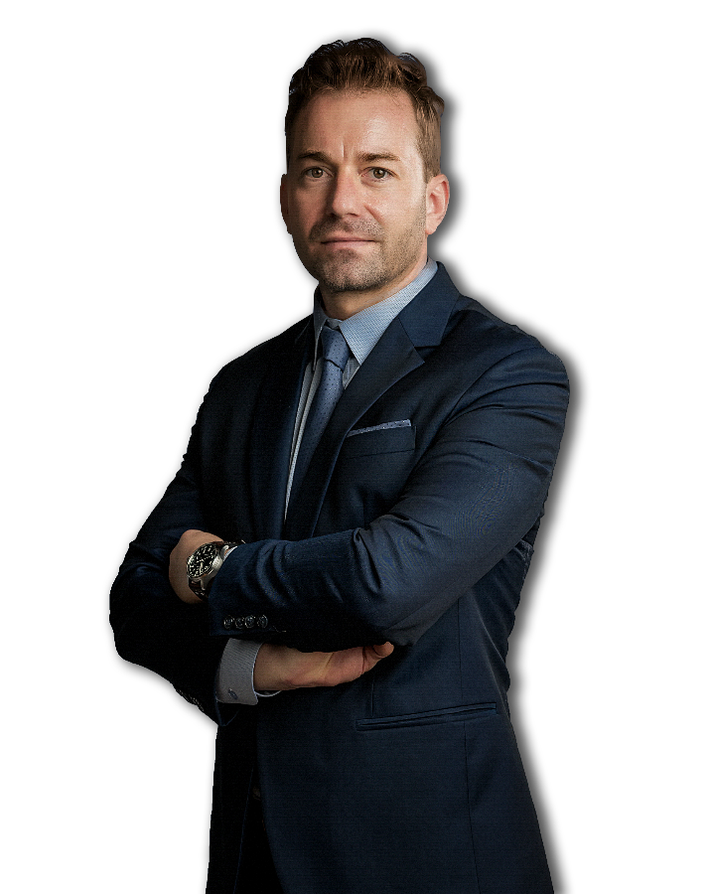
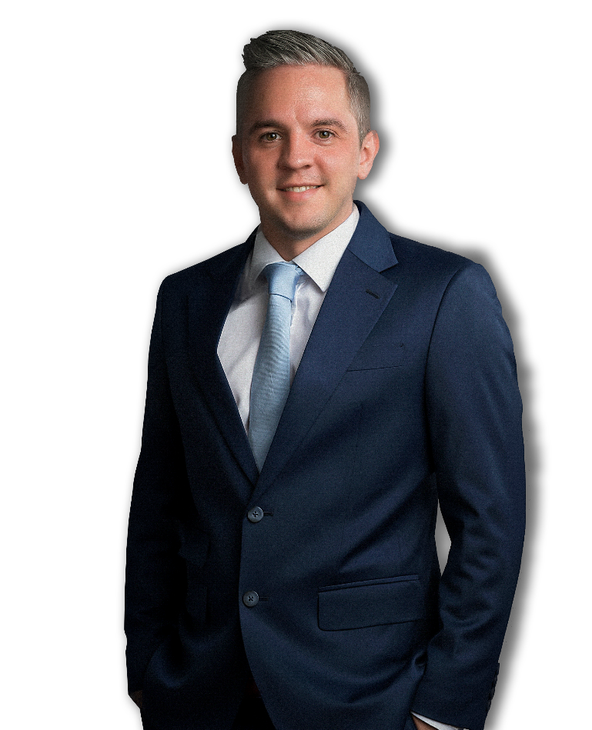
INTRODUCTION OF FLS VIETNAM
Christopher Schnieders
Global Director Projects (VN)
Sven Hoehle
Head of Global Project Solution (VN)
Chris is a project logistics specialist with more than 20 years’ experience in leading logistics teams for large-scale industrial projects. Most notable experience was as project logistics lead on Fluor’s USD 6 Billion Ivanhoe Mines Oyu Tolgoi Copper Mine Construction Project in Mongolia, one of the largest copper/gold mines in the world. This involved the complete charter management of shipments amounting to 300,000 frtons from all over the world to Beijing, including 1,600 km trucking into Inner Mongolia. He arrived in Saigon in 2006 and since then has built an extensive Network through which the company can provide outstanding services to its clients in Vietnam. Chris has the global responsibility for project logistics within the FLS Group.
Sven started his career in project freight forwarding and logistics back in 2009. Prior to joining the FLS Team he spent 6 years working in Germany gaining valuable knowledge and experience in Ocean Freight, Freight Forwarding and Project Handling. He speaks English and German fluently.
+84 986 580 829
christopher.schnieders@fls-group.com
+84 909 277 688
sven.hoehle@fls-group.com

Slide 12
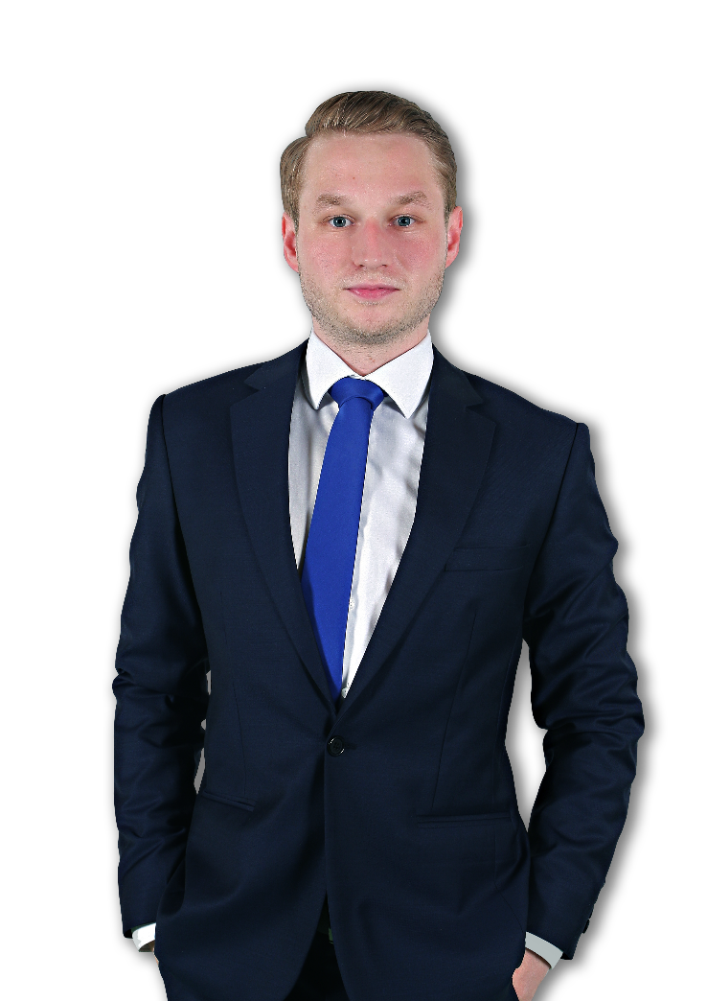
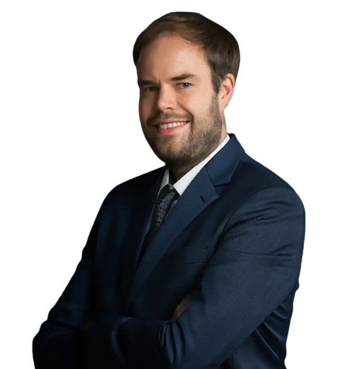
INTRODUCTION OF FLS VIETNAM
Florian Passut
Country Manager (VN)
Johannes Linnenbruegger
Projects Operations Supervisor (VN)
Florian 'Flo' Passut has recently joined the FLS Vietnam family as Country Manager. Flo brings nine years of logistics experience across Germany, Australia, Papua New Guinea and now Vietnam.
As a project freight forwarding and logistics professional, Johannes, or "Hansi," brings a wealth of experience to FLS Projects Vietnam. Prior to joining FLS, Hansi gained valuable insights in Germany and contributed to diverse project sites worldwide. Apart from that, he is working on supporting IT solutions, making him a versatile asset to any project team. He speaks English and German fluently.
+84 931 411 558
florian.passut@fls-group.com
+84 981 400 770
johannes.linnen@fls-group.com

Slide 13
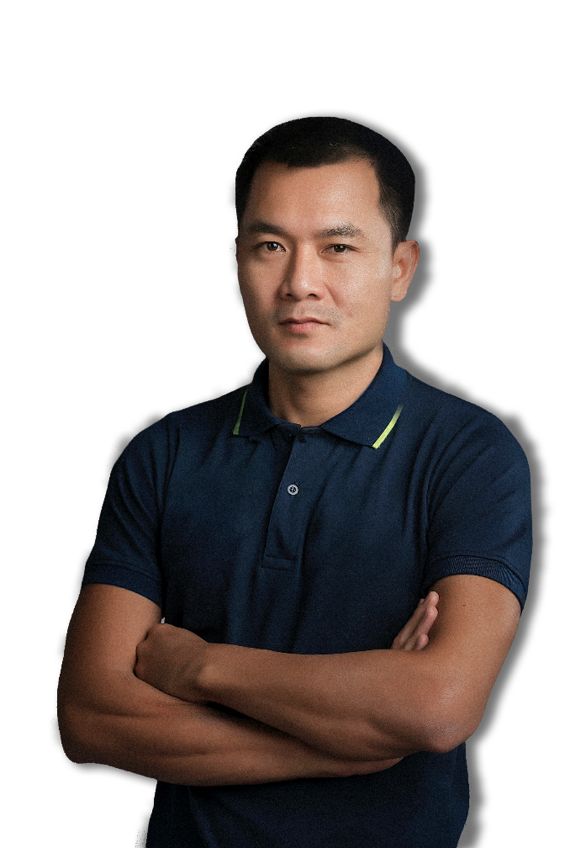

INTRODUCTION OF FLS VIETNAM
Le Quoc Trung
Port Captain / HSE Mgr (VN)
Nguyen Manh Hung
Project Engineer (VN)
Trung has been in the shipping industry since 2006. Starting as a deck cadet he worked his way up the ladder to become a captain in 2013. As a seaman traveling the world on all sorts of vessels such as chemical tankers and general cargo ships he gained priceless knowledge. Being the man on the ground supervising all our port operations Trung will take outmost care of your valuable cargo. Self-explanatory the motto is always “safety first”. Trung is a Certified Marine Warranty Surveyor and has a perfect referenceas a HSE and Quality Manager.
Hung has a vast experience in the Shipbuilding and Oil&Gas Industry. For 11 years he has been the Senior Commercial Executive of an international shipyard. Prior to that he worked as a Deputy Technical Manager in the Engineering Department of a Vietnam based Offshore Company. He was part of the QC and Production department and carried out project required documents, prepared tenders and commercial proposals and also overviewed the execution of the jobs. Hung speaks Vietnamese and English fluently.
+84 68 801 0168
trung.le@fls-group.com
+84 918 260 540
hung.nguyen@fls-group.com

Slide 14
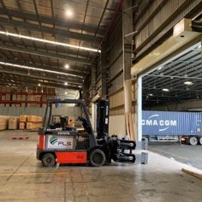
WAREHOUSE SERVICES
WAREHOUSES
Address 1: Can Giuoc district, Long An province
The size of the storage area: 10,000 m2
Address 2: Song Than 1 Industrial Zone, Di An district, Binh Duong province
The size of the storage area: 25,000 m2

Slide 15
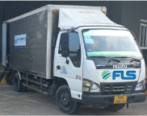
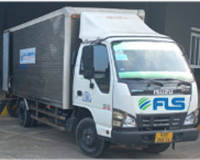
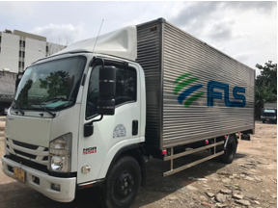
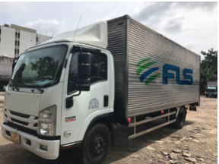
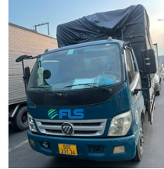
TRANSPORTATION SERVICES
FLEET
1 Ton Truck | 2 Tons Truck | 3 Tons Truck | 5 Tons Truck | 7 Tons Canvas Truck
Max. Weight: 1 ton Capacity: < 6 cbm Dimensions: 3 x 1.6 x 1.7 m | Max. Weight: 2 tons Capacity: <12 cbm Dimensions: 4.3 x 1.7 x 1.8 m | Max. Weight: 3 tons Capacity: <17 cbm Dimensions: 4.3 x 1.9 x 2.2 m | Max. Weight: 22 tons Capacity: <22 cbm Dimensions: 6.2 x 2.1 x 2.0 m | Max. Weight: 7 tons Capacity: <26 cbm Dimensions: 6.1 x 2.1 x 2.0 m
Truck Ban in City such as: HCM, HAN, HPH,… 6:00 -> 9:00 and 16:00 -> 20:00 |  | Truck Ban in City such as: HCM, HAN, HPH,… 6:00 -> 22:00

Slide 16
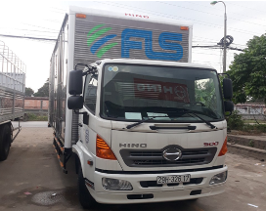
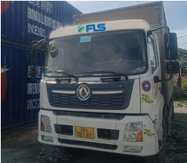
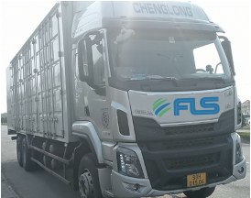
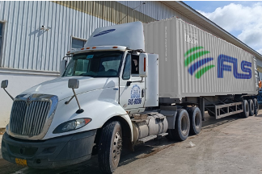
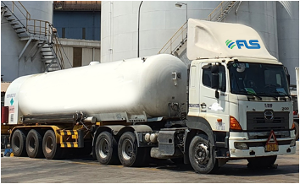
TRANSPORTATION SERVICES
FLEET
8 Ton Truck | 10 Tons Truck | 15 Tons Truck | Header Truck | Header Truck for Gas Tank
Max. Weight: 8 tons Capacity: <46 cbm Dimensions: 8 x 2.3 x 2.5 m | Max. Weight: 10 tons Capacity: <55 cbm Dimensions: 9.7 x 2.3 x 2.5 m | Max. Weight: 15 tons Capacity: <55 cbm Dimensions: 9.5 x 2.3 x 2.5 m | Max. Weight: 26 tons Capacity: 17-22 cbm Dimensions: 6 x 2.4 x 2.4 m 12 x 2.4 x 2.4 m | Max. Weight: 25 tons Capacity: 52 cbm
Truck Ban in City such as: HCM, HAN, HPH,… 6:00 -> 22:00 |  | Truck Ban in City such as: HCM, HAN, HPH,… 6H -> 22H

Slide 17
KEY INDUSTRIES AND KEY CUSTOMERS
AUTOMOTIVE
PETROCHEMICAL
We’re proud to contribute to Thailand's successful automotive industry
Our customers and projects: Triumph (2002, 2006: delivering equipment for their 1st and 2nd factories in Thailand), Continental, Ducati, CTV Doll, Eisenmann, Vinfast.
We support clients in the upgrade and green field construction of petrochemical plants worldwide with economical, time-saving solutions through modular shipping and extensive studies.
INFRASTRUCTURE
CONSUMER GOODS
With our extensive knowledge and experience, we have been supporting the unique needs of large infrastructure projects in supplying, shipping and transportation.
26 years of serving clients in the consumer products, food and beverage industries across the world
Our customer and projects: Coca Cola plant relocation from Thailand to Laos, Carlsberg brewery Greenfield Construction; installation of several beverage canning and bottling lines in Thailand, Vietnam, Myanmar; Greenfield construction of a bathroom tile factory; transporting products from factories to consumers worldwide
POWER
As a strong player in the power industry, we offer world-class expertise in handling equipment for gas, coal, oil-fired power plants, hydropower plants heat recovery steam generators (HRSG), boilers, generators, steam and gas turbines as well as all other related equipment.

Slide 18




















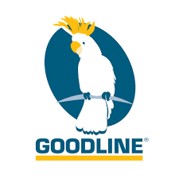


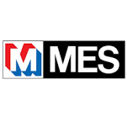



INTRODUCTION
Key Industries and Key Customers
Since its earliest days, FLS has been a strong player in the power business. Today, handling equipment for gas, coal, and oil-fired power plants as well as hydro power plants remains one of FLS's core activities.
FLS offers unique expertise in handling Heat Recovery Steam Generators (HRSG), boilers, generators, steam and gas turbines, and related equipment.
Power
The recent boom in the upgrade and green field construction of petro chemical plants worldwide has strengthened FLS’ activity in this industry. We support the desire of many of our clients in this field, to ship modular in order to save construction time and cost on site. FLS’ conducts extensive studies before commencement of each project to find the best solution.
Petrochemical
FLS offers a wide range of services for the mining industry. Often these projects are located in remote locations with little or no transport infrastructure. FLS offers high-level knowledge in providing logistics for the actual construction of mines to shipping consumables and equipment such as dump trucks and earth-moving machines.
Mining
The construction of large infrastructure projects presents unique challenges. FLS’ has been supporting clients in port as well as road construction for many years. Major infrastructure requires precise coordination to ensure that equipment and materials from various suppliers are in the right place at the right time. FLS’ team draws on extensive knowledge and experience to give our clients the best possible options and project management in supply, shipping, and transportation.
Infrastructure
Being a creative and innovative organization, FLS is always looking for new markets and challenges. From the construction of steel and other plants to the Oil & Gas industry, FLS continues to strive to lead by providing excellent services.
Others
18

Slide 19

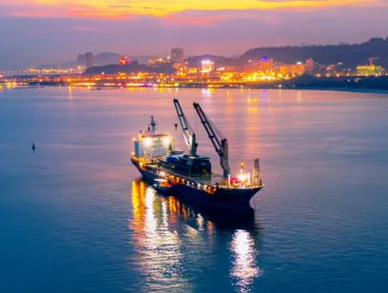
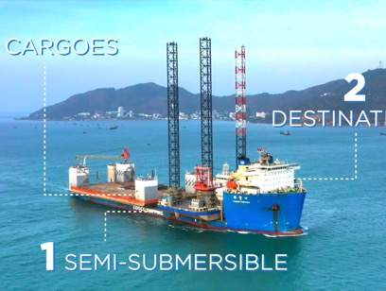
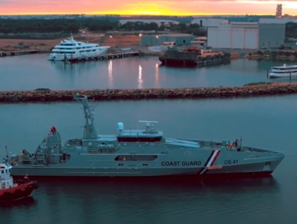
PROJECT REFERENCES
SELECTED PROJECT VIDEOS
Six Floating Units Delivered in a Single Shipment
Two-single Piece Shipment On Semi-submersible Vessel
Two Austal Cape-class Patrol Boats
https://www.youtube.com/watch?v=IUKHEoSbJjc
https://www.youtube.com/watch?v=UZNELauPN0s
https://www.youtube.com/watch?v=ykaVyf4CEug

Slide 20
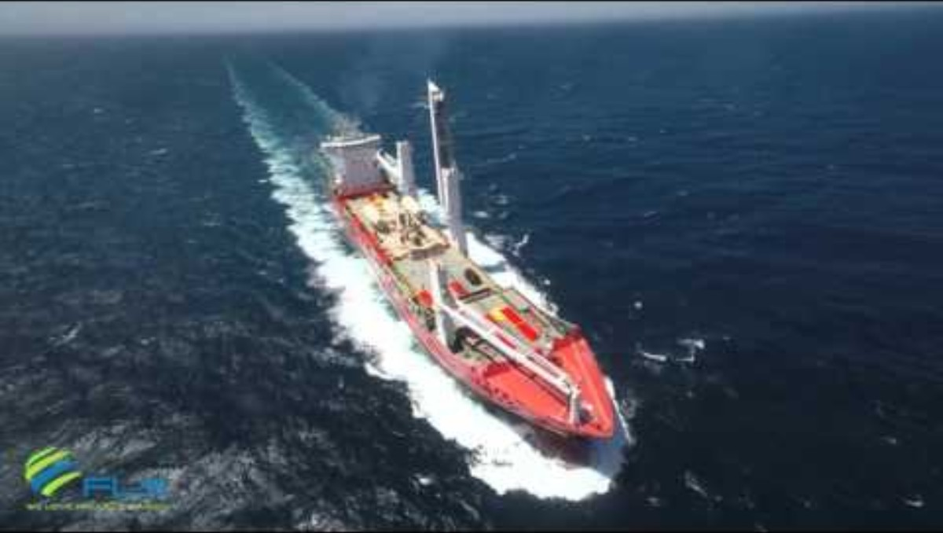
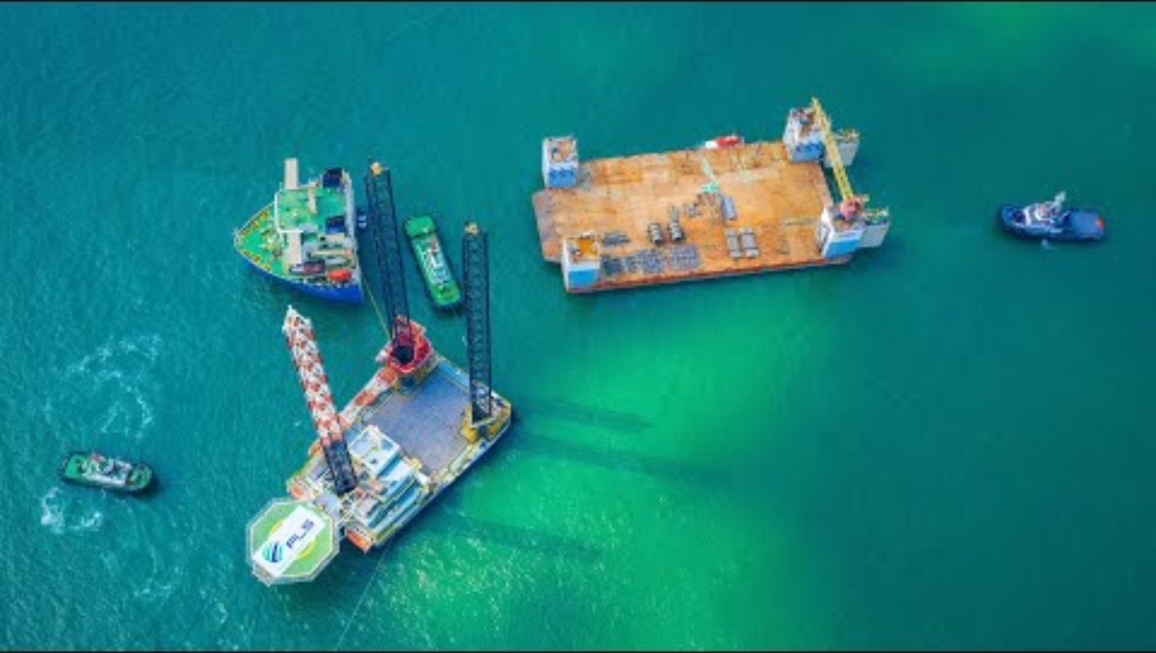
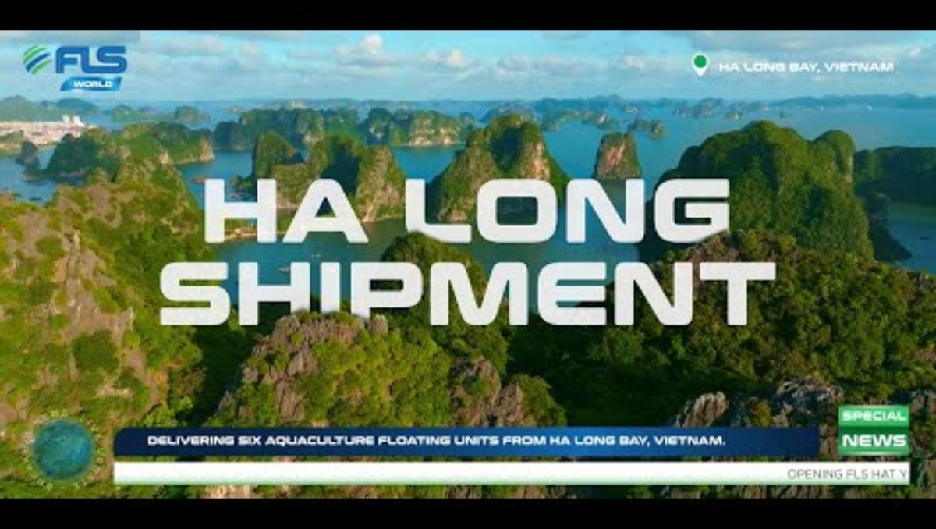
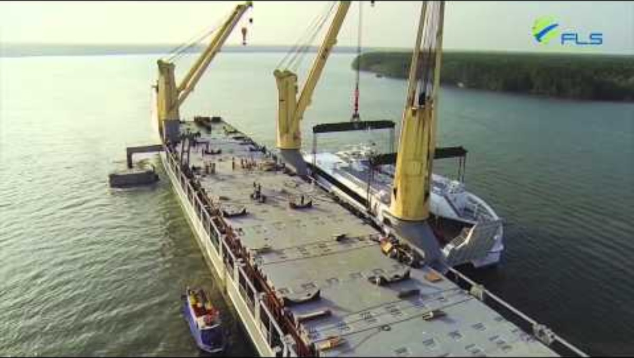
PROJECT REFERENCES
SELECTED PROJECT VIDEOS
700 MT bio power mega unit
Two-single Piece Shipment On Semi-submersible Vessel
Ha Long Shipment: Six Floating Units Delivered in a Single Shipment
FLS Projects – 2x 200MT Ferries shipped from Vung Tau to Oman

Slide 21
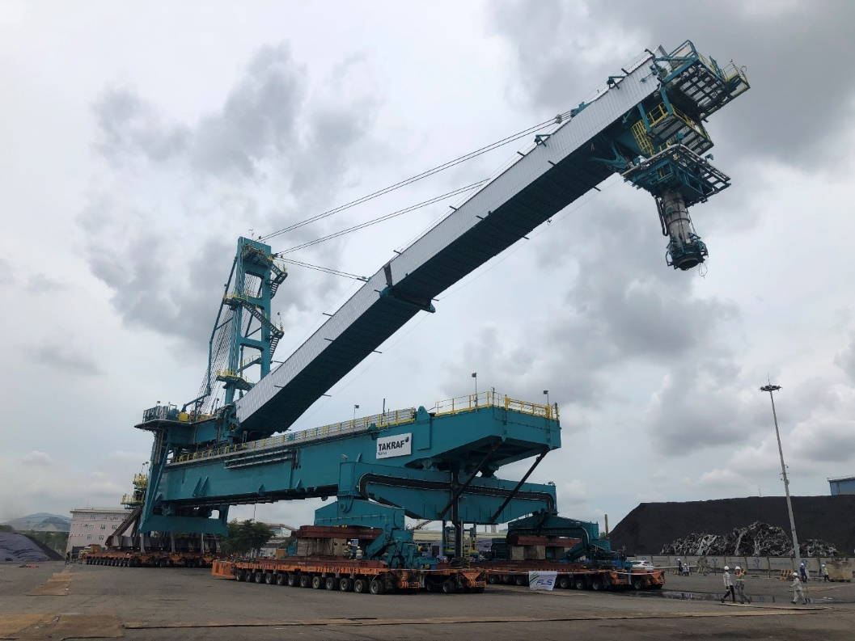
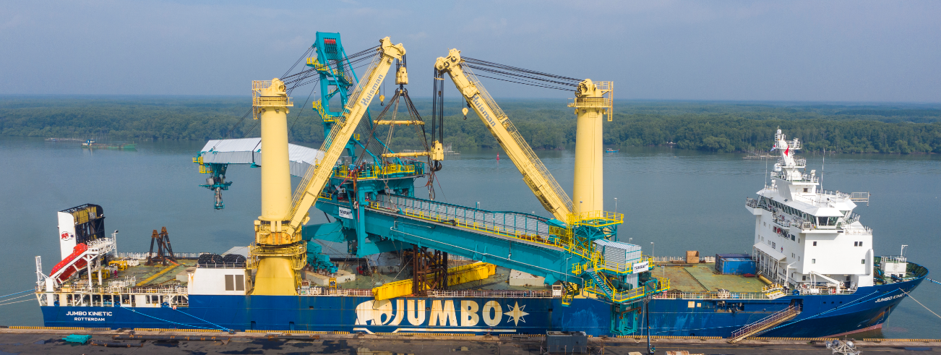
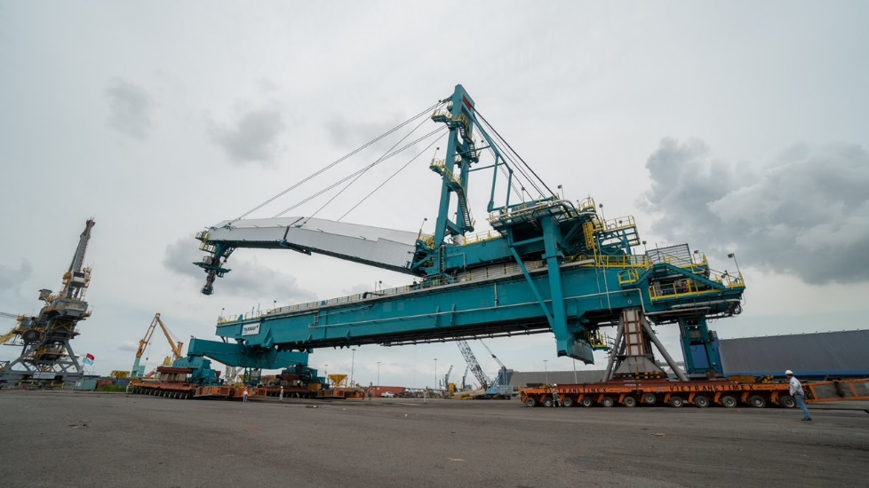
PROJECT REFERENCES
PROJECT REFERENCES
Case Study – 1500 TON BULK SHIPLOADER
Dimensions: 135 x 25 x 43 M – 1,500 MT
Commodity: Radial Quadrant Shiploader
Origin: Phu My, Vietnam
Destination: Vancouver, Canada
Ground preparation (foundation)
Leveling of transport route
Removal of light towers, fire equipment, concrete divider
Shifting via 96 SPMT axles
Setup + movements were shaped to match the schedule of the vessel, construction team + port operator
Supervision by multiple FLS professionals
Scope:
21

Slide 22
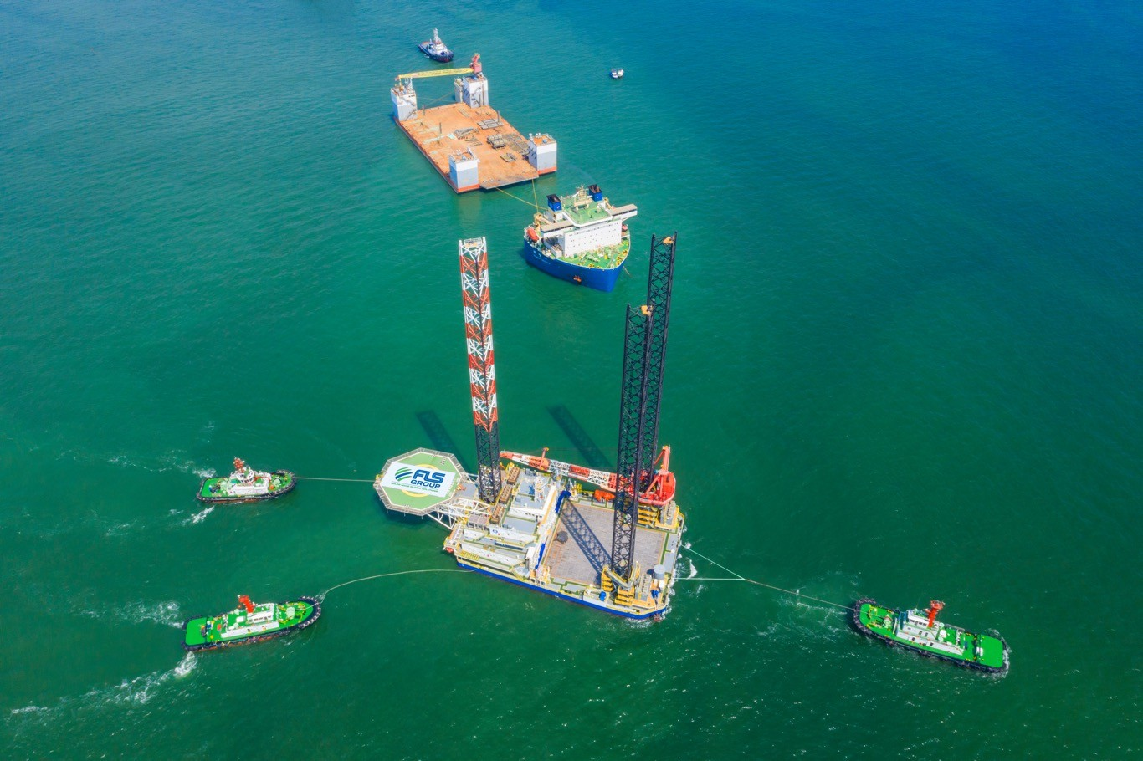
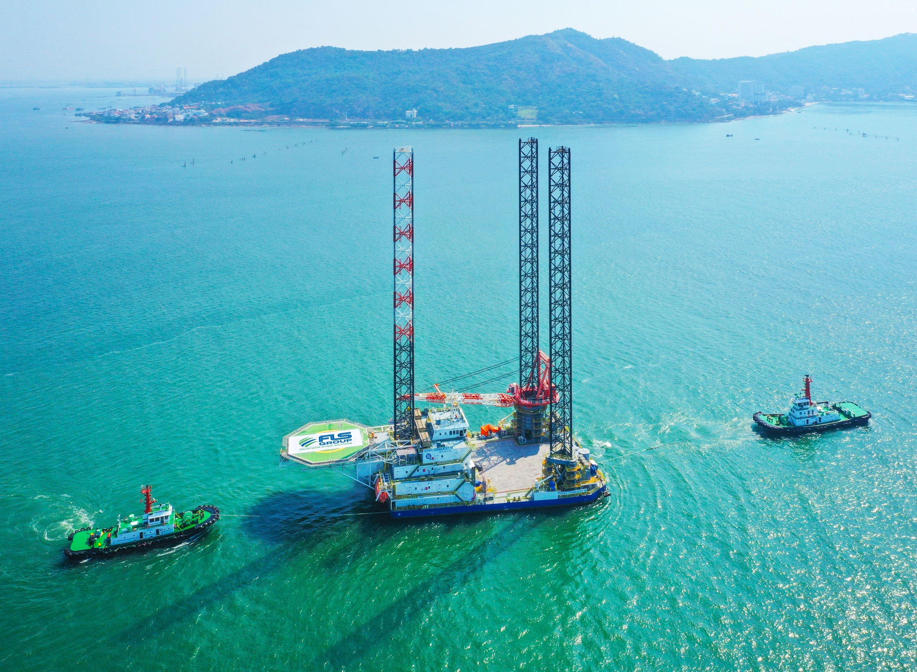
PROJECT REFERENCES
PROJECT REFERENCES
CASE STUDY – SEMI-SUBMERSIBLE (1/2)
Dimensions: 101.5 x 52.5 x 31 M – 7,000 MT
Commodity: Drydock
Origin: Vung Tau, Vietnam
Destination: Balamban, Philippines
Chartering Semi-submersible Vessel for two Different Cargo Owners
Initially the Drydock was Supposed to be Dry-towed, but FLS Managed to Pair the Dock Together with a Liftboat. This way Both Owners Benefited From Each Other.
FLS Coordinated Towing From Ho Chi Minh City to Anchorage Outside of Vung Tau Port.
Some of the Most Powerful Tugs in Vietnam Were Required to Position the Dock Overnight Just in Time for Readiness of M/V XIANG YUN KOU.
The Port Authority Issued Strict Operational Saftey Guidelines That Have Been Fully Satisfied.
FLS was the Communication Tool Between Cargo and Vessel Owners, Customs, Port Authority, Tug Operators, Marine Warranty Surveyors and Stevedores.
Our Port Captains Have Been on Scene For an Entire Week to Accompany both Assets From Their Origins Until Departure out of Vietnam Waters.
Scope:
22

Slide 23
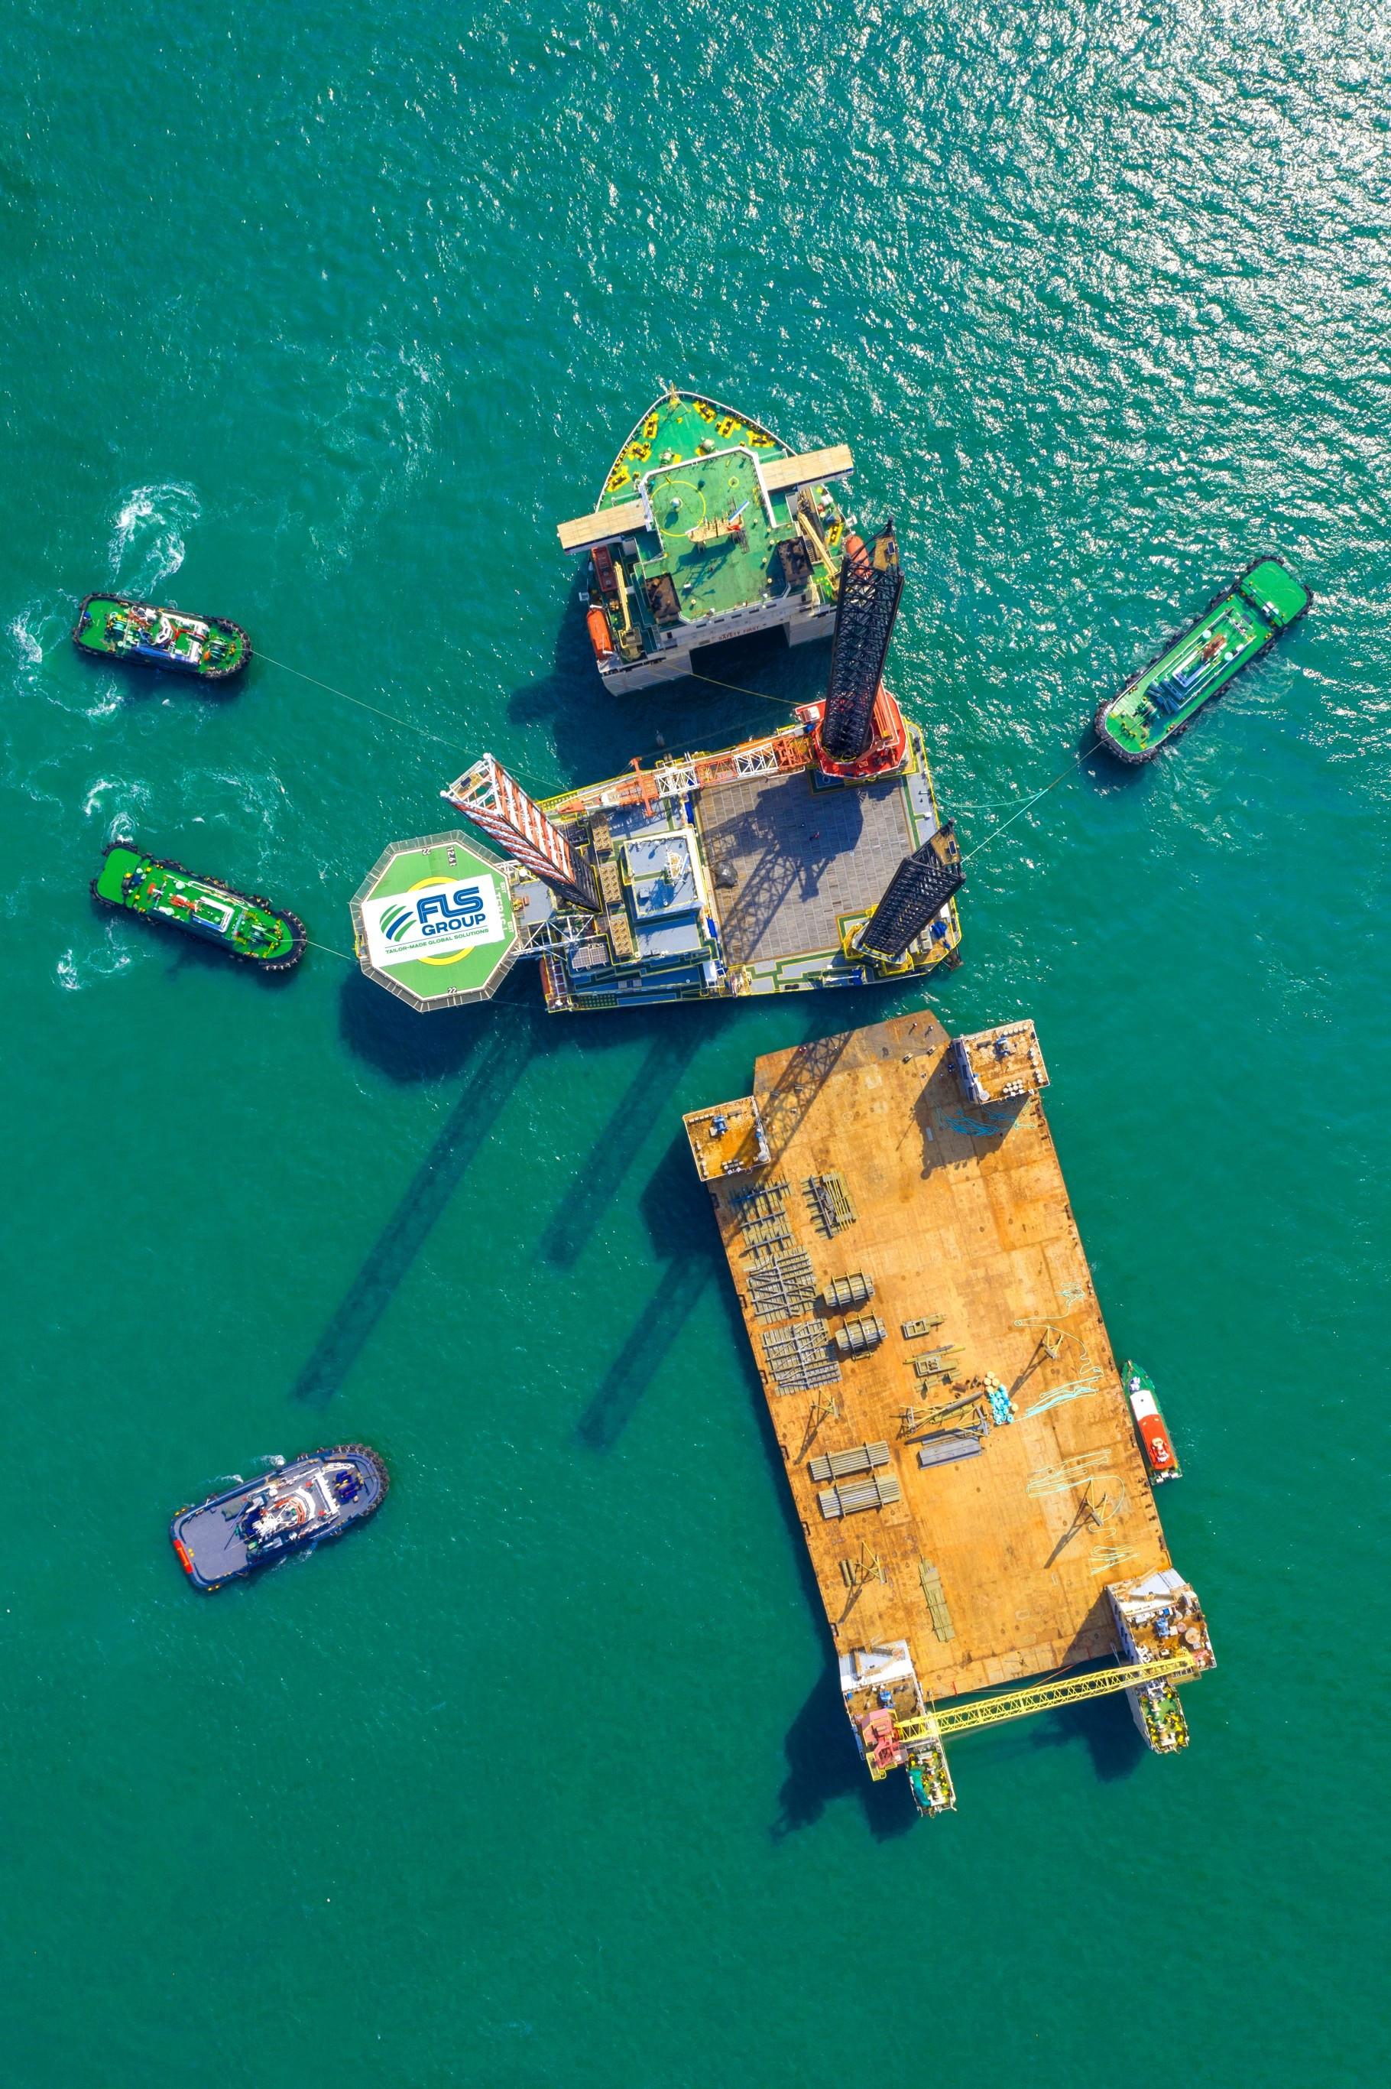
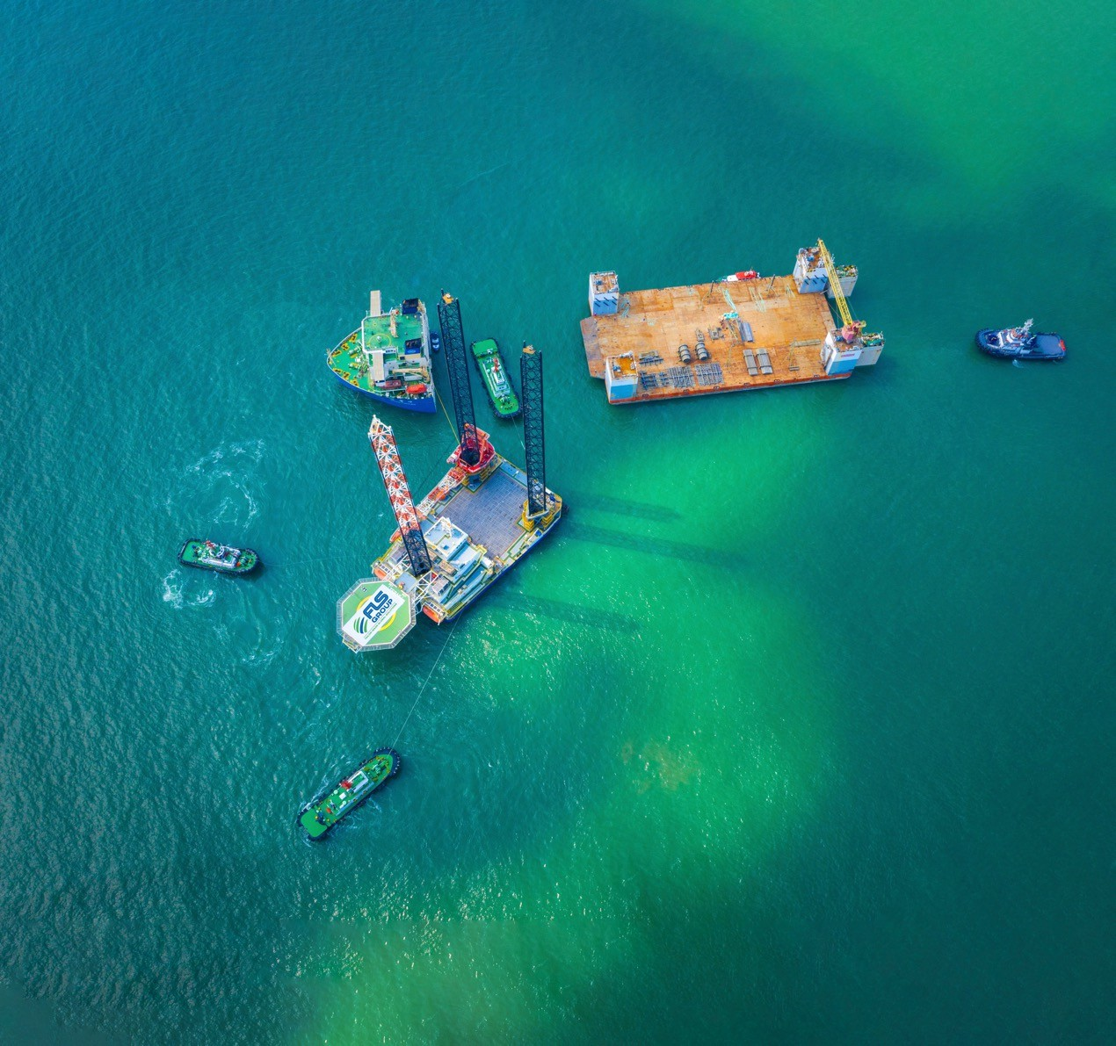
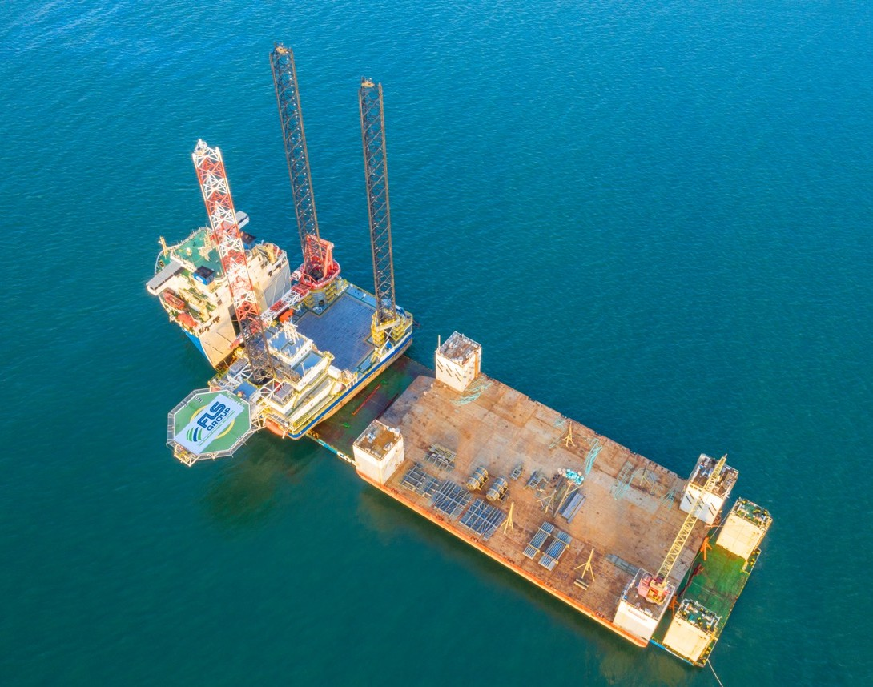
PROJECT REFERENCES
PROJECT REFERENCES
CASE STUDY – SEMI-SUBMERSIBLE (2/2)
Dimensions: 90 x 42 x 102 M – 6,000 MT
Commodity: Liftboat
Origin: Vung Tau, Vietnam
Destination: Pasir Gudang, Malaysia
Cosco X Class Semi-submersible Vessel was Contracted Having Sufficient Deck Space
FLS Coordinated Towing From Shipyard to Anchorage
Preparation of two Transport Manuals (Liftboat and Drydock)
Approval Process for Both Manuals was Completed in Less Than two Weeks. Two Independent Marine Warranty Surveyors had to Sign-off the Parallel Operation
Scope:
23

Slide 24
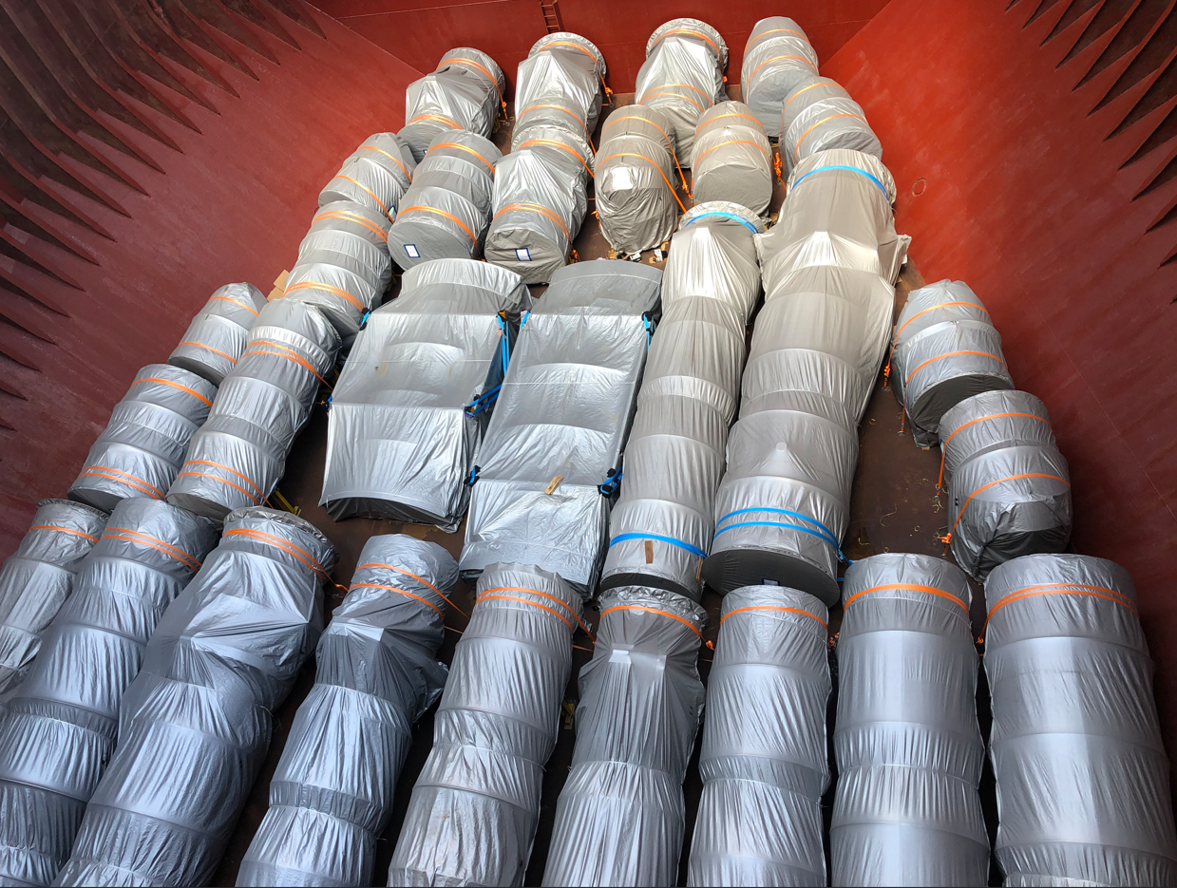
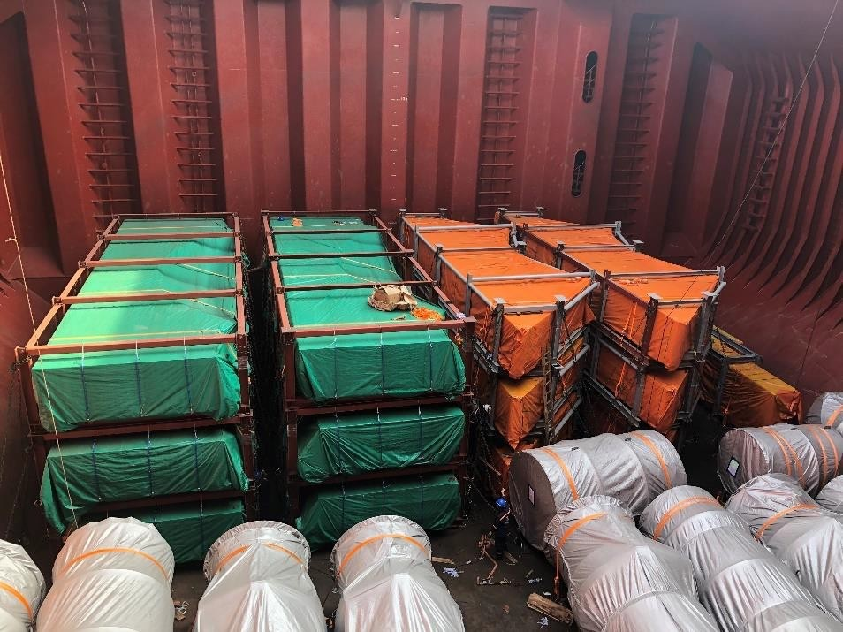
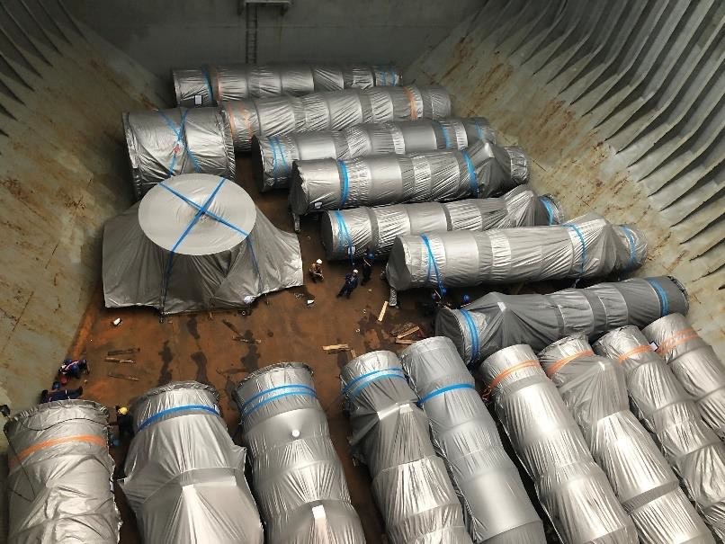
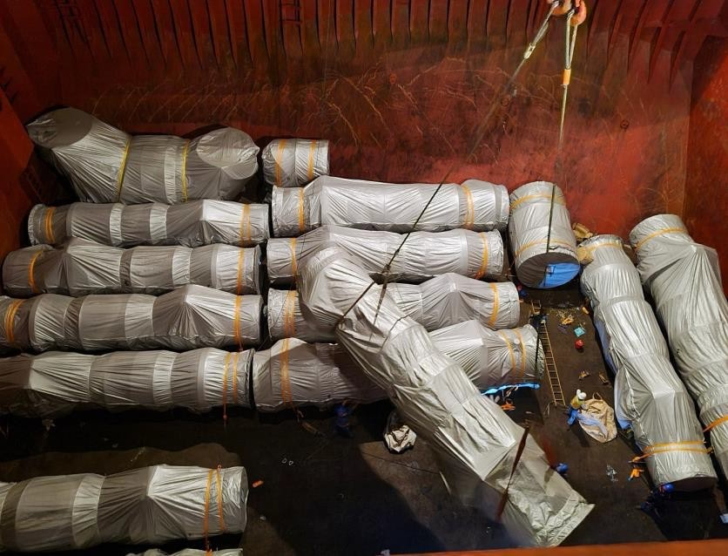
PROJECT REFERENCES
PROJECT REFERENCES
CASE STUDY – Niles + Guernsey Combined-Cycle Power
Volume: Approx. 29,000 FRT
Commodity: Power plant structure
Origin: Phu My, Vietnam
Port of Discharge: Houston, TX, USA
Giving packaging solutions to ensure cargo optimize handling efficiency
Chartering of suitable bulk and multi-purpose (MPP) vessels for six scheduled voyages, tailored to cargo specifications and route requirements
Deployment of in-house stevedoring teams to support complex lifting and lashing operations, ensuring safe and compliant cargo handling
Scope:
24

Slide 25
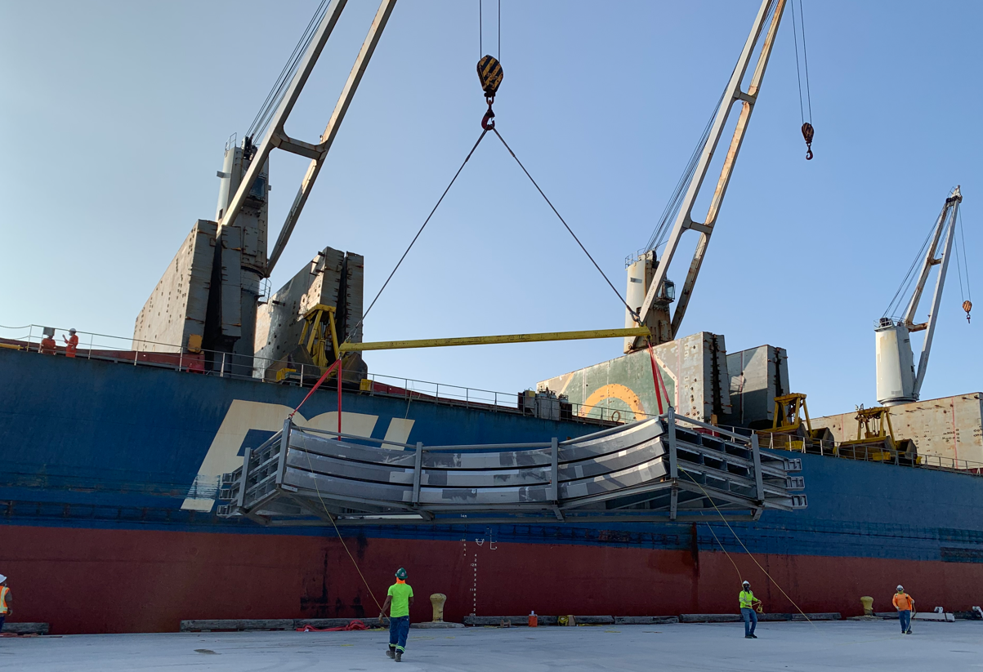
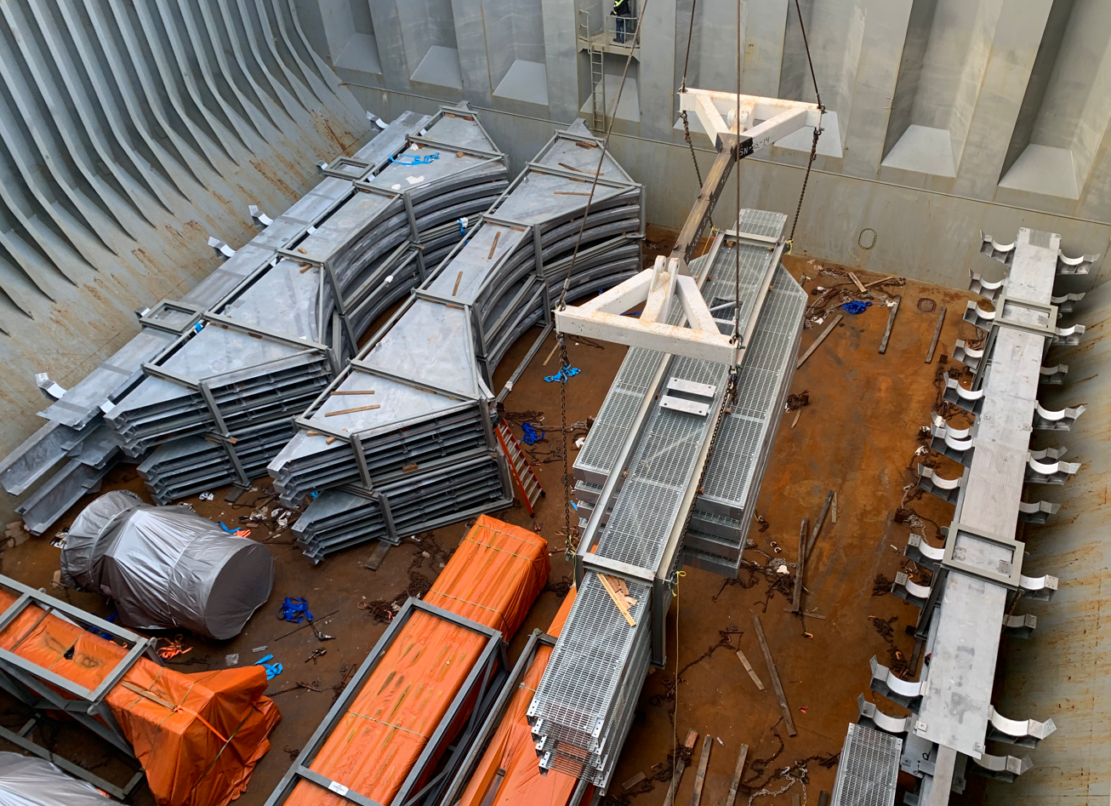
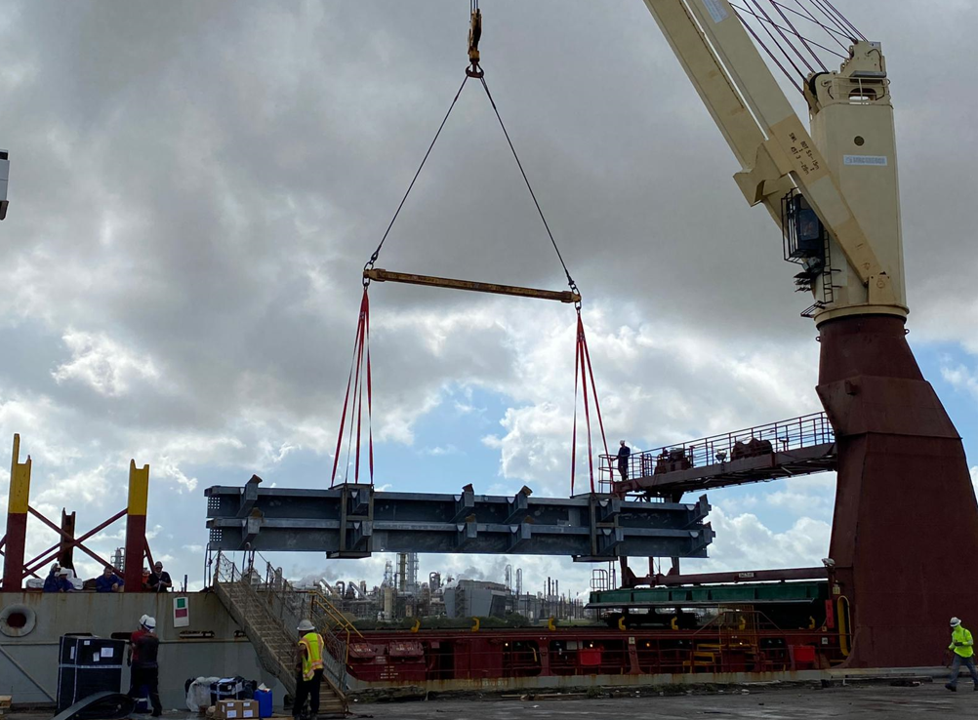

PROJECT REFERENCES
PROJECT REFERENCES
CASE STUDY – JACKSON POWER PLANT Elwood, IL USA
Commodity: Steel Structures
Volume: 8,816 cbm , 1,538 MT Break Bulk
Containers: 160 x40’ HC Weight 2,400 MT
Origin: Vung Tau, Vietnam
Destination: Houston TX USA , DAP Elwood, IL, USA
Scope:
Trucking from workshop up to the export terminal
Chartering of a Suitable multi-purpose heavy lift vessel
FLS was the communication tool between cargo and vessel owners, customs, port authority, tug operators, marine warranty surveyors and stevedores
Our port captains have been on scene for supervising purposes
Discharge in Houston, TX and trucking up to the job site in Elwood, IL, USA.
25

Slide 26




PROJECT REFERENCES
PROJECT REFERENCES
CASE STUDY – PELICAN POINT POWER PLANT PROJECT 1/2
Volume: 28 packages, 3,779 cbm, 341. MT
Origin: Dung Quat, Vietnam
Port of Discharge: Adelaide, Australia
Final Destination: Pelican Point Combined Cycle Power Plant
Apply for a special oversize transportation permit
Transporting cargo from the work-shop to the port of loading
Two specialized electric power teams providing escort services throughout the transportation process to ensure safety and operational efficiency
Third party survey and inspection of the cargo
Coordination and strategic placement of lifting beams to ensure alignment with the appropriate Working Load Limit (WLL) for safe and efficient operations.
Ocean freight from Dung Quat to port of discharge Adelaide
Loading onto vessel incl appropriate cargo stow arrangements. Cargo hold preparation for loading, including layout of dunnage by FLS owned stevedores
Lashing and securing
FLS Port Captains supervised the whole trucking and loading operation
Scope:
26

Slide 27




PROJECT REFERENCES
CASE STUDY – PELICAN POINT POWER PLANT PROJECT 2/2
Volume: 28 packages, 3,779 CBM, 341.212 MT
Origin: Dung Quat, Vietnam
Port of Discharge: Adelaide, Australia
Final Destination: Pelican Point Combined Cycle Power Plant
Challenges:
Complexity due to the cargo’s size with max length 15.46M, width 9.55M, height 5.30M
The nearest BBK terminal at the POD to the job site is not workable
Investigate suitable direction to the job site, adjust construction to fit the cargo during transportation
→ We got involved in the discussions at a very early stage, which allowed the client to design and fabricate up to the absolute maximum dimensions.
→ Coordination with carrier for special berthing at RO-RO/ Cruise ship terminal
Scope:
Apply for a special permit in order to berth at the RO-RO/ cruise terminal.
Traffic management survey in Australia
Vessel berthed at a RO-RO/ Cruise ship berth
Cargo unlashing discharge operation, supervision by FLS PM
Due to cargo dimensions, FLS had to remove fencing and widen the gate at the port
Traffic lights, traffic signs had to be removed during the trucking from port to the jobsite
Police escorted our trucks and stopped the traffic when necessary
27

Slide 28




PROJECT REFERENCES
PROJECT REFERENCES
CASE STUDY – TENOVA S.P.A GENOA ITALIA
Project name: Tenova DS0036
Dimensions: 2,826 CBM / 350.99MT / 45 PKGS
Commodity: Duct and Panel
Origin: Hoang Dieu Haiphong, Vietnam Port
Destination: Antwerp, Belgium
Delivery from Vietnam to Belgium ,Dec 2021
Chartering of suitable heavy lift vessel within tight schedule and in budget
Hooking on including arrangement of operation
Supervision both ends
Lashing and securing on the vessel
Experienced marine surveyor perform Control
Scope:
28

Slide 29





PROJECT REFERENCES
PROJECT REFERENCES
CASE STUDY – POWER PLANt NIGERIA
Volume: 24 packages / 5,905 CBM / 403 MT
Origin: Dung Quat port, Viet Nam
Destination: Warri port, Nigeria
Scope:
Full liner terms Ocean freight
Pre-carriage ex-work to port
Chartering Heavy lift vessel
Loading onto vessel incl appropriate cargo stow arrangements. Cargo hold preparation for loading, layout dunnage by FLS own stevedores
Loading supervision by FLS Port Captain
29

Slide 30






PROJECT REFERENCES
PROJECT REFERENCES
CASE STUDY – POWER PLANT SINGAPORE
Volume: 44 packages / 6,594 CBM / 774 MT
Origin: Dung Quat port, Viet Nam
Destination: Singapore port
Scope:
Full liner terms Ocean freight
To receive cargo along side ship
Chartering Heavy lift vessel
Loading onto vessel incl appropriate cargo stow arrangements. Cargo hold preparation for loading, layout dunnage by FLS own stevedores
Loading supervision by FLS Port Captain
30

Slide 31




PROJECT REFERENCES
PROJECT REFERENCES
CASE STUDY – BIOPOWER UNIT
Project name: BioPower Unit
Dimensions: Unit 1: 36 x 18.3 x 8.3 M / 700 MT
Unit 2: 13.2 x 9.2 x 5.56 M / 61 MT
Commodity: Renewable Energy System Vung Tau Anchorage
Origin: Vung Tau, Vietnam
Destination: Australia
Chartering of a suitable geared multi-purpose heavy lift vessel
Co-ordination of the FAS delivery (Roll-out onto barge via SPMT’s)
Loading and securing the cargo board of the vessel
Subsea installation in Australia incl. all customs and quarantine formalities, as well as divers
Extended scope: Use of the ships dynamic positioning (DP2) system, to discharge from deck under water onto the foundation
Scope:
31

Slide 32

PROJECT REFERENCES
PROJECT REFERENCES
Case Study – SURGE BIN
Project name: Surge bin
Dimensions: Height: 24 M / 350 MT;
Unit 2: 13.2 x 9.2 x 5.56 M / 61 MT
Commodity: Surge bin for coal export terminal
Origin: Phu My, Vietnam
Destination: Gladstone, Australia
Pre-carriage ex shipper’s jetty up to port via barge
Organizing and loading onto vessel + ocean transport
Loading and securing the cargo on the vessel
Scope:
32

Slide 33



PROJECT REFERENCES
CASE STUDY – 800 TON RIVER cruise boat
Dimensions: 63 x 12 x 14 M – 800 MT
Commodity: Fully Equipped Amazon River Cruise Boat
Origin: Vung Tau, Vietnam
Destination: Amazon Delta, Brazil
Scope:
  Chartering of heavy lift vessel with sufficient lifting capacity
  Divers for positioning of slings
  In-house stevedores to conduct hooking-on
  Protection of Valuable In-/exterior
  Loading Supervision
  Lift Studies
33

Slide 34




PROJECT REFERENCES
PROJECT REFERENCES
CASE STUDY – BAYTOWN REFINERY Project
Project Name: NAG Baytown Refinery
Client: MES, Heurtey Petrochem
Project Owner: Exxon Mobile
Volume: Appr. 225,000 FRT
Commodity: Equipment for a petrochemical plant,
incl. 164 modules
Origin: Worldwide
Destination: Houston
Project duration: 2015 – 2017
Scope:
Surveys and selection of storage facility close to fabrication yard
Trucking from fabrication yard to storage area
Shrink wrapping of modules
Trucking from storage area to port
Stowage planning and scheduling
Shipping modules from Sattahip, Thailand and Shanghai, China to Houston, USA on 13 full charter vessels
Surveys and selection of suitable jetty location
Barging from Houston Port to jetty with 28 Barge trips
Trucking from jetty to site
Coordination with local authorities for permits
34

Slide 35





PROJECT REFERENCES
CASE STUDY - letter of recommendation
35

Slide 36
office.vn@fls-group.com
+84 828 73 002 864
36

