Slide 1
TRANSFORMER PRESENTATION
09th Mar, 2026
1

Slide 2
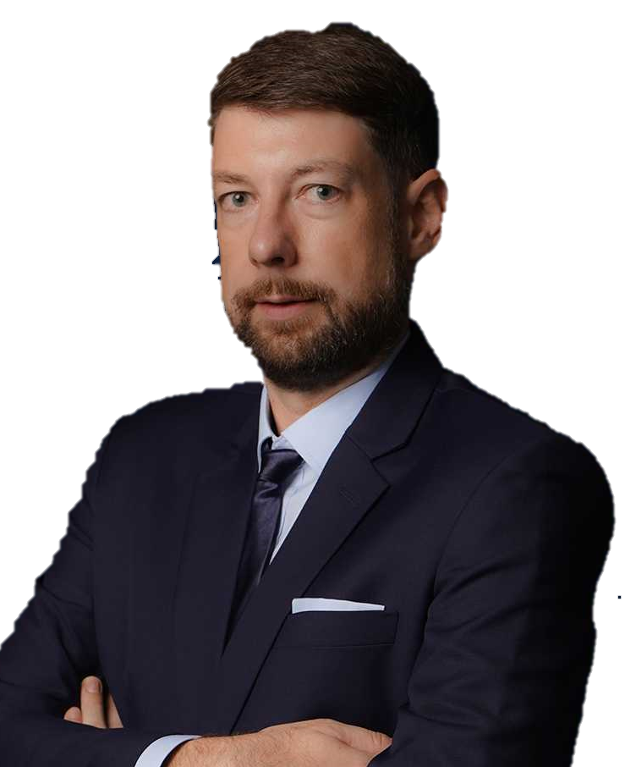
OUR MISSION:
“We keep the world moving, by deploying the best expertise to craft tailor-made solutions that solve the most challenging logistic problems all around the world.”
TORBJÖRN LARISCH
CHIEF EXECUTIVE OFFICER

Slide 3
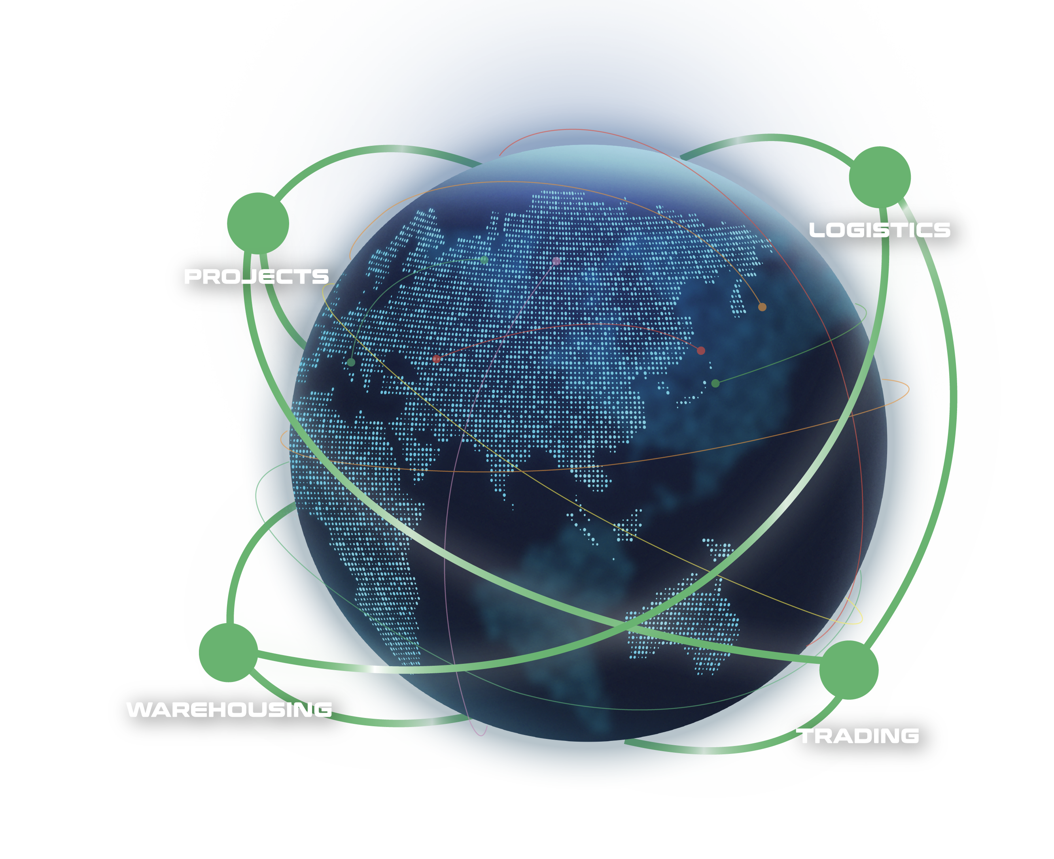
WHAT ARE OUR CAPABILITIES
Our interconnected supply chain solutions are tailor-made to keep your world in business.
OUR VISION:
To be recognized globally as the logistics experts who understand and empower global business leaders to dream and act big; moving the world forward.
PROJECTS: With expert hands, we handle the complicated with precision.
LOGISTICS: We humanize a seemingly standardized experience.
WAREHOUSING: We envision spaces that bring supply chains to the next level.
TRADING: We define and shape solutions to meet ever-changing needs.
3

Slide 4











FLS SNAPSHOT
32
500+
100+
years of experience
professionals
global partners
14
$65 million
countries
is the largest single contract award
ANNUALLY
15,000+
5,000+
trucks moved
customs clearance cases
25,000+
20,000+
14 million kg
$219 million
TEUs shipped
shipments delivered
air freight cargo handled
consolidated revenue
4

Slide 5
FLS HISTORY
FLS ventured more and more into handling export projects from steel fabricators in Thailand, Korea, China, Vietnam, Malaysia and Indonesia to global destinations for major engineering companies in the Power, Petrochemical and Mining industries.
After almost three decades, we have expanded our services from project cargo into a wider portfolio include:
FLS Logistics
FLS Warehousing
FLS Trading
Neon Orient acquisition
FLS Supply Chain Center establishment
2001 – 2010
2020 – 2023
1993 - 2000
2011 – 2020
NOW
The company was founded in Bangkok in May 1993 by Martin Häberli when he was awarded several major projects in Thailand.
In 2011 FLS (Vietnam) Ltd. was established, followed by
FLS (Australia) Pty Ltd. in 2013
FLS (Singapore) Pte Ltd. in 2014
PT. Federal Logistik Sistem (Indonesia) in 2014
FLS Projects (USA) Inc. in 2016
FLS Projects (Taiwan) Ltd. in 2016
FLS Projects (Malaysia) Sdn. Bhd, in 2018
FLS 1993 (India) Pvt Ltd.
In 2024, we embarked on a new chapter, broadening our global reach with the establishment of
FLS Scandinavia
FLS Norfolk, USA
FLS Group (Japan)
ITL acquisition
FLS Philippines
FLS Italy
5

Slide 6
OUR GLOBAL PRESENCE
USA
Denmark
India
Thailand
Italy
China
Japan
Myanmar
Vietnam
Philippines
Malaysia
Singapore
Australia
FLS Offices
Indonesia
FLS close network partners
6

Slide 7
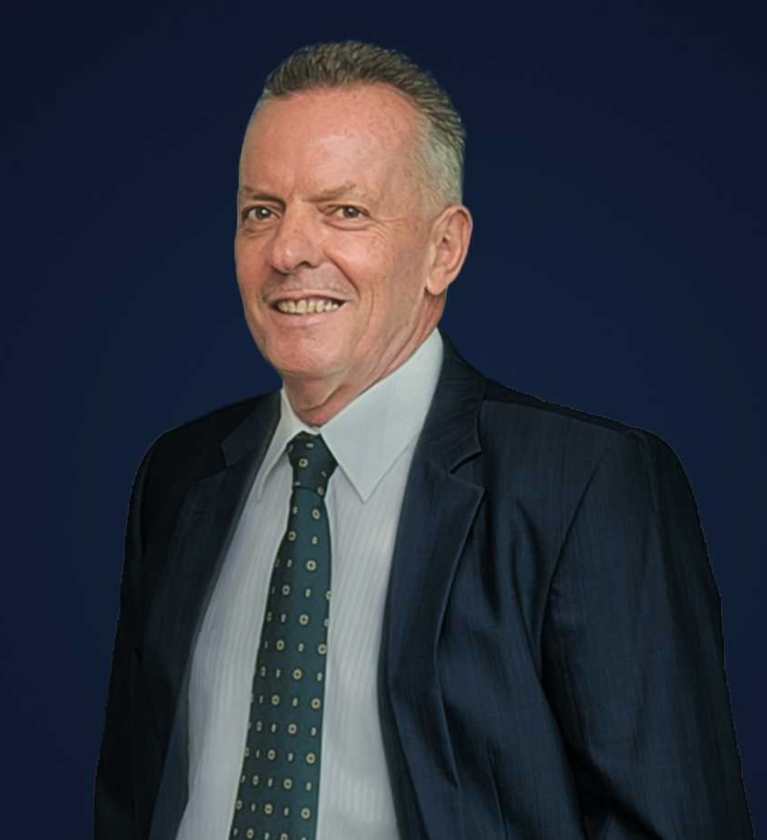
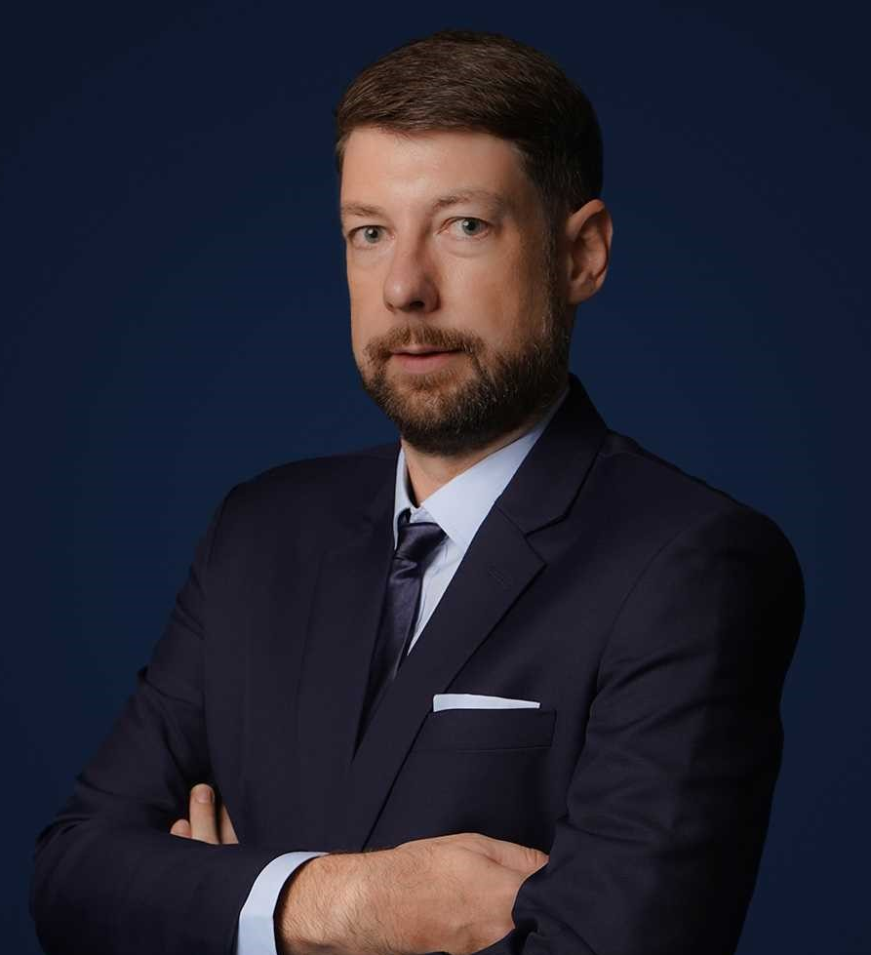
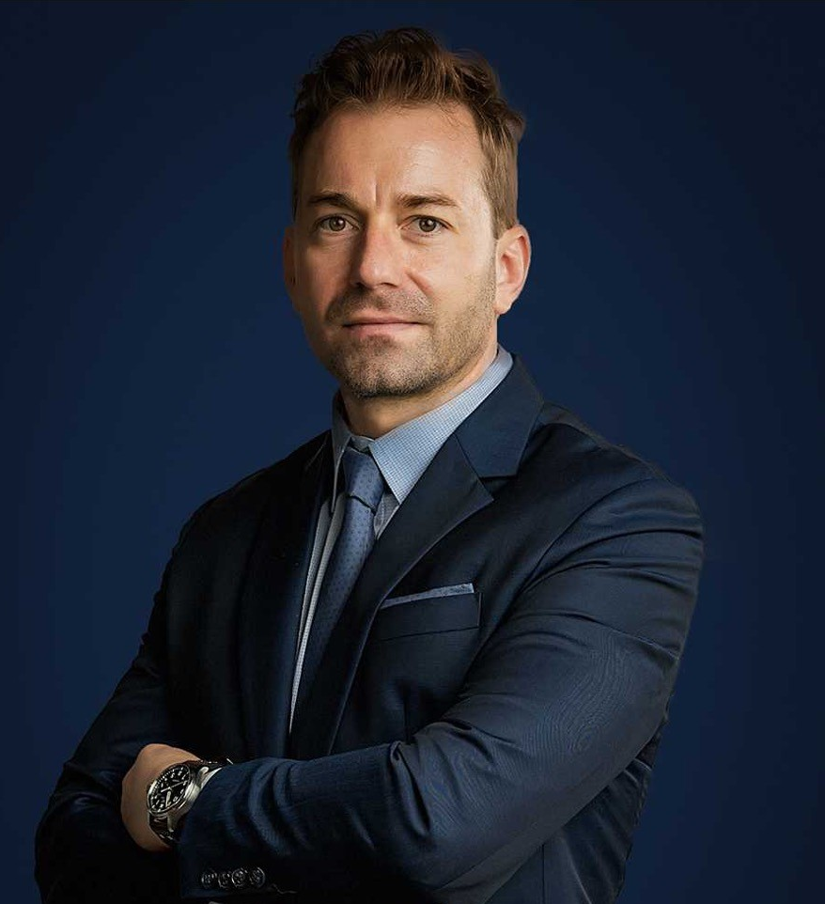
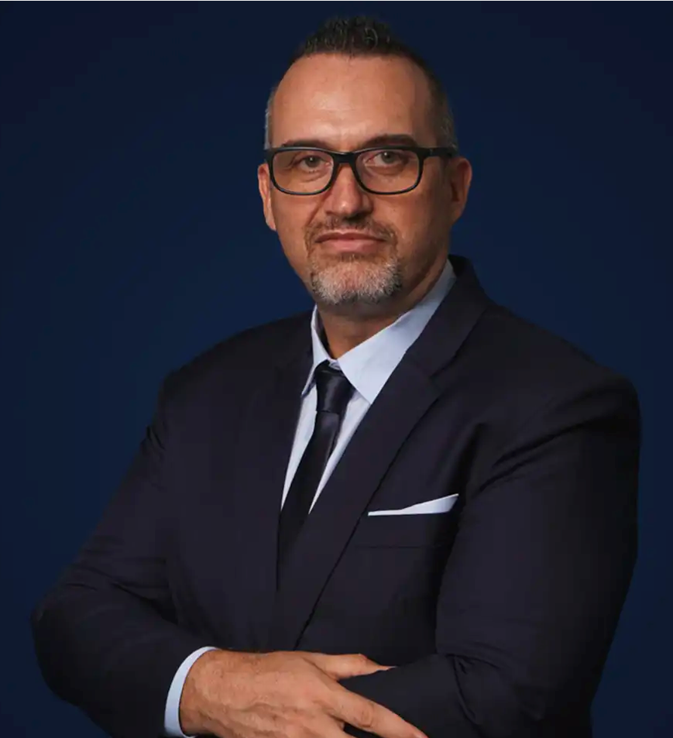
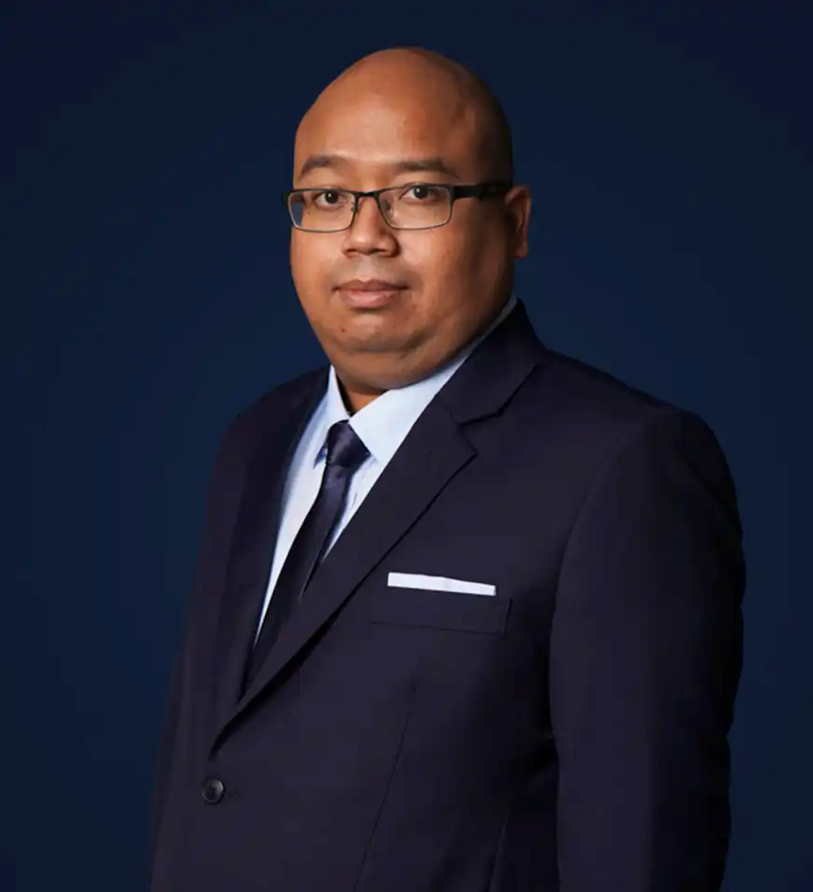
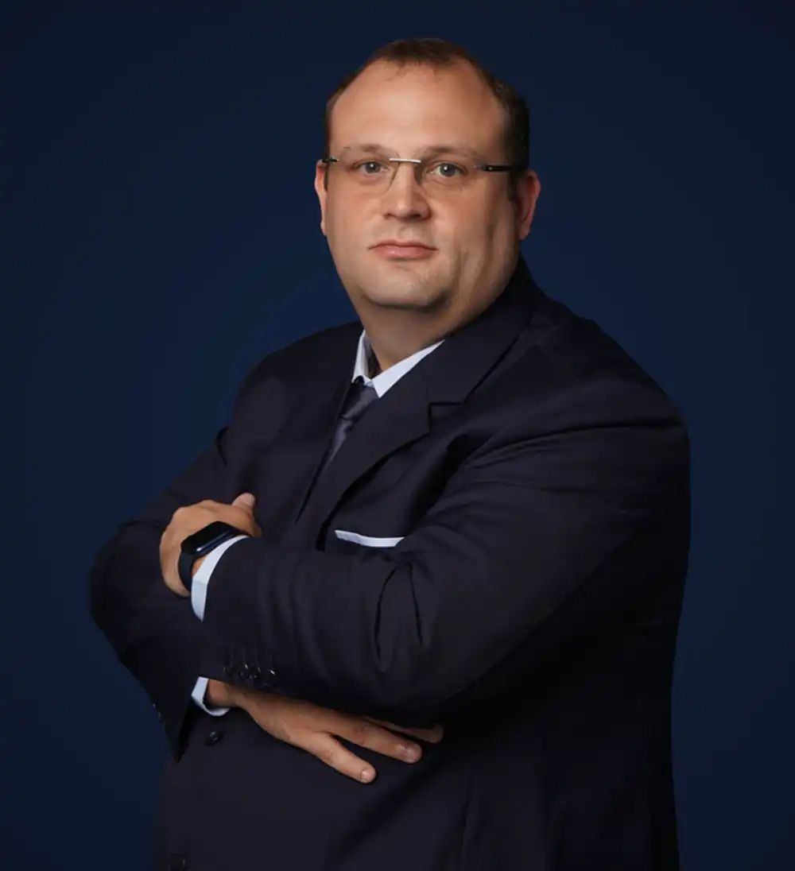
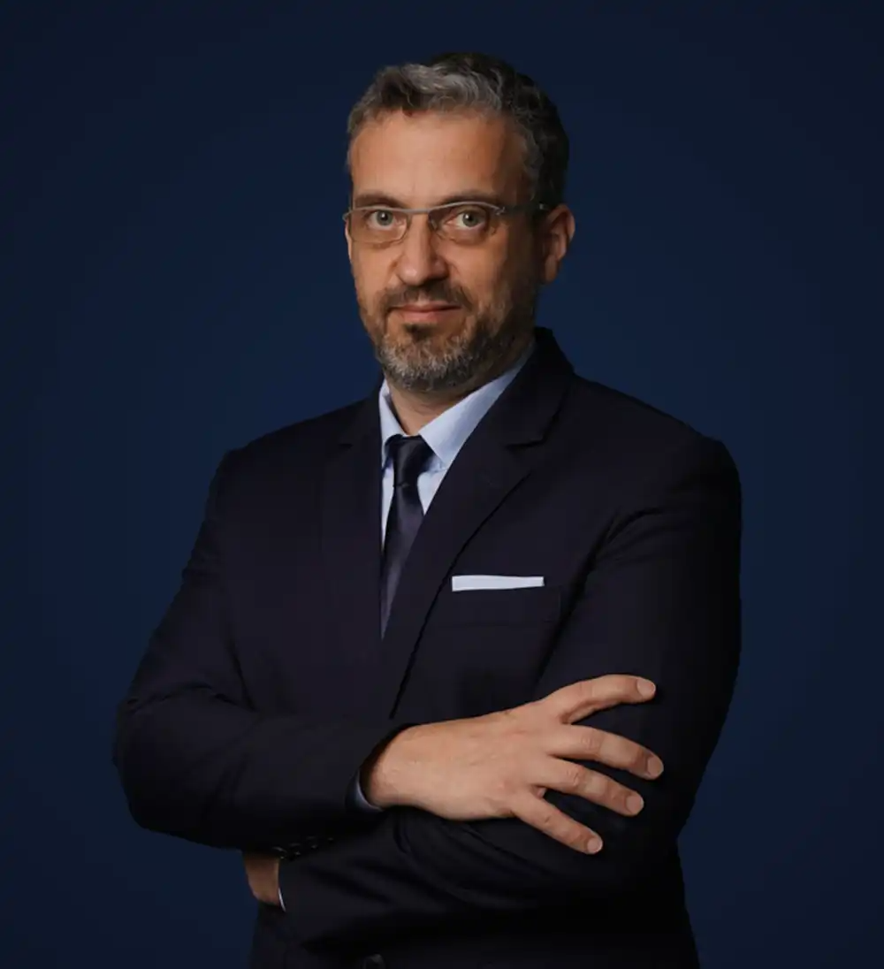
OUR MANAGEMENT TEAM
MARTIN HÄBERLI
Chairman
Founded FLS in 1993, Martin has over 40 years of international freight forwarding experience.
TORBJÖRN LARISCH
Chief Executive Officer
With more than 23 years of experience, Torbjörn joined as Managing Director in 2007 and became CEO in 2016.
CHRISTOPHER SCHNIEDERS
Global Director Projects
Christopher has been in the project forwarding industry for 19 years with an extensive network in Vietnam.
FRANCESCO JOSÈ RIVI
Global Head of Warehousing & Managing Director APAC
Francesco has been in the logistics industry for over 20 years, with various experiences in France, Spain, Romania, Poland and Italy.
HAFIZ ROSLAN
Chief Financial Officer
To lead the transformation of the Finance and Human Resources functions, Hafiz Roslan joined us in 2020 as the CFO and CPO.
Marcel Kirschnick
Global Director Logistics
FLS Logistics was launched in 2019, headed by the Director, Marcel Kirschnick.
Christoph Campbell
Managing Director - FLS Trading
Christoph joined FLS Group in 2021, where he established the Trading division and later also assumed the role of Managing Director at Neon Orient following its acquisition by FLS.
7

Slide 8





OUR COMPETENCIES
EXPERIENCED
COMPETIVE
More than 30 years of experience
Global access to carriers, local contract negotiations
FLEXIBLE
INNOVATIVE
Matching right partners for each project
We can solve problems with creative solutions and will adjust our operation to your requirements
PRO-ACTIVENESS
Eyes and ears always on the market and therefore can react to possible constraints early
DYNAMIC
Growth through opportunity, where others see a problem, we see an opportunity
Fast decision-making process
CONTINUITY
High employee retention rate: average is 8.32 years. Some key staff have been with FLS for more than 15 years
8

Slide 9






WE ARE A PROUD MEMBER OF:
9

Slide 10
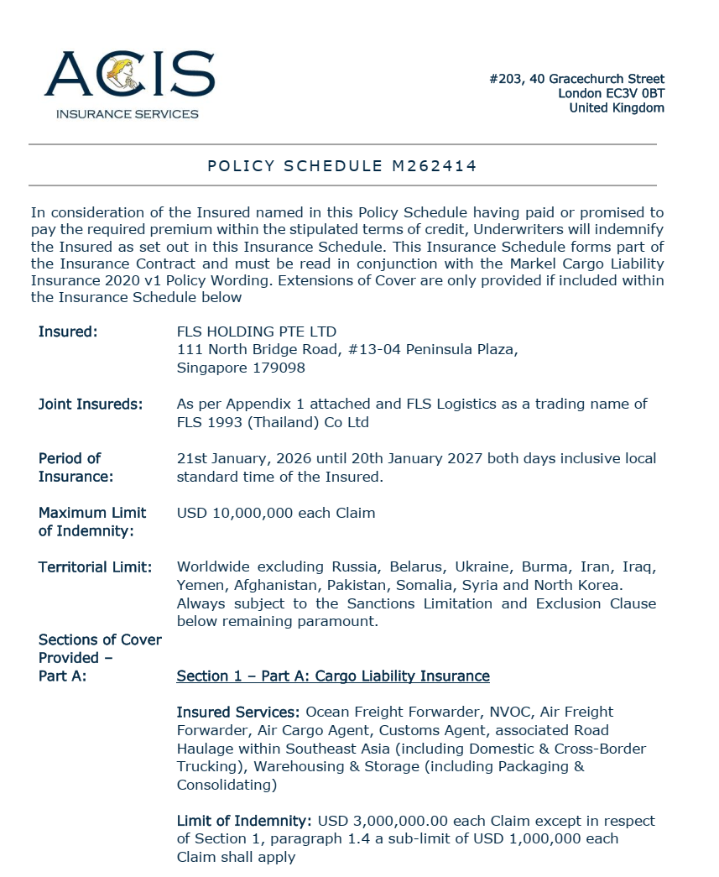
INSURANCE POLICY
Base coverage:
Cargo liability
USD 3,000,000 each claim
3rd party legal liability
USD 3,000,000 each claim
Professional indemnity
USD 400,000 each claim
Fines and duties liability
USD 100,000 each claim
Please note: Limits are flexible & negotiable, and liabilities can be extended on request and a case-by-case basis. Marine cargo insurance can be provided. on request.
10

Slide 11
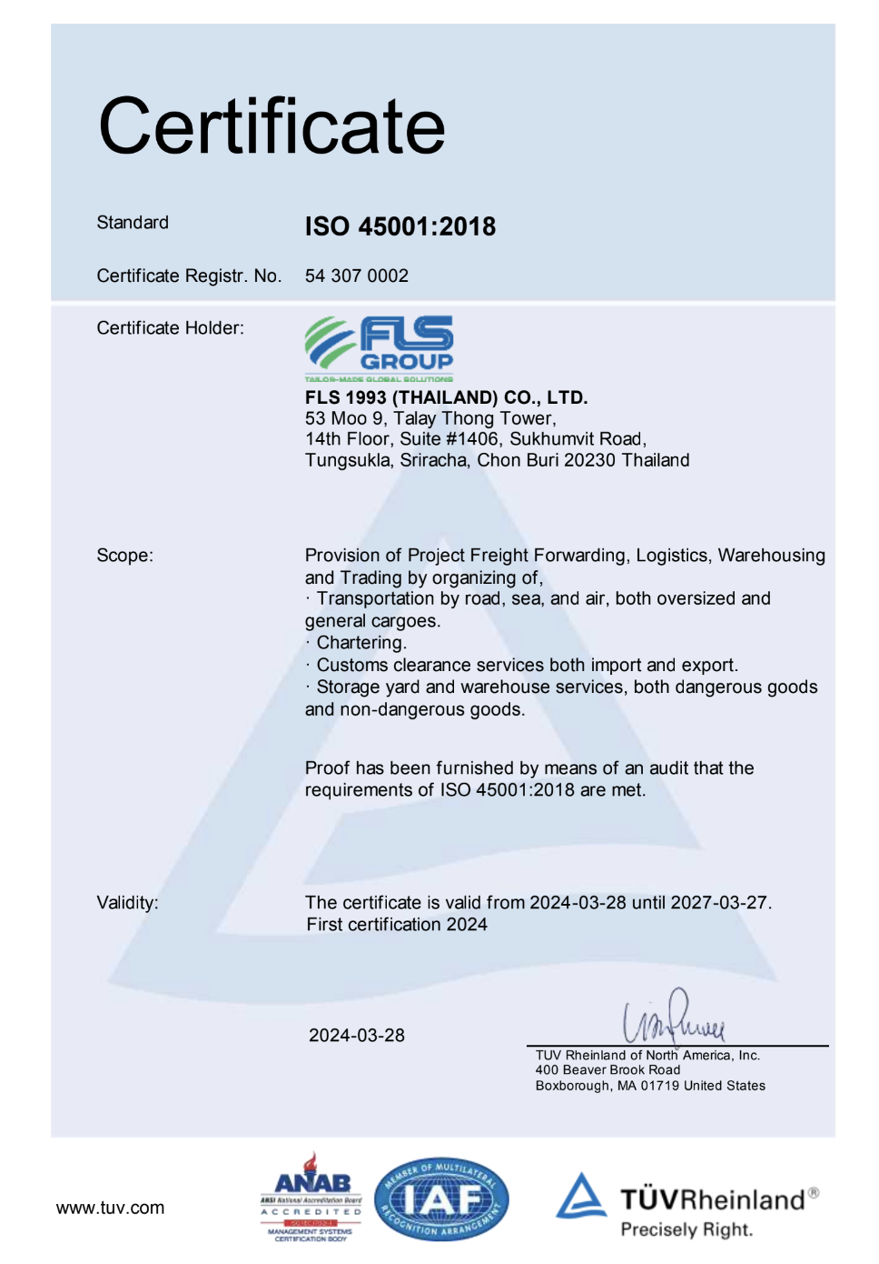
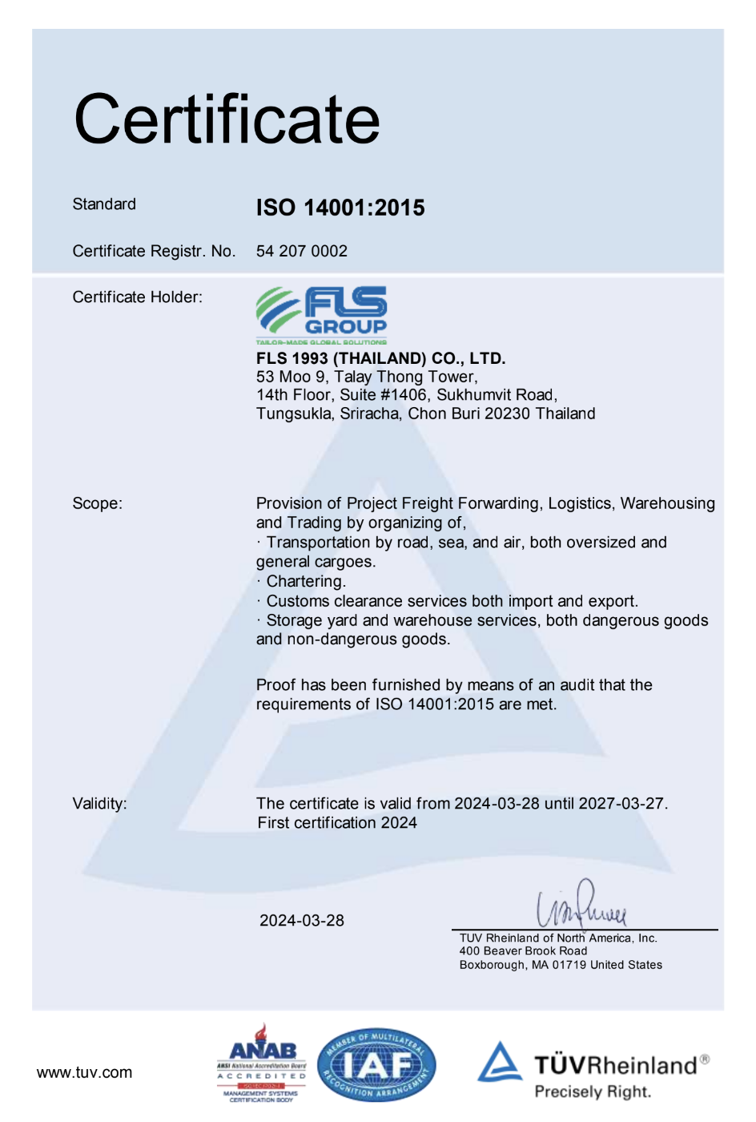
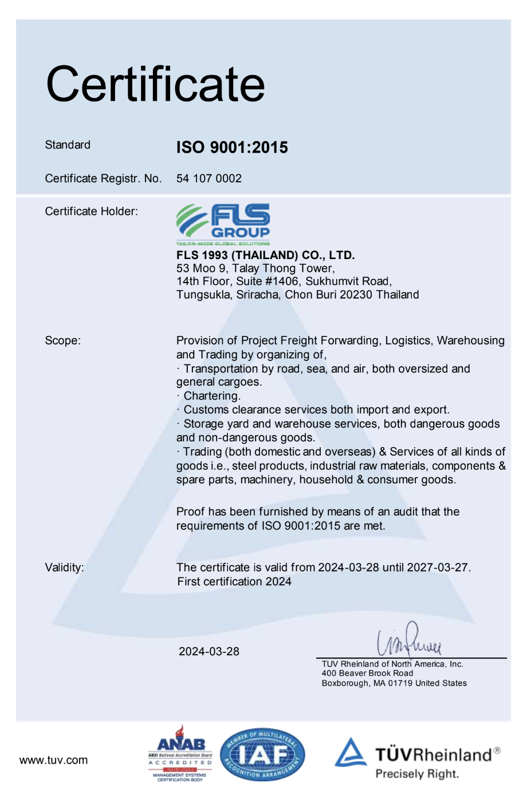
HSEQ Procedures
SAFETY, QUALITY & INTERNATIONAL COMPLIANCE
ISO 45001:2018 CERTIFICATE
ISO 4001:2015 CERTIFICATE
ISO 9001:2015 CERTIFICATE
ISO-certified own operations in Thailand, Australia, Singapore, USA, Vietnam, Taiwan, Indonesia, Malaysia, India and Myanmar.
11

Slide 12


SAFETY, QUALITY
& INTERNATIONAL COMPLIANCE
QUALITY ASSURANCE
HEALTH & SAFETY
OUR STANDARDS
FLS Quality Management Systems meet all our customer’s applicable statutory and regulatory requirements.
We use one of the world’s leading modular enterprise systems to streamline operations, accounting and business development.
Provide Health & Safety training for all members of staff as well as blue-collar and sub-contracting parties.
Follow international rules and guidelines to foster a safe and healthy working environment for our teams.
Ensure that each project and every shipment is handled in a safe, timely, systematic, and efficient manner.
We select and work only with agents and partners who:
are fully certified to international standards
fulfill our own strict quality standards
have sufficient insurance coverage
operate with well-maintained and regularly tested equipment
are well managed and staff regularly trained
have a long successful history and proven track record.
12

Slide 13

OCCUPATIONAL HEALTH, SAFETY
AND ENVIRONMENTAL POLICY
FLS requires the active commitment to, and accountability for, occupational health, safety and environment from all employees and contractors.
Comply with all relevant legislations and corporate requirements of OHSE;
Meet specified customer requirements and ensure continuous customer satisfaction;
Protect, and strive for improvement of, the health, safety and security of our people at all time;
Eliminate accidents and minimize potential risks;
Set OHSE performance objectives, measure results, assess and continuously improve processes and services, through the use of an effective management system;
Plan for, respond to and recover from any emergency, crisis and business disruption;
Minimize our impact on the environment through pollution prevention, reduction of natural resource consumption and emissions, and the reduction and recycling of waste;
Apply our technical skills to all OHSE aspects in the design and engineering of our services;
Communicate openly with stakeholders and ensure an understanding of our OHSE policies, standards, programs and performance. Reward outstanding OHSE performance;
Improve our performance on issues relevant to our stakeholders that are global concern and on which we can have an impact and share with them our knowledge of successful OHSE programs and initiatives.
13

Slide 14
Case studies

Slide 15
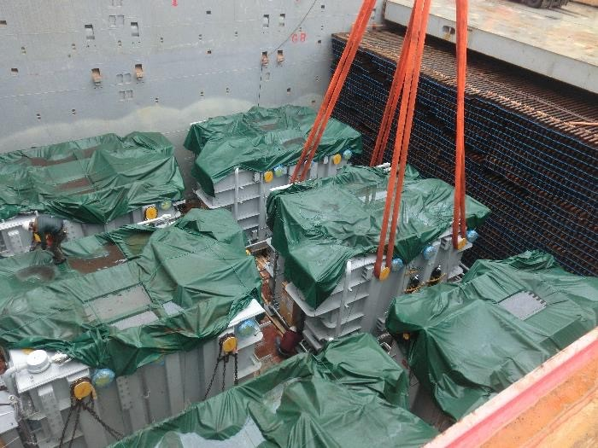
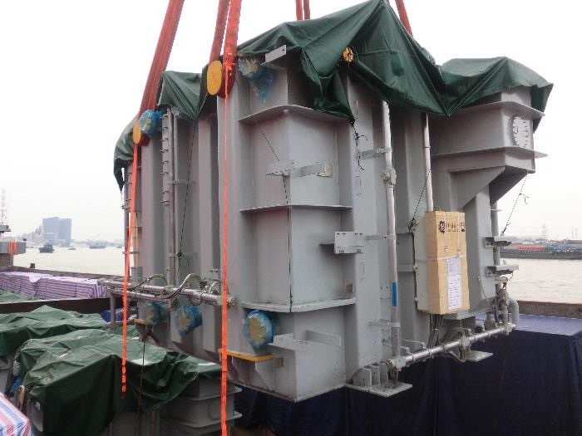
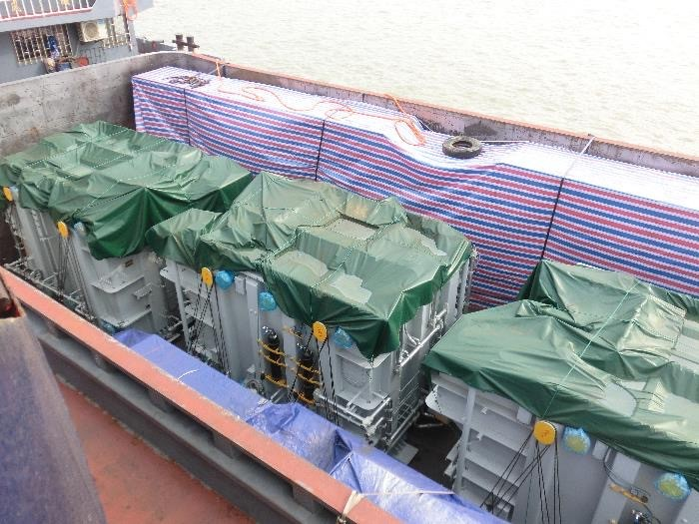
PROJECT REFERENCES
PROJECT REFERENCES
CASE STUDY – TRANSFORMERS #1
Volume: 4,000 CBM
Commodity: Transformers and accessories (max weight 143mt)
Origin: Shanghai, China
Destination: Laem Chabang, Thailand for destination in Laos
Year: 2018
Scope:
Chartering of suitable vessel for ocean transportation
FLS Supervision at loading and discharge port
Liasing with all related parties for smooth operations
Delivery to destination in Laos site
Permit for delivery in Thailand and Laos
15

Slide 16
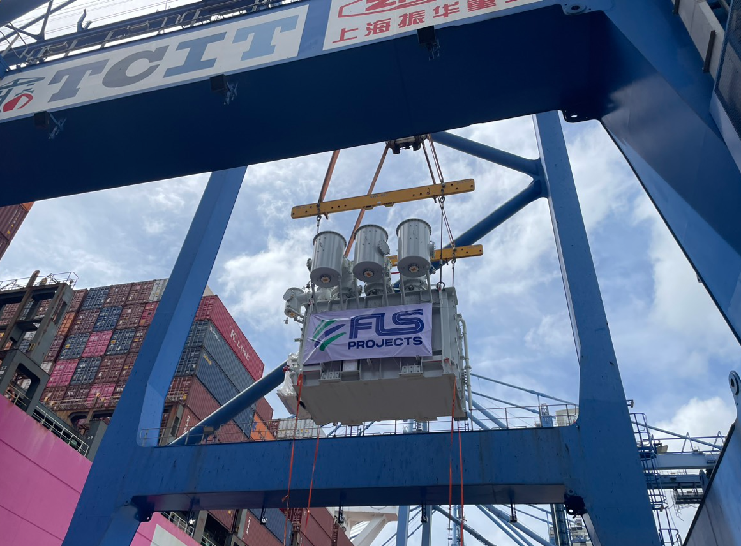
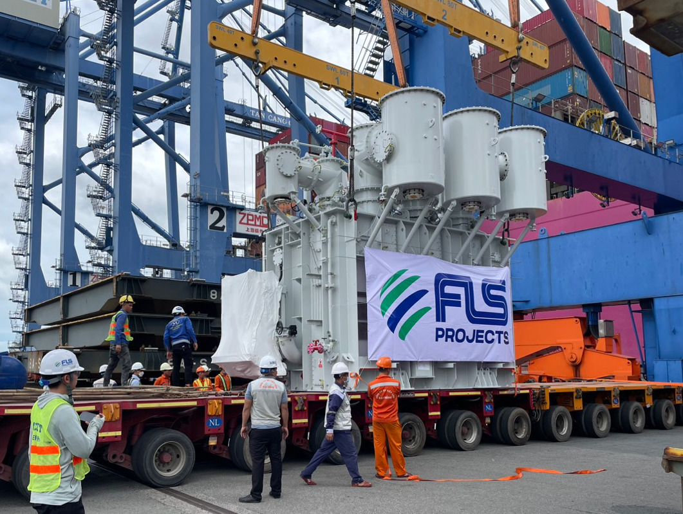
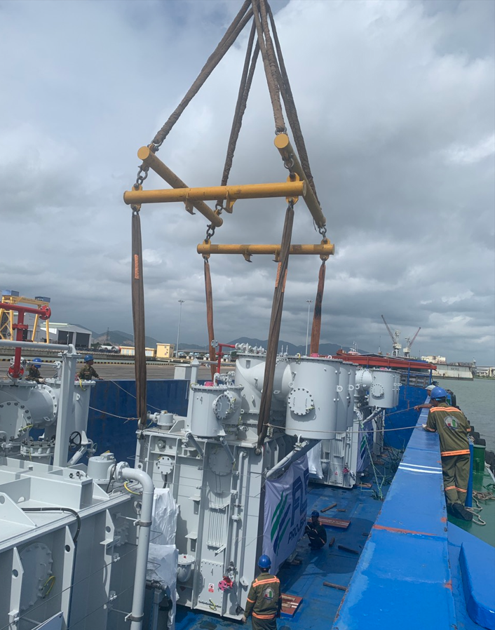
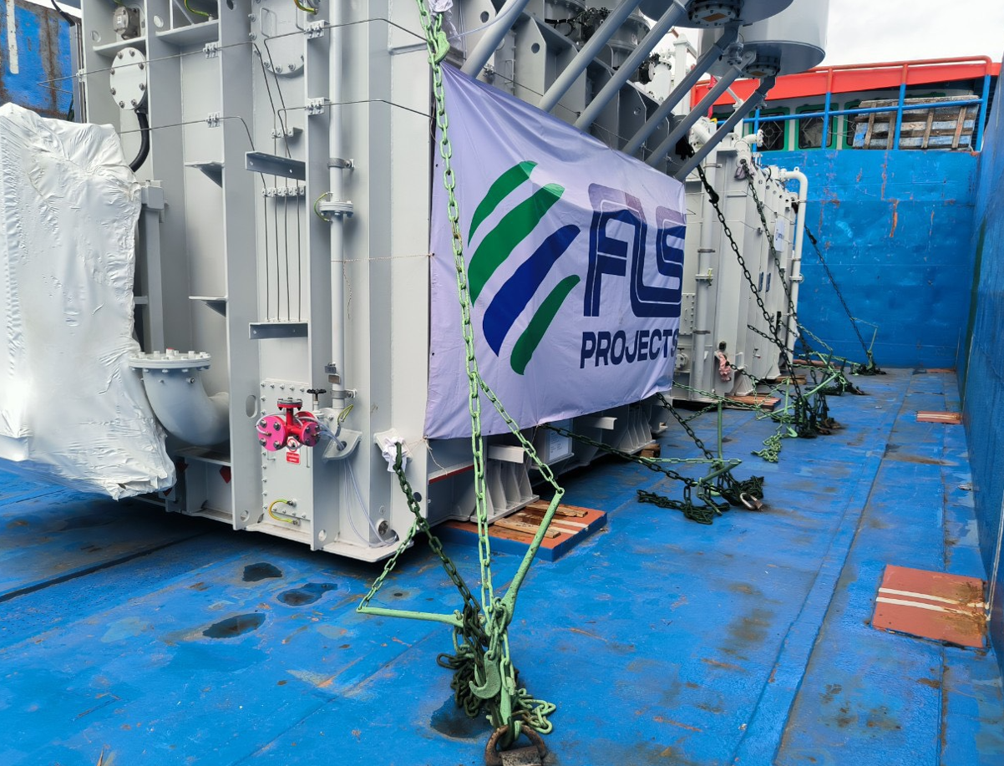
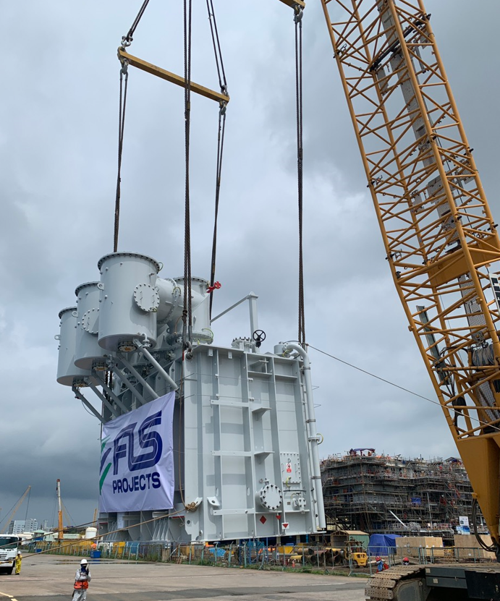
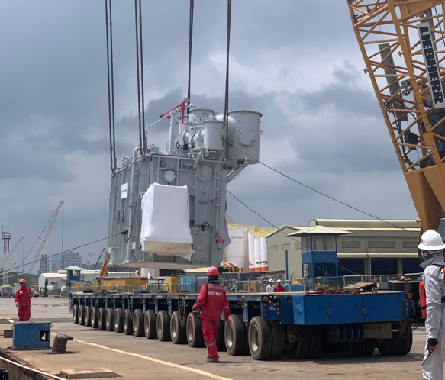
PROJECT REFERENCES
PROJECT REFERENCES
CASE STUDY – 4x transformer 69.1 tONS per each hai long PROJECT
Commodity: 4X 6.12x 4.37x5.16m , 69.1tons per each
Origin: Rotterdam , Netherland
Destination: PTSC port, Vietnam
Scope:
To receive cargo from container vessel at Container port
Load cargo on truck with trailer
Trucking to Bason port ready for load on barge
Barging to PTSC port facility
Loading onto trucks and barge incl appropriate cargo stow arrangements. Cargo hold preparation for loading, layout dunnage by FLS own stevedores
Lashing and secure proper for operation
Loading supervision by FLS Port Captain
16

Slide 17
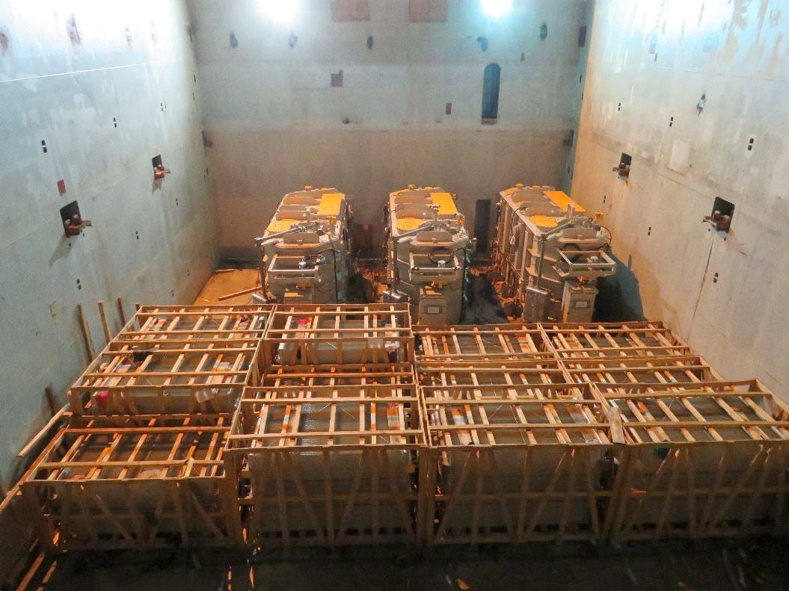
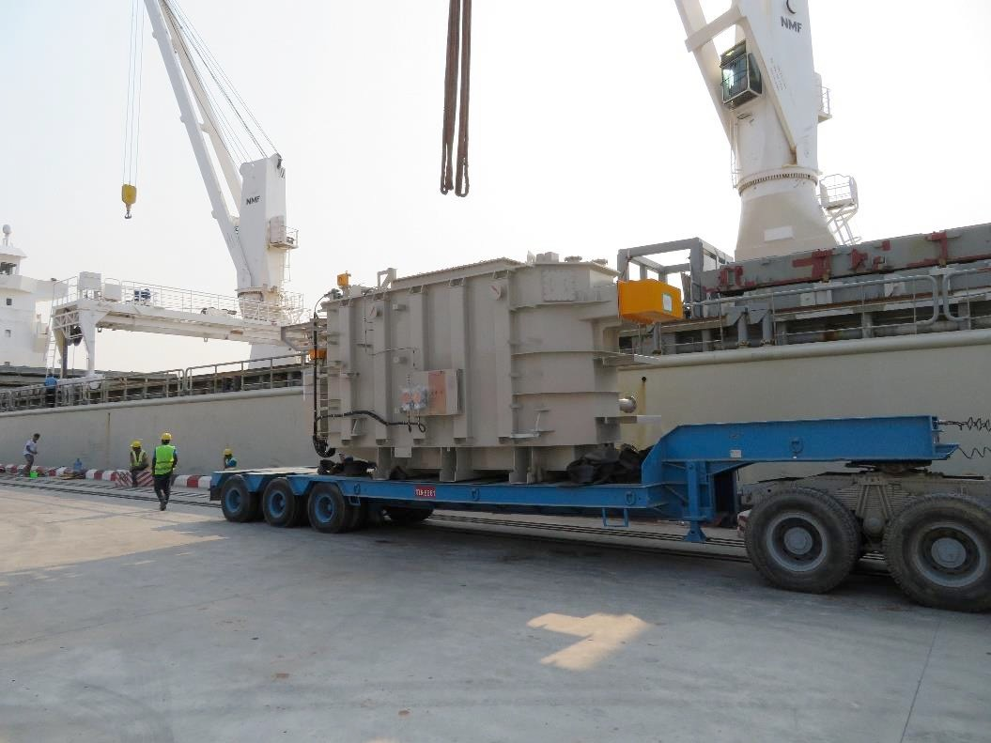
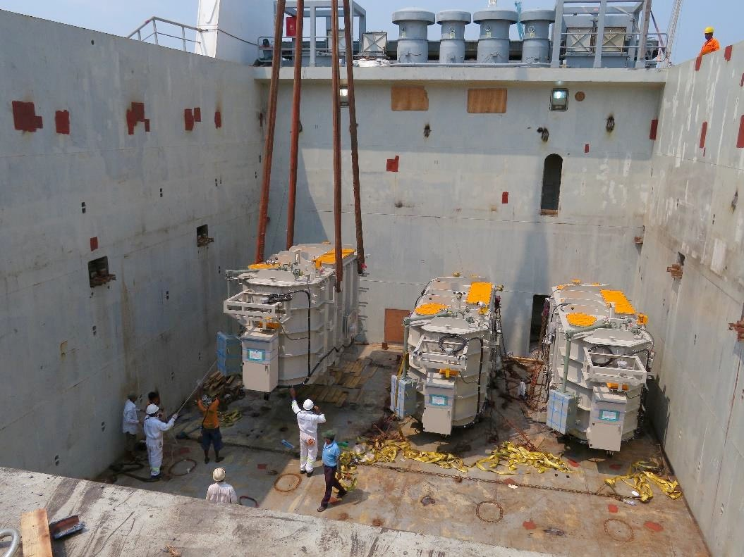
PROJECT REFERENCES
PROJECT REFERENCES
CASE STUDY – TRANSFORMERS #2
Volume: 505.4 CBM
Commodity: 3 Units of transformers and accessories (max weight 44mt)
Origin: Yokohama, Japan
Destination: Yangon, Myanmar
Year: 2018
Scope:
Chartering of suitable vessel for the cargo
Supervision at loading and discharge port
Liasing with all related parties for smooth operations
17

Slide 18
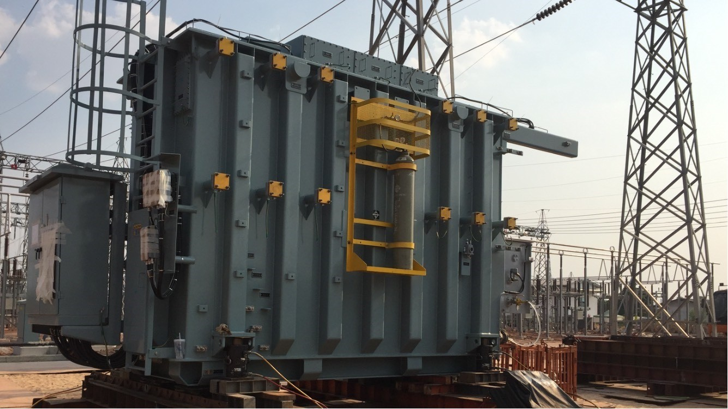
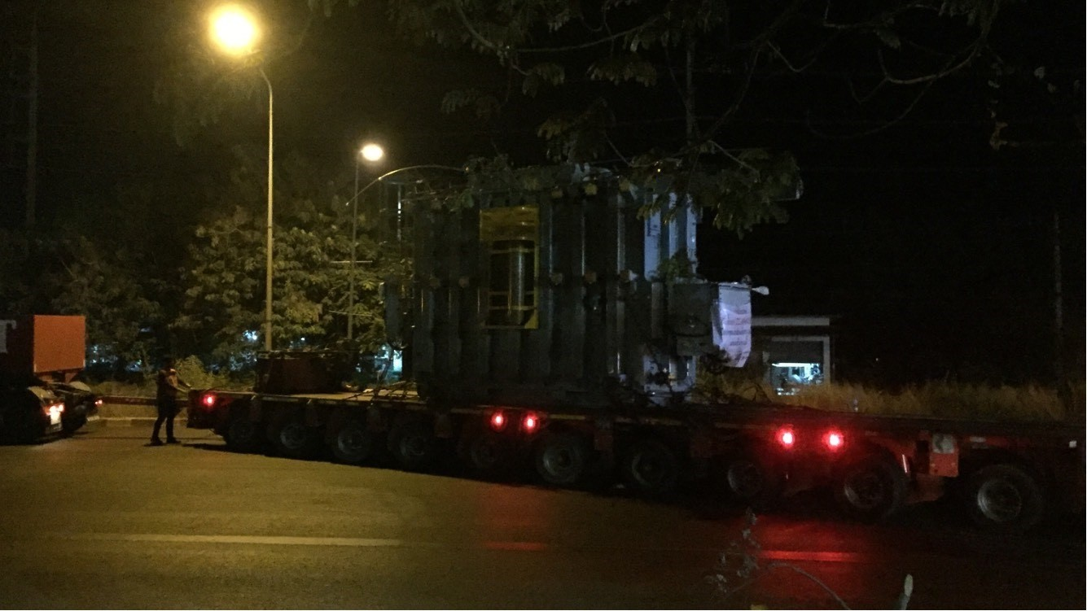
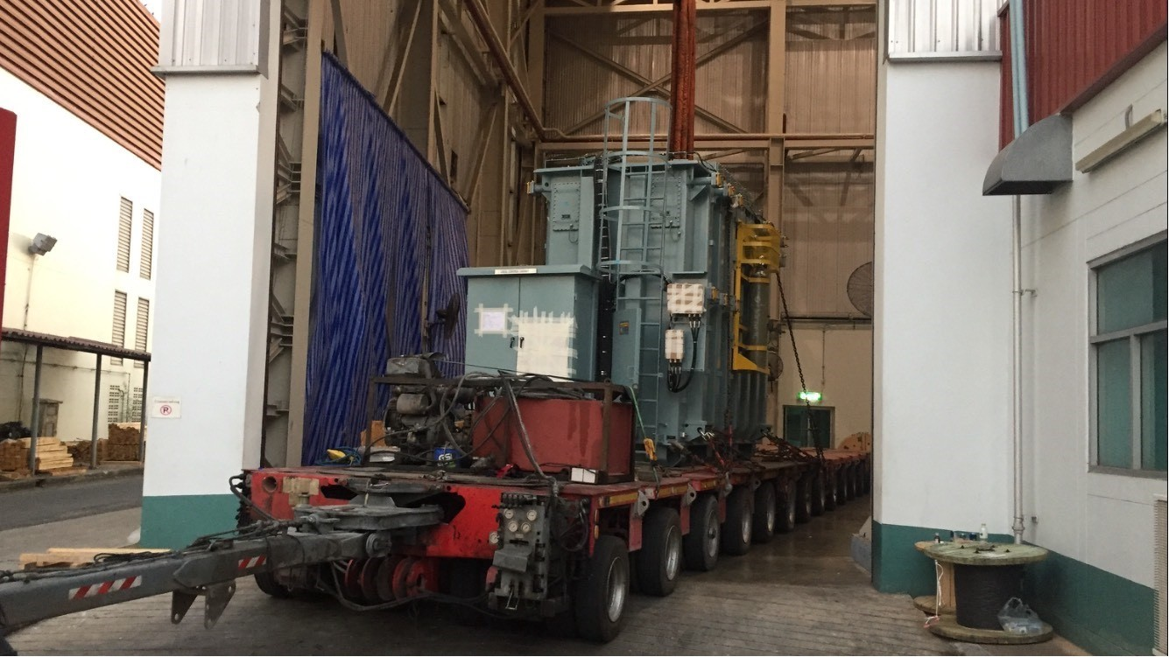
PROJECT REFERENCES
PROJECT REFERENCES
CASE STUDY – TRANSFORMERS #3
Commodity: Transformers and accessories (max weight 67mt)
Origin: Thai Trafo
Destination: Buriram, Thailand
Year: 2019
Scope:
Trucking
Transportation plan and DOH permit
Jacking and skidding at site
18

Slide 19
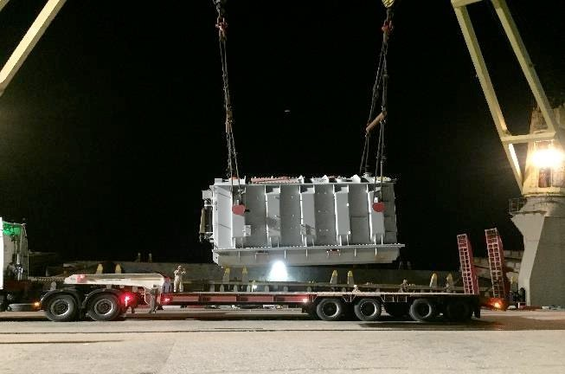
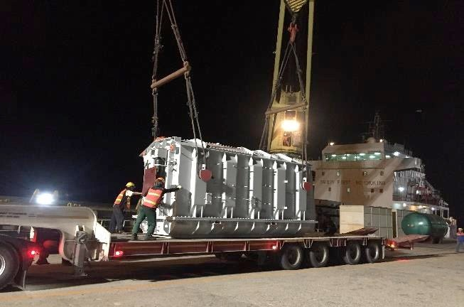
PROJECT REFERENCES
PROJECT REFERENCES
CASE STUDY – TRANSFORMERS #4
Volume: 250 CBM
Commodity: Transformers and accessories (max weight 44.1 MT)
Origin: Shanghai, China
Destination: Laem Chabang, Thailand for destination in Cambodia
Year: 2019
Scope:
Supervision at discharge port
Receiving cargo alongside vessel
Liasing with all related parties for smooth operations
Delivery to destination in Cambodia site by truck
Permit for delivery in Thailand and Cambodia
Jacking and Skidding transformer to foundation
19

Slide 20
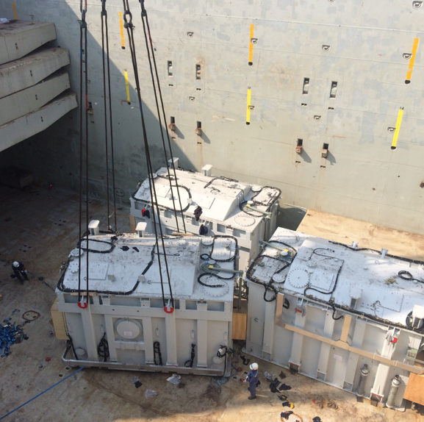
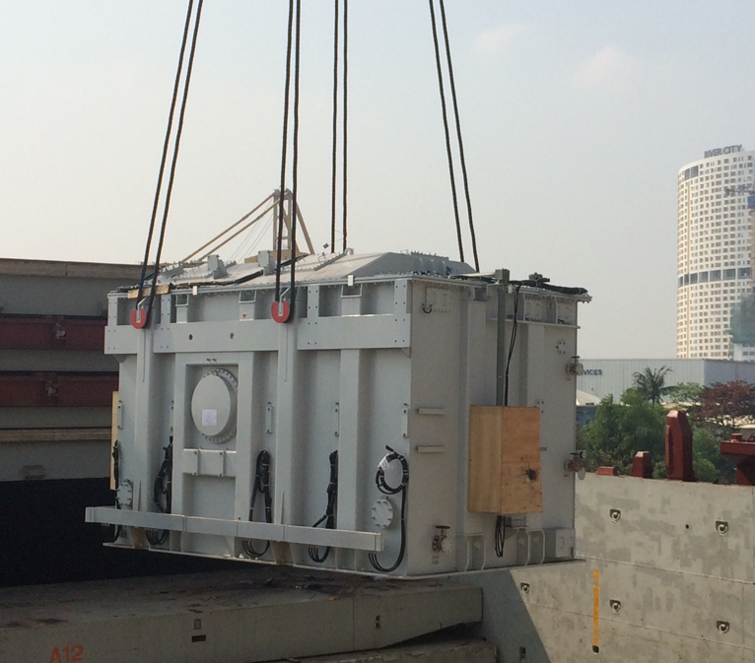
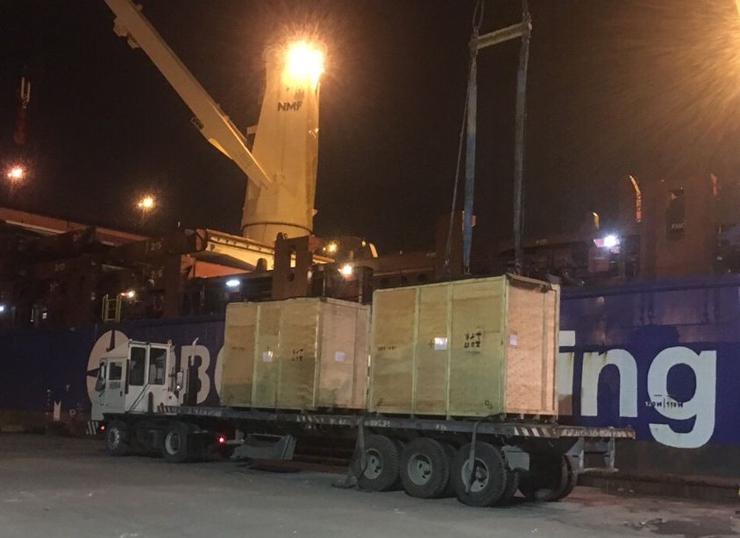
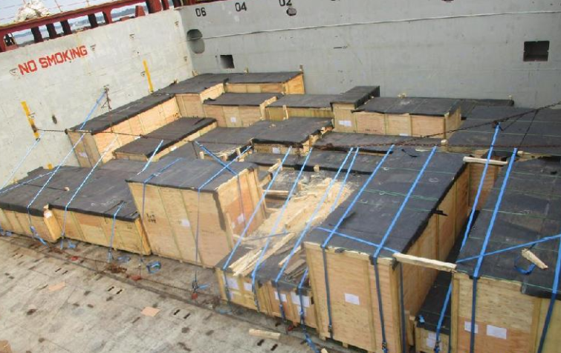
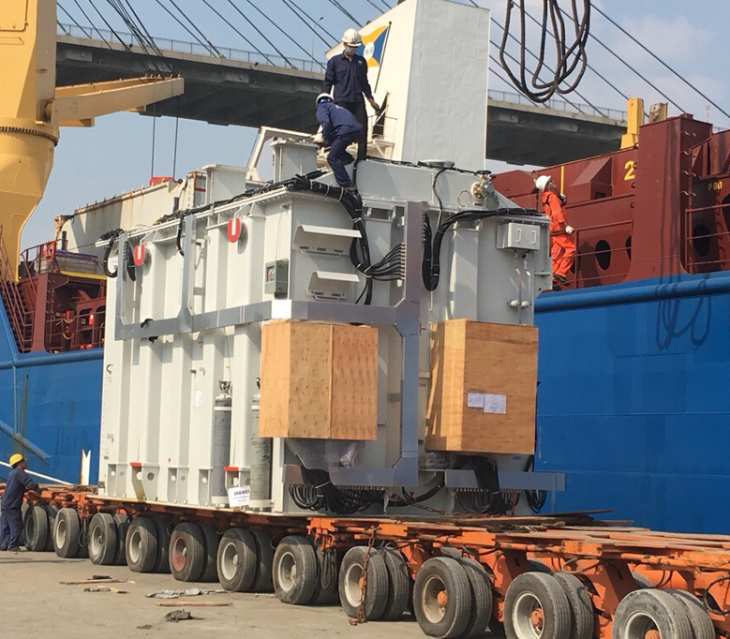
PROJECT REFERENCES
PROJECT REFERENCES
CASE STUDY – 744.9 CBM , 546 tONS 500kv tan dinh substation PROJECT
Volume: 744.9 CBM,546 MT heavy 3x155 MT
52 packages
Commodity: Transformer and Accessories
Origin: Shanghai port, China
Destination: Ho chi Minh, VietNam
Scope:
Full liner terms ocean freight
Chartering heavy lift vessel
Port handling and discharge to FAS
Discharge cargo out vessel incl appropriate cargo stow arrangements. Cargo hold preparation for discharge by FLS own stevedores
Discharge and load on trucks under supervision by FLS Port Captain
20

Slide 21
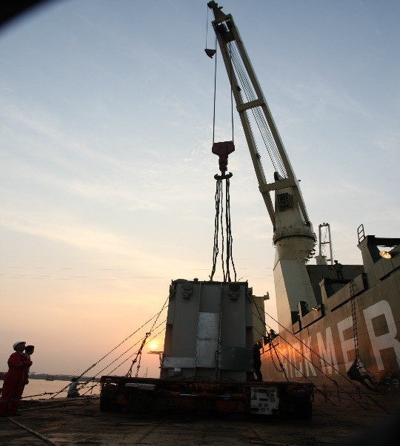
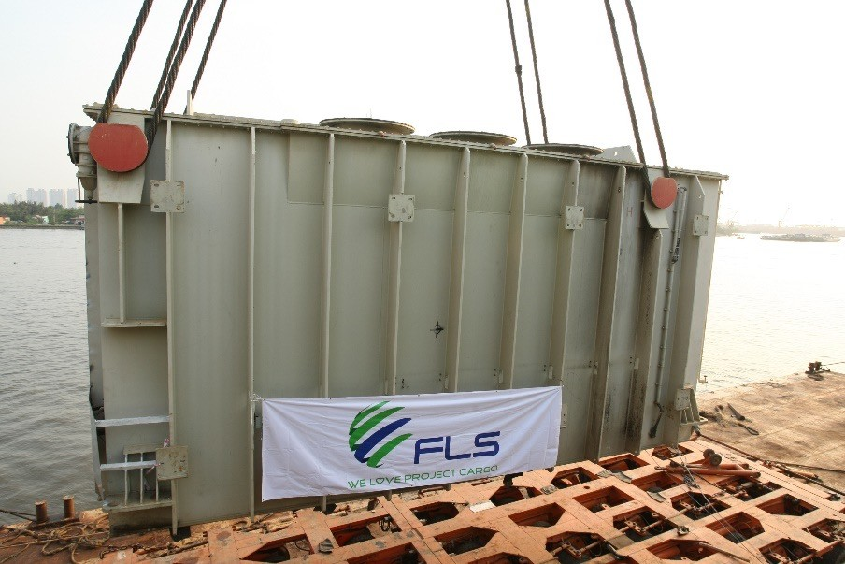
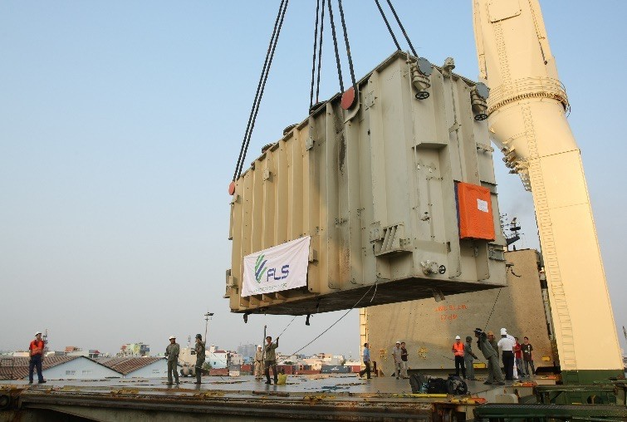
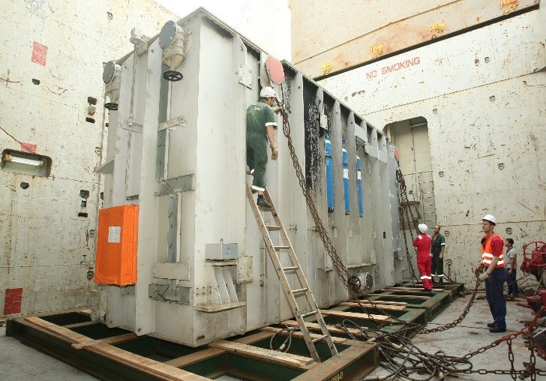
PROJECT REFERENCES
PROJECT REFERENCES
CASE STUDY – 1x TRANSFORMER EA 74 TONS
Volume: 9.50 x 3.20 x 4.65 M, 74 MT
Commodity: Transformer
Origin: Phu My / HCMC
Destination: Qingdao
Scope:
Order from Phu My 3 BOT Co. Ltd to transport a broken transformer from Phu My site foundation to Quingdao port for a repairing job at Siemens China workshop.
FLS arranged pre-carriage ex site foundation and barging alongside ocean vessel.
As well as part chartered a heavy lift vessel shipping the 202MT Trafo from HCMC port to Quingdao port
Return transport including vessel chartering back to Vietnam had been arranged by FLS as well.
21

Slide 22
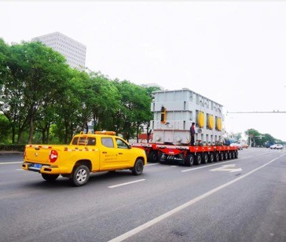
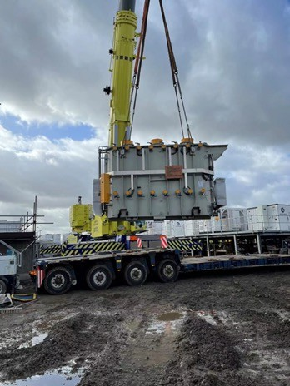
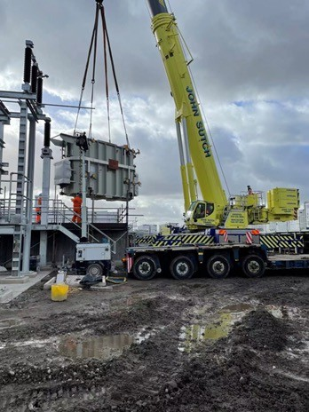
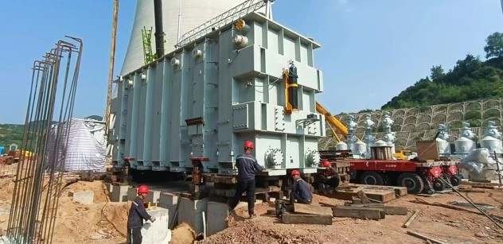
PROJECT REFERENCES
PROJECT REFERENCES
CASE STUDY – 350MT DOMESTIC TRANSPORT AND JACKING
Volume: 350 MT heavy, 1 package
Commodity: Transformer
Origin: China
Scope:
Transportation from factory to job site for Toshiba
Jacking and skidding from trailer onto trafo foundation
Jacking down onto foundation including alignment under the supervision by a FLS Project Manager
22

Slide 23
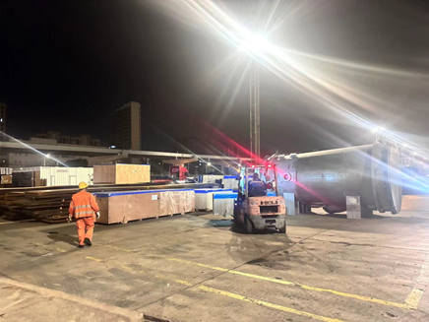
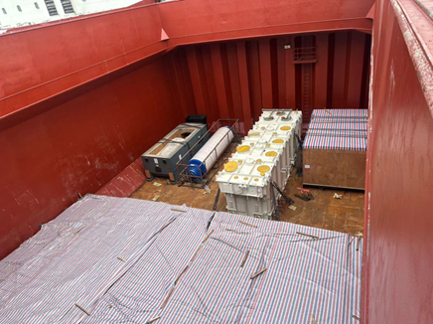
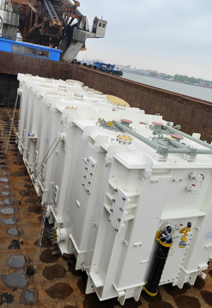
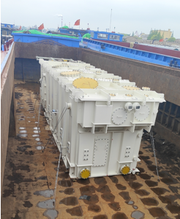
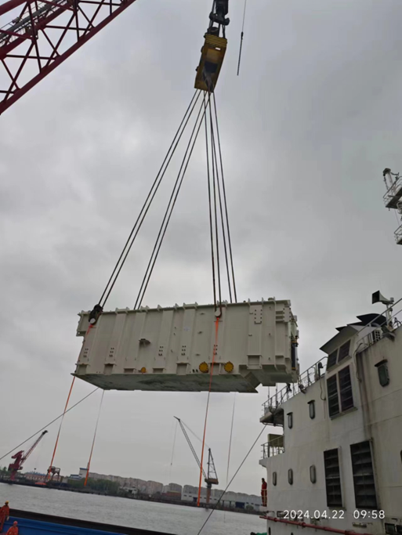
PROJECT REFERENCES
PROJECT REFERENCES
CASE STUDY – 354m3 , 173 tONS pre-carriage and port handling
Volume: 354 m3 ,173tons heavy 1x145tons
25 packages
Commodity: 25 transformers
Origin: Shanghai port, China
Destination: Hai Phong, VietNam
Scope:
Pre-carriage from Changzhu factory and pre-carriage to Shanghai port
Port handling and discharge to FAS
Pre-carriage and port handling incl appropriate cargo stow arrangements. Cargo hold preparation for loading by FLS own stevedores
Discharge and load under supervision by FLS supervisor
23

Slide 24
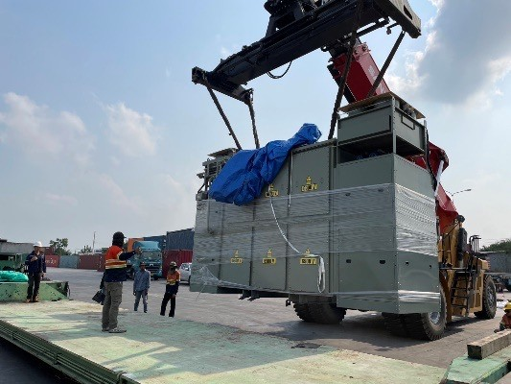
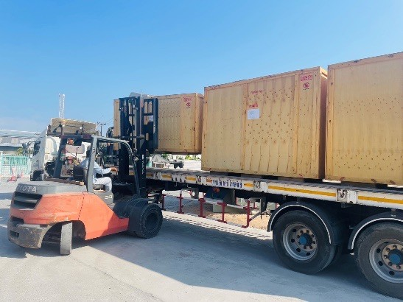





PROJECT REFERENCES
PROJECT REFERENCES
CASE STUDY – TIRATHAI PUBLIC COMPANY LIMITED
Volume: Each between 18 – 25 MT
Commodity: 25 transformers
Origin: Trucking from Tirathai Public Company Limited
located in Bang Poo Industrial Estate
Destination: Natureworks site at Nakornsawan
Scope:
Lashing securing on flat racks and lowbeds
Transport on lowbed trailer
Offloading from flat racks via mobile crane
Position to place of rest / offloading and positioning in the power house
Reading shock recorders
Site supervision with our experienced FLS Project Manager
24

Slide 25






PROJECT REFERENCES
PROJECT REFERENCES
CASE STUDY – BATU HIJAU CCPP-1 PROJECT
Project Name: BATU HIJAU CCPP-1 PROJECT
Commodity: GAS TURBINE GENERATOR SYSTEM
Volume: EX NRK: 73 PKGS / 327,640.00 KGS / 1,447.836 CBM (Heaviest: 90MT)
EX HAM: 80 PKGS / 370,092.76 KGS / 1,560.838 CBM (Heaviest: 86MT)
EX HAY: 26 PKGS / 81,746.00 KGS / 1,139.633 CB
Destination: Benete Bay
Scope:
Loading from Ex Norrkoping, Hamburg & Haydarpasa and discharge at Benete Bay
25

Slide 26




PROJECT REFERENCES
PROJECT REFERENCES
CASE STUDY – Saha cogen & egco cogen
Project Name: SAHA COGEN & EGCO COGEN
Volume: Approx 5,700 CBM
Commodity: Gas Turbine, Generator and Accessories
Origin: Mersin, Hamburg, Norrkoping
Destination: Laem Chabang, Thailand
Scope:
Booking vessel according to client’s requirement
Coordinating with shippers at origins for delivery cargo alongside
Coordinate with vessel agents and vessel owner, port Captain for proper loading / lashing method as per client’s instruction
Loading survey at Origins and Discharging supervision at destination
26

Slide 27






PROJECT REFERENCES
PROJECT REFERENCES
CASE STUDY – SUNCOR, CANADA
Volume: 273 packages / 13,366 CBM / 5,800 MT
Origin: Penglai + Zhangjiagang + Masan
Destination: Longview, USA
Scope:
Full liner terms Ocean freight
Shrink wrapping and protection
Pre-carriage cargo ex-work to port
Chartering Heavy lift vessel
Under dynamic covid condition
In house designed lifting frame SWL 216mt tandem lift, SWL 166.5 single lift BV Class Certificate, FEA calculation
27

Slide 28



PROJECT REFERENCES
PROJECT REFERENCES
Case Study – 1500 TON BULK SHIPLOADER
Dimensions: 135 x 25 x 43 M – 1,500 MT
Commodity: Radial Quadrant Shiploader
Origin: Phu My, Vietnam
Destination: Vancouver, Canada
Ground preparation (foundation)
Leveling of transport route
Removal of light towers, fire rquipment, concrete divider
Shifting via 96 SPMT axles
Setup + movements were shaped to match the schedule of the vessel, construction team + port operator
Supervision by multiple FLS professionals
Scope:
28

Slide 29




PROJECT REFERENCES
PROJECT REFERENCES
CASE STUDY – BIOPOWER UNIT
Project name: BioPower Unit
Dimensions: Unit 1: 36 x 18.3 x 8.3 M / 700 MT
Unit 2: 13.2 x 9.2 x 5.56 M / 61 MT
Commodity: Renewable Energy System Vung Tau Anchorage
Origin: Vung Tau, Vietnam
Destination: Australia
Chartering of a suitable geared multi-purpose heavy lift vessel
Co-ordination of the FAS delivery (Roll-out onto barge via SPMT’s)
Loading and securing the cargo board of the vessel
Subsea installation in Australia incl. all customs and quarantine formalities, as well as divers
Extended scope: Use of the ships dynamic positioning (DP2) system, to discharge from deck under water onto the foundation
Scope:
29

Slide 30
office.vn@fls-group.com
+84 828 73 002 864
30

