Slide 1
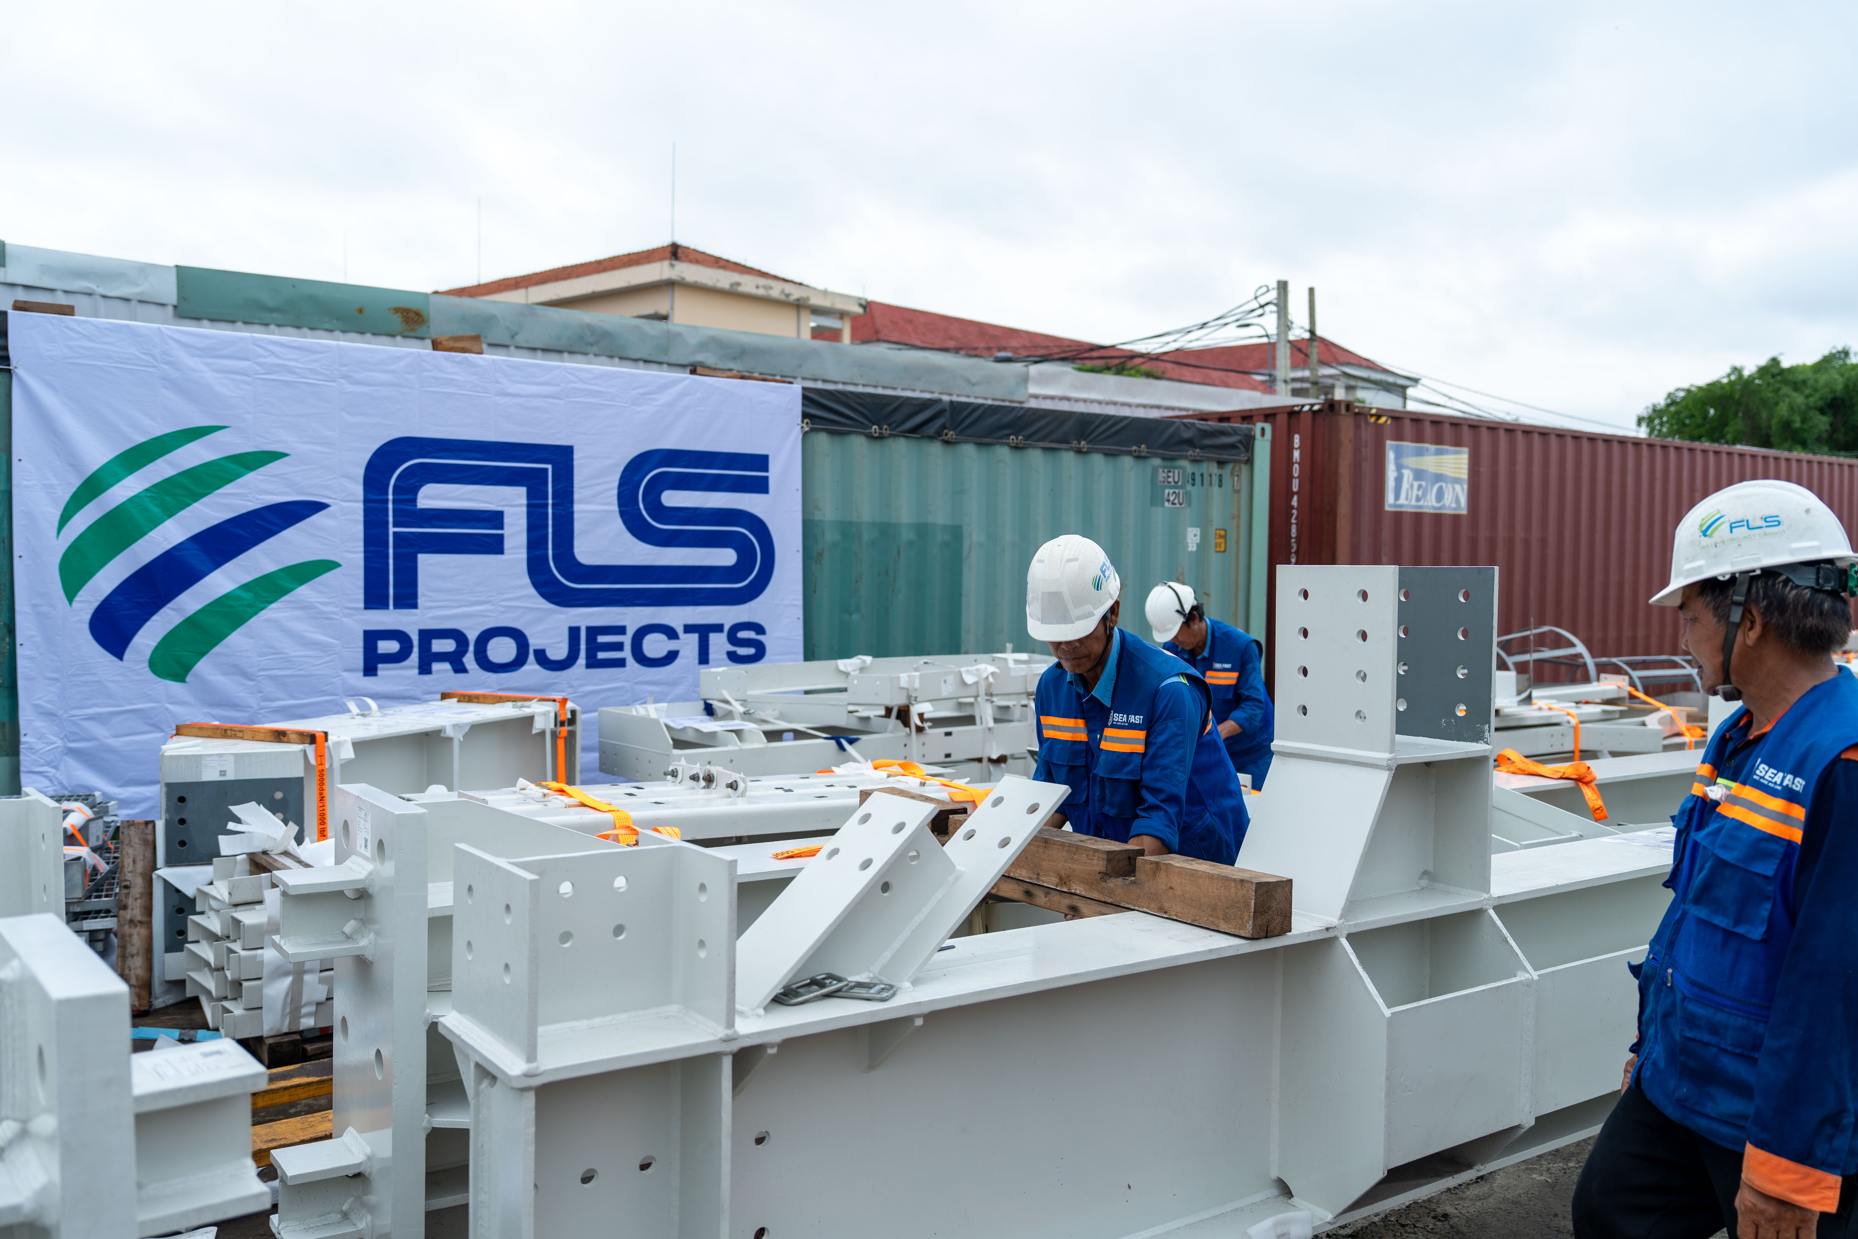
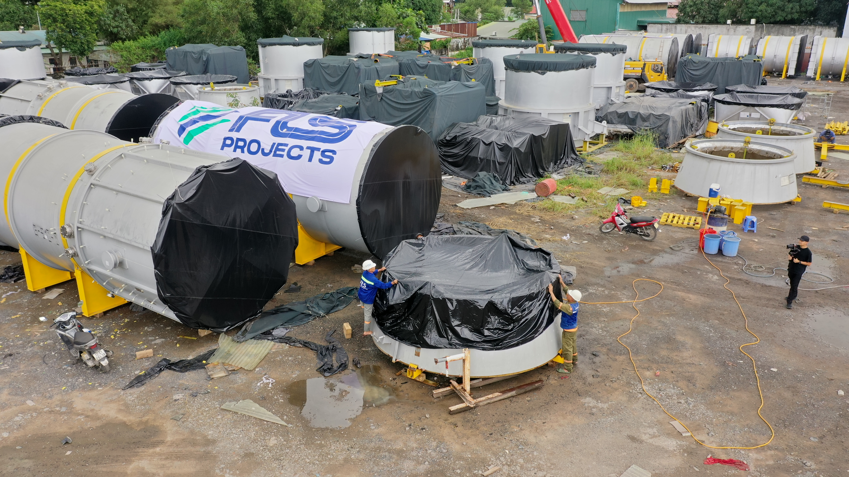
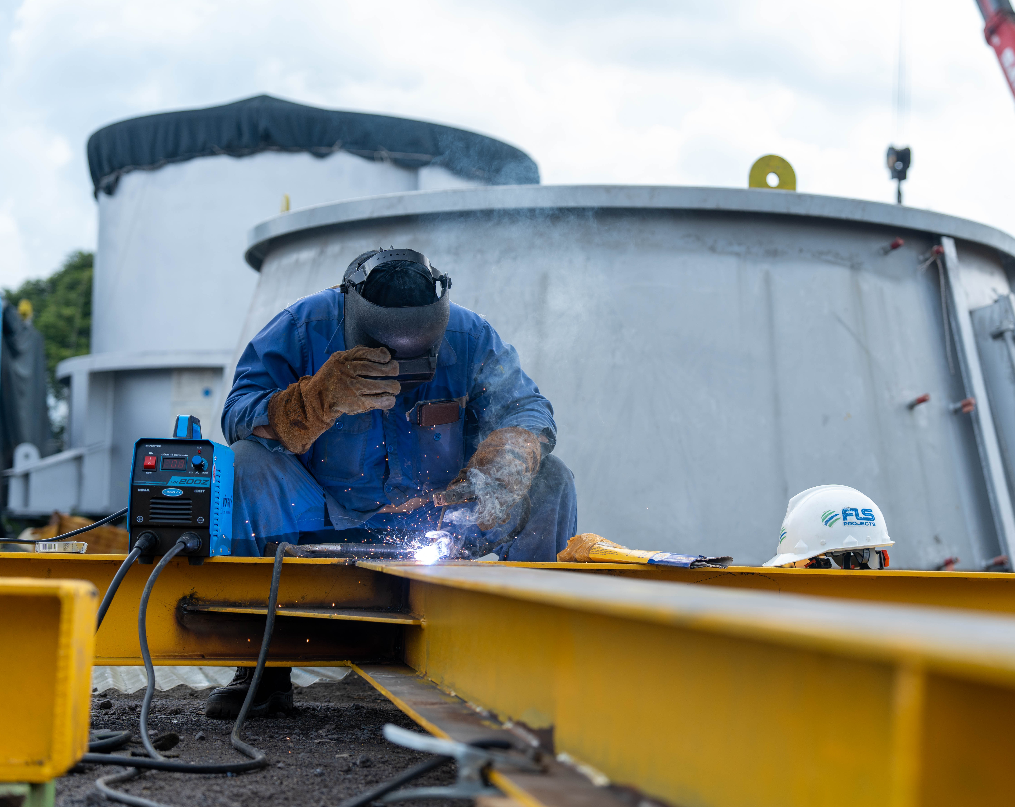
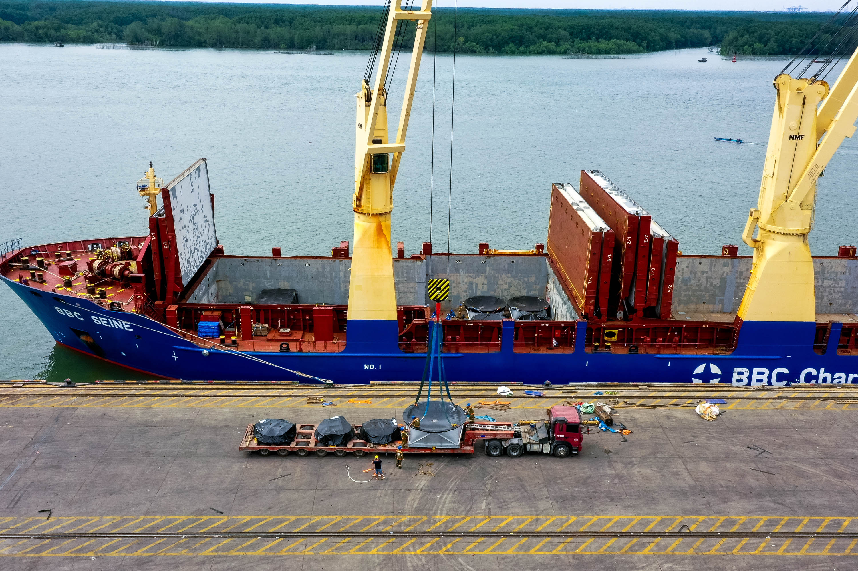
PROJECT REFERENCES
PROJECT REFERENCES
Industrial Machinery Export — Vietnam to USA
Volume: 280+ containerized pieces + 66 break-bulk units (20 MT steel)
Commodity: Industrial machinery & oversized break-bulk units
Origin: Vietnam
Destination: USA
Long-term warehousing and routine cargo maintenance from 2020
Intensive repacking of 280+ containerized pieces within 40 days
Steel framework fabrication for 66 oversized break-bulk units
Procurement of 25 SOC containers (40' OT and 40' DC) with SCS certification
Lashing and fumigation of all units in compliance with US standards
24/7 transport operation with Free Alongside Ship (FAS) delivery to vessel
Scope:
1

