Slide 1
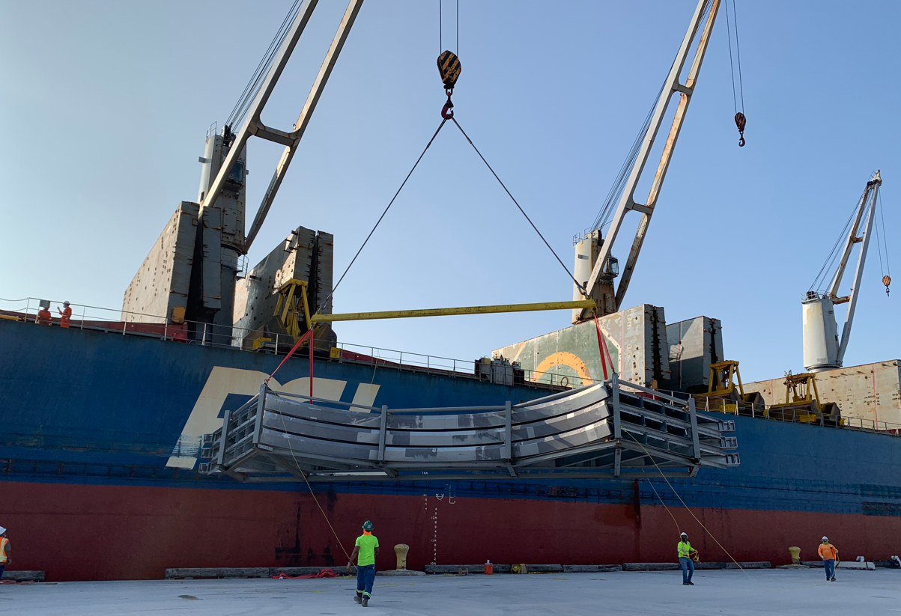
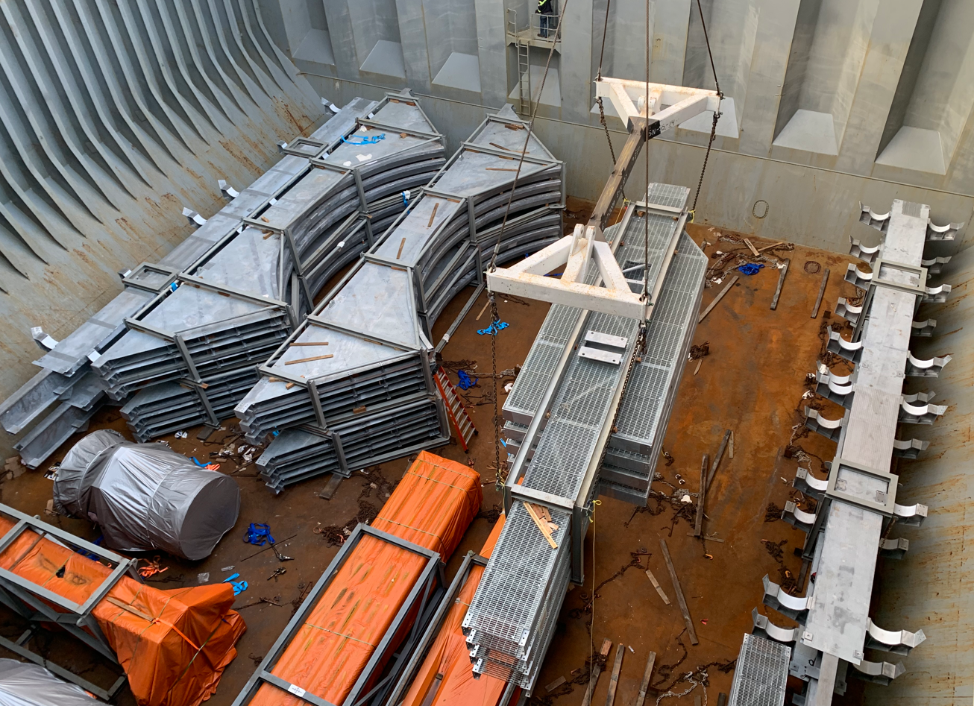
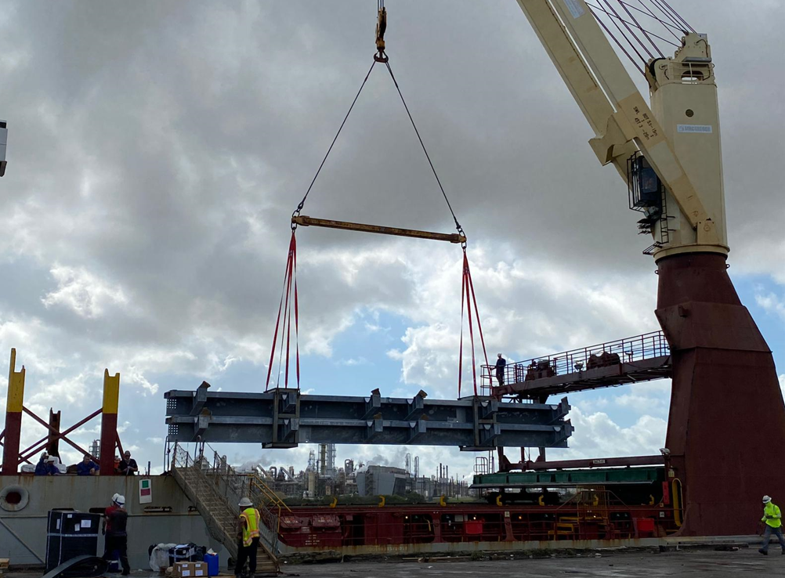
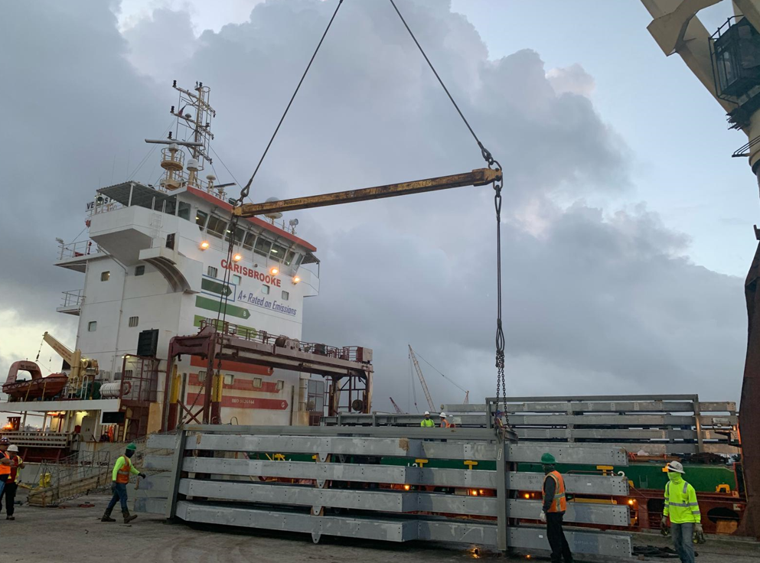
PROJECT REFERENCES
PROJECT REFERENCES
CASE STUDY – JACKSON POWER PLANT Elwood, IL USA
Volume: 8,816 CBM , 1,538 MT Break Bulk
Containers: 160 x40’ HC Weight 2,400 MT
Commodity: Steel Structures
Origin: Vung Tau, Vietnam
Port of Discharge: Houston TX USA , DAP Elwood, IL, USA
Trucking from workshop up to the export terminal
Chartering of a Suitable multi-purpose heavy lift vessel
FLS was the communication tool between cargo and vessel owners, customs, port authority, tug operators, marine warranty surveyors and stevedores
Our port captains have been on scene for supervising purposes
Discharge in Houston, TX and trucking up to the job site in Elwood, IL, USA.
Scope:
1

