Slide 1
POWER AND PETROCHEMICAL PROJECTS PRESENTATION
03th Apr 2026
1

Slide 2
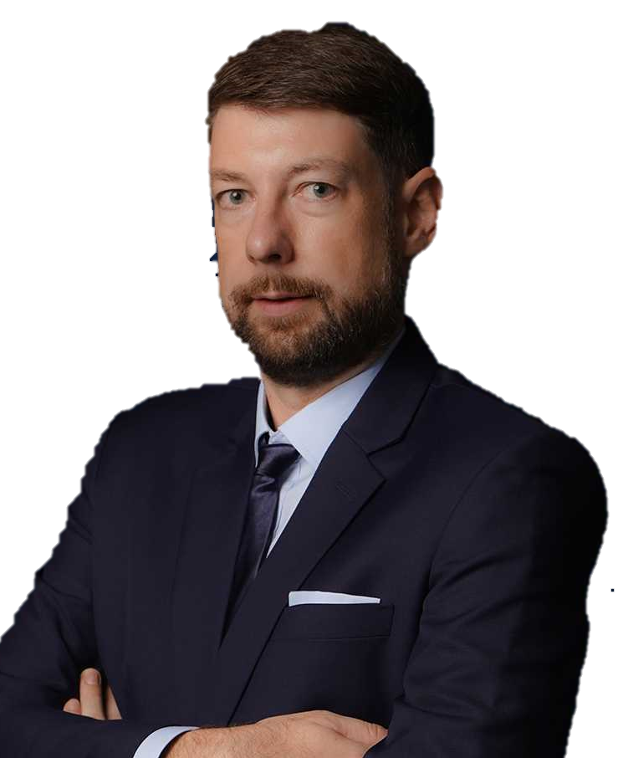
OUR MISSION:
“We keep the world moving, by deploying the best expertise to craft tailor-made solutions that solve the most challenging logistic problems all around the world.”
TORBJÖRN LARISCH
CHIEF EXECUTIVE OFFICER

Slide 3
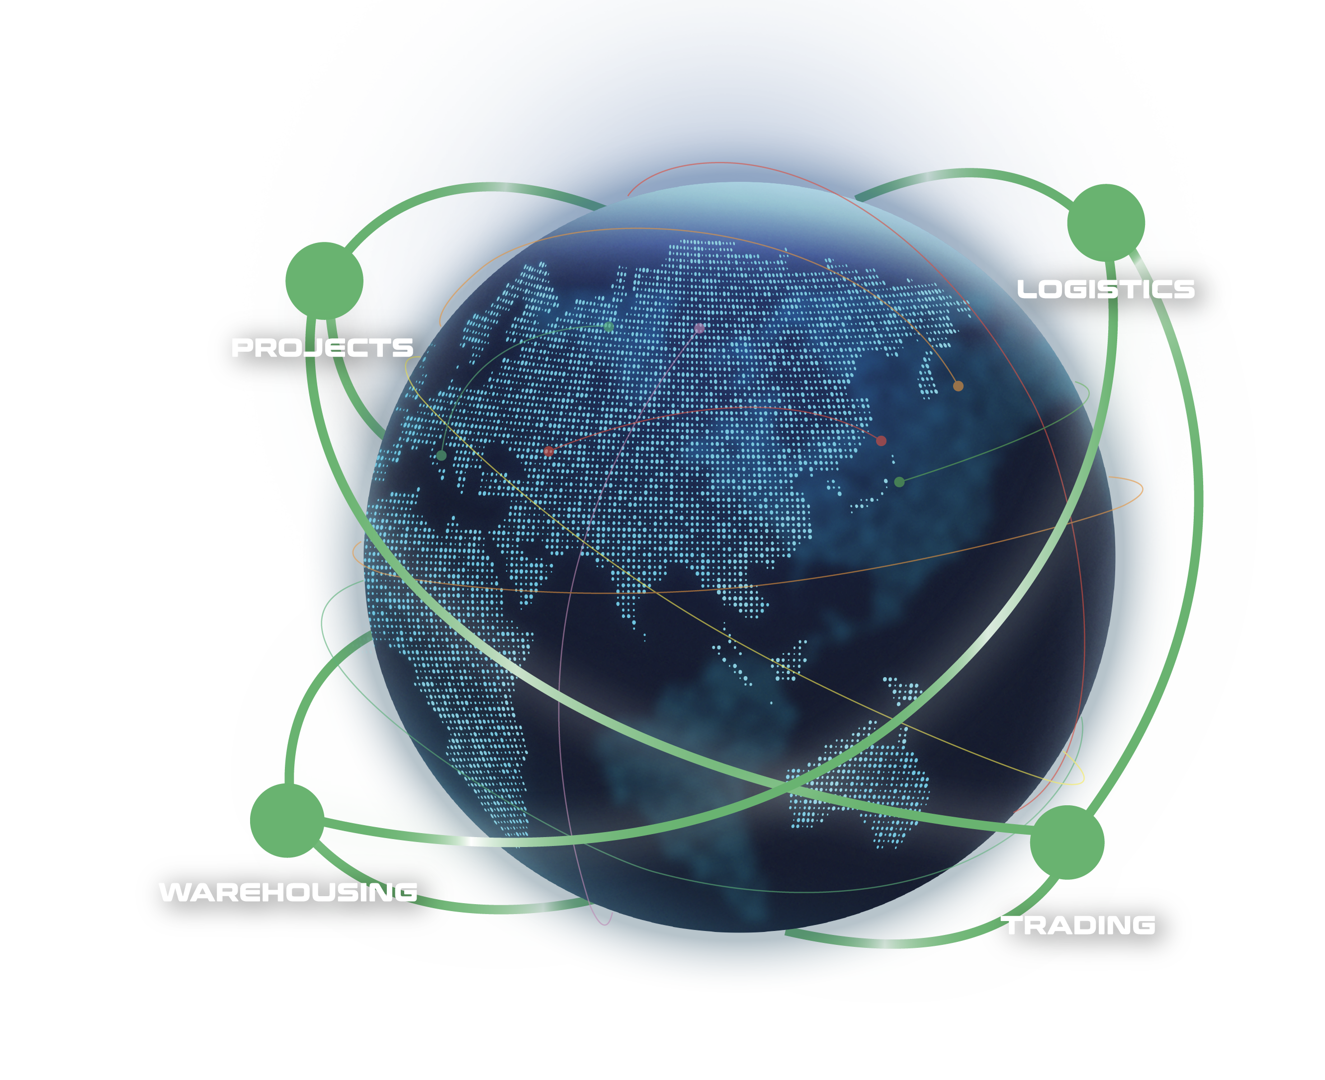
WHAT ARE OUR CAPABILITIES
Our interconnected supply chain solutions are tailor-made to keep your world in business.
OUR VISION:
To be recognized globally as the logistics experts who understand and empower global business leaders to dream and act big; moving the world forward.
PROJECTS: With expert hands, we handle the complicated with precision.
LOGISTICS: We humanize a seemingly standardized experience.
WAREHOUSING: We envision spaces that bring supply chains to the next level.
TRADING: We define and shape solutions to meet ever-changing needs.
3

Slide 4
FLS SNAPSHOT
32
500+
100+
years of experience
professionals
global partners
14
$65 million
countries
is the largest single contract award
ANNUALLY
15,000+
5,000+
trucks moved
customs clearance cases
25,000+
20,000+
14 million kg
$219 million
TEUs shipped
shipments delivered
air freight cargo handled
consolidated revenue
4

Slide 5
FLS HISTORY
FLS ventured more and more into handling export projects from steel fabricators in Thailand, Korea, China, Vietnam, Malaysia and Indonesia to global destinations for major engineering companies in the Power, Petrochemical and Mining industries.
After almost three decades, we have expanded our services from project cargo into a wider portfolio include:
FLS Logistics
FLS Warehousing
FLS Trading
Neon Orient acquisition
FLS Supply Chain Center establishment
2001 – 2010
2020 – 2023
1993 - 2000
2011 – 2020
NOW
The company was founded in Bangkok in May 1993 by Martin Häberli when he was awarded several major projects in Thailand.
In 2011 FLS (Vietnam) Ltd. was established, followed by
FLS (Australia) Pty Ltd. in 2013
FLS (Singapore) Pte Ltd. in 2014
PT. Federal Logistik Sistem (Indonesia) in 2014
FLS Projects (USA) Inc. in 2016
FLS Projects (Taiwan) Ltd. in 2016
FLS Projects (Malaysia) Sdn. Bhd, in 2018
FLS 1993 (India) Pvt Ltd.
In 2024, we embarked on a new chapter, broadening our global reach with the establishment of
FLS Scandinavia
FLS Norfolk, USA
FLS Group (Japan)
ITL acquisition
FLS Philippines
FLS Italy
5

Slide 6
OUR GLOBAL PRESENCE
USA
Denmark
India
Thailand
Italy
China
Japan
Myanmar
Vietnam
Philippines
Malaysia
Singapore
Australia
FLS Offices
Indonesia
FLS close network partners
6

Slide 7
OUR COMPETENCIES
EXPERIENCED
COMPETIVE
More than 30 years of experience
Global access to carriers, local contract negotiations
FLEXIBLE
INNOVATIVE
Matching right partners for each project
We can solve problems with creative solutions and will adjust our operation to your requirements
PRO-ACTIVENESS
Eyes and ears always on the market and therefore can react to possible constraints early
DYNAMIC
Growth through opportunity, where others see a problem, we see an opportunity
Fast decision-making process
CONTINUITY
High employee retention rate: average is 8.32 years. Some key staff have been with FLS for more than 15 years
7

Slide 8






WE ARE A PROUD MEMBER OF:
8

Slide 9
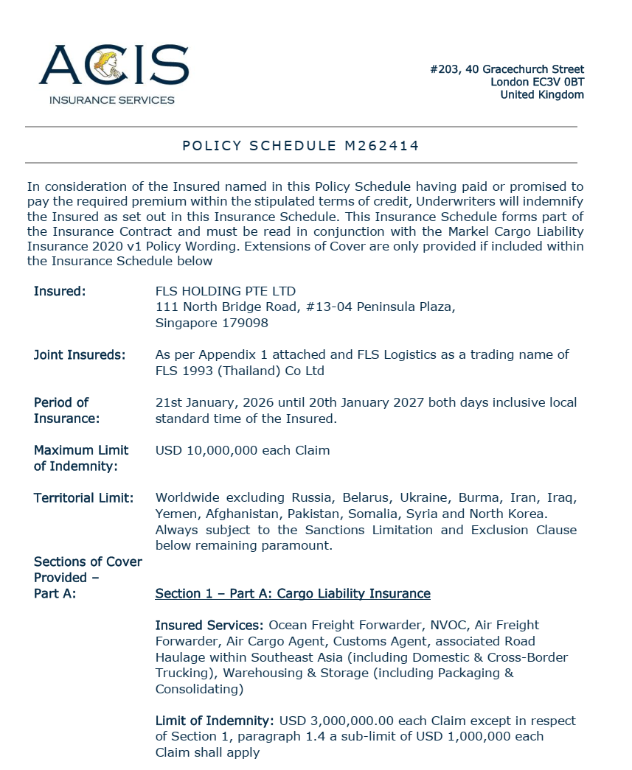
INSURANCE POLICY
Base coverage:
Cargo liability
USD 3,000,000 each claim
3rd party legal liability
USD 3,000,000 each claim
Professional indemnity
USD 400,000 each claim
Fines and duties liability
USD 100,000 each claim
Please note: Limits are flexible & negotiable, and liabilities can be extended on request and a case-by-case basis. Marine cargo insurance can be provided. on request.
9

Slide 10
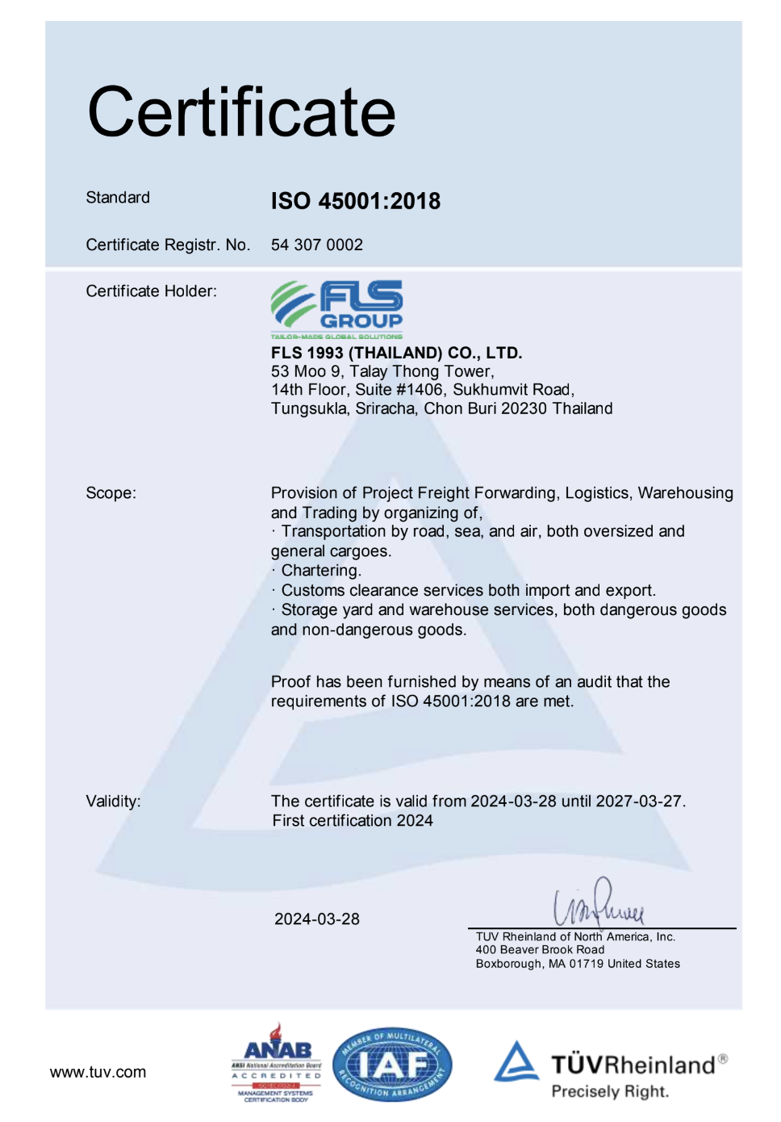
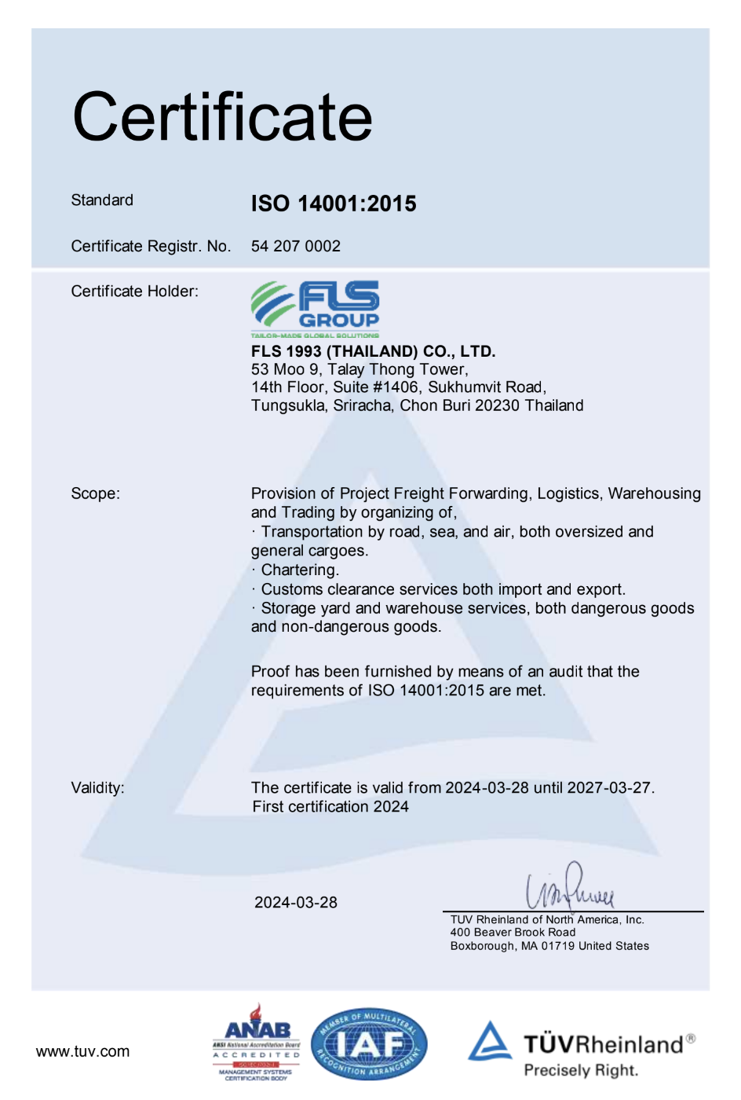
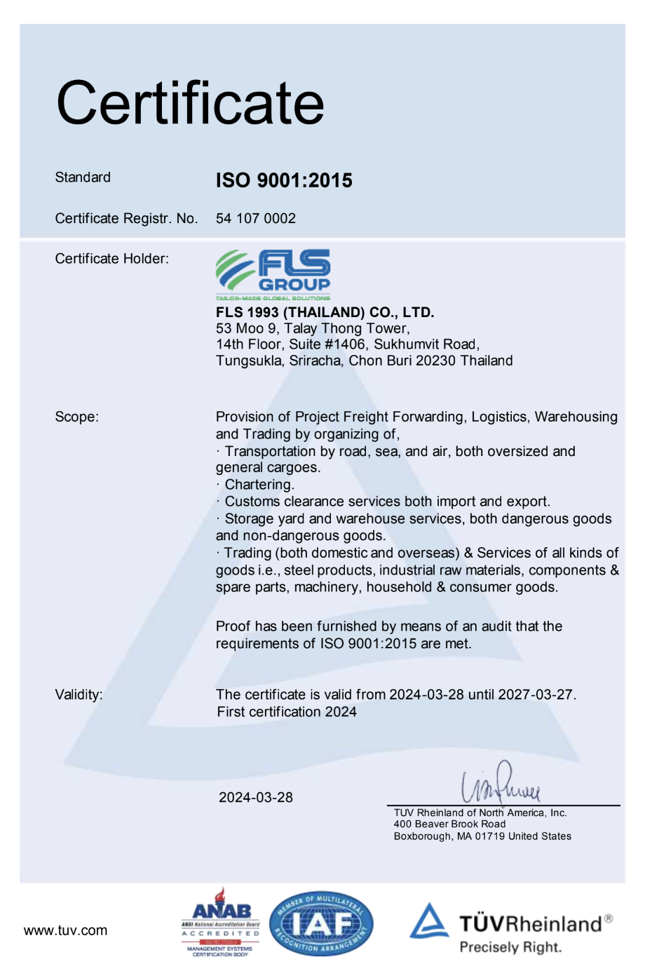
HSEQ Procedures
SAFETY, QUALITY & INTERNATIONAL COMPLIANCE
ISO 45001:2018 CERTIFICATE
ISO 4001:2015 CERTIFICATE
ISO 9001:2015 CERTIFICATE
ISO-certified own operations in Thailand, Australia, Singapore, USA, Vietnam, Taiwan, Indonesia, Malaysia, India and Myanmar.
10

Slide 11


SAFETY, QUALITY
& INTERNATIONAL COMPLIANCE
QUALITY ASSURANCE
HEALTH & SAFETY
OUR STANDARDS
FLS Quality Management Systems meet all our customer’s applicable statutory and regulatory requirements.
We use one of the world’s leading modular enterprise systems to streamline operations, accounting and business development.
Provide Health & Safety training for all members of staff as well as blue-collar and sub-contracting parties.
Follow international rules and guidelines to foster a safe and healthy working environment for our teams.
Ensure that each project and every shipment is handled in a safe, timely, systematic, and efficient manner.
We select and work only with agents and partners who:
are fully certified to international standards
fulfill our own strict quality standards
have sufficient insurance coverage
operate with well-maintained and regularly tested equipment
are well managed and staff regularly trained
have a long successful history and proven track record.
11

Slide 12

OCCUPATIONAL HEALTH, SAFETY
AND ENVIRONMENTAL POLICY
FLS requires the active commitment to, and accountability for, occupational health, safety and environment from all employees and contractors.
Comply with all relevant legislations and corporate requirements of OHSE;
Meet specified customer requirements and ensure continuous customer satisfaction;
Protect, and strive for improvement of, the health, safety and security of our people at all time;
Eliminate accidents and minimize potential risks;
Set OHSE performance objectives, measure results, assess and continuously improve processes and services, through the use of an effective management system;
Plan for, respond to and recover from any emergency, crisis and business disruption;
Minimize our impact on the environment through pollution prevention, reduction of natural resource consumption and emissions, and the reduction and recycling of waste;
Apply our technical skills to all OHSE aspects in the design and engineering of our services;
Communicate openly with stakeholders and ensure an understanding of our OHSE policies, standards, programs and performance. Reward outstanding OHSE performance;
Improve our performance on issues relevant to our stakeholders that are global concern and on which we can have an impact and share with them our knowledge of successful OHSE programs and initiatives.
12

Slide 13

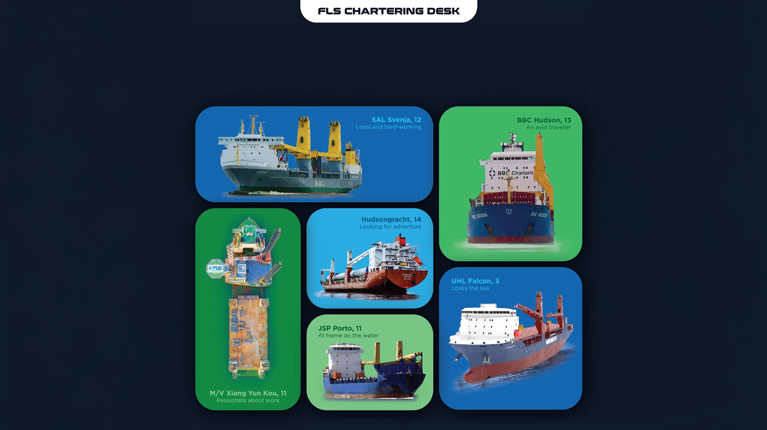
WE’LL FIND YOU
THE PERFECT MATCH

Slide 14
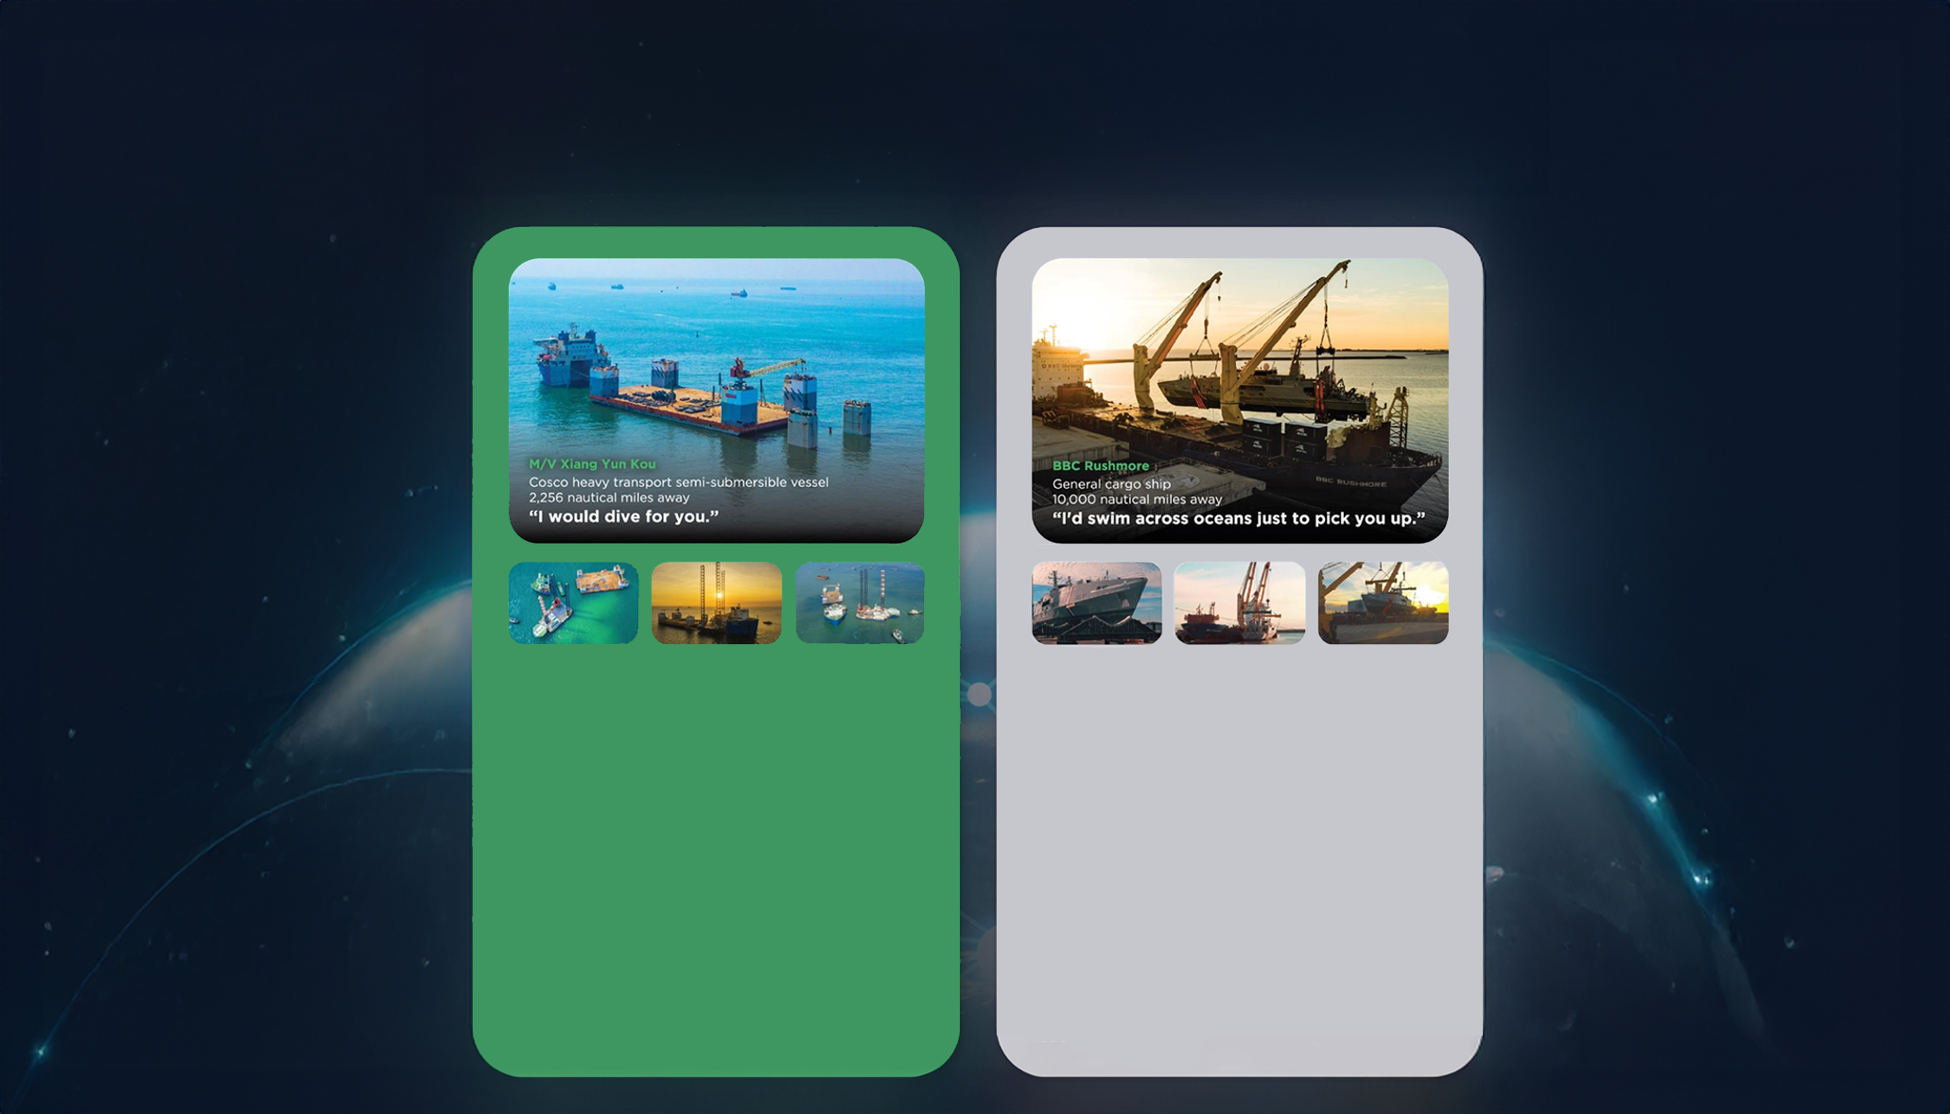
THE RIGHT VESSEL AT THE
RIGHT PRICE AT THE RIGHT TIME
• Half swimmer, half diver
• The big lady of the sea
• Nothing is too big to handle
• Matched with: a 7.000 tonne-floatina drudock and a 6.000-tonne liftboat.
Our buying power and creative solution of combining two shipments allowed us to lock in thebest pricing and the fastest shipping time, despite an extremelv short notice period.
The float-on, float-off loading operation went smoothly and the threesome enioyed a safe journey from Vietnam to Malavsia and the Philippines.
• Any port. Any cargo.
• Accommodating and spacious
• Sailing under the name of the global market
leader of ocean
• Matched with: Austal-built coast guard vessels
As these state-of-the-art vessels are crucial assets for the Trinidad and Tobago coast guard, a best-in-class, door-to-door delivery solution was needed. After securing the reputable BBC Rushmore for these vessels.
FLS experts designed special shipping cradles to support and protect the mono aluminum hulls during the lifting operation and arranged professional divers for a precise loading operation

Slide 15
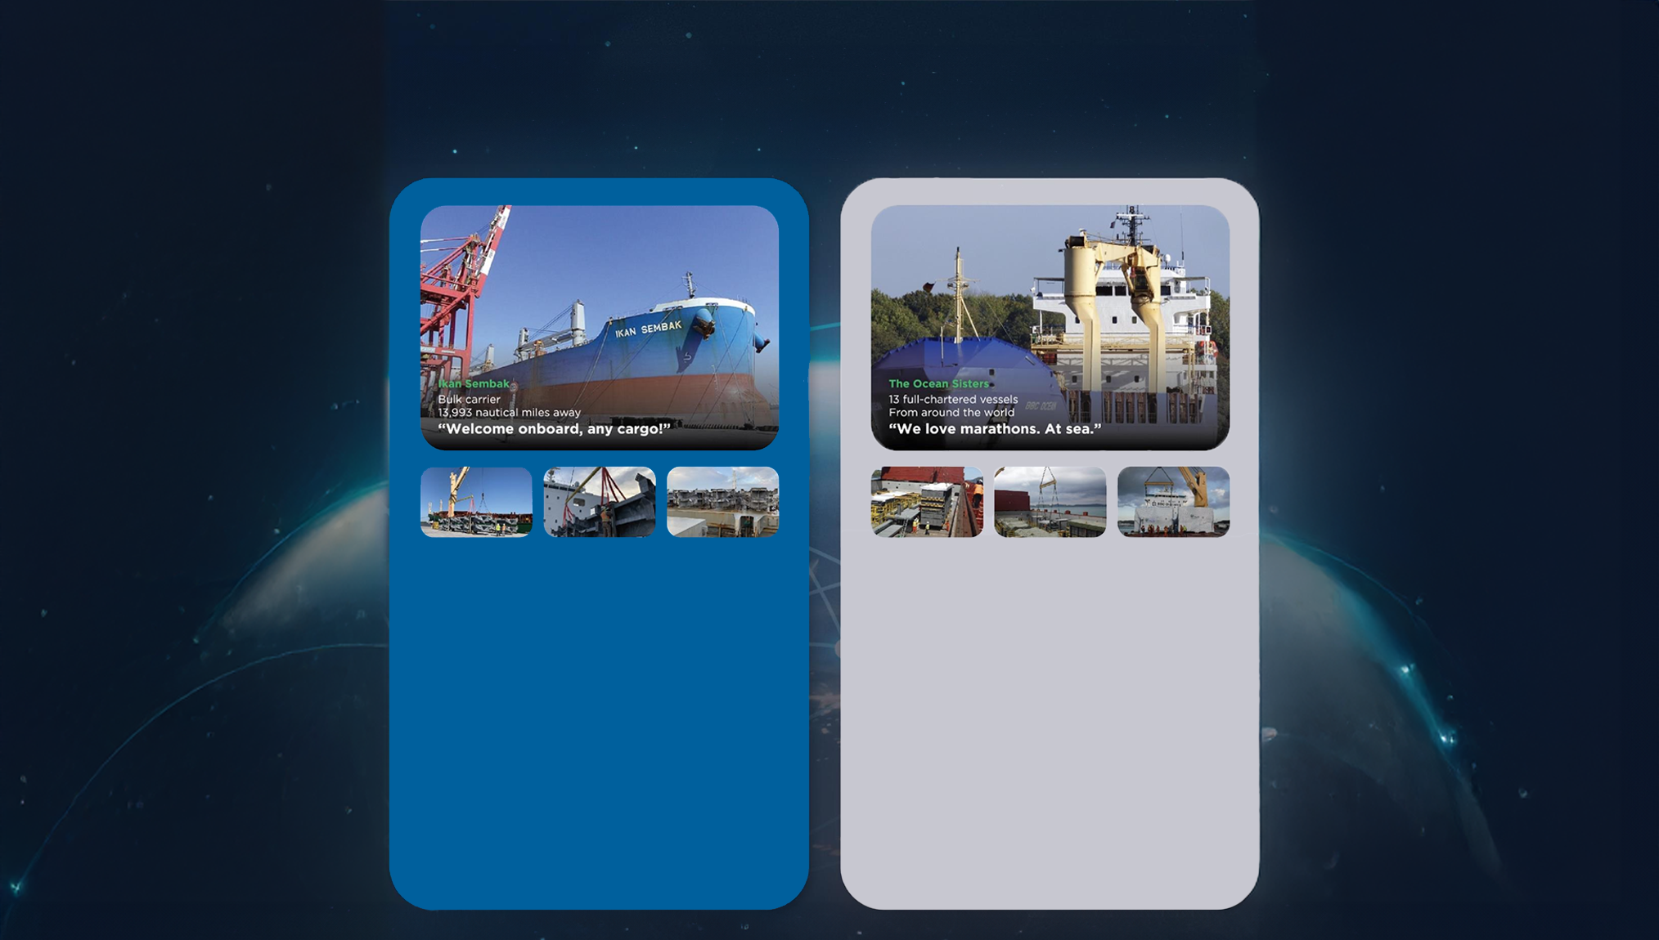
At FLS Chartering Desk we pride ourselves on having long-standing relationships with vessel owners all around the world. This means we can find the perfect match for your needs, while also trying to fulfill your budget and time requirements.
Below are just a few of the perfect matches we've made for our customers.
• Born in Japan
• Enjoying fantastic voyages for the last decade
• Making friends across the globe
• Matched with: Niles, Guernsey and Jackson
combined-cvcle power plants.
Six successful voyages matched so far! FLS
provided packaging guidance and improvement, with customised metal frames to protect the stability of the heavy cargos and our in house stevedores assisted various lifting and lashing operations.
We successfullv saved costs and reduced transit time for two clients in this consolidated shipment.
• We go where cargos love to be
• Devoted to you
• Teamwork is dreamwork
• Matched with: 164 modules, around 225.000
FRT of equipment for a petrochemical plant
in Houston, USA.
A complicated multimodal project which took us 1,5 years to complete. As well as 13 full-chartered vessels, we also provided bespoke trucking, wrapping, stowage and barging solutions.
Our good relationship with carriers and local authorities helped the cargo enjoy a comfortable journey.

Slide 16
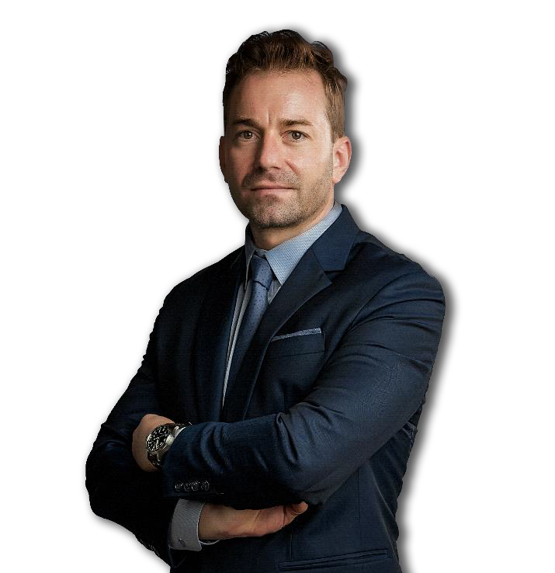
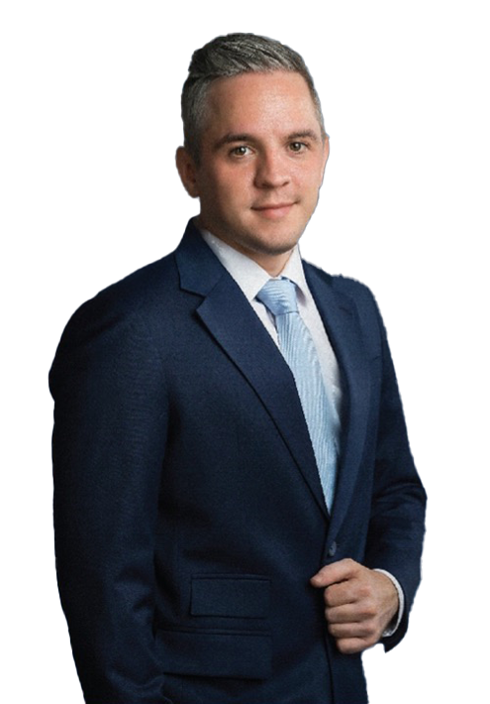
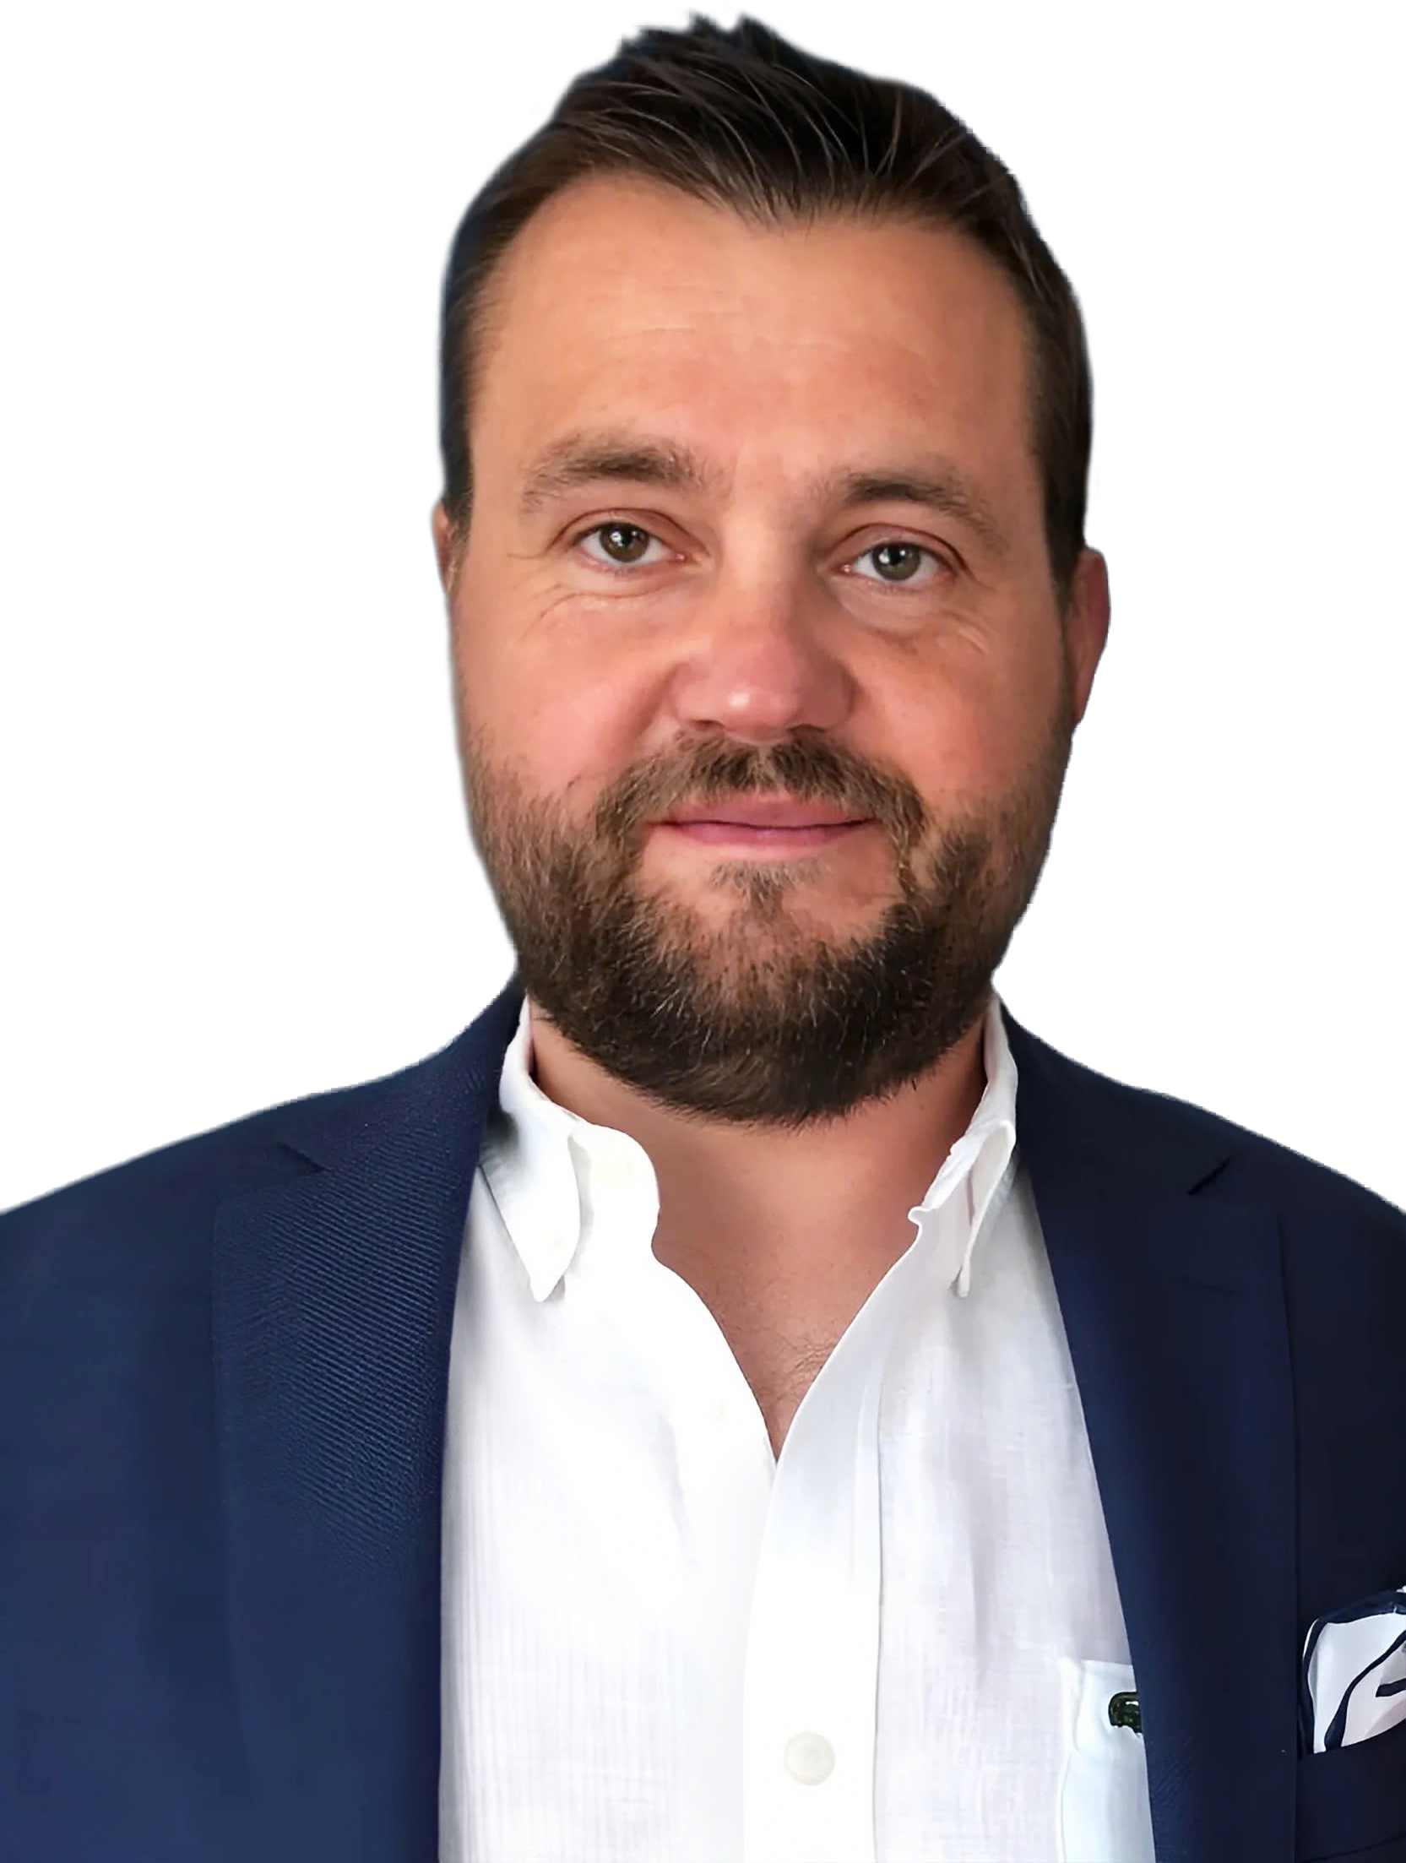
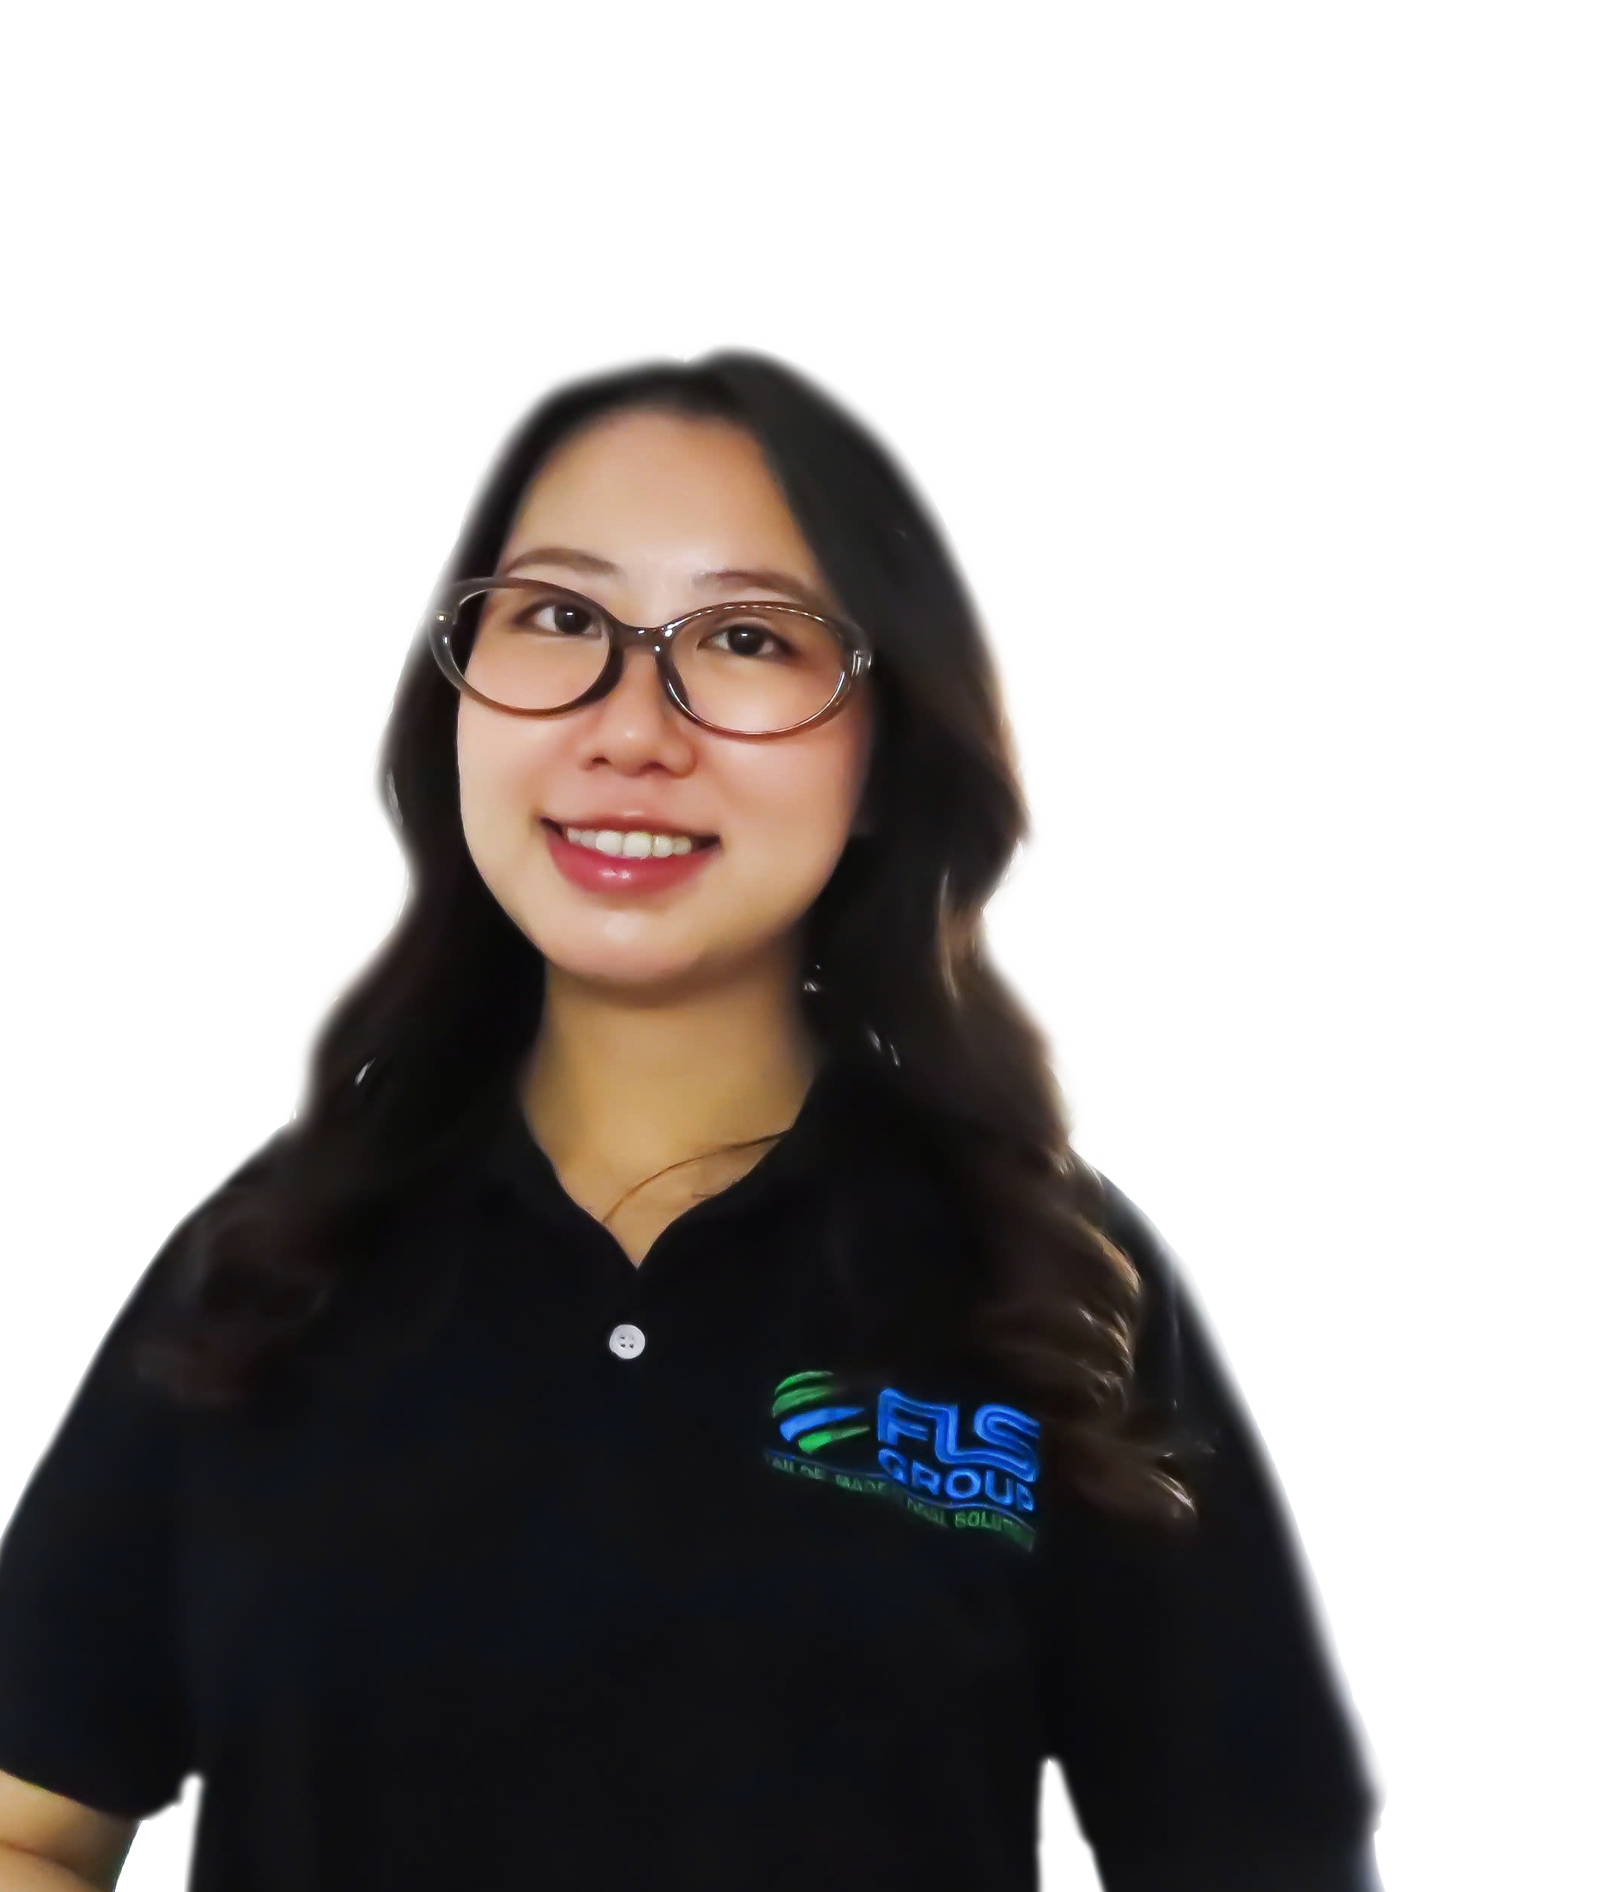
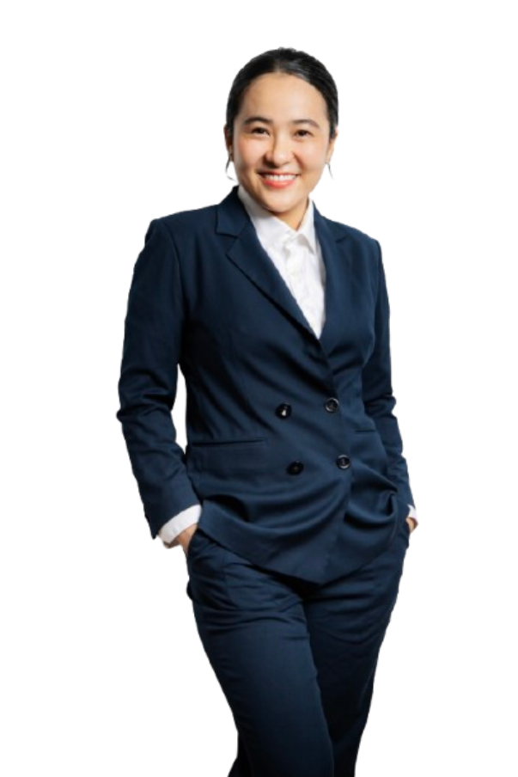
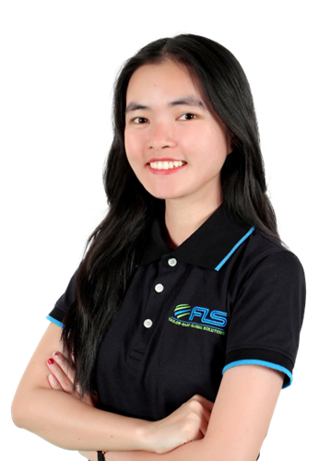
GLOBAL VESSEL ACCESS. PRECISION OPTIMIZATION
FLS Chartering Desk provides direct access to a global network of vessel owners, enabling unrestricted selection across the market. Leveraging strong buying power and deep market understanding, we optimise every charter for cost, timing and operational performance.
SVEN
HOEHLE
HEAD OF GLOBAL PROJECT SOLUTIONS
CHARTERING DESK
CHRISTOPHER SCHNIEDERS
GLOBAL DIRECTOR PROJECTS
SUNE
THORLEIFSSON
MANAGING PARTNER | CHARTERING
VI
NGUYEN
CHARTERING
MANAGER
KHUONG
NGUYEN
PROJECT SOLUTIONS
EXECUTIVE
LINH
NGUYEN
CHARTERING
EXECUTIVE

Slide 17
FLS Group Chartering Desk
Purpose of the chartering desk
1 | Centralize market insight, customers benefit from up-to-date insights on freight rates, bunker prices, and carrier performance, conditions, often securing better deals than if the customer approached shipowners directly
2 | Legal and limit commercial risk, direct oversight ensures that all transport activities comply with regulations, reducing the risk of legal issues, ensuring smooth operations and protecting customer interests
3 | Get unfiltered first-hand information in order to make quick and qualified decisions (in case of delays in production, on the job-site etc.). Greater visibility into supply chain.
4 | Provide technical input and increased usage of inhouse engineer to add value. Transport plan will be tailor-made to your needs.
17

Slide 18
Power and Petrochemical Project References

Slide 19
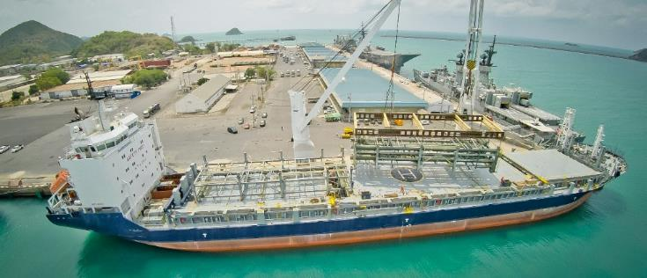
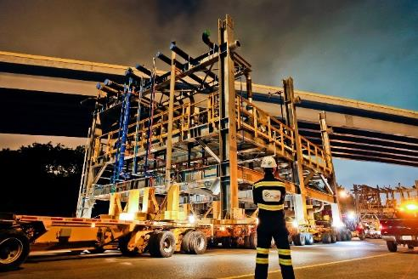
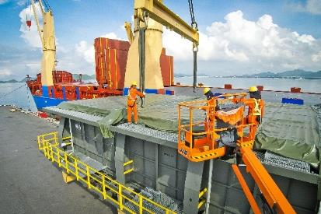
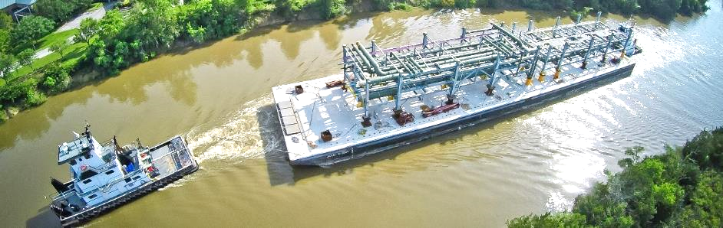
PROJECT REFERENCES
PROJECT REFERENCES
CASE STUDY – BAYTOWN REFINERY Project
Project Name: NAG Baytown Refinery
Client: MES, Heurtey Petrochem
Project Owner: Exxon Mobile
Volume: Appr. 225,000 FRT
Commodity: Equipment for a petrochemical plant,
incl. 164 modules
Origin: Worldwide
Destination: Houston
Project duration: 2015 – 2017
Scope:
Surveys and selection of storage facility close to fabrication yard
Trucking from fabrication yard to storage area
Shrink wrapping of modules
Trucking from storage area to port
Stowage planning and scheduling
Shipping modules from Sattahip, Thailand and Shanghai, China to Houston, USA on 13 full charter vessels
Surveys and selection of suitable jetty location
Barging from Houston Port to jetty with 28 Barge trips
Trucking from jetty to site
Coordination with local authorities for permits
19

Slide 20
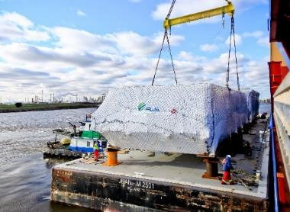
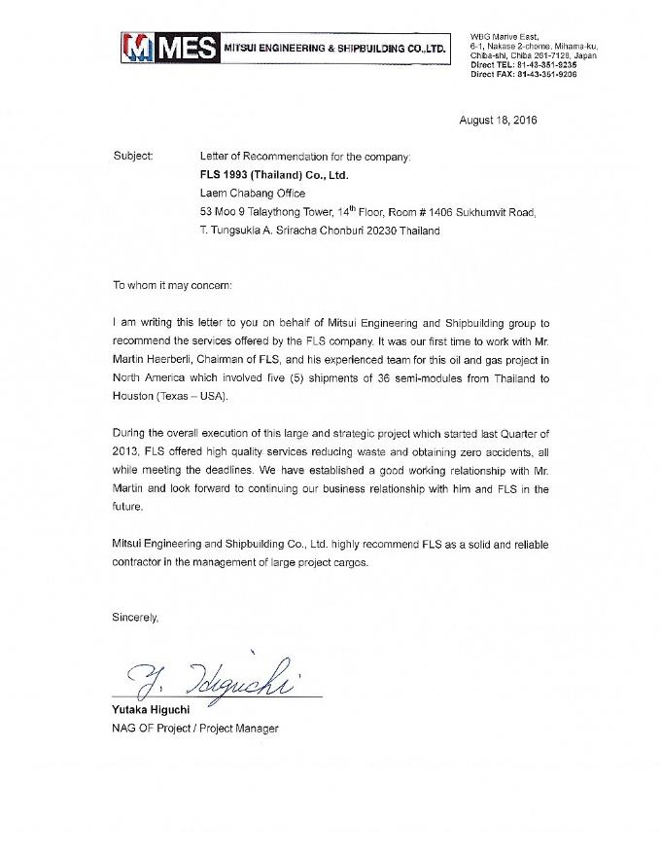
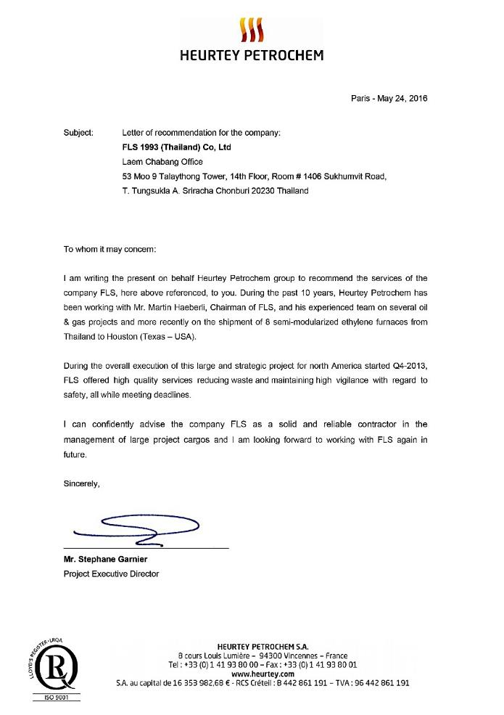
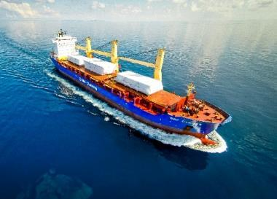
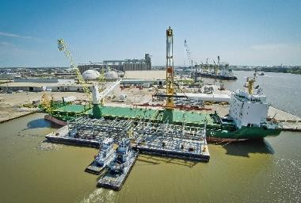
PROJECT REFERENCES
CASE STUDY - letter of recommendation
20

Slide 21
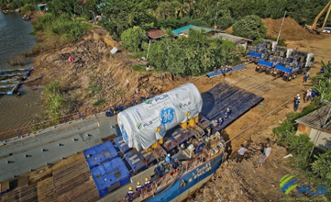
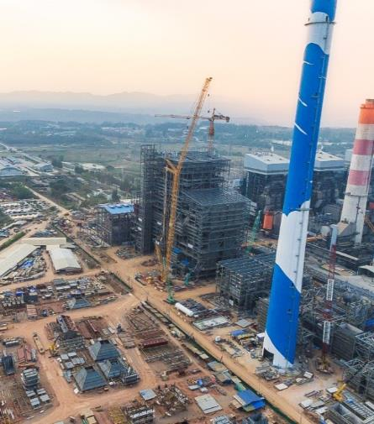
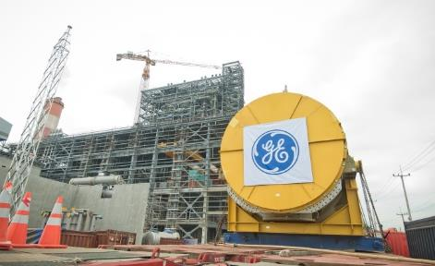
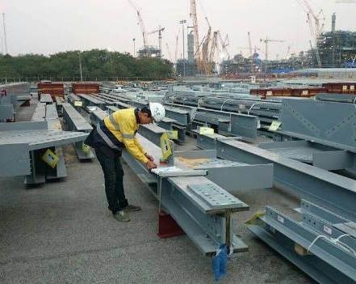
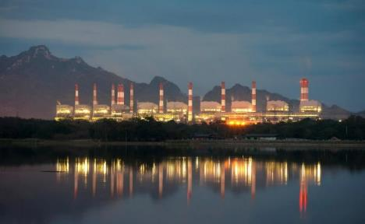
PROJECT REFERENCES
PROJECT REFERENCES
CASE STUDY – MAE MOH POWER PLANT PROJECT
Project Name: Mae Moh Unit 4-7 Replacement Project
Client: GE Power Switzerland, USA, China and India
Black & Veatch, USA
Balanced Engineering & Construction,
Volume: Appr. 135,000 FRT break bulk, 25,000 FRT
Commodity: Structure steel for boiler house, turbines,
generators (including one 360 metric tons), tanks, environmental control, units, feed water system,
Origin: Worldwide
Destination: Mae Moh, appr. 600 km north of Bangkok (around 444km north of Nakhon Sawan)
Scope:
Import port handling in Laem Chabang, customs clearance
Thai Flag Waiver, road transport to construction site, barging, site co-ordination
Ocean freight for specific parts of the project
Warehousing and storage, re-packing, repair, de-and re-consolidation
Survey and consultation work
Co-ordination with suppliers worldwide
21

Slide 22
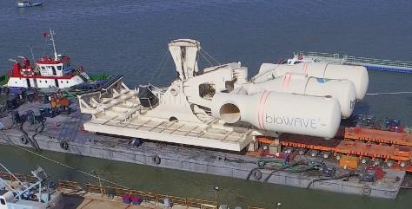
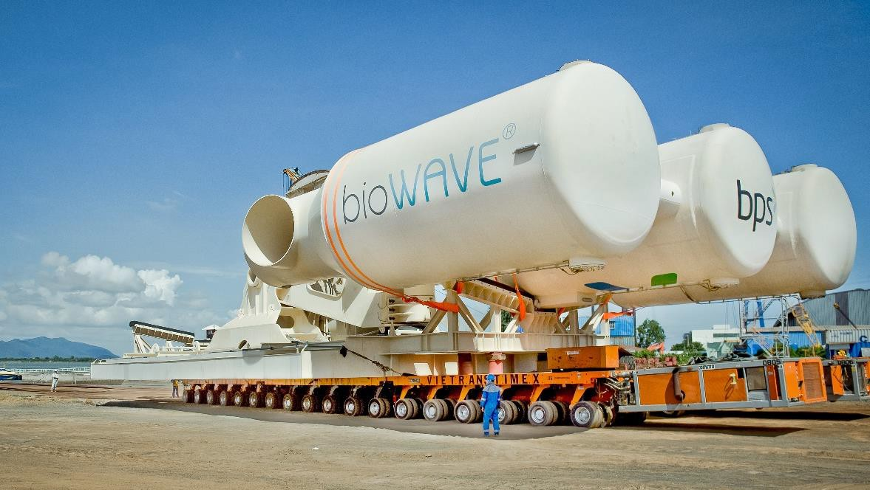
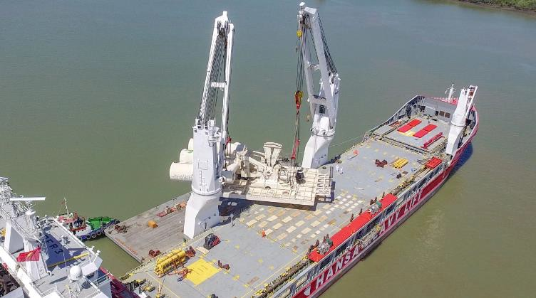
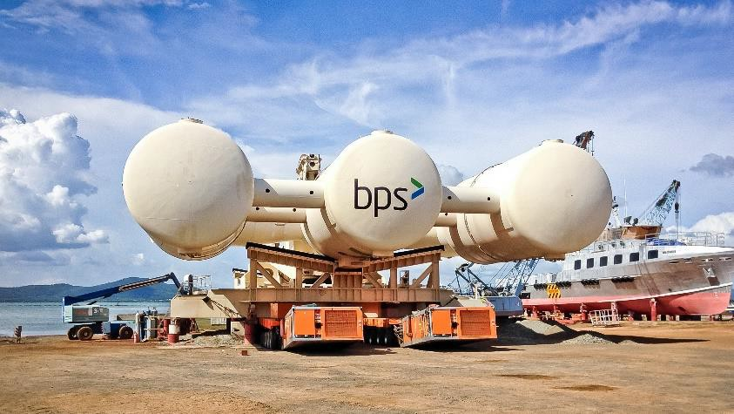
PROJECT REFERENCES
CASE STUDY – BIOPOWER UNIT
Project Name:
Volume:
Commodity: Origin: Destination:
BioPower Unit
Unit 1: 36 x 18.3 x 8.3 m / 700 MT
Unit 2: 13.2 x 9.2 x 5.56 m / 61 MT
Renewable Energy System
Vung Tau Anchorage, Vietnam
Australia
Scope:
Chartering of a suitable geared multi-purpose heavy lift vessel
Co-ordination of the FAS delivery (Roll-out onto barge via SPMT’s)
Loading and securing the cargo board of the vessel
Subsea installation in Australia incl. all customs and quarantine formalities, as well as divers
Extended scope: Use of the ships dynamic positioning (DP2) system, to discharge from deck under water onto the foundation

Slide 23
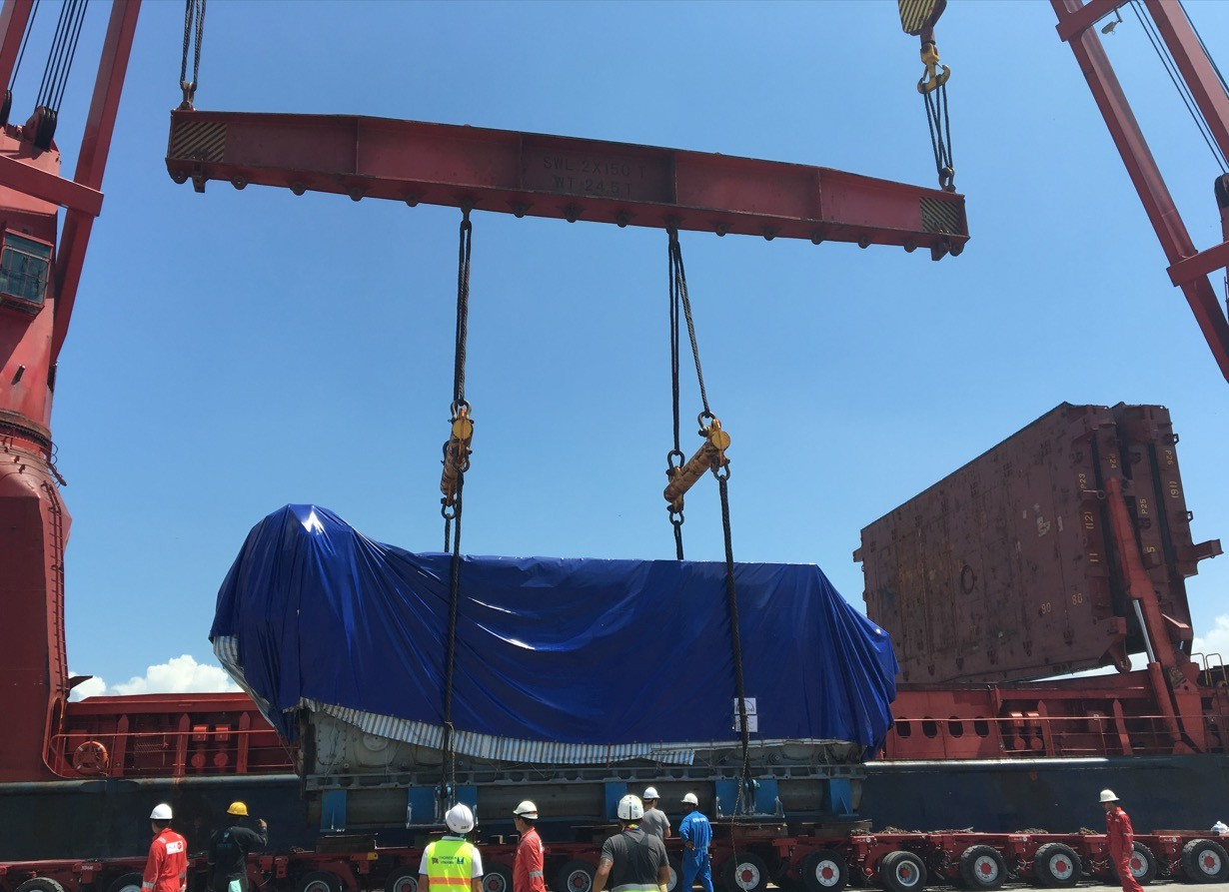
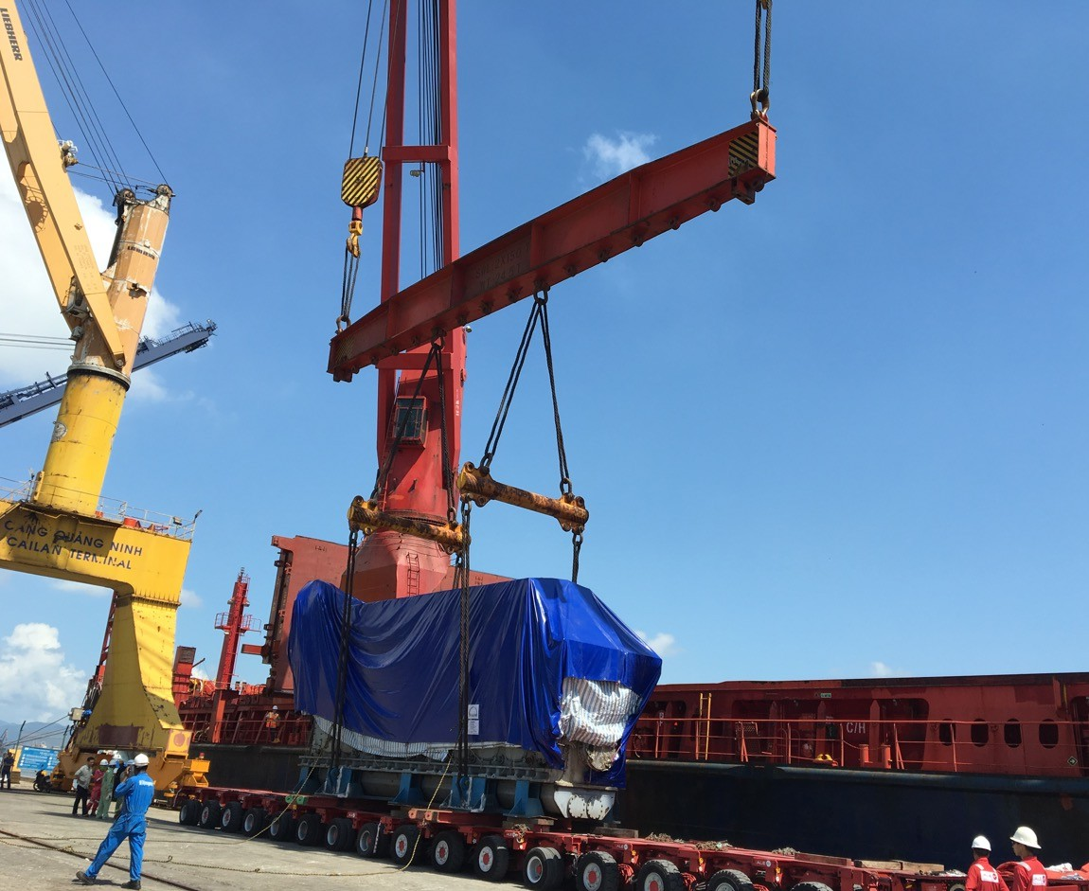
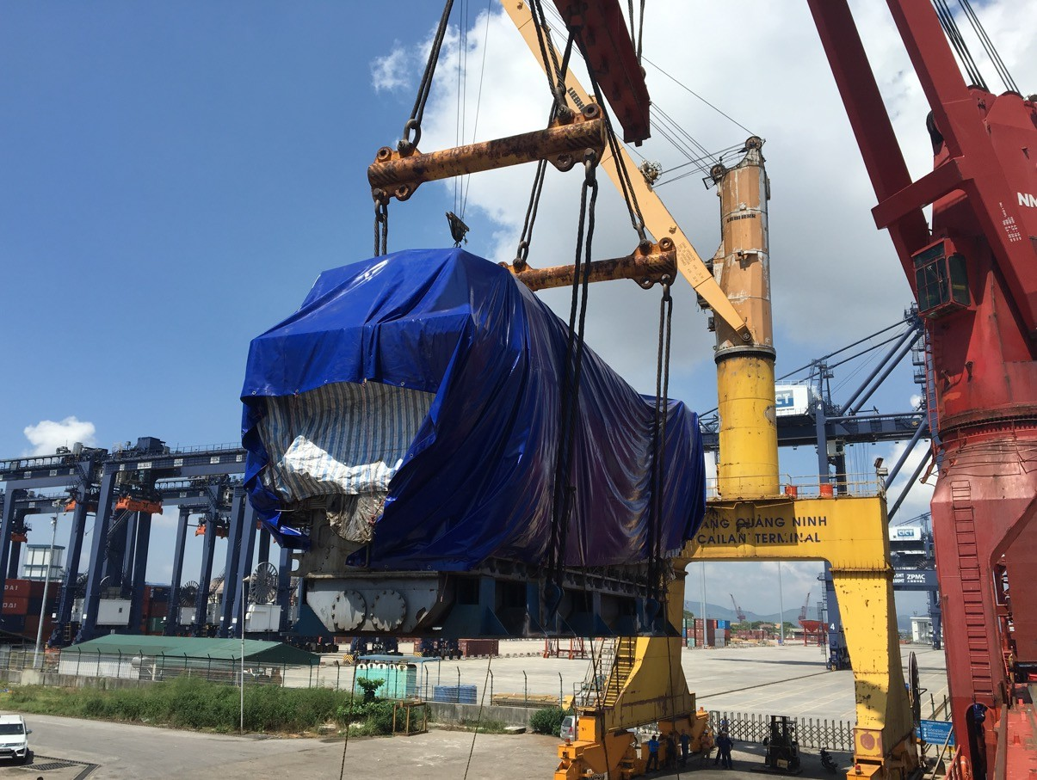
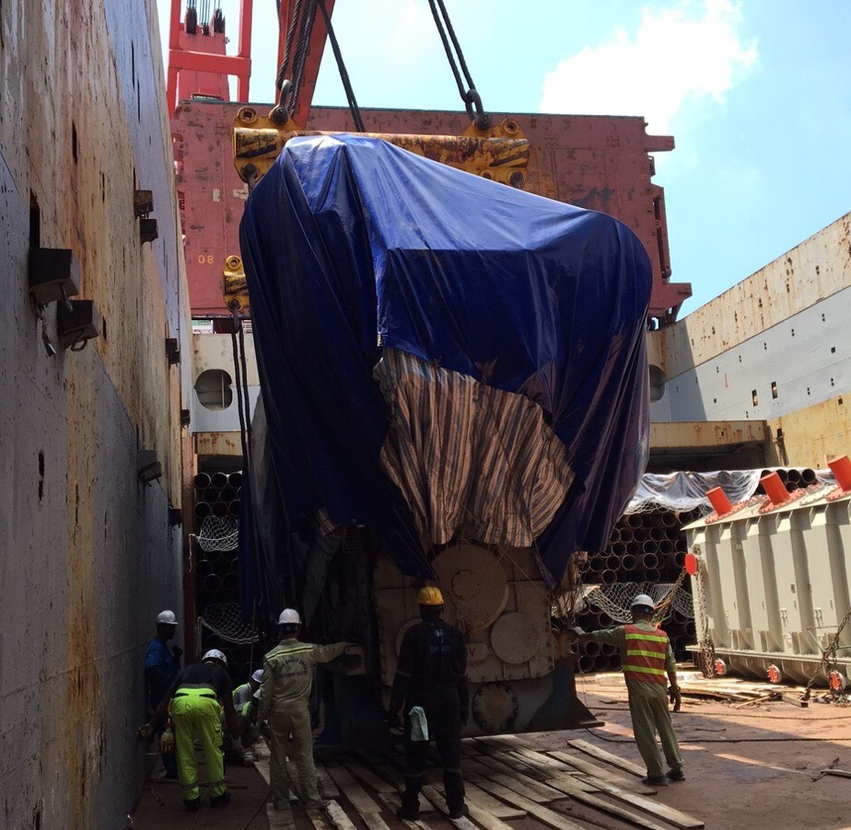
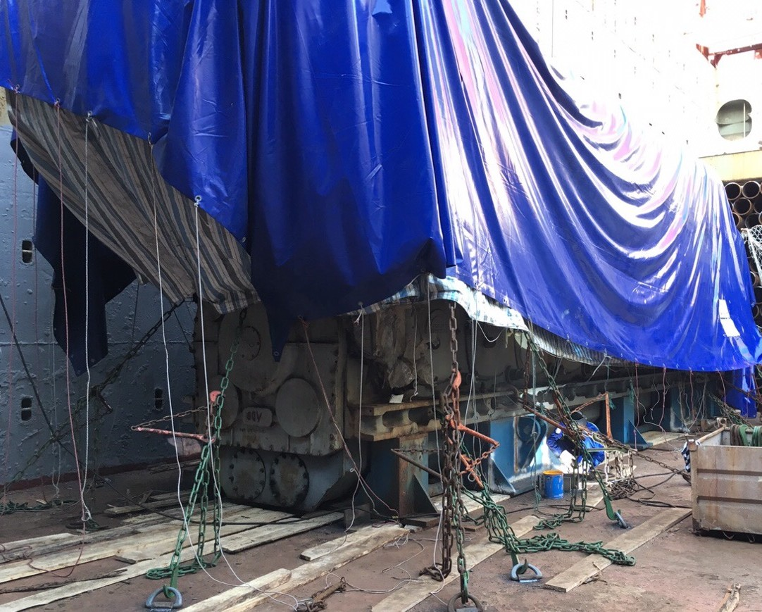
PROJECT REFERENCES
CASE STUDY – 234.5MT DIESEL ENGINE PROJECT
Volume: Origin: Destination:
Scope:
1x 13.05x3.65x5.50M , 234.5 T
Cai Lan port, Vietnam Hamburg, Germany
Chartering Heavy lift vessel based on Liner Terms hook/hook
Preparing technical design for stow plan, lifting plan and secure cargo in accordance to the LASHCON IMO Standard.
Loading onto vessel incl appropriate cargo stow arrangements. Cargo hold preparation for loading, layout dunnage by FLS own stevedores
Loading supervision by FLS Port Captain

Slide 24
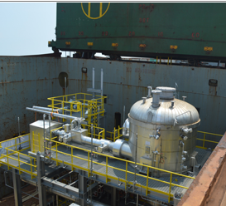
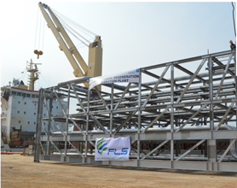
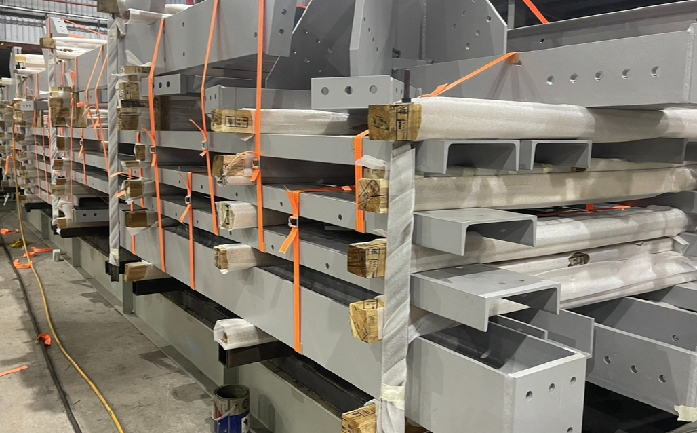
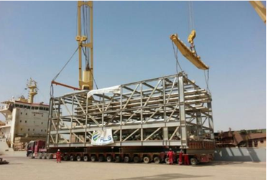
PROJECT REFERENCES
PROJECT REFERENCES
CASE STUDY – WASIT GAS REFINERY
Project Name: Wasit Gas Refinery
Client: VME Process Pte. Ltd.
Volume: Approximately 90,000 FRT
Commodity: Pipe-racks, skids, spools
Origin: Batam, Indonesia
Destination: Wasit Project Site, Saudi Arabia
Loading at fabrication site in Batam, ocean freight to KSA, customs clearance and storage and haulage to project site
5 full and part charter break bulk ocean vessels, of approximately 90,000 Frtons of modules, from Batam to Jubail Industrial Port, KSA
100 container loads of loose items from Batam to Dammam Port
Haulage of cargo from Jubail Industrial Port and Dammam Port to site (approximately 80 km & 120km respectively)
Scope:
24

Slide 25
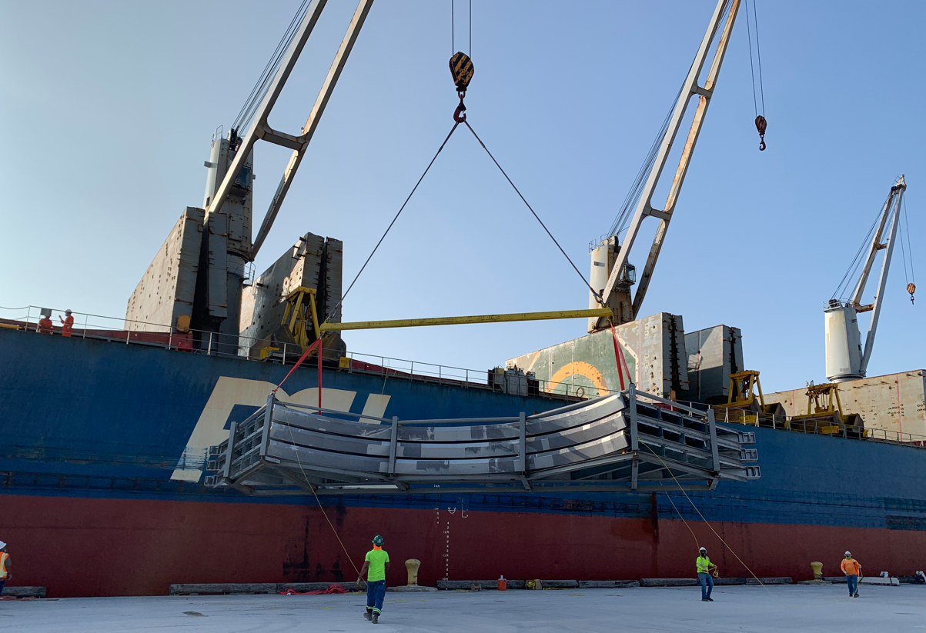
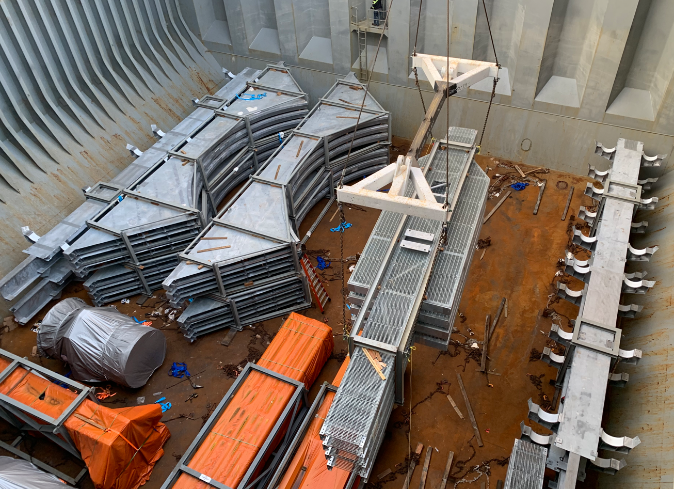
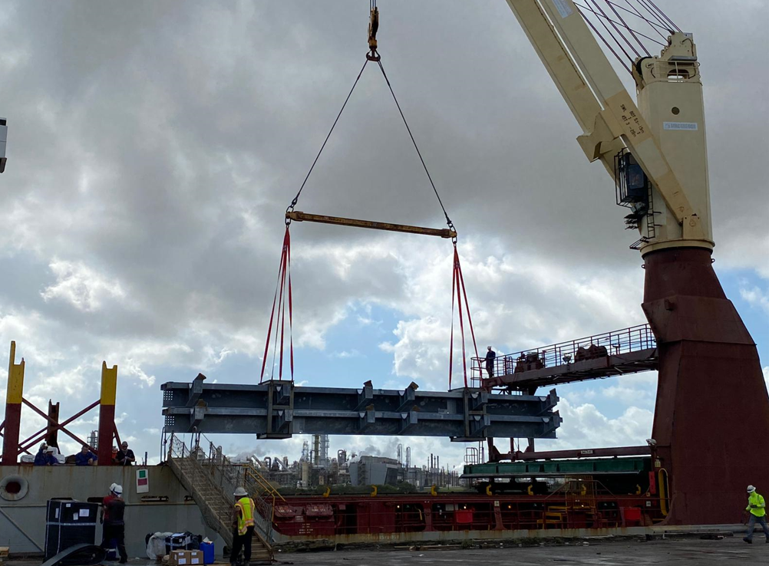
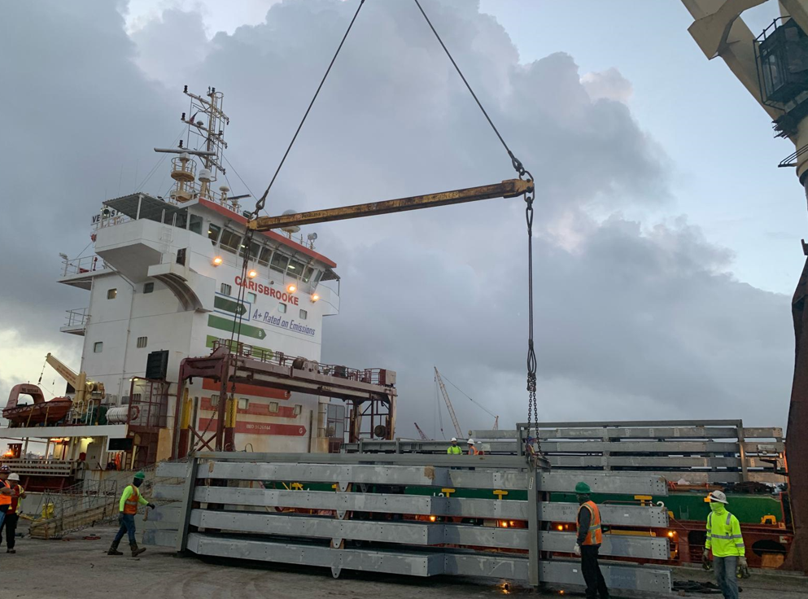
PROJECT REFERENCES
PROJECT REFERENCES
CASE STUDY – JACKSON POWER PLANT Elwood, IL USA
Volume: 8,816 CBM , 1,538 MT Break Bulk
Containers: 160 x40’ HC Weight 2,400 MT
Commodity: Steel Structures
Origin: Vung Tau, Vietnam
Port of Discharge: Houston TX USA , DAP Elwood, IL, USA
Trucking from workshop up to the export terminal
Chartering of a Suitable multi-purpose heavy lift vessel
FLS was the communication tool between cargo and vessel owners, customs, port authority, tug operators, marine warranty surveyors and stevedores
Our port captains have been on scene for supervising purposes
Discharge in Houston, TX and trucking up to the job site in Elwood, IL, USA.
Scope:
25

Slide 26
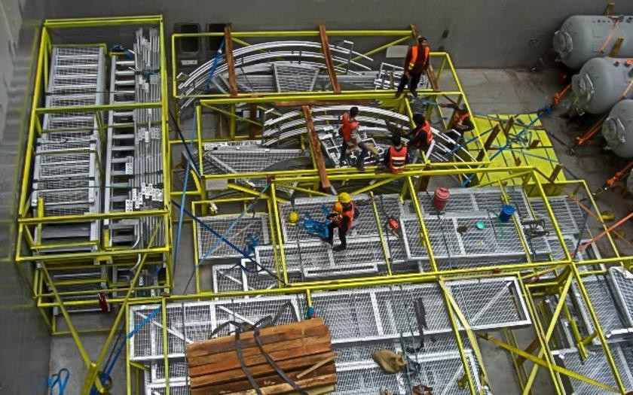
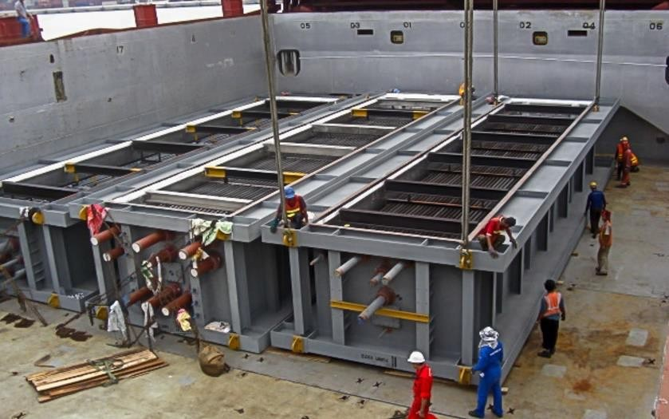
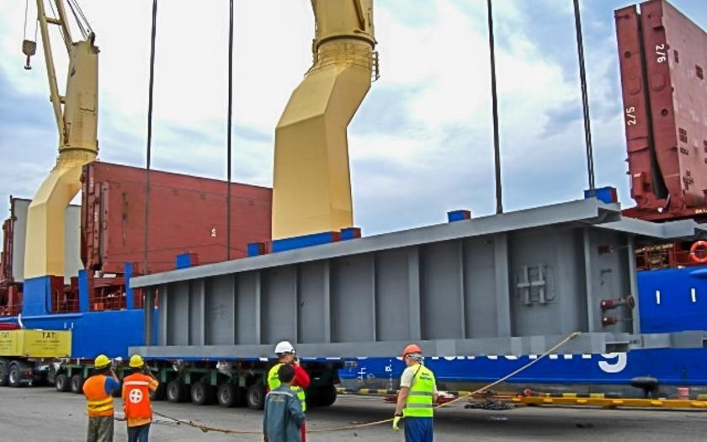
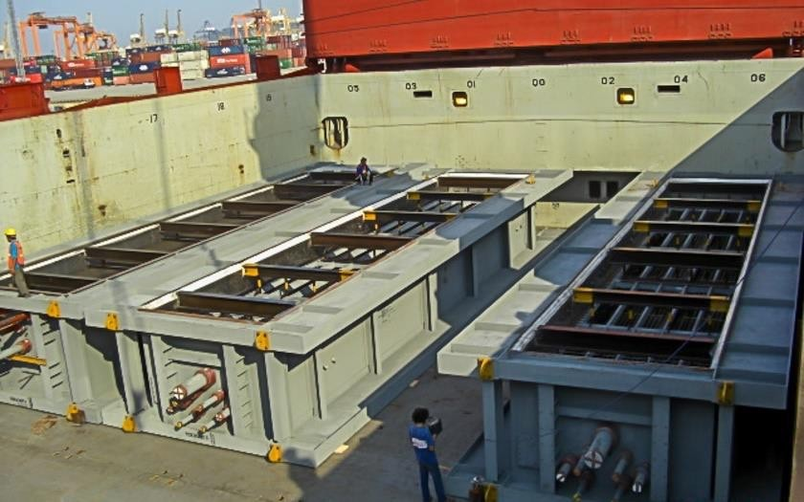
PROJECT REFERENCES
CASE STUDY – LOS ESTEROS
Project Name: Project Owner: Volume: Commodity: Origin: Destination:
Los Esteros Project VPI
7,000 cbm, Max. GW 150 MT
Steel beams, modules Thailand
Stockton, USA
Scope:
Loading and FAS delivery at Laem Chabang port
Loading and securing onto break bulk vessel
Break bulk ocean freight from Laem Chabang port to port of Stockton

Slide 27
PROJECT REFERENCES
CASE STUDY – Freeport lng houston
Project Name:
Project Owner:
Volume:
Commodity:
Origin:
Destination:
Project Duration:
Freeport LNG Liquefaction Project
Freeport LNG Expansion, L.P
Approximately 5,370 ton
Vacuum Insulated Pipe Spools
Thailand
USA
2017
Scope:
Packing of spools onto wooden saddles according to client’s specifications
Transport from factory to Laem Chabang port
Off-loading and storage at Laem Chabang port
Re-loading and FAS delivery at Laem Chabang port
Loading and securing onto breakbulk vessel
Breakbulk ocean freight from Laem Chabang port to CFR Port of Houston

Slide 28




PROJECT REFERENCES
PROJECT REFERENCES
CASE STUDY – PELICAN POINT POWER PLANT PROJECT 1/2
Volume: 28 packages, 3,779 cbm, 341. MT
Origin: Dung Quat, Vietnam
Port of Discharge: Adelaide, Australia
Final Destination: Pelican Point Combined Cycle Power Plant
Apply for a special oversize transportation permit
Transporting cargo from the work-shop to the port of loading
Two specialized electric power teams providing escort services throughout the transportation process to ensure safety and operational efficiency
Third party survey and inspection of the cargo
Coordination and strategic placement of lifting beams to ensure alignment with the appropriate Working Load Limit (WLL) for safe and efficient operations.
Ocean freight from Dung Quat to port of discharge Adelaide
Loading onto vessel incl appropriate cargo stow arrangements. Cargo hold preparation for loading, including layout of dunnage by FLS owned stevedores
Lashing and securing
FLS Port Captains supervised the whole trucking and loading operation
Scope:
28

Slide 29




PROJECT REFERENCES
CASE STUDY – PELICAN POINT POWER PLANT PROJECT 2/2
Volume: 28 packages, 3,779 CBM, 341.212 MT
Origin: Dung Quat, Vietnam
Port of Discharge: Adelaide, Australia
Final Destination: Pelican Point Combined Cycle Power Plant
Challenges:
Complexity due to the cargo’s size with max length 15.46M, width 9.55M, height 5.30M
The nearest BBK terminal at the POD to the job site is not workable
Investigate suitable direction to the job site, adjust construction to fit the cargo during transportation
→ We got involved in the discussions at a very early stage, which allowed the client to design and fabricate up to the absolute maximum dimensions.
→ Coordination with carrier for special berthing at RO-RO/ Cruise ship terminal
Scope:
Apply for a special permit in order to berth at the RO-RO/ cruise terminal.
Traffic management survey in Australia
Vessel berthed at a RO-RO/ Cruise ship berth
Cargo unlashing discharge operation, supervision by FLS PM
Due to cargo dimensions, FLS had to remove fencing and widen the gate at the port
Traffic lights, traffic signs had to be removed during the trucking from port to the jobsite
Police escorted our trucks and stopped the traffic when necessary
29

Slide 30











PROJECT REFERENCES
PROJECT REFERENCES
PackCASE STUDY – CRISP Project age C
Project Name: CRISP Project
Client: UTE TR Jurong Project ( Spain )
Project Owner: Exxon Mobil Asia Pacific Pte. Ltd
( Singapore )
Volume: Appr. 200,000 FRT of Breakbulk and RORO
Commodity: Machinery and Equipment use for construction of Refinery Plant
Origin: Europe, Southeast Asia
Destination: Singapore
Project duration: 2020-2023
Import handling in Singapore,
Arrange road transport with Haulier to Jurong Island,
Site co-ordination with TR site team of the project
Unloading supervision for Breakbulk shipment
Co-ordination with Agents and Carrier
Co-ordinating with Transport Haulier for day and night delivery
Scope:
30

Slide 31






PROJECT REFERENCES
PROJECT REFERENCES
PackCASE STUDY – CRISP Project age C
Project Name: CRISP Project
Client: Tecnicas Reunidas Singapore Branch On Behalf Of Exxon Mobil Asia Pacific Pte.Ltd (Singapore)
Project Owner: BJC Heavy Industries Public Company Limited (Thailand) STP & I Public Company Limited (Thailand)
Volume: Appr. 100 rtons of FCL containerized, Break Bulk and Roro
Commodity: Machinery and Equipment use for construction of Refinery Plant
Origin: Singapore
Destination: Laem Chabang, Thailand
Project duration: 2022-2023
Export handling in Singapore,
Arrange road transport with Haulier from
Jurong Island to PSA port or Jurong Port
Site co-ordination with TR site team of the project
Co-ordination with Agents and Carrier
Scope:
31

Slide 32






PROJECT REFERENCES
PROJECT REFERENCES
CASE STUDY – SUNCOR, CANADA
Volume: 273 packages / 13,366 CBM / 5,800 MT
Origin: Penglai + Zhangjiagang + Masan
Destination: Longview, USA
Scope:
Full liner terms Ocean freight
Shrink wrapping and protection
Pre-carriage cargo ex-work to port
Chartering Heavy lift vessel
Under dynamic covid condition
In house designed lifting frame SWL 216mt tandem lift, SWL 166.5 single lift BV Class Certificate, FEA calculation
32

Slide 33




PROJECT REFERENCES
PROJECT REFERENCES
CASE STUDY – Niles + Guernsey Combined-Cycle Power
Volume: Approx. 29,000 FRT
Commodity: Power plant structure
Origin: Phu My, Vietnam
Port of Discharge: Houston, TX, USA
Giving packaging solutions to ensure cargo optimize handling efficiency
Chartering of suitable bulk and multi-purpose (MPP) vessels for six scheduled voyages, tailored to cargo specifications and route requirements
Deployment of in-house stevedoring teams to support complex lifting and lashing operations, ensuring safe and compliant cargo handling
Scope:
33

Slide 34





PROJECT REFERENCES
PROJECT REFERENCES
CASE STUDY – Terminal Power plant
Volume: 8,293 CBM / 638.2 MT
Origin: Hoang Dieu Port, Hai Phong Vietnam
Destination: Gamagori Port, Japan
Scope:
Chartering of two suitably geared multi-purpose heavy lift vessels
Co-ordination of the FAS delivery, loading and stowage of the cargo on the vessel
34

Slide 35





PROJECT REFERENCES
PROJECT REFERENCES
CASE STUDY – POWER PLANt NIGERIA
Volume: 24 packages / 5,905 CBM / 403 MT
Origin: Dung Quat port, Viet Nam
Destination: Warri port, Nigeria
Scope:
Full liner terms Ocean freight
Pre-carriage ex-work to port
Chartering Heavy lift vessel
Loading onto vessel incl appropriate cargo stow arrangements. Cargo hold preparation for loading, layout dunnage by FLS own stevedores
Loading supervision by FLS Port Captain
35

Slide 36






PROJECT REFERENCES
PROJECT REFERENCES
CASE STUDY – POWER PLANT SINGAPORE
Volume: 44 packages / 6,594 CBM / 774 MT
Origin: Dung Quat port, Viet Nam
Destination: Singapore port
Scope:
Full liner terms Ocean freight
To receive cargo along side ship
Chartering Heavy lift vessel
Loading onto vessel incl appropriate cargo stow arrangements. Cargo hold preparation for loading, layout dunnage by FLS own stevedores
Loading supervision by FLS Port Captain
36

Slide 37
PROJECT REFERENCES
PROJECT REFERENCES
CASE STUDY – BIOPOWER UNIT
Project name: BioPower Unit
Dimensions: Unit 1: 36 x 18.3 x 8.3 M / 700 MT
Unit 2: 13.2 x 9.2 x 5.56 M / 61 MT
Commodity: Renewable Energy System Vung Tau Anchorage
Origin: Vung Tau, Vietnam
Destination: Australia
Chartering of a suitable geared multi-purpose heavy lift vessel
Co-ordination of the FAS delivery (Roll-out onto barge via SPMT’s)
Loading and securing the cargo board of the vessel
Subsea installation in Australia incl. all customs and quarantine formalities, as well as divers
Extended scope: Use of the ships dynamic positioning (DP2) system, to discharge from deck under water onto the foundation
Scope:
37

Slide 38
office.vn@fls-group.com
+84 828 73 002 864
38

